Slide 1
3조
안승찬 신동근 이건희 최세영
AI비전응용
Team meeting with processor

Slide 2
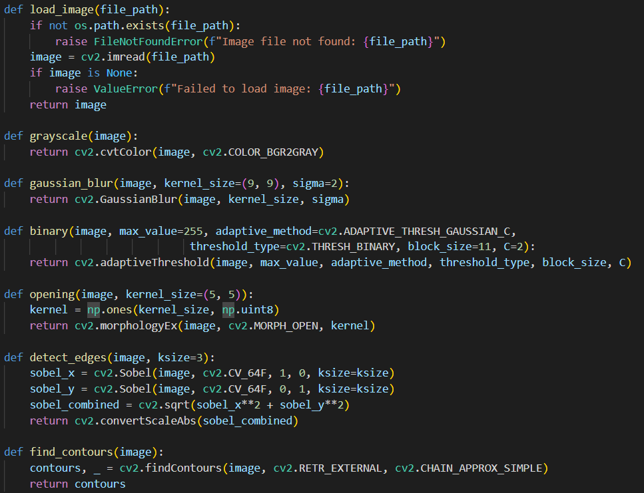
AI비전응용 Team meeting with processor

Slide 3
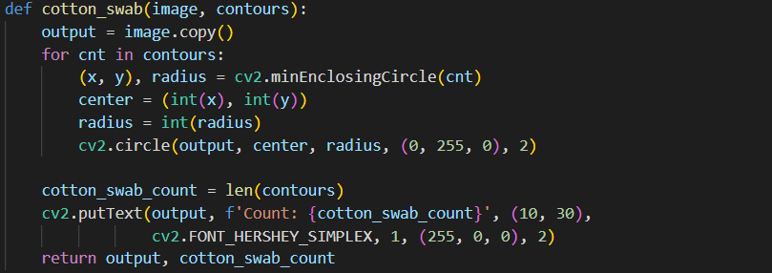
AI비전응용 Team meeting with processor

Slide 4
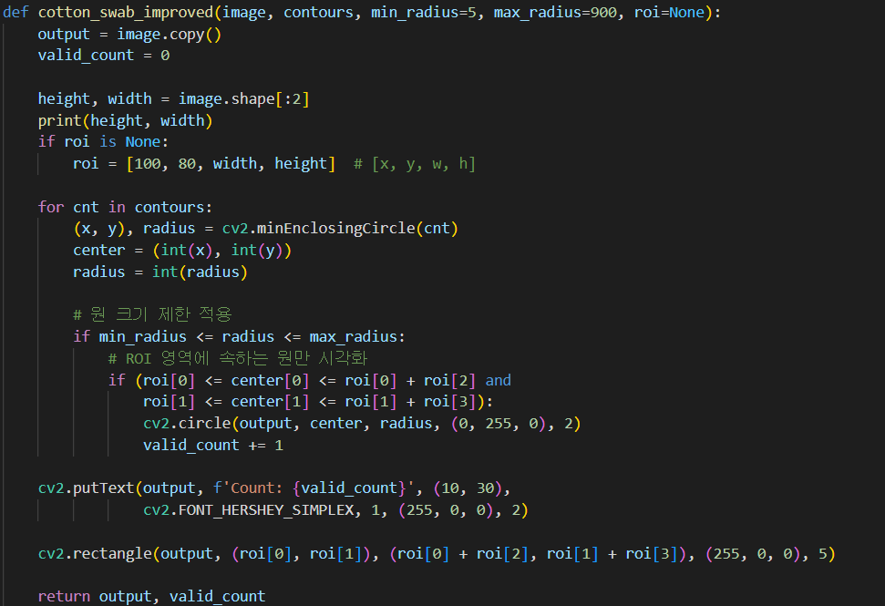
AI비전응용 Team meeting with processor

Slide 5
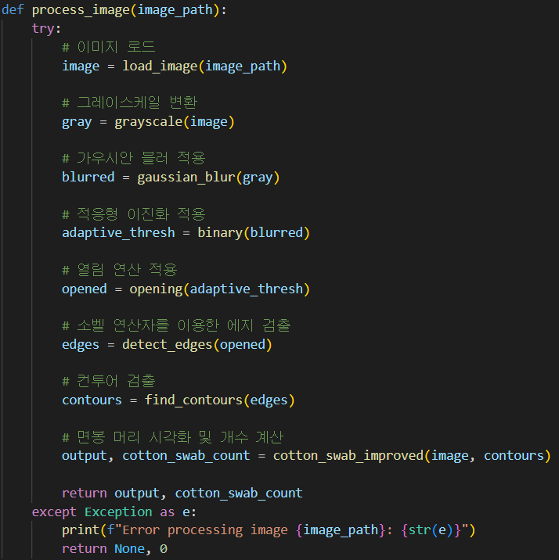
AI비전응용 Team meeting with processor

Slide 6
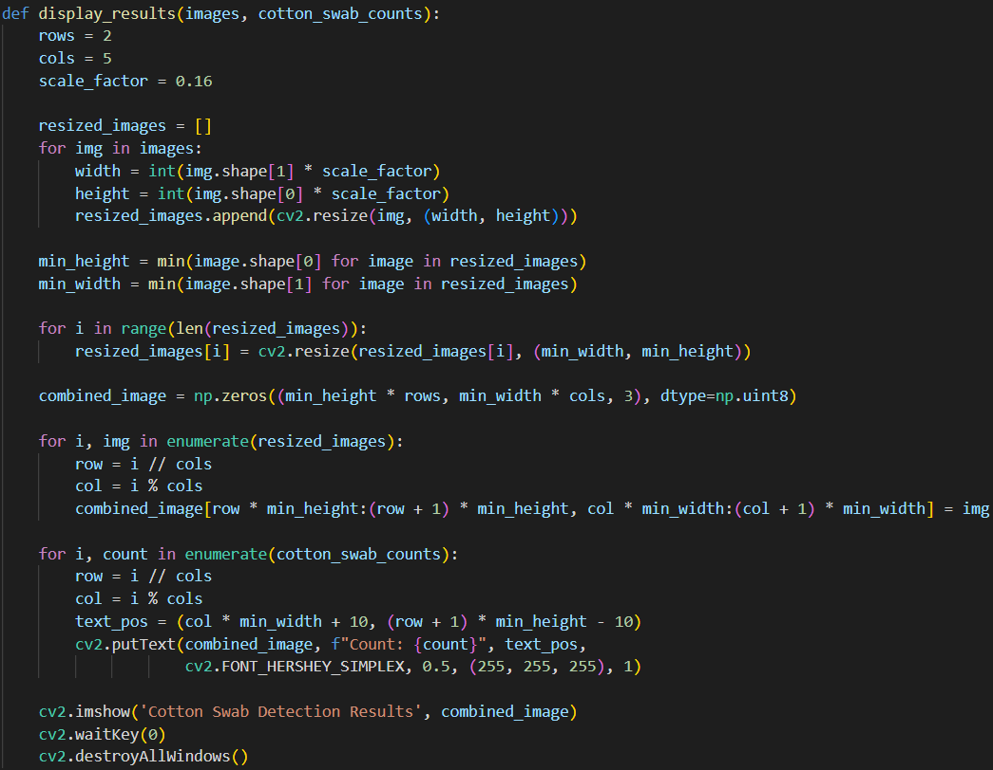
AI비전응용 Team meeting with processor

Slide 7
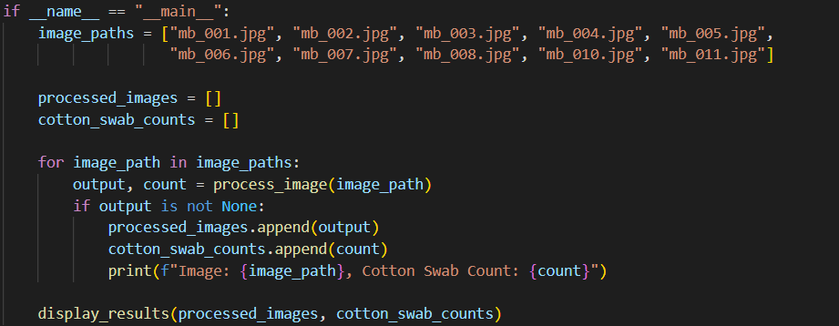
AI비전응용 Team meeting with processor

Slide 8
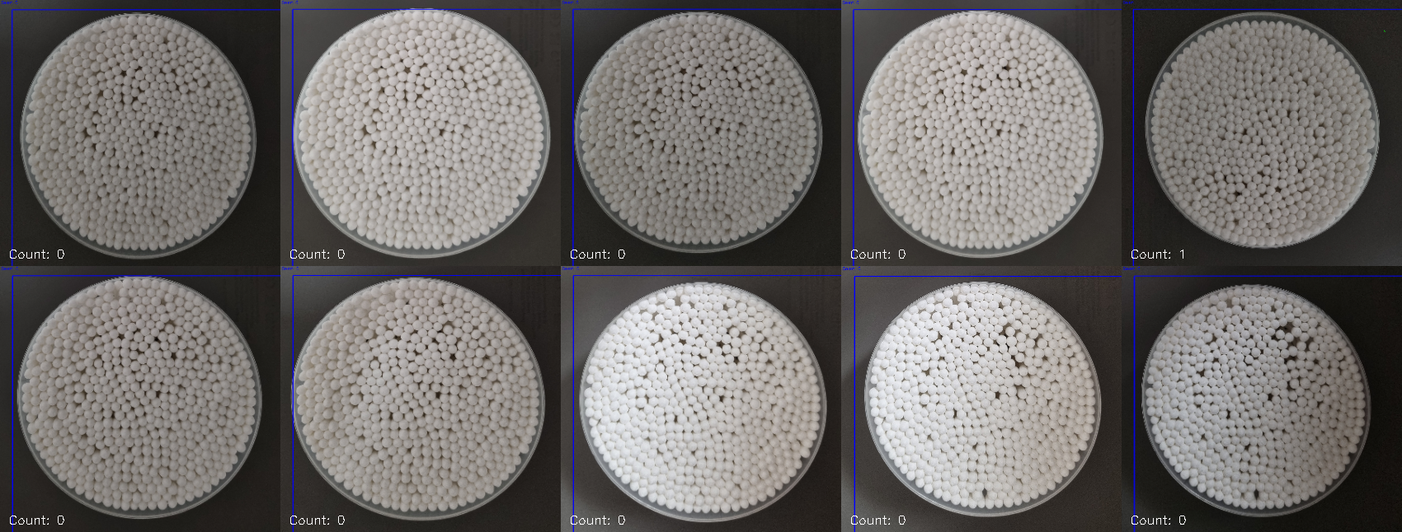
AI비전응용 Team meeting with processor

Slide 9
AI비전응용 Team meeting with processor
그레이스케일 적용 → HSV 조절 → 이원화
HSV 조절 바 추가

