Slide 1
Building Highly Scalable HTML5 Applications with the Tribe Platform
Dale Anderson

Slide 2
Introduction
Scalability
Consistency models
Message based architectures
Tribe

Slide 3
Performance and Scalability

Slide 6
ACID Transaction Model

Slide 7
Atomic
Consistent
Isolated
Durable

Slide 8
Locking
Isolation levels
Lock escalation
Deadlocks

Slide 9
Transaction 1 | Transaction 2
/* Query 1 */ SELECT * FROM users WHERE id = 1;
 | /* Query 2 */ UPDATE users SET age = 21 WHERE id = 1; COMMIT;
/* Query 1 */ SELECT * FROM users WHERE id = 1; COMMIT;

Slide 10
Scalability
Vertical
Significantly impacted by isolation level
Horizontal
Replication
Sharding

Slide 11
CAP Theorem

Slide 12
CAP Theorem
Conjecture made by Eric Brewer of UC, Berkeley at the 2000 Symposium on Principles of Distributed Computing
Seth Gilbert and Nancy Lynch of MIT published a formal proof in 2002

Slide 13
CAP Theorem
Consistency
Availability
Partition tolerance

Slide 16
Eventual Consistency

Slide 17
BASE
Basically Available
Soft-state
Eventually consistent

Slide 18
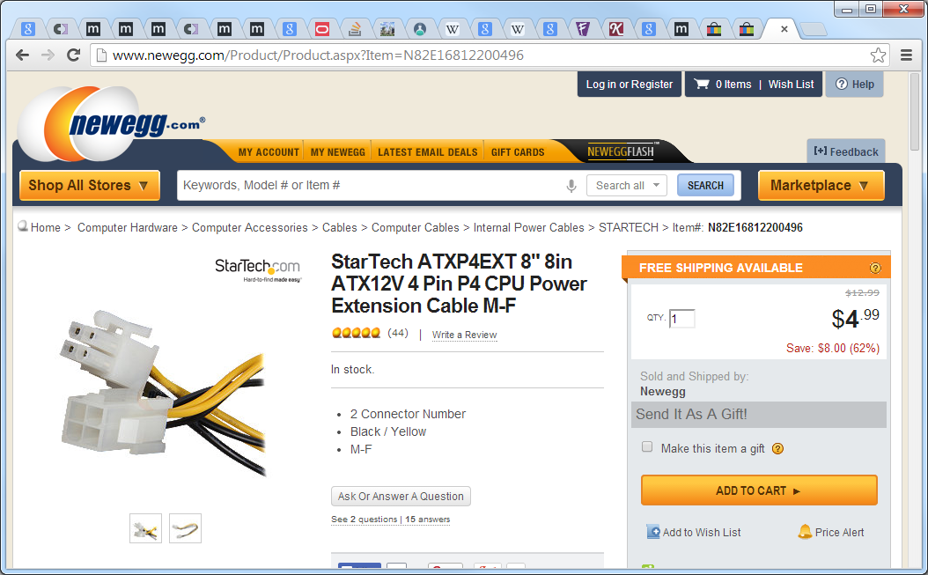

Slide 19
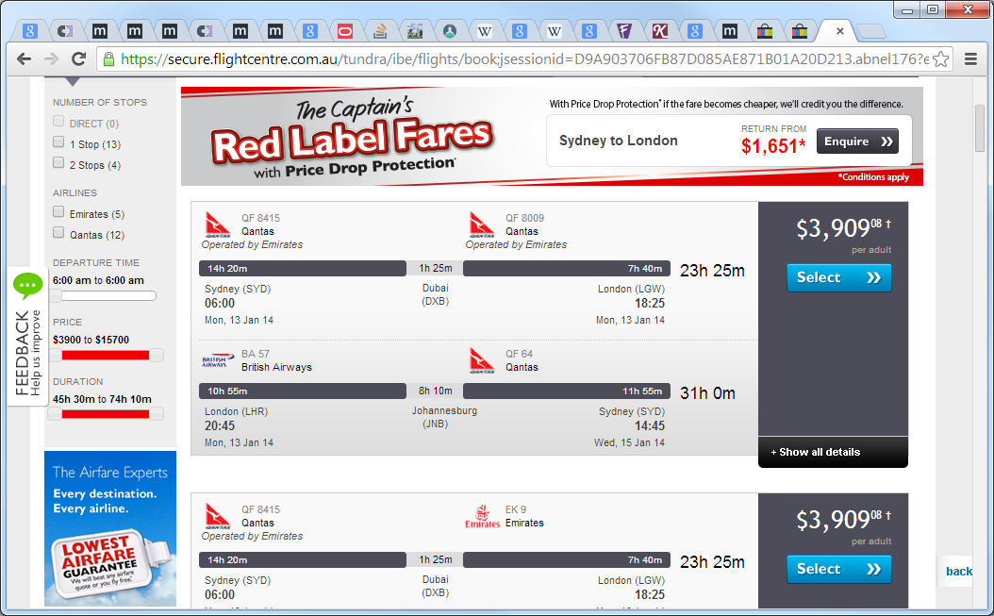

Slide 20
Message Based Architectures

Slide 21
Events
An event can be defined as "a significant change in state".
- http://en.wikipedia.org/wiki/Event-driven_architecture

Slide 22
Commands
An asynchronous request for a specific action to be performed by a receiver.

Slide 23
Message based architectures
Guaranteed delivery
Error handling
Transactions
Idempotence

Slide 24
Idempotence
“Idempotence is the property of certain operations in mathematics and computer science, that can be applied multiple times without changing the result beyond the initial application” - http://en.wikipedia.org/wiki/Idempotence

Slide 25
User interface design
Capture user intent
Excel-like grids don’t capture intent

Slide 26
Prioritising
Split specific message types into queues
Assign additional resources to specific queues
Auto-scale with Azure to ensure SLAs are met

Slide 27
CQRS

Slide 28
Driving forces
Collaboration
Staleness

Slide 29
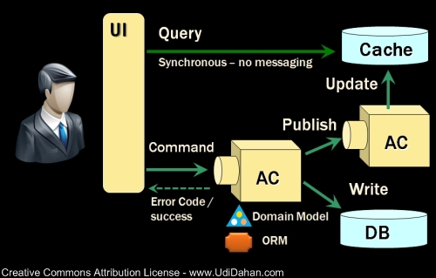

Slide 30
Event Sourcing

Slide 31
Event Sourcing
“Capture all changes to an application state as a sequence of events.”
- http://martinfowler.com/eaaDev/EventSourcing.html

Slide 32
Benefits
Event log
Complete rebuild
Temporal query
Event replay

Slide 33
Reversing Events
Complete rebuild
Reversal method
Epochs

Slide 34
Composite UIs

Slide 35
Composite Pattern
A group of objects can be treated same as a single object
Objects are “composed” into hierarchies

Slide 36
Composite View Pattern
A recursive UI structure of views containing children that are themselves views

Slide 37
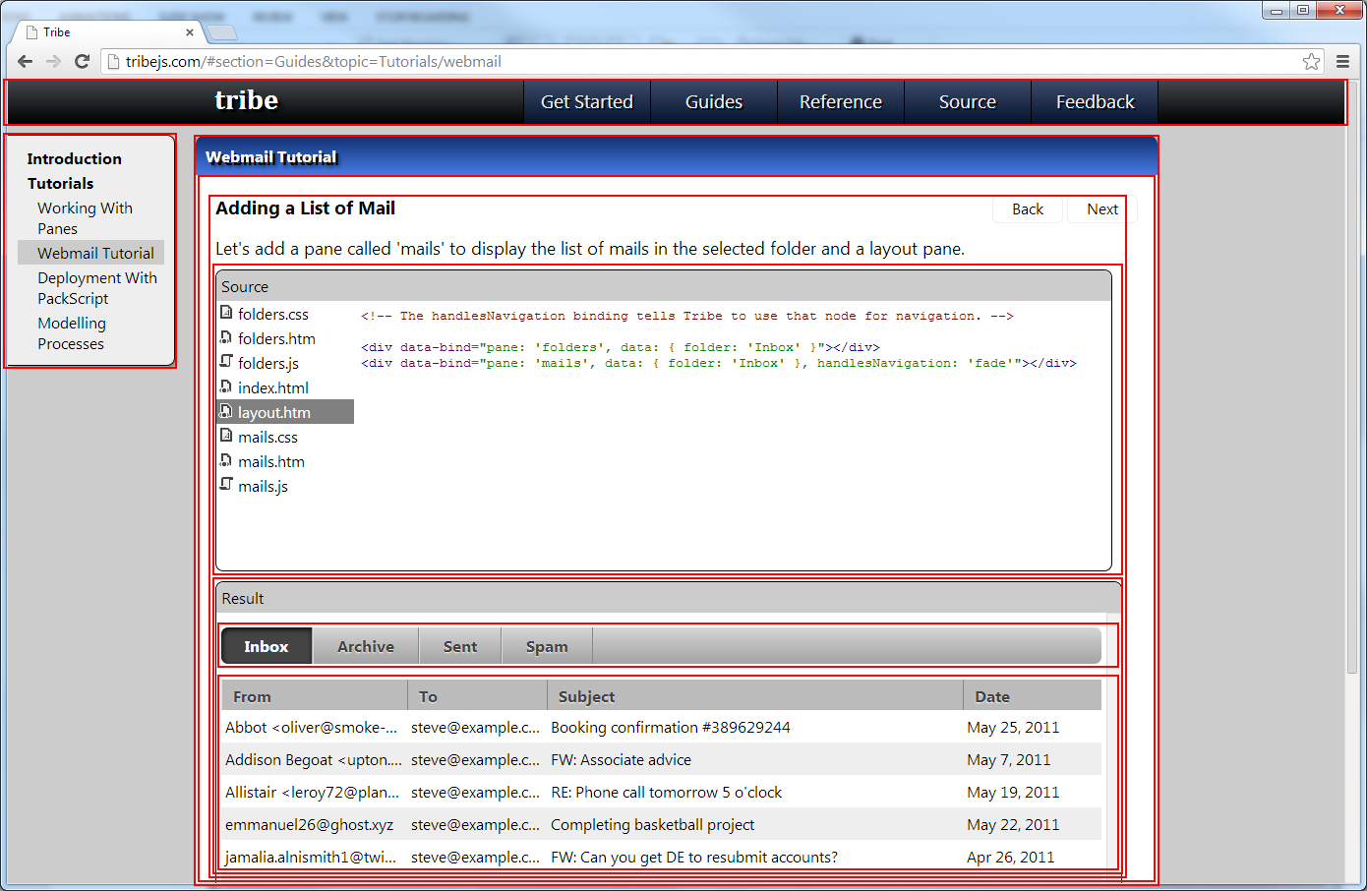

Slide 38
MVVM
Model View ViewModel
Originated from Microsoft
Specialization of the Presentation Model (Martin Fowler)

Slide 39
View Models
“Value converter”
Exposes objects from the model such that they are easily managed and consumed

Slide 40
Data Binding
Two way
Observability

Slide 41
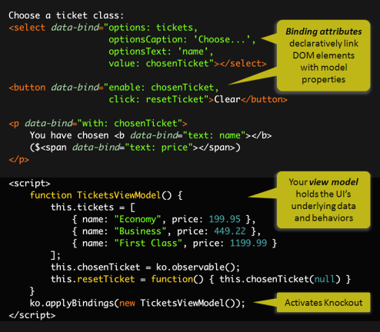

Slide 42
Questions?

Slide 43
Tribe

Slide 44
Why?
Built on knockoutjs
Knockout is not a full SPA framework
Focused around reducing friction
Zero configuration
Resource management
Build and deployment, dev to prod
Debugging experience
Passion

Slide 45
Other Frameworks
Backbone
Meteor
Angular
EmberJS
Durandal
JavascriptMVC
Etc., etc.

Slide 46
Features
Full composite UI
Simple, recursive component structure
Zero configuration
Hardware accelerated transitions
Navigation and process modelling
Resource lifecycle / memory management
Synchronise event buses across clients and server
Simple, seamless message distribution
Mobile toolkit for targeting mobile devices
Forms / scaffolding
Resource build system (PackScript)

Slide 47
Pure JavaScript
Run the same code on both the client and server
Such code needs to be constrained and given a common environment
Highly testable!

Slide 48
Components
PubSub
Composite
Forms
Mobile
Components
Server
PackScript

Slide 49
Composite
Production ready
Dependencies
jQuery
knockoutjs
Mobile
Forms
Components

Slide 50
Server
Previously SignalR, now nodejs based
Pure JavaScript
Dependencies
nodejs
express
socket.io
PackScript
Prototype status

Slide 51
Testing
Standard JavaScript unit testing techniques for infrastructure code
Unit test view models in isolation
Integration test panes
Full functional test with DSL

Slide 52
Demo

Slide 53
Roadmap
nodejs release candidate
Finalise API and semantics
Persistence mechanisms (mongodb, Azure Storage)
Basic authorisation
Server side debugging
Worker nodes
Perform message handling on scaled-out nodes
Queue priority
Assign worker nodes to specific queues
Scale-out server component
socket.io supports multiple instances, but only with sticky sessions
Bootstrapped scale-out module to ensure messages are distributed to all clients

Slide 54
Roadmap
Testing
Functional and integration test helpers
Built in test platform
Full HTML UI built with Tribe.Composite
Full debugging, both client and server side
Command line / build integration
Mobile
Integrate with nodejs component
Prepare skins for each target platform
PhoneGap / Apache Cordova integration
General
Dependency injection
Ability to control object lifetimes

Slide 55
Contact
Email: danderson00@gmail.com
Twitter: @danderson00
Github: http://github.com/danderson00

