Slide 1
Building Highly Scalable HTML5 Applications with the Tribe Platform
Dale Anderson

Slide 2
Introduction
Scalability
Consistency models
Message based architectures
Tribe

Slide 3
Performance and Scalability

Slide 4
ACID Consistency Model

Slide 5
Atomic
Consistent
Isolated
Durable

Slide 6
Atomic
Atomicity requires that each transaction is "all or nothing": if one part of the transaction fails, the entire transaction fails, and the database state is left unchanged.

Slide 7
Consistent
The consistency property ensures that any transaction will bring the database from one valid state to another.

Slide 8
Isolated
Concurrent transactions should behave as if each were the only transaction running in the system.

Slide 9
Isolated
The isolation property ensures that the concurrent execution of transactions results in a system state that would be obtained if transactions were executed serially, i.e. one after the other.

Slide 10
Durable
Durability means that once a transaction has been committed, it will remain so, even in the event of power loss, crashes, or errors.

Slide 11
Locking

Slide 12
Isolation Levels
Serializable
Repeatable reads
Read committed (SQL Server default)
Read uncommitted

Slide 13
Transaction 1 | Transaction 2
/* Query 1 */ SELECT * FROM users WHERE id = 1;
 | /* Query 2 */ UPDATE users SET age = 21 WHERE id = 1; COMMIT;
/* Query 1 */ SELECT * FROM users WHERE id = 1; COMMIT;

Slide 14
Lock Escalation
“Lock escalation is the process of converting many fine-grain locks into fewer coarse-grain locks, reducing system overhead while increasing the probability of concurrency contention.”
– technet.microsoft.com

Slide 15
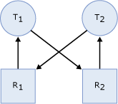
Deadlocks

Slide 16
Scalability
Vertical
Horizontal
Replication
Sharding

Slide 17
CAP Theorem

Slide 18
Consistency (all nodes see the same data at the same time)
Availability (a guarantee that every request receives a response about whether it was successful or failed)
Partition tolerance (the system continues to operate despite arbitrary message loss or failure of part of the system)

Slide 21
Eventual Consistency Model

Slide 22
BASE
Basically Available
Soft-state
Eventually consistent

Slide 23
Basically Available
The system guarantees availability, where availability has the same meaning as that of the CAP theorem.

Slide 24
Soft State
“In computer science, soft state is state which is useful for efficiency, but not essential, as it can be regenerated or replaced if needed.”
- wikipedia

Slide 25
Eventually Consistent

Slide 26
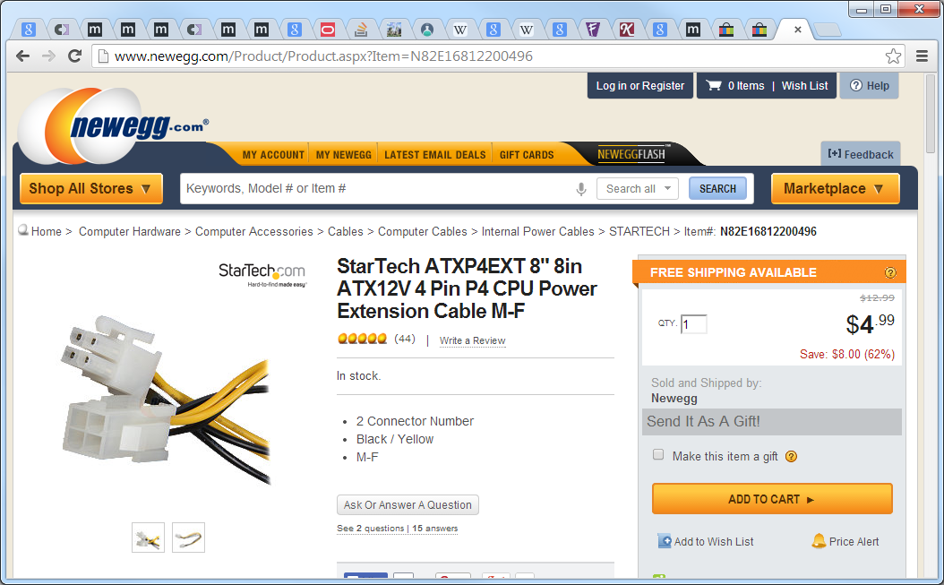

Slide 27
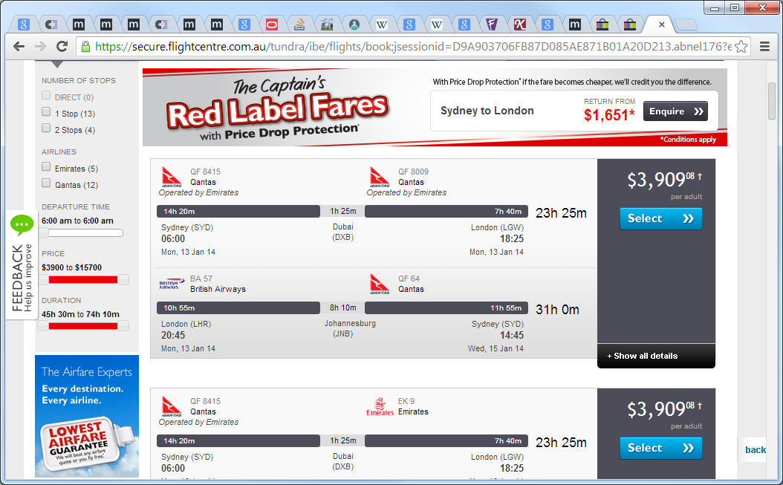

Slide 28
Resolving Conflicts

Slide 29
Message Based Architectures

Slide 30
Events
An event can be defined as "a significant change in state".
- http://en.wikipedia.org/wiki/Event-driven_architecture

Slide 31
Commands
An asynchronous request for a specific action to be performed by a receiver.

Slide 32
Guaranteed delivery
Necessary to support asynchronous operations
Provided by infrastructure

Slide 33
Error handling
Genuine exceptions
Place on to error queue or holding area

Slide 34
Transactions
Distributed transactions
Idempotence

Slide 35
Idempotence
“Idempotence is the property of certain operations in mathematics and computer science, that can be applied multiple times without changing the result beyond the initial application” - http://en.wikipedia.org/wiki/Idempotence

Slide 36
User interface design
Capture user intent
Excel-like grids don’t capture intent

Slide 37
Prioritising
Split specific message types into queues
Assign additional resources to specific queues
Auto-scale with Azure to ensure SLAs are met

Slide 38
CQRS

Slide 39
Driving forces
Collaboration
Staleness

Slide 40
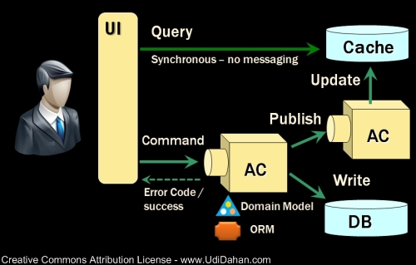

Slide 41
Event Sourcing

Slide 42
Event Sourcing
“Capture all changes to an application state as a sequence of events.”
- http://martinfowler.com/eaaDev/EventSourcing.html

Slide 43
Benefits
Event log
Complete rebuild
Temporal query
Event replay

Slide 44
Reversing Events
Complete rebuild
Reversal method
Epochs

Slide 45
Sagas
Implementation of the Process Manager pattern http://www.eaipatterns.com/ProcessManager.html
Maintain state across long running processes
Saga subscribes to specific message topics and mutates state in message handlers

Slide 46
Saga Implementation
public class MySaga : Saga<MySagaData>,
IHandleMessages<Message1>,
IHandleMessages<Message2>
{
public void Handle(Message1 message)
{
Data.Status = “Started”;
}
public void Handle(Message2 message)
{
Data.Count++;
}
}

Slide 47
Saga Data
public class MySagaData : IContainSagaData
{
// the following properties are mandatory
public virtual Guid Id { get; set; }
public virtual string Originator { get; set; }
public virtual string OriginalMessageId { get; set; }
public virtual string Status { get; set; }
public virtual int Count { get; set; }
}

Slide 48
Composite UIs

Slide 49
Composite Pattern
The composite pattern describes that a group of objects are to be treated in the same way as a single instance of an object.
The intent of a composite is to "compose" objects into tree structures to represent part-whole hierarchies.
Implementing the composite pattern lets clients treat individual objects and compositions uniformly.

Slide 50
Composite View Pattern
The Composite View design pattern describes a recursive UI structure of views containing children that are themselves views.
The views are then composed by a mechanism—usually at run time, in contrast to being statically composed at design time.

Slide 51
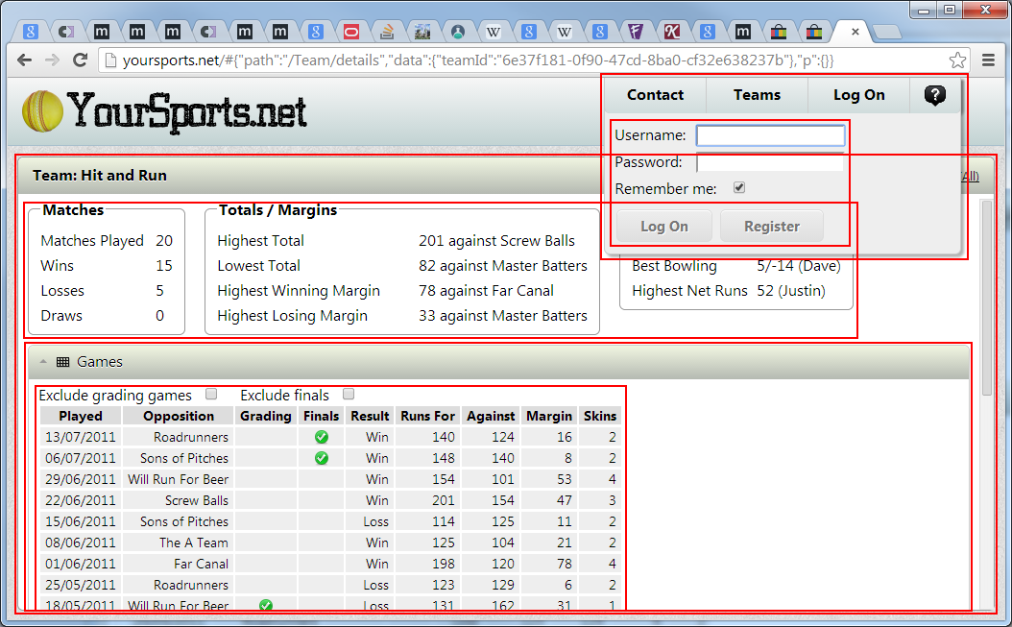

Slide 52
MVVM
Model View ViewModel is an architectural pattern used in software engineering that originated from Microsoft as a specialization of the Presentation Model design pattern introduced by Martin Fowler.

Slide 53
Presentation Model
“Represent the state and behaviour of the presentation independently of the GUI controls used in the interface”
- http://martinfowler.com/eaaDev/PresentationModel.html

Slide 54
View Models
“The view model of MVVM is a value converter, meaning that the view model is responsible for exposing the data objects from the model in such a way that those objects are easily managed and consumed.”
- http://en.wikipedia.org/wiki/Model_View_ViewModel

Slide 55
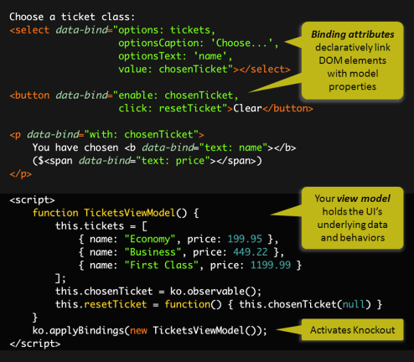

Slide 56
Communicating
Event aggregator – publish / subscribe
Sharing “observables”

Slide 57
SOA

Slide 58
Tribe

Slide 59
Why?
Built on knockoutjs
Not a full SPA framework
Focused around reducing friction
Ultimate debugging experience
Passion

Slide 60
Other Frameworks
Backbone
Angular
EmberJS
Durandal
Meteor
JavascriptMVC
Etc., etc.

Slide 61
Features
Full composite UI
Simple, recursive component structure
Zero configuration
Hardware accelerated transitions
Navigation and process modelling
Resource lifecycle / memory management
Simple, seamless message distribution
Mobile toolkit for targeting mobile devices
Forms / scaffolding
Resource build system (PackScript)

Slide 62
Pure JavaScript
run the same code on both the client and server
such code needs to be constrained and given a common environment
highly testable!

Slide 63
Deployment
Simple and powerful
Entirely static resources
CDN
Caching

Slide 64
Components
PubSub
Composite
Forms
Mobile
Components
Server
PackScript

Slide 65
Composite
Most mature component, along with PubSub
Dependencies
jQuery
knockoutjs
Forms
Mobile
Components

Slide 66
Server
Previously SignalR, now nodejs based
Pure JavaScript
Dependencies
nodejs
express
socket.io
PackScript
Prototype status

Slide 67
Testing
Standard JavaScript unit testing techniques for infrastructure code
Unit test view models in isolation
Integration test panes
Full functional test with DSL

Slide 68
Roadmap
nodejs release candidate
Finalise API and semantics
Persistence mechanisms (mongodb, Azure Storage)
Basic authorisation
Server side debugging
Worker nodes
Perform message handling on scaled-out nodes
Queue priority
Assign worker nodes to specific queues
Scale-out server component
socket.io supports multiple instances, but only with sticky sessions
Bootstrapped scale-out module to ensure messages are distributed to all clients

Slide 69
Roadmap
Testing
Functional and integration test helpers
Built in test platform
Full HTML UI built with Tribe.Composite
Full debugging, both client and server side
Command line / build integration
Mobile
Integrate with nodejs component
Prepare skins for each target platform
PhoneGap / Apache Cordova integration
General
Dependency injection
Ability to control object lifetimes

