Slide 1
Using Twitter API to find Informal Networks in the National Security Arena
Dan Detzi
School of Government and Public Policy
University of Arizona

Slide 2
The purpose of the project is to identify an informal network of national security officials who may act as influencers within the formal national security decision-making structure.
Topic and Purpose

Slide 3
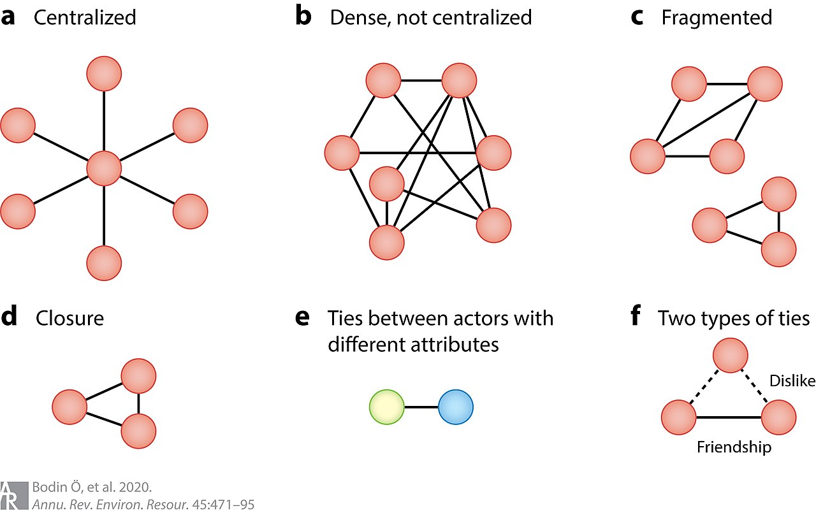
What I’m Looking For: What is expected and what I predict

Slide 4
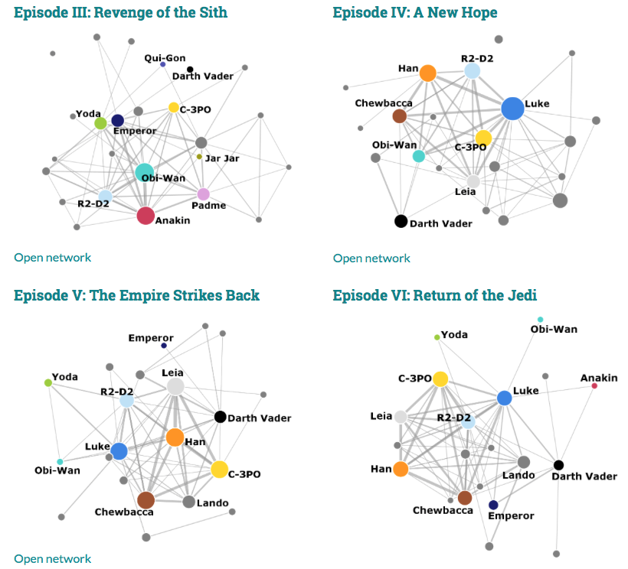
What I’m Looking For Results
Evelina Gabasova (evelinag.com/@evelgab)

Slide 5
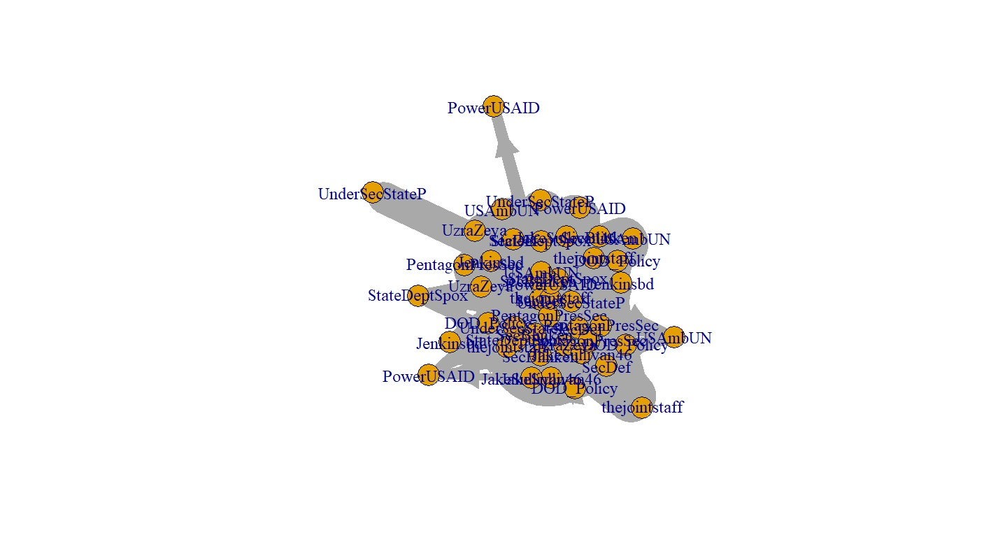
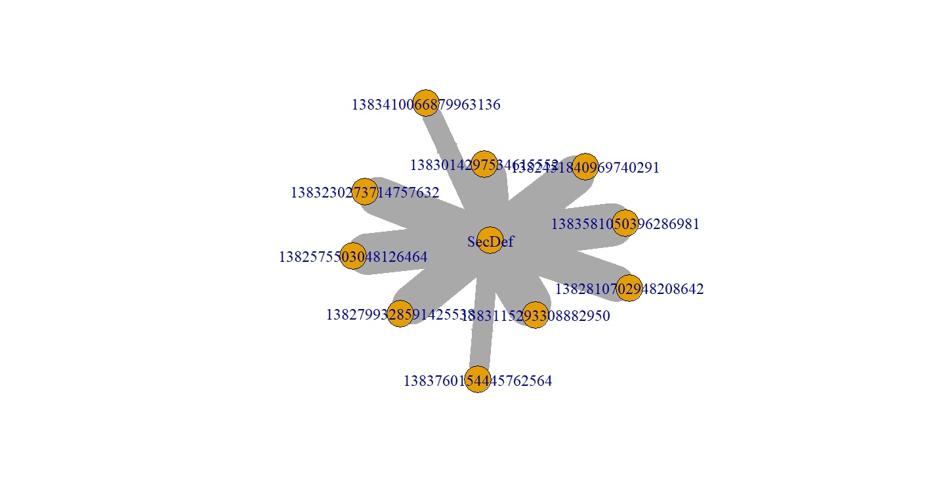
Where I’m at (ugh…it’s OK to laugh!)

Slide 6
I use Twitter API (Academic Twitter) to collect tweets from a select group of national security officials following President Biden’s announcement of the withdraw from Afghanistan. Tweets were collected from April 13 to April 21, 2021 (one week’s worth of tweets following the announcement)
Data Collection

Slide 7
Secretary of Defense
Secretary of State
Nat Sec Adviser
DOD Press Secretary
DOS Press Secretary
USD Policy
USAID
Under Sec International Security Affairs
Under Sec Political Affairs
Chairman, Joint Chiefs of Staff
USUN

Slide 8
I’ve experimented with two packages in R: academictwitteR twitteR
Data Processing
 | academictwitteR | twitteR
Advantages | -Good for finding all tweets with a keyword, like “Afghanistan”, and user in the same line of code -Start and end dates for tweets, instead of tweet IDs | -Good for network analyses -More mature with better help pages and examples
Disadvantages | -Not very good for network analyses (so far) -Too new to have many help pages (troubleshooting) | -Cannot filter tweets based on both user and keyword -Functions aren’t as intuitive

Slide 9
1. I use code produced by Shmargad and Sanchez (2020) and available from: https://github.com/thesickish/Congress2016 2. The code allows for the collection of tweets, retweets, and retweets of retweets, thus identifying influencers that can ‘boost the signal’ of the original tweeter.
Data Processing and Analysis

Slide 10
Packages Used in R
Package | Use
twitteR | Gathers data from Twitter API
igraph | Visualization of network data
httpuv | Used to facilitate downloads and processing
curl | Used to facilitate downloads and processing
openssl | Helps with encryption issues (like tokens)
plyr | For data manipulation (separating and bringing together datasets)

Slide 11
1. I don’t know enough about Social Network Analysis 2. . I need to know what data I actually need to help answer my question: This would help with both coding and data presentation. 3.I need to find a way to easily filter the tweets to include both username and keyword: This would pinpoint specific policy issues and the associated networks 4. R: The Greatest Challenge!! I went line by line with the Shmargad code to figure out (as best I could) what each function and loop was doing. This took a good deal of time. 5. Visualization and Interpretation
Challenges

Slide 12
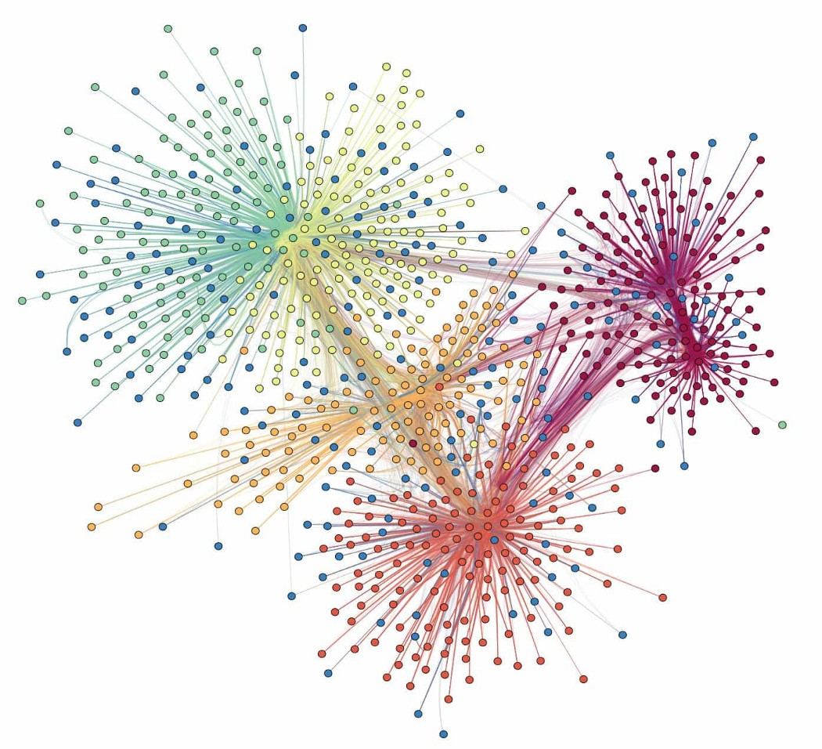
Looking Ahead: This type of data could be a game changer in Civil-Military Relations scholarship
I but with much work ahead!
Image by: Prakhar Ganesh, from: https://towardsdatascience.com/influential-communities-in-social-network-simplified-fe5050dbe5a4

