Slide 1
Sales and Performance Analysis
Breakdown of sales and market trends

Slide 2
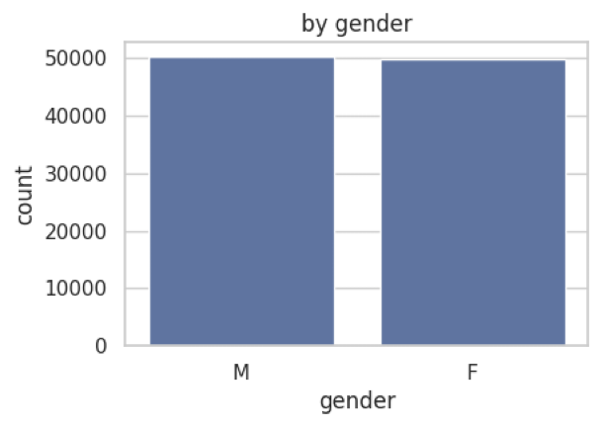
Sales by Gender
Sales distribution is nearly equal across genders, indicating a well-balanced product offering appealing to both men and women.

Slide 3
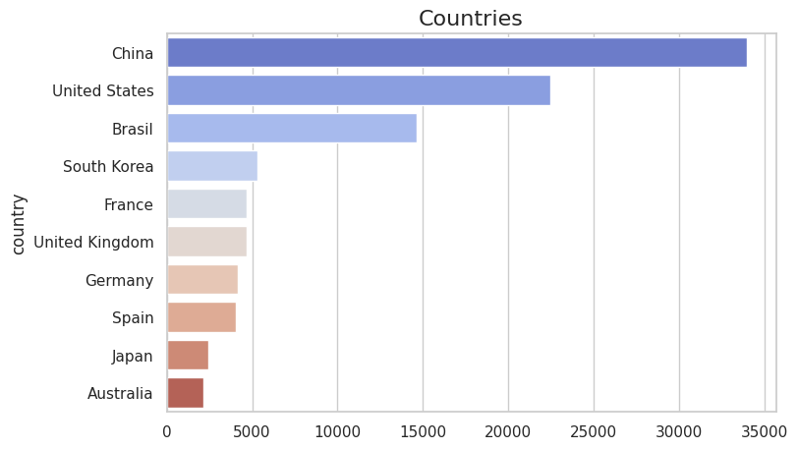
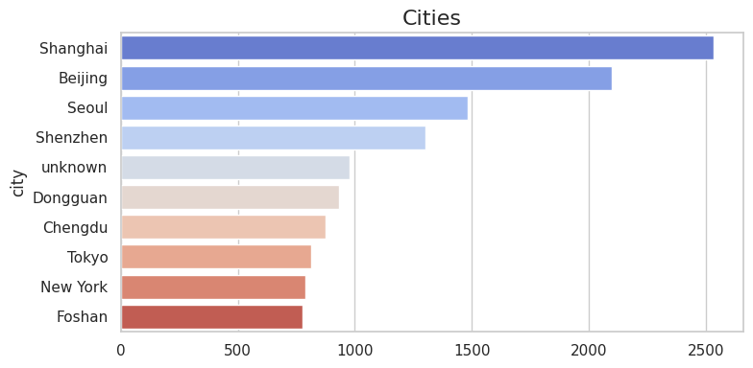
Key Markets: Cities and Countries
China, especially cities like Shanghai and Beijing, represents the largest share of our market. Other key regions include the U.S., Brazil, and South Korea.

Slide 4
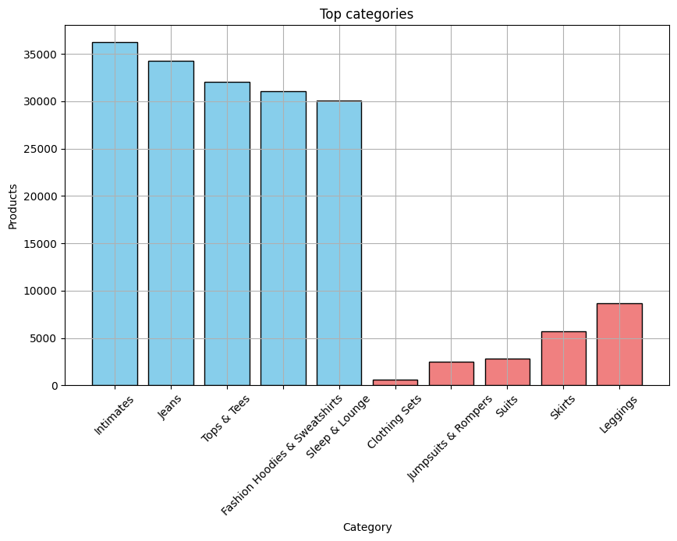
Top and Bottom Performing Categories
Which categories are performing well and which are lagging

Slide 5
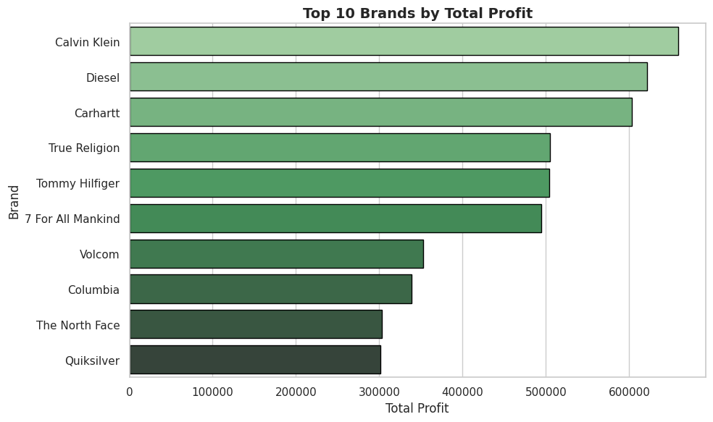
Top Brands by Profit
Fashion brands, particularly Calvin Klein and Diesel, lead the market in total profit, reflecting strong brand loyalty and high product margins.

Slide 6
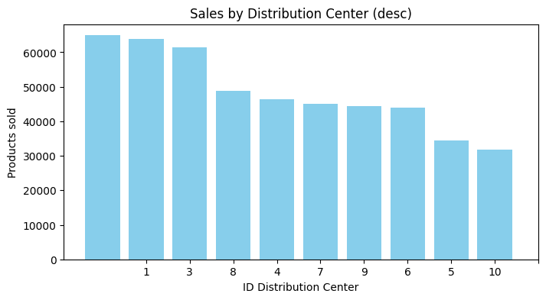
Sales by Distribution Center
Top Performers: Distribution centers 2, 1, and 3 lead in product sales.
Areas for Improvement: Centers 6, 5, and 10 are underperforming, potentially requiring operational reviews.

Slide 7
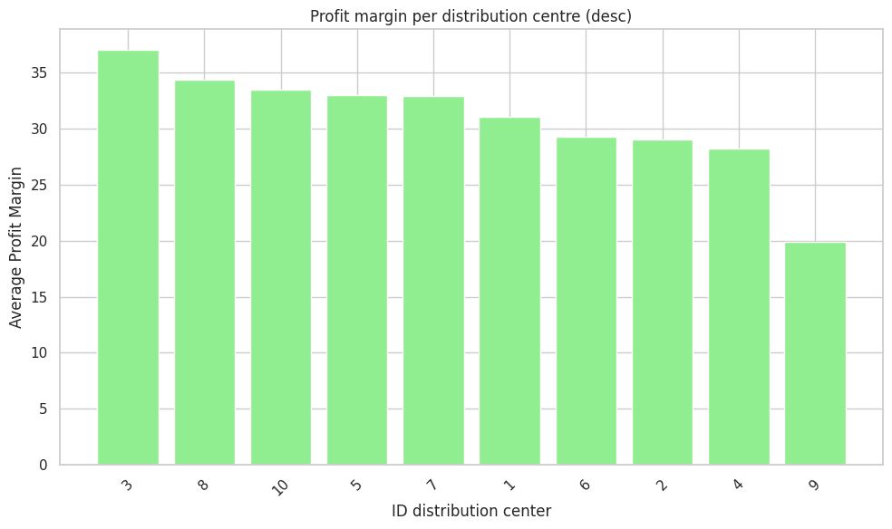
Profit Margin per Distribution Centre
High Margins: Centers 3, 8, and 10 show strong profit margins, indicating good cost efficiency.
Focus on Costs: Center 9 has the lowest margin, suggesting the need for cost optimization and efficiency improvements.

Slide 8
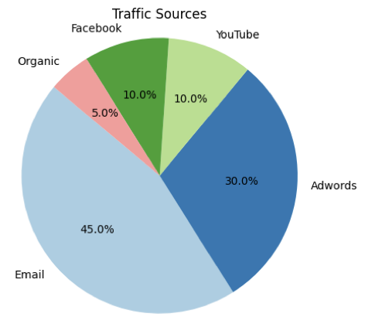
Traffic Sources Breakdown
Email is the most effective channel for driving traffic, followed by Google Adwords and YouTube. However, social media like Facebook plays a minor role.

Slide 9
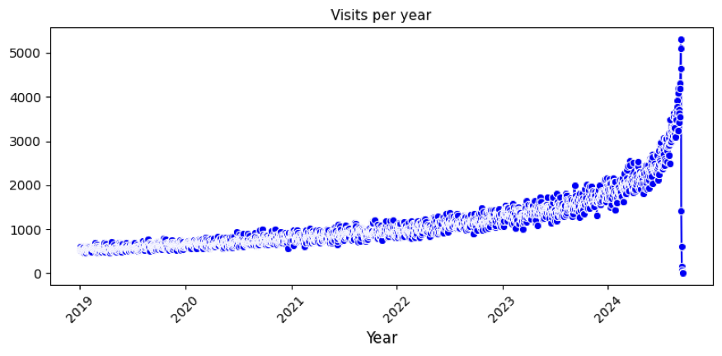
Yearly Visits Growth
The exponential growth in site visits over the years highlights the increasing demand, with a significant spike expected in 2024.

Slide 10
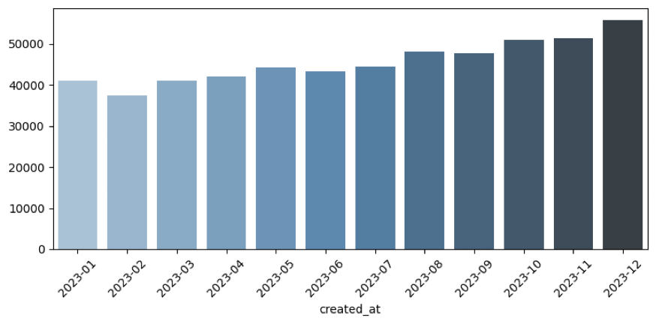
Monthly Visits (2023)
Visits grew steadily throughout 2023, with a peak in December, possibly due to holiday season promotions.

