Slide 1

IndexSQL
CBD Project
Daniel Diment Rodríguez

Slide 2
What is IndexSQL?
IndexSQL is a wrapper that helps with the use of IndexedDB.
Indexed
DB

Slide 3


But, what is IndexedDB?
IndexedDB is a low-level API for client-side storage in the web.
That is a database for the browser, to store data in the client.
It works by storing in tables a key and a json object.

Slide 4
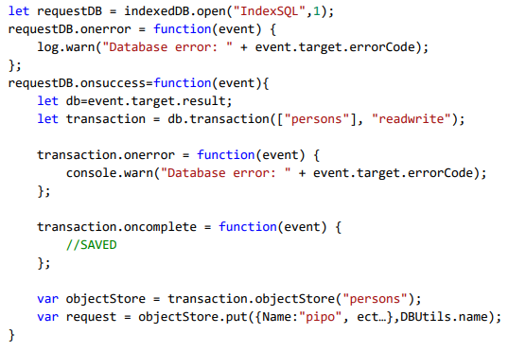
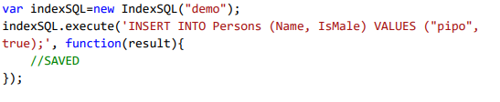
Why not to use IndexedDB, then?
Insert in indexedDB
Insert in indexSQL

Slide 5
Characteristics of IndexSQL
Compatible with major browsers
It does not block HTML DOM
It is fast
Easy to use for people with knowledge of SQL

Slide 6
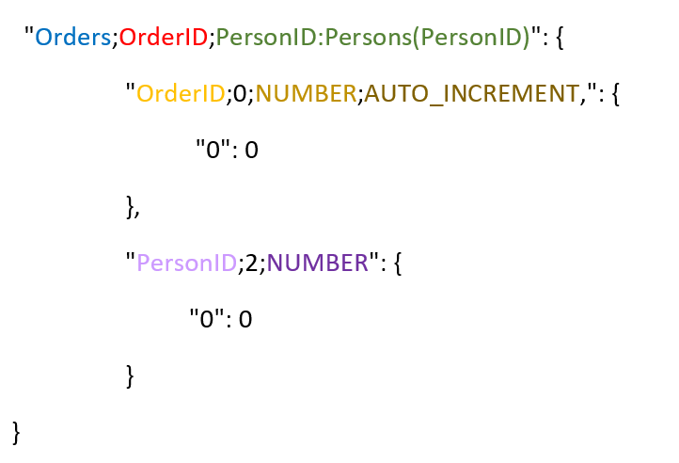
The JSON-SQL Architecture
CREATE TABLE Orders (
OrderID number AUTO_INCREMENT,
PersonID number,
PRIMARY KEY (OrderID),
FOREIGN KEY (PersonID) REFERENCES Persons(PersonID)
);

Slide 7
Now, a living demo
https://dandimrod.github.io/IndexSQL/demo.html

Slide 8
Any questions?

