Slide 1


Stage de développement d'interface homme-machine
Deltacad
60610, Lacroix Saint-Ouen, France
TN09 - Stage assistant ingénieur - Zhentao XU
du 13 février 2023 au 28 juillet 2023

Slide 2
Introduction
Notes:
Le sujet de mon stage était initialement <Développement/Intégration de fonctions de Vision par ordinateur pour l’inspection automatisée>. Durant toute la période de mon stage, mon travail s’est axé autour d’un logiciel appelé PowerEye. C’est un logiciel développé pour des scénarios industriels qui utilise la vision par ordinateur pour détecter les défauts des pièces sur la chaîne de production. Et le processus de développement du logiciel est basé sur les données d'image des pièces fournies par le système AML.

Slide 3
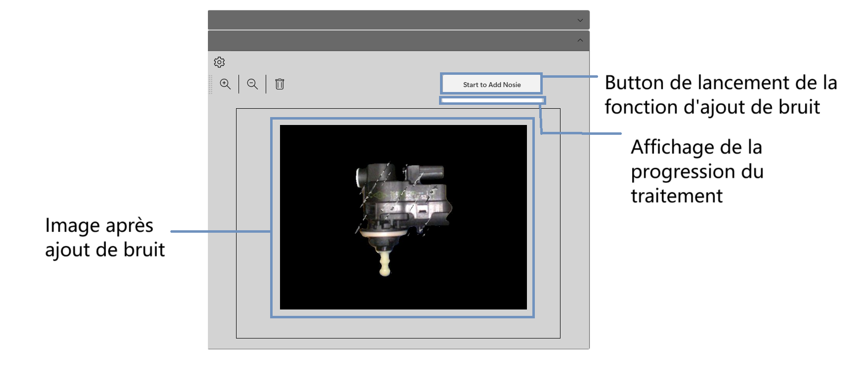
Onglet 1
Préparation des données

Slide 4
Recruitment Methods
To reach a wide pool of qualified candidates, we employ a variety of recruitment methods. Our approach combines both internal and external sourcing strategies to ensure a robust talent pipeline.
Internal Sourcing | Employee referrals: Encouraging current employees to refer candidates
 | Internal job postings: Advertising job openings within the company
External Sourcing | Job boards: Posting vacancies on popular job search platforms
 | Professional networks: Utilising industry-specific platforms
 | Partnerships: Collaborating with educational institutions or industry associations
Recruitment Agencies | Engaging external agencies to assist with talent acquisition
Ingoude Company: Recruitment and Selection Policy Presentation

Slide 5
Advertising Channels
Advertising Channel | Description
Company Website | Showcasing job openings on our dedicated careers page
Industry Platforms | Utilising industry-specific job boards and professional networks
Social Media | Leveraging social media platforms
Targeted Marketing | Tailoring advertising campaigns to reach specific candidate demographics
Diversity Networks | Engaging with diversity-focused networks and organisations
Ingoude Company: Recruitment and Selection Policy Presentation

Slide 6
Application Procedures
Our company is committed to conducting a fair and thorough application and screening process to identify the most qualified candidates for our open positions.
01. Application Submission
02. Confidentiality
03. Initial Screening
All candidates are required to submit their applications through our designated application portal or email address. Applications must include a comprehensive resume, cover letter (if applicable), and any other requested documents specified in the job posting.
All candidate information provided during the application process will be treated with strict confidentiality and in compliance with relevant privacy laws and regulations. Access to candidate data will be limited to authorised personnel involved in the recruitment process.
The HR department will review all applications to ensure they meet the minimum qualifications and requirements specified in the job posting. The initial screening will be based solely on the information provided in the application materials. Candidates who do not meet the minimum requirements will be notified promptly.
Ingoude Company: Recruitment and Selection Policy Presentation

Slide 7
Application Procedures continued
04. Shortlisting
05. Interviews
06. Evaluations
Shortlisting will be conducted by a selection committee consisting of HR representatives and relevant hiring managers. Shortlisting criteria will be established in advance and will align with the job requirements and desired qualifications. Candidates who best match the established criteria will be selected for further evaluation, such as interviews or assessments.
Shortlisted candidates will be invited for interviews and/or assessments as part of the selection process. Interviews may include behavioural, technical, or panel interviews, depending on the nature of the position. All interviews and assessments will be conducted in a fair, consistent, and unbiased manner.
Detailed notes and evaluations will be documented for each candidate during the interview and assessment process. Evaluations will be based on predetermined criteria established by the selection committee. Consistent evaluation methods will be used to ensure fair and objective assessments of each candidate.
Ingoude Company: Recruitment and Selection Policy Presentation

Slide 8

Application Procedures continued
07. Candidate Communication
08. Record Keeping
All candidates, both successful and unsuccessful, will be promptly and professionally notified of their application status. Feedback may be provided to candidates upon request, highlighting areas of strength and areas for improvement. Communication with candidates will be clear, respectful, and consistent throughout the application and screening process.
All application materials, interview notes, assessment results, and related documents will be securely maintained for a defined period as per our company's data retention policies. Candidate information will be handled in compliance with applicable privacy laws and regulations.
By adhering to this policy, we aim to ensure transparency, fairness, and efficiency in our recruitment process while selecting the most suitable candidates for our organisation.
Ingoude Company: Recruitment and Selection Policy Presentation

Slide 9

Be a catalyst for change

Slide 10



Interviews and Assessments
We believe in a structured and comprehensive interview and assessment process, including:
Conducting behavioural and technical interviews to evaluate candidates' skills and competencies.
Utilising assessments, tests, and practical exercises tailored to the job requirements.
Ensuring interview panels are diverse and represent various perspectives.
Ingoude Company: Recruitment and Selection Policy Presentation

Slide 11
Interviews and Assessments
Interview Panel | An interview panel will be formed for each position, consisting of at least two members, including a representative from the HR department and the hiring manager or relevant subject matter expert.
Interview Preparation | Prior to the interview, panel members will review the candidate's application materials, including their resume, cover letter, and any other relevant documents. Panel members will familiarise themselves with the job description, required qualifications, and the interview questions designed to assess the candidate's suitability for the position.
Interview Structure and Questions | Interviews will be structured to gather relevant information about the candidate's skills, experience, and fit for the role. All candidates will be asked the same core questions to ensure consistency and fairness.
Behavioural Interviews | Behavioural interviews will focus on past experiences and specific scenarios to assess the candidate's abilities, problem-solving skills, and behavioural competencies.
Technical Interviews | Technical interviews will be conducted for roles requiring specific technical knowledge or expertise. The panel will assess the candidate's technical skills through questions, case studies, or practical exercises designed to evaluate their proficiency.
Assessments and Tests | Assessments and tests may be administered to evaluate specific skills, aptitude, or knowledge relevant to the position. The type of assessment will be determined based on the requirements of the role and the industry best practices. Candidates will be provided with clear instructions and guidelines for completing the assessments.
Ingoude Company: Recruitment and Selection Policy Presentation

Slide 12
Selection, Checks and Offers
How We Select
Collaborating with relevant stakeholders to make informed decisions.
Evaluating candidates objectively based on predetermined criteria.
Documenting the selection process and maintaining confidentiality.
How We Check
Verifying educational
qualifications, employment history, and professional credentials.
Requesting candidate consent and handling personal data in accordance with privacy laws.
Using reputable sources and maintaining confidentiality
throughout the process.
How We Offer
Extending job offers in a timely manner, clearly stating terms and conditions.
Conducting salary negotiations
and benefits discussions
professionally and transparently.
Ensuring clear communication with
the selected candidate regarding
next steps.
Ingoude Company: Recruitment and Selection Policy Presentation

Slide 13
Rejection and Feedback
We understand that not every candidate will be successful in their application. However, we are committed to treating all candidates with respect and providing constructive feedback whenever possible. We believe that offering feedback helps candidates understand areas for improvement and enhances their overall job search experience.
Our aim is to deliver rejection messages promptly and professionally, accompanied by specific and actionable feedback when requested.
Ingoude Company: Recruitment and Selection Policy Presentation

Slide 14

Candidate Experience
We believe that providing an exceptional candidate experience not only reflects our commitment to professionalism but also strengthens our employer brand and enhances our ability to attract top talent.
Follow this policy to ensure a remarkable candidate experience.
Ingoude Company: Recruitment and Selection Policy Presentation

Slide 15

Compliance
Our Recruitment and Selection Policy complies with all relevant laws and regulations, including:
Equal Employment Opportunity laws, promoting fairness and diversity.
Data privacy and protection laws, ensuring the secure handling of candidate information.
Any specific industry regulations applicable to our business.
Ingoude Company: Recruitment and Selection Policy Presentation

Slide 16

Questions?
If you have any questions or need clarification regarding this policy, please don't hesitate to reach out to your supervisor or HR representative. We are here to support and guide you.
Email HR representatives via hello@reallygreatsite.com
Drop by the HR department in your nearest office
Ingoude Company: Recruitment and Selection Policy Presentation

