Slide 1
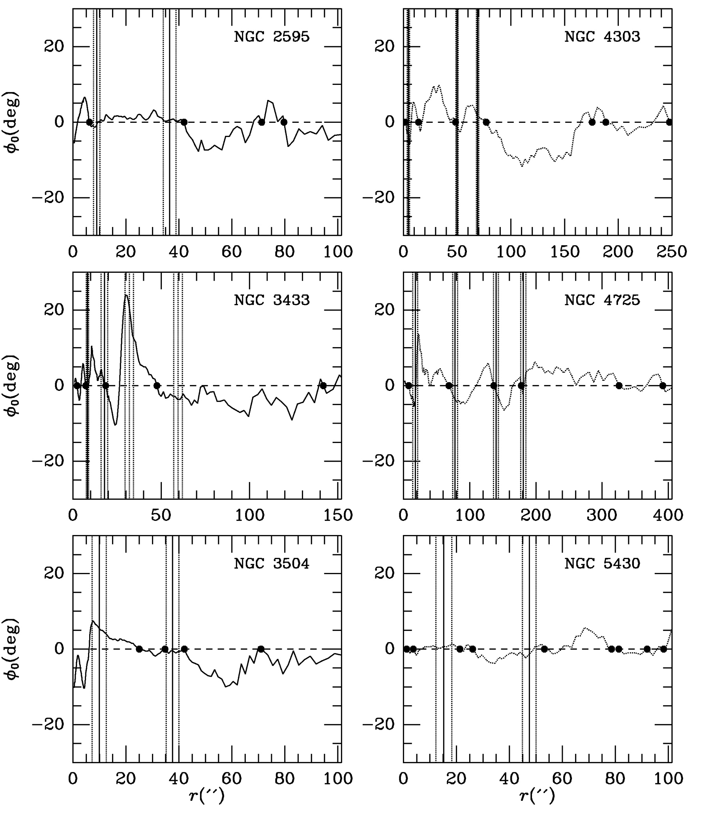
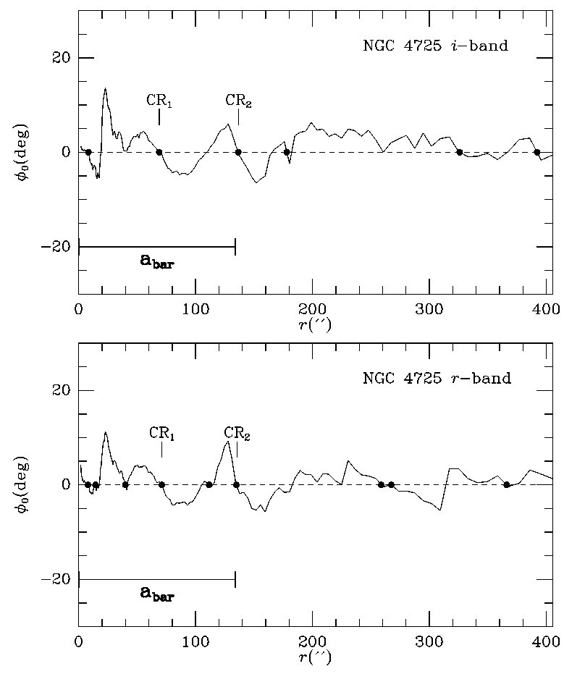
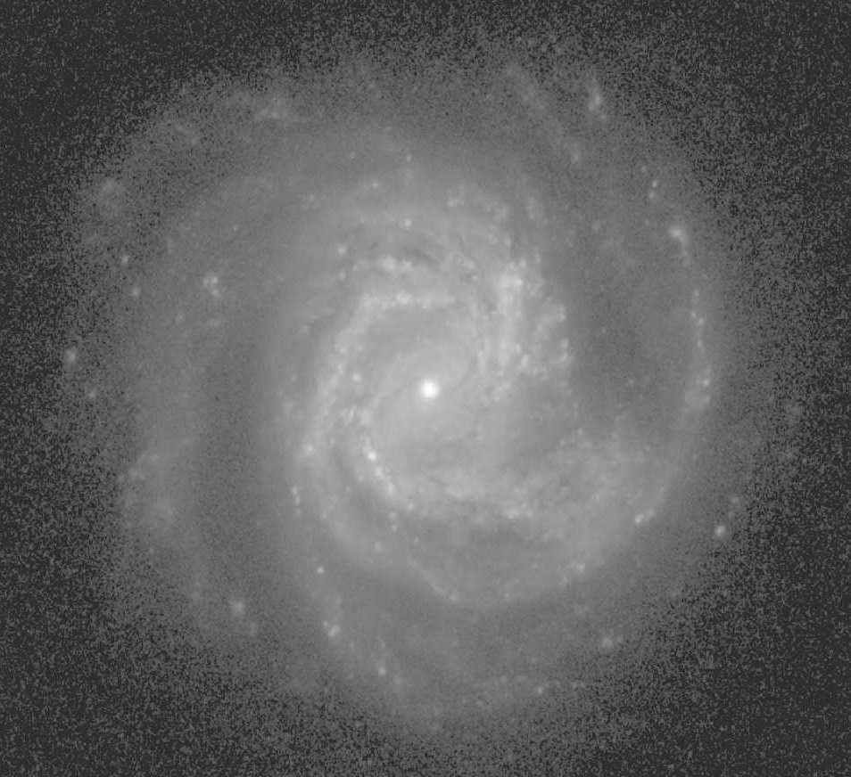
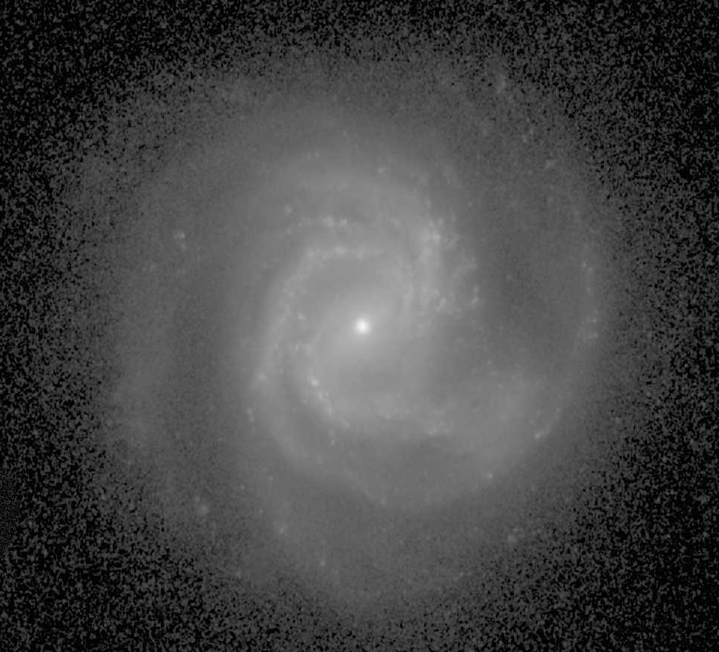
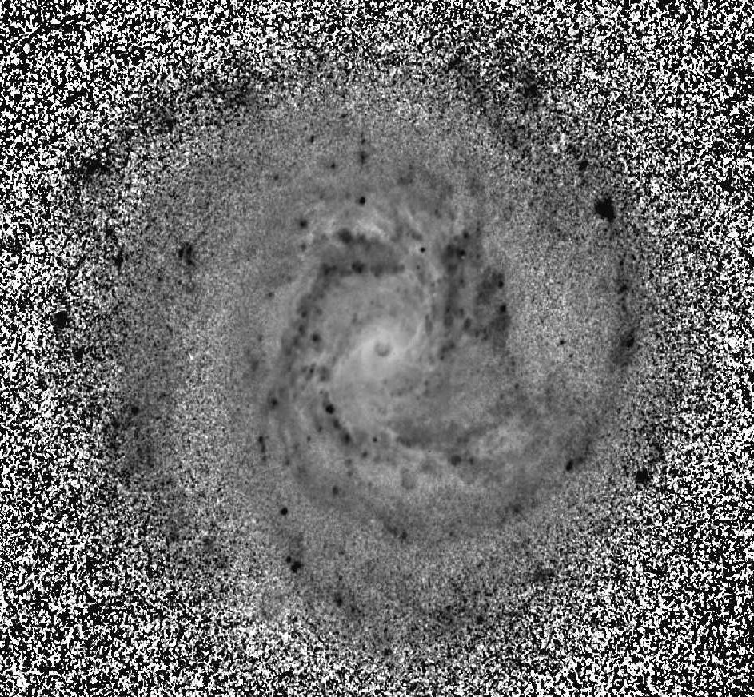
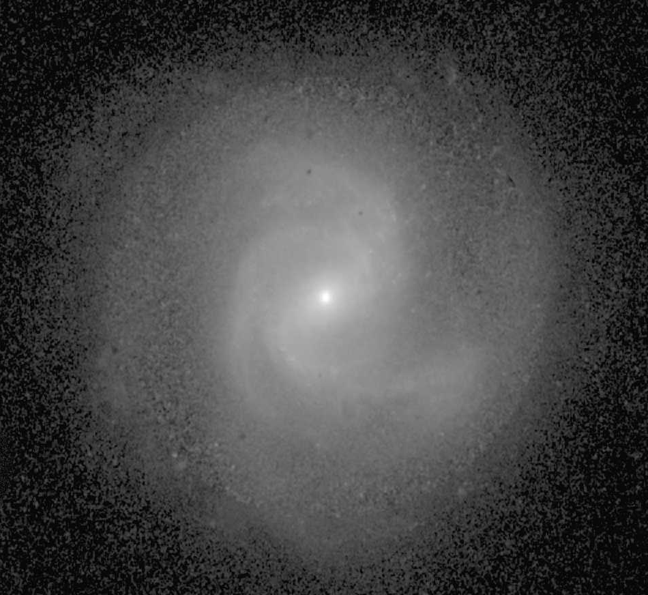
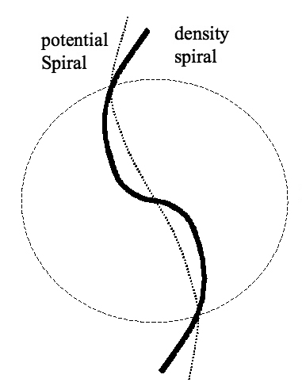
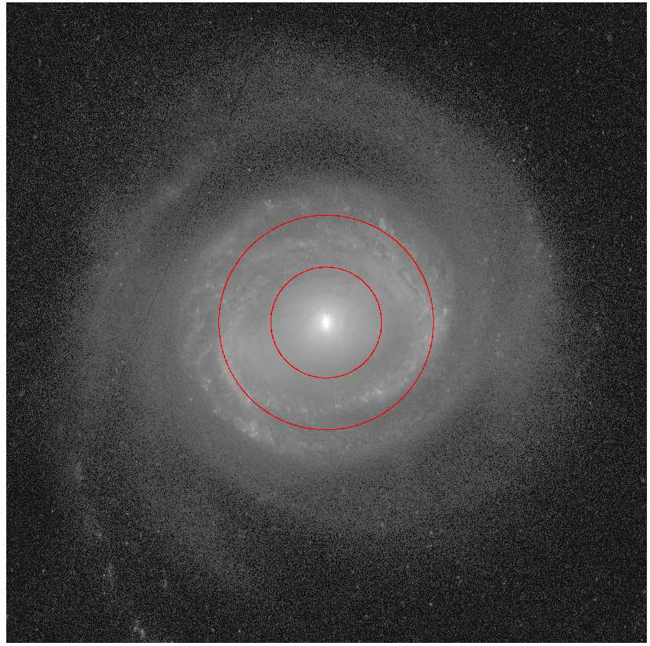
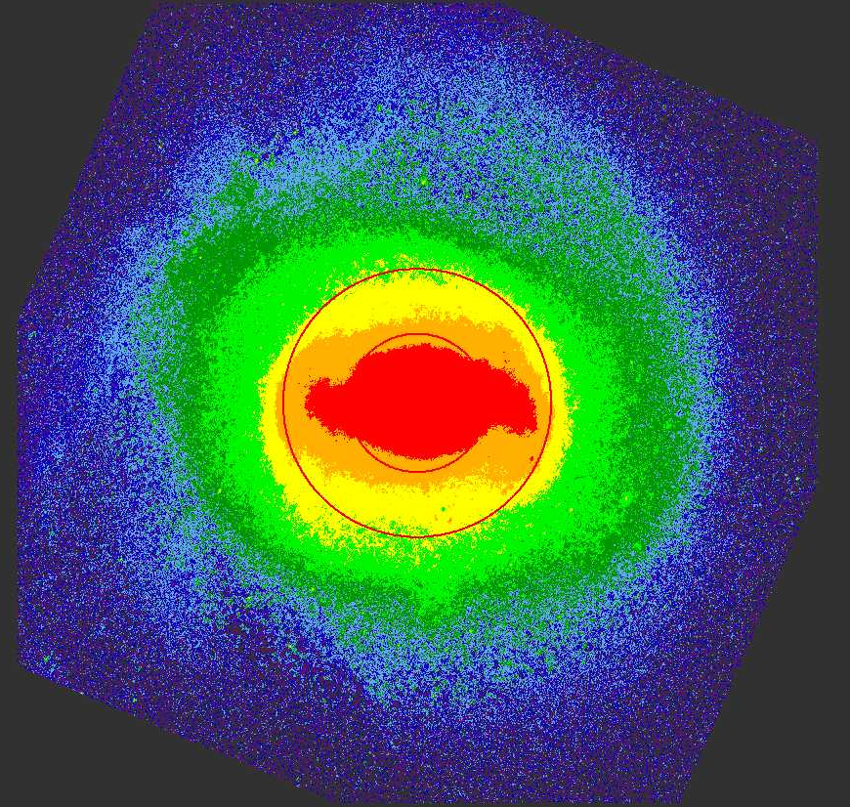
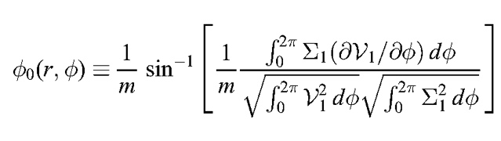
Comparison of Corotation Radius Estimates
R. Buta & X. Zhang
University of Alabama and George Mason University
Abstract
Materials and Methods
Results
Results (cont.)
The corotation resonance (CR) is the most important resonance governing
the structure and dynamics of disk-shaped galaxies. A number of methods
have been proposed for determining the CR radius, r_{CR}, based either on kinematics, photometry, or both. Font et al. (2011, 2014a,b) developed an effective kinematic approach called the "streaming phase-reversal" (SPR) method to locate CR radii in disk galaxies with well-sampled velocity fields. Here we compare estimates of r_{CR} for 6 galaxies from Font et al. (2014a) and Beckman et al. (2018) with those estimated using a very different apporach: the potential-density phase-shift (PDPS) method of Zhang & Buta (2007).
Our analysis is based on Sloan Digital Sky Survey (SDSS; Gunn et al. 1998; York et al. 2000) DR7 (Abazajian et al. 2009) images in filters g, r. and i. The images were downloaded using an SDSS query tool, calibrated using tsField files, cleaned of foreground and background objects using IRAF routine IMEDIT, deprojected, corrected for Galactic extinction, and then r and i were converted to mass surface density using color-dependent
mass-to-light ratios (Bell et al. 2003). The map based on i used g-i for the conversion, while the map based on r used g-r. Table 1 summarizes the sample galaxies,. Figure 2 shows the input images and resulting mass map for one of these cases.
Table 1: Sample Galaxies
--------------------------------------------------------------
Galaxy CVRHS Type
--------------------------------------------------------------
NGC 2595 (R’)SAB(p,rs,nr)bc
NGC 3433 SA(s)c
NGC 3504 (R₁’)SAB(rs,nr’)ab
NGC 4303 (R’)SAB(rs,nr)bc
NGC 4725 (R’)SAB(r,nb)ab
NGC 5430 SAB(s,nr’)b pec
--------------------------------------------------------------
The phase-shift as a function of galactocentric radius is shown for each galaxy in Figure 3. Filled circles indicate all positive-to-negative (P/N) crossings , each of which is a candidate for a CR radius although many in the outer regions are likely due to noise. The vertical lines show the CR radii for five galaxies from Font et al. (2014a), while those for the 6th (NGC 3433) are from Beckman et al. (2018). The results show some clear matches that are unlikely to be random noise alignments.
The r- and i-band phase-shift distributions of NGC 4725 are similar, but the comparison highlights how most if not all of the outer crossings are likely due to noise. Within the bar region, however, the two filters are in agreement on three CR radii. The most prominent crossings occur at 70” (CR₁) and 136” (CR₂) (circles in Figure 4), both of which are close to the SPR radii of 78” and 140” (Font et al. 2014a). The PDPS method also identifies a third CR at 8” which is matched more poorly by an SPR CR of 18” radius. CR₁ likely refers to an inner broad section of the bar while CR₂ may refer to an inner spiral which skews the outer part of the bar (seen well in the false color mass map in Figure 4, right). The innermost CR is likely associated with a prominent nuclear bar.
Introduction
The corotation resonance in a galaxy is a special place where the angular speed, Ω, of stars and interstellar gas clouds equals the angular speed Ω_{p}, of a perturbation, such as a bar, oval, or spiral density wave. For any such feature, the location of the CR in conjunction with a rotation curve determines the location of all other resonances. Thus, the CR is one of the most important resonances shaping galaxies and locating it is essential to understanding disk galaxy structure.
The ``streaming phase-reversal" method (Font et al. 2011, 2014a,b;
Beckman et al. 2018) is a direct kinematic approach to locating the radius of corotation in any disk-shaped galaxy having a well-defined, and
well-sampled, velocity field. The method uses the residual velocity
field, and interprets any radius where these residuals systematically
change sign (reverse phase) as a CR radius (or in some cases the radius of other resonances; Font et al. 2014b).
In contrast, the potential-density phase-shift method (Zhang & Buta
2007) uses red or infrared images to infer stellar mass surface density distributions and gravitational potentials to locate CR radii, independent of knowledge of kinematics. The basis of the PDPS method is that a stellar spiral can interact with the basic state of a galaxy disk through collective effects in the arms. The interaction is mediated by a phase-shift between the potential and density spirals. This phase-shift arises from the long-range nature of gravity, and is such that the density spiral leads the potential spiral (positive phase-shift) inside r_{CR} and lags the potential spiral (negative phase-shift) outside r_{CR} (Figure 1). Any radius where the phase-shift changes from positive to negative is considered a CR radius.
Figure 1. Illustration showing the phase difference between a spiral-shaped surface mass density perturbation (Σ₁) and its corresponding gravitational potential (V₁). The difference changes sign across the circle, which is the radius of corotation, r_{CR} (Zhang 1996).
Our objectives are to examine:
- how well the PDPS and SPR methods agree with each other
- how effectively noise in the phase shifts can be reduced
Figure 3: Phase-shifts as a function of galactocentric radius for the 6 galaxies in Table 1, based on mass maps inferred from i-band images and g–i color index maps. Any P/N crossing, no matter how slight, is indicated by a filled circle. The vertical lines show resonance radii and their error bars from the SPR method.
g-band i-band
Figure 5: Phase-shifts versus galactocentric radius for NGC 4725, comparing the results based on r-band and i-band mass surface density maps. The bar radius a_{bar} is based on ellipse fits to the deprojected i-band bar. CR₁ and CR₂ refer to two modes related to the bar and inner spiral plus ring.
While there are some clear agreements between the two methods, there are also some significant disagreements, as for the two outer resonance radii in NGC 3433 which do not coincide with any PDPS CR radii. Font et al (2014b) show how some SPR-method phase reversal peaks are associated with other resonances besides corotation, such as the inner and outer Lindblad and 4:1 resonances. Font et al. (2014b) found that most SPR peaks are associated with CR radii.
The issue of noise in the PDPS and the reliability of outer P/N crossings as well as weak inner crossings can in part be dealt with using different combinations of images and color index maps. Figure 5 shows a comparison between the phase-shifts inferred from the i-band mass map of NGC 4725 (Figure 4, right) and an r-band mass map (not shown).
Conclusions
The SPR and PDPS methods are two very different approaches to estimating CR radii is normal disk-shaped galaxies. In the case of NGC 4725, the methods are in good agreement on three innermost resonances. Some good agreements, as well as poor agreements, are found for the other five galaxies. It would be useful to apply the SPR method to ringed galaxies to further examine these issues, but the often highly localized nature of star formation in such galaxies may in some cases preclude getting the well-sampled velocity fields needed to apply the method.
Funding for the SDSS and SDSS-II has been provided by the Alfred P. Sloan Foundation, the Participating Institutions, the National Science Foundation, the U.S. Department of Energy, the National Aeronautics and Space Administration, the Japanese Monbukagakusho, the Max Planck Society, and the Higher Education Funding Council for England. The SDSS Web Site is http://www.sdss.org/.
g – i Σ (M_{sun} pc^{–2})
Figure 2: Images used for the application of the PDPS to NGC 4303. All have been deprojected according to ellipse fits to outer disk light.
The final step in the analysis is to calculate the phase-shift as a function of radius. This is derived from the mass map using (Zhang 1996):
References
Abazajian, K. N. et al. 2009, ApJS, 182, 543
Beckman, J. E. et al. 2018, ApJ, 854, 182
Bell, E. F. et al., 2003, ApJS, 149, 289
Font, J. et al. 2011, ApJ, 741, L14
Font, J. et al. 2014a, MNRAS, L85
Font, J. et al. 2014b, ApJS, 210, 2
Gunn, J. E. et al. 1998, AJ, 116, 3040
York, D. G. et al. 2006, AJ, 120, 1579
Zhang, X. 1996, ApJ, 457, 125
Zhang, X. & Buta, R. 2007, AJ, 133, 2584
g-band Σ(M_{sun} pc ^{–2} )
Figure 4: Optical and surface mass density images of NGC 4725. The red circles show the locations of two CR radii inferred from the PDPS method.

