Slide 1
PARSING
Daniel Dobozy November - 2024
1

Slide 2
Introduction to PARSING
Definition of Parsing:
Parsing is the process of analyzing a string of symbols (input) to determine if it can be generated by a given grammar.
Essential in compiler design for interpreting the code’s structure.
2

Slide 3
PARSING IN COMPILERS
Role:
The parser checks if code follows the language’s grammar.
It operates after lexical analysis and before code generation, structuring token sequences into a syntax-based format.
Purpose:
Verifies code syntax to catch errors before code generation.
Ensures only syntactically correct structures move forward.
Parse Tree:
Represents the nested structure of code based on grammar rules.
Some compilers don’t build an actual parse tree but treat the code as if it’s structured hierarchically, easing later stages of translation.

Slide 4
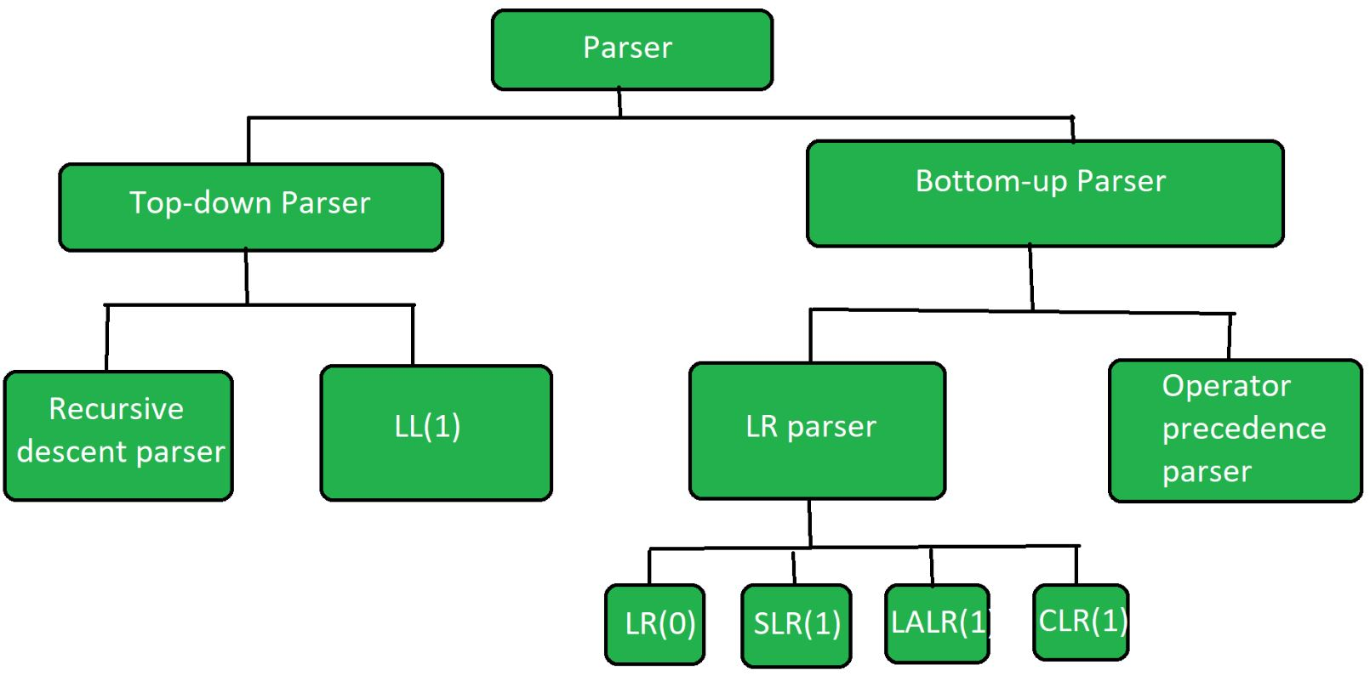
TYPES OF PARSING METHODS
TOP-DOWN PARSING
This method starts at the highest level of the parse tree (the root) and works its way down to the leaves. It attempts to break down the input string into smaller components according to the grammar rules.
BOTTOM-UP PARSING
In contrast, this method begins at the lowest level (the leaves) and builds up to the root of the parse tree. It identifies the input symbols and combines them according to the grammar to form larger constructs.
DIFFERENCE
Top-Down Parsers: Construct the parse tree from the start symbol down to the leaves, expanding until they match the input.
Bottom-Up Parsers: Build the parse tree from the input tokens up to the root, reducing them to higher-level constructs in the grammar.

Slide 5
TOP-DOWN PARSING
Definition:
Top-down parsing is a method that starts from the root of the parse tree and moves downward towards the leaves.
It begins with the start symbol of the grammar and applies production rules to generate the desired string.
Characteristics:
Each non-terminal in the grammar corresponds to a procedure in the parser.
The parser attempts to match the input tokens by expanding the grammar symbols until it either produces the input or encounters an error.
Advantages:
Ease of Implementation: Top-down parsers, especially recursive-descent parsers, are often simpler to implement and understand.
Natural Representation: This method reflects the hierarchical structure of the grammar, making it intuitive for some applications.
Common Approach:
Recursive-descent parsing is a well-known technique for top-down parsing that uses a set of recursive procedures to process the input.
5

Slide 6
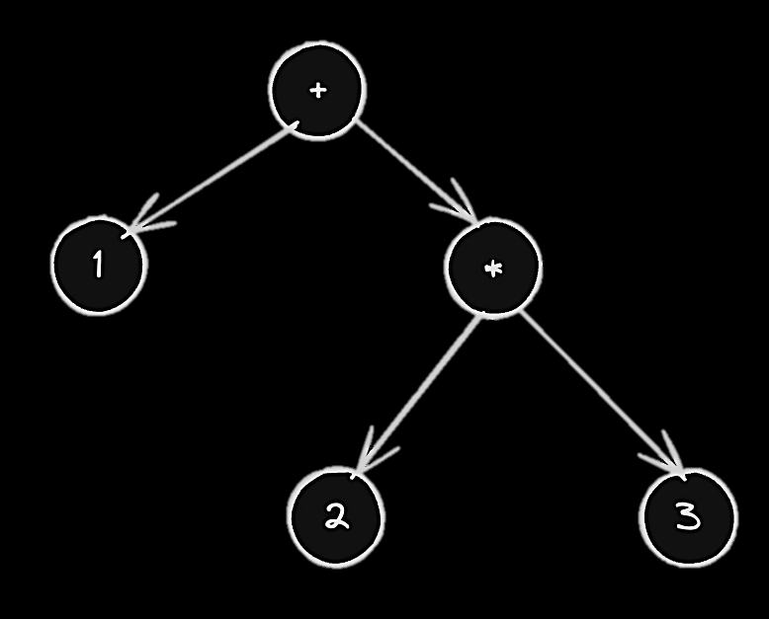
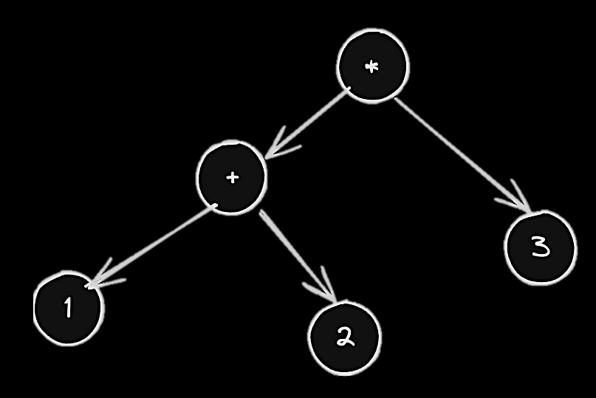
RECURSIVE-DESCENT PARSING
Definition:
A specific method of top-down parsing.
Utilizes a set of recursive procedures to process the input.
Mechanism:
Each nonterminal in the grammar has a corresponding procedure.
Procedures call each other recursively based on the grammar rules.
Processes input tokens sequentially, moving through the parse tree.
Parse Tree Construction:
Can construct the parse tree either implicitly (using call stack) or explicitly (using data structures).
Offers a direct correlation between grammar structure and parsing logic.
Use Case:
Commonly used in simple programming languages and domain-specific languages.
Ideal for grammars that do not require backtracking.

Slide 7
PREDICTIVE PARSING
Definition:
A type of recursive-descent parsing.
Uses lookahead to decide which grammar production to apply next.
Key Features:
Inspects the next input symbol to predict the correct production.
Helps avoid backtracking by making decisions based on upcoming symbols.
Lookahead
FIRST Set

Slide 8
FIRST SETS IN PREDICTIVE PARSING
What is a FIRST Set?
A set that includes all possible terminals that can start strings derived from a specific nonterminal.
Purpose in Parsing:
Helps the parser decide which production to apply without backtracking.
Ensures the parser can make efficient and accurate choices by looking at the next input symbol.
How it Works:
For each nonterminal, FIRST sets are precomputed.
When a nonterminal is encountered, the parser checks its FIRST set to determine which rule to apply based on the current lookahead symbol.
Example of Use:
A→aB∣ϵ
Benefit:
Improves parsing efficiency and makes predictive parsing possible for a wider range of grammars.
For a grammar rule like:
The FIRST set of A would include {a,ϵ}since A can derive a or nothing.
8

Slide 9
HANDLING ϵ-PRODUCTIONS
What are ϵ-Productions?
Definition: Productions that allow a nonterminal to derive an empty string (ϵ).
Role: Useful in grammars to handle optional elements or sequences with flexible structure.
Why ϵ-Productions Matter:
Allows the parser to proceed when a nonterminal doesn’t match any input symbol.
Helps manage cases where no specific tokens are expected in certain positions.
How Predictive Parsers Use ϵ-Productions:
Check FIRST Sets: If the lookahead symbol is not in the FIRST set of any production, the parser can consider an ϵ-production.
Apply ϵ-Production: If applicable, the parser chooses the ϵ-production to move forward without consuming any input symbols.
Example: When parsing optional elements, the parser selects ϵ if the lookahead doesn’t match other alternatives.
Benefit:
Provides flexibility, allowing parsers to handle variations in structure without errors.

Slide 10
Designing a PREDICTIVE PARSER
Key Steps:
Grammar Analysis:
Ensure the grammar is free of left recursion and ambiguity.
FIRST and FOLLOW Sets:
Calculate FIRST (terminals that start derivable strings) and FOLLOW (terminals that can follow a non-terminal).
Constructing the Parsing Table:
Use FIRST and FOLLOW sets to fill a parsing table based on productions.
Parsing Algorithm:
Implement a stack-based algorithm to process input tokens and consult the parsing table.
Error Handling:
Include error detection for mismatched symbols and recovery strategies to continue parsing.
Testing:
Test with diverse input cases to validate parser behavior and handle edge cases.

Slide 11
LEFT RECURSION
Definition:
Left recursion occurs when a grammar rule references itself as the leftmost symbol in its own production.
Problem in Predictive Parsing:
Predictive parsers struggle with left recursion, leading to infinite loops in parsing.
Elimination Methods:
Refactoring Grammar:
Rewrite rules to remove left recursion by introducing new non-terminals.
Example:
Original: A→Aα∣β
Refactored: A→βA′ and A′→αA′∣ϵA'
Importance:
Removing left recursion ensures that predictive parsing is effective and terminates correctly.

Slide 12
SUMMARY OF PARSING TYPES
Top-Down Parsing:
Starts from the root and works downward to the leaves.
Includes Recursive-Descent and Predictive Parsing.
Pros: Easier to implement manually; good for simpler grammars.
Cons: Limited in handling certain complex grammars, especially left-recursive ones.
Bottom-Up Parsing:
Builds from the leaves up to the root.
Includes Shift-Reduce and LR Parsing.
Pros: Handles a broader range of grammars; suitable for more complex languages.
Cons: More complex implementation, often requiring automated tools.
12

Slide 13
Applications of Parsing in Compilers
Role in Compilers:
Parsing is a fundamental phase in compiler design, serving as the bridge between the lexical analysis and semantic analysis stages.
Syntax Analysis:
Ensures that the source code adheres to the language's syntax rules.
Produces an abstract syntax tree (AST) that represents the structure of the code.
Error Detection:
Identifies syntax errors, helping programmers locate issues early in the development process.
Language Translation:
Facilitates the translation of high-level programming languages into machine code or intermediate representations.
Tools and Frameworks:
Utilizes tools like Yacc and Bison for automatic parser generation from grammar specifications.
Real-World Applications:
Used in various programming languages compilers, interpreters, and integrated development environments (IDEs).

