Slide 1
Environmental overlap and its impact on bodyplan similarity between Onychophora and Chilopoda

Slide 2
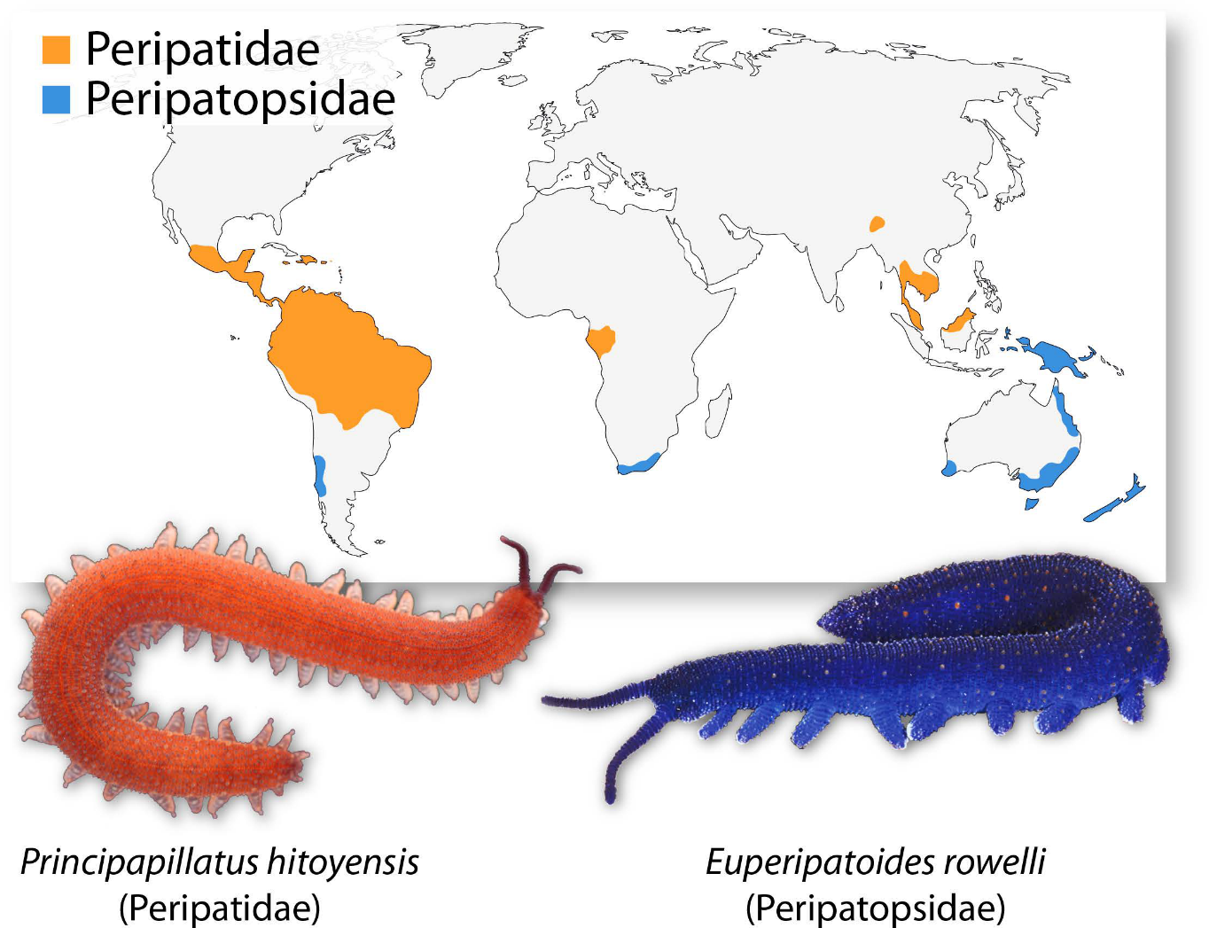
Onychophora are an unique and elusive phylum
Often referred to as “Velvet Worms”
Closest living relatives of Arthropods (Mayer et al, 2015)
Found in humid regions
  Tropical and temperate forests
  Prefer leaf litter
Potential model organism for studying Arthropod evolution (Treffkorn, 2019)
Treffkorn, 2019

Slide 3
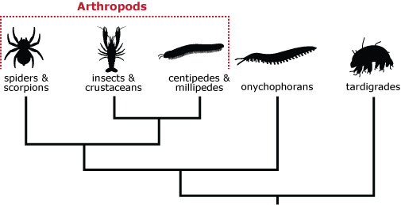
Chilopoda share some morphology with Onychophora
Commonly referred to as “Centipedes”
Part of the subphylum Myriapoda
  Is superficially similar to Onychophorans
  Many-legged, predatory, related organisms
A new old animal, 2013

Slide 4
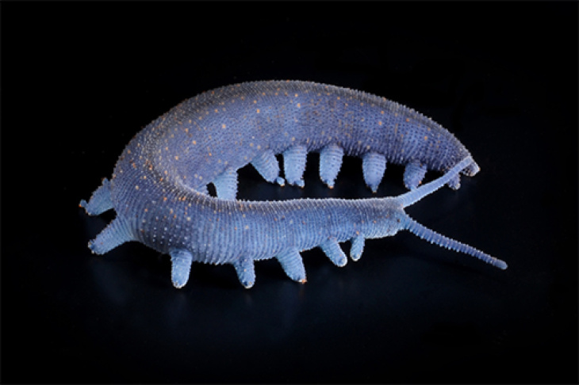
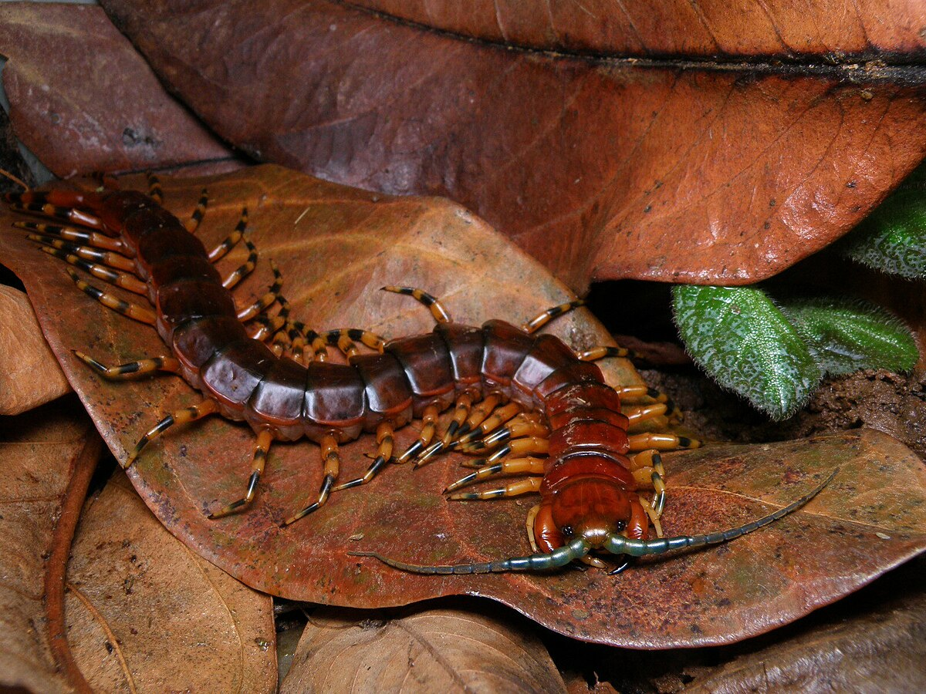
Are their morphological similarities explained by convergent evolution, as a result of environmental pressures?
(Martin C, 2022)
(Borges C, 2023)

Slide 5
Hypothesis: There will be considerable environmental overlap between Onychophora and Chilopoda.

Slide 6
Methods

Slide 7
Download Onychophora and Chilopoda data from BOLD and read it into RStudio
Visually represent number of species found in shared environments, and compare it to species not sharing environments
Determine if there is evidence of environmental pressures causing morphological similarities between Onychophorans and Chilopodans
Explore the dataframes to understand their structure and content
Conduct a pairwise analysis of Onychophora and Chilopoda BINs to determine similarity
Determine shared environments, and all unique species found in those environments
Visually represent BIN similarity with a pairwise alignment heatmap

Slide 8
Figures

Slide 9
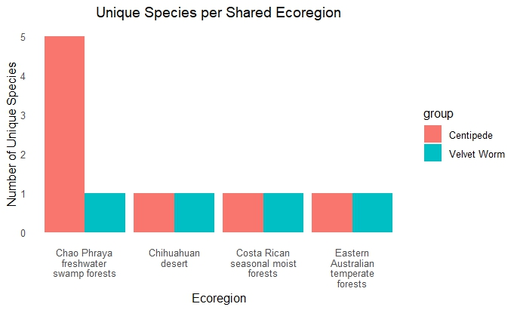
Few Onychophora and Chilopoda species have been sampled in their shared environments

Slide 10
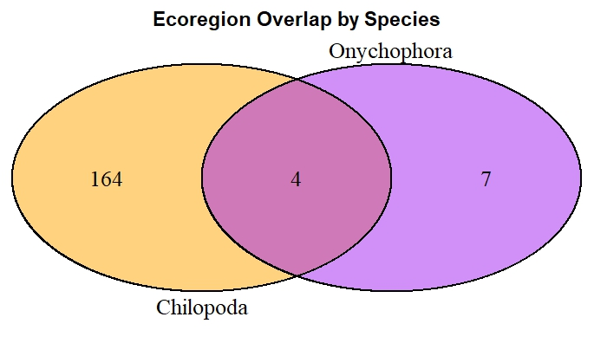
The majority of Chilopoda species do not share an ecoregion with Onychophora species

Slide 11
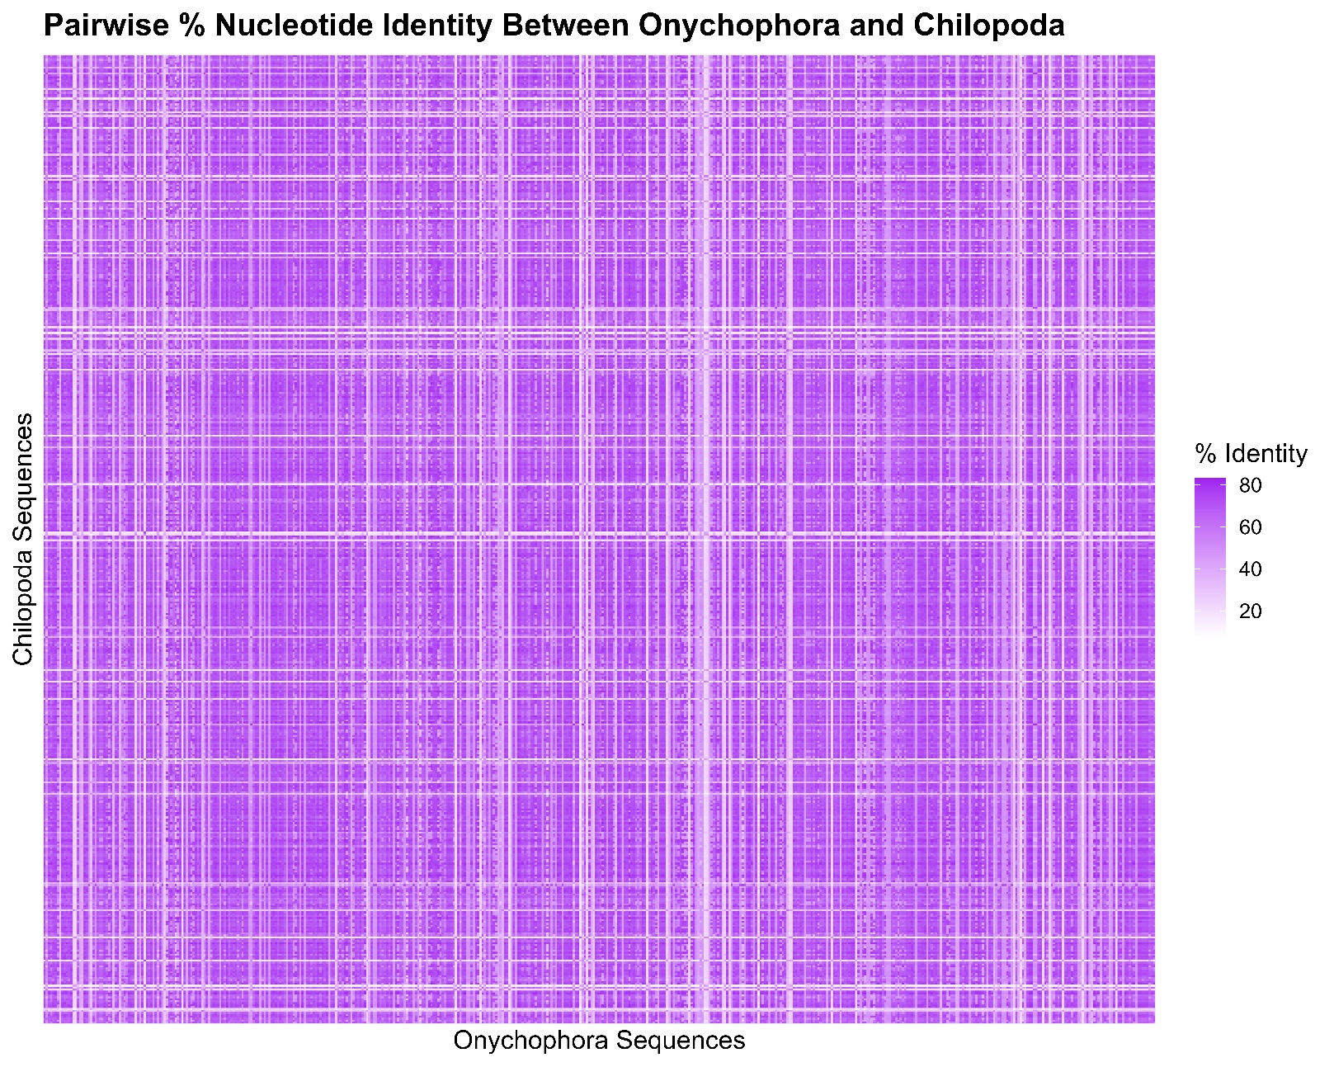
A pairwise alignment of 500 sampled Onychophora and Chilopoda BIN sequences showed some relatedness

Slide 12
Results and Discussion

Slide 13
Analysis shows little environmental overlap between Onychophora and Chilopoda
It is unlikely that environmental pressures are a major contributing factor to similarities in body plan between velvet worms and centipedes.
Proportionally, very few sampled Chilopoda species are located in regions shared with Onychophora.
  Further, there are few regions that host both species simultaneously.
Pairwise alignment shows some, but not strong BIN sequence similarity.

Slide 14
Issues with analysis and further steps
Onychophora is not a well sampled taxa.
  Known to be elusive, and sightings are rare.
  The majority of BOLD samples were taken from NCBI, and not sampled directly from an environment.
  As a result, very few Onychophora entries have an associated region.
Chilopoda is better sampled, but there may be more overlap than this analysis shows
  With more thorough Onychophora sampling, added regions would also likely contain Chilopoda species.
Analysis of percent similarity of sampled BINs could be improved.
  Additional comparisons should be made, such as Chilopoda with Diplopoda, or Onychophora with Tardigrada.
    Determine how strong percent similarity is compared to other relatives.
  Using a stronger computer, the entire set of BINs could be aligned.

Slide 15
References
Campbell L et al. (2011). MicroRNAs and phylogenomics resolve the relationship of Tardigrada and suggest that velvet worms are the sister group of Arthropoda. Proceedings of the National Academy of Sciences USA. 108: 15920-15924.
Oliveira I et al. (2013). A new species of Eoperipatus (Onychophora) from Vietnam reveals novel morphological characters for the South-East Asian Peripatidae. Zoologischer Anzeiger. 252: 495-510.
Mayer G, Franke FA, Treffkorn S, Gross V, Oliveira IS, Wanninger A (Ed). (2015). Evolutionary Developmental Biology of Invertebrates 3: Ecdysozoa I: Non- Tetraconata. Springer: 53–98.
Treffkorn S. (2019, August 7). A day in the life of an onychophoran lab. The Company of Biologists. https://thenode.biologists.com/a-day-in-the-life-of-an-onychophoran-lab/lablife
(2013, September). A new old animal. Understanding Evolution. https://evolution.berkeley.edu/evo-news/a-new-old-animal
Hammel JU, Wöhrle C. (2022, March 29). Velvet worm brains in HD. Helmholtz-Zentrum hereon. https://www.hereon.de/communication_media/news/105329/index.php.en
Borges C. (2023, January 3). Amazonian Tricolor Centipede (Scolopendra viridicornis). iNaturalist. https://www.inaturalist.org/observations/145767270
(2025, August). Data visualization with ggplot2 :: Cheat Sheet. Posit Software. https://rstudio.github.io/cheatsheets/html/data-visualization.html
(2025, August). String manipulation with stringr :: Cheatsheet. Posit Software. https://rstudio.github.io/cheatsheets/html/strings.html
(2025, August). Data transformation with dplyr :: Cheatsheet. Posit Software. https://rstudio.github.io/cheatsheets/html/data-transformation.html

Slide 16
References
(2025, August). Venn Diagram. the R graph gallery. https://r-graph-gallery.com/14-venn-diagramm
Aboyoun P. (2011, March 2). Pairwise sequence alignments. Bioconductor. https://www.bioconductor.org/packages//2.7/bioc/vignettes/Biostrings/inst/doc/Alignments.pdf
Thompson RC. (2011, April 13). What is the easiest way to parallelize a vector in R?. StackOverflow. https://stackoverflow.com/questions/5571774/what-is-the-easiest-way-to-parallelize-a-vectorized-function-in-r?utm_source=chatgpt.com
Privé F. (2017, September 5). A guide to Parallelism in R. https://privefl.github.io/blog/a-guide-to-parallelism-in-r/?utm_source=chatgpt.com
Sanderson SP. (2024, May 21). How to split a vector into chunks in R. Steve’s Data Tips and Tricks. https://www.spsanderson.com/steveondata/posts/2024-05-21/?utm_source=chatgpt.com
Radečić D. (2024, March 20). R doParallel: How to parallelize R Dataframe computations. Appsilon. https://www.appsilon.com/post/r-doparallel-dataframe?utm_source=chatgpt.com
(2023, June). How to use pivot_longer in R?. StackOverflow. https://stackoverflow.com/questions/76280929/how-to-use-pivot-longer-in-r?utm_source=chatgpt.com
(2025). Heat map in ggplot2. R Charts. https://r-charts.com/correlation/heat-map-ggplot2/?utm_source=chatgpt.com
(2022, May). Why am I not getting high-resolution with ggsave()?. StackOverflow. https://stackoverflow.com/questions/70309119/why-am-i-not-getting-high-resolution-with-ggsave?utm_source=chatgpt.com
(2025, September). Set size of ggsave exactly. StackOverflow. https://stackoverflow.com/questions/44711236/set-the-size-of-ggsave-exactly?utm_source=chatgpt.com
Tmiendo2. Saving a ggplot object as an image. R as GIS for Economists, bookdown. https://tmieno2.github.io/R-as-GIS-for-Economists/ggsave.html?utm_source=chatgpt.com

