Slide 1
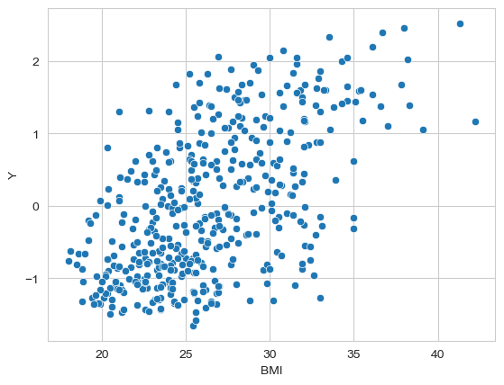

regression
Can BMI explain Y?
Can BMI predict Y?
How does Y vary with BMI?
Regression is a general term for modeling the relationship between a label
(a.k.a. dependent variable or target) and one or more features (a.k.a. the attributes, the independent or explanatory variable(s)).
Machine Learning Methods for Biomedical Data (D012554)

Slide 2
linear regression
We need to make
assumptions
about the
model
that generated the data.
linear relationship
linear model
Machine Learning Methods for Biomedical Data (D012554)

Slide 3
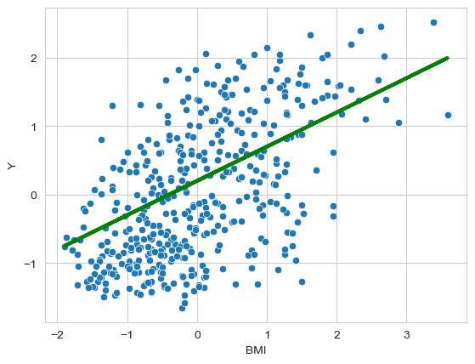

linear regression
a and b are model parameters
a is the slope to the line (direction)
b is the intercept or bias (position)
Machine Learning Methods for Biomedical Data (D012554)

Slide 4
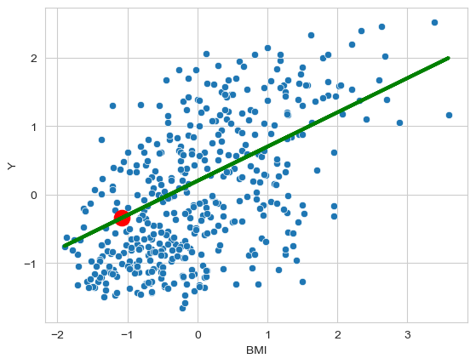
linear regression: prediction
BMI(70kg, 1.8 meter) = 21.6
scaled data!
scaled BMI = -1.08
predicted value = -0.34
generalization!!
Machine Learning Methods for Biomedical Data (D012554)

Slide 5
linear regression: fitting
What values for a and b fit the data best?
How can we evaluate them?
Machine Learning Methods for Biomedical Data (D012554)

Slide 6
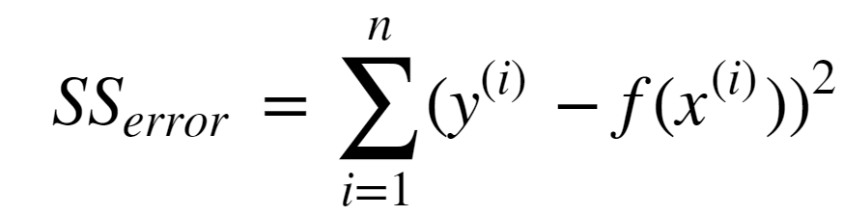
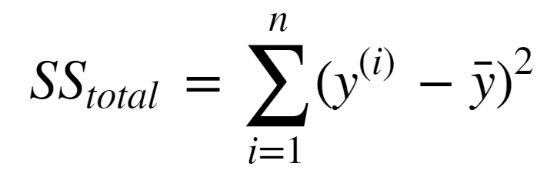
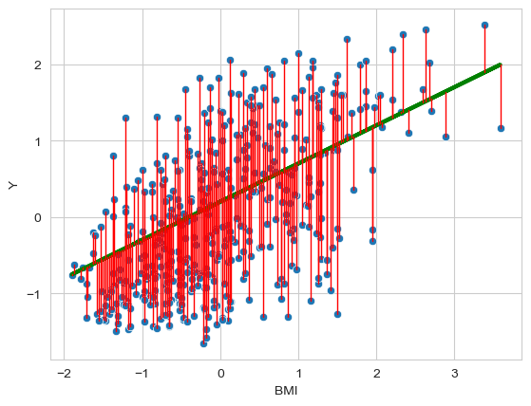
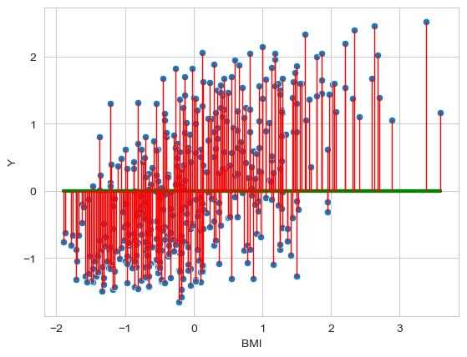


linear regression: fitting
Machine Learning Methods for Biomedical Data (D012554)

Slide 7





linear regression: formalized
Dataset
linear regression
Learning Algorithm
Machine Learning Methods for Biomedical Data (D012554)

Slide 8
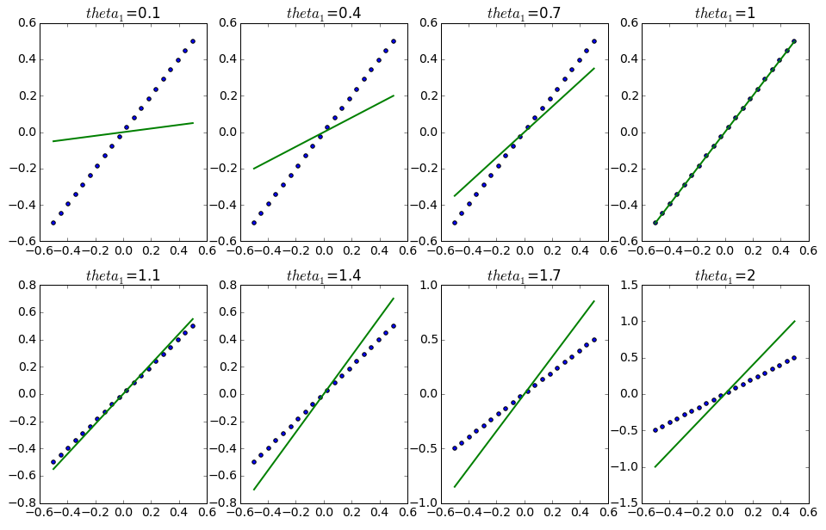
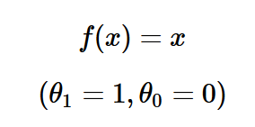
linear regression: cost (loss function)
Machine Learning Methods for Biomedical Data (D012554)

Slide 9
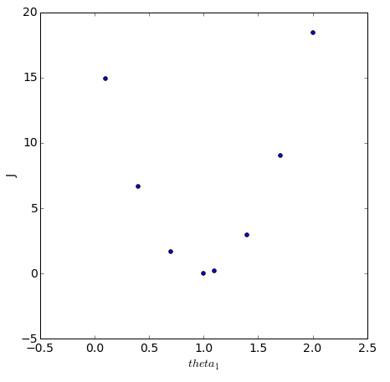



linear regression: cost (loss function)
Machine Learning Methods for Biomedical Data (D012554)

Slide 10

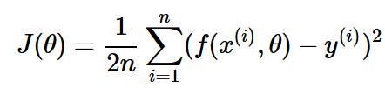
linear regression
Fit a linear model
to the data set such that the cost function
is minimal.
Machine Learning Methods for Biomedical Data (D012554)

Slide 11
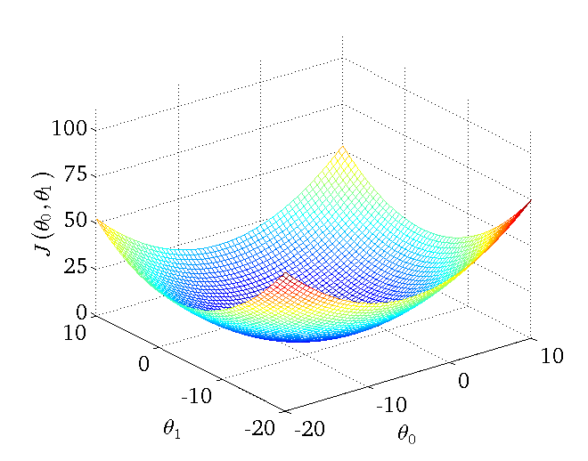
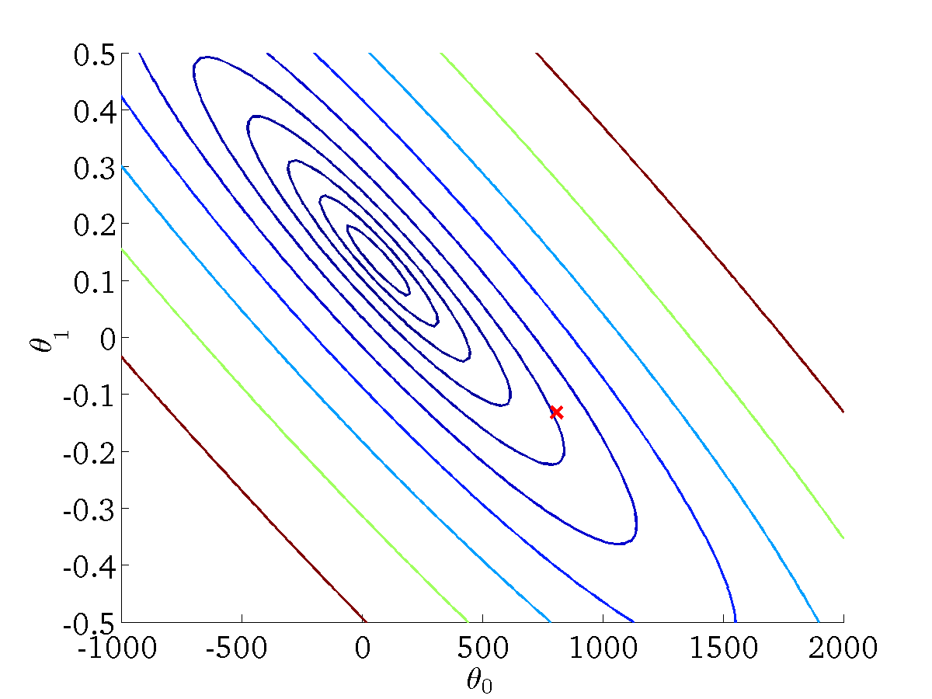
linear regression: cost (loss function)
Machine Learning Methods for Biomedical Data (D012554)

Slide 12
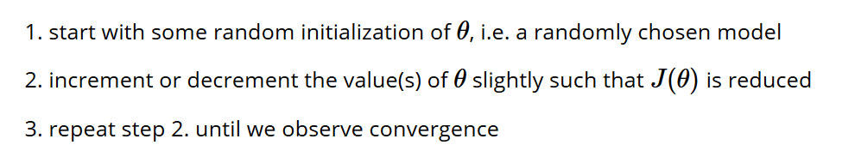
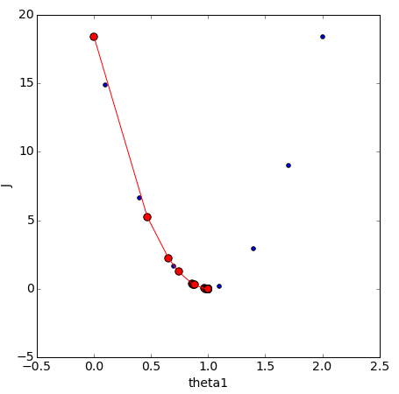
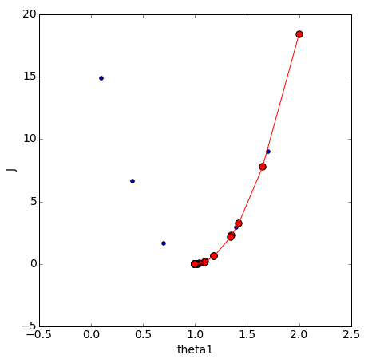

gradient descent
Machine Learning Methods for Biomedical Data (D012554)

Slide 13
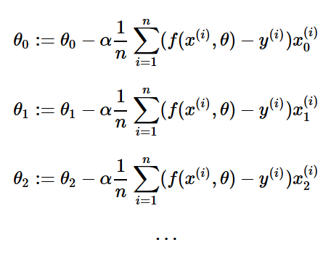
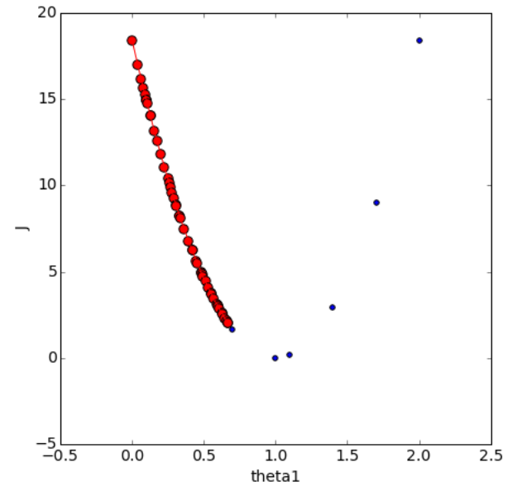
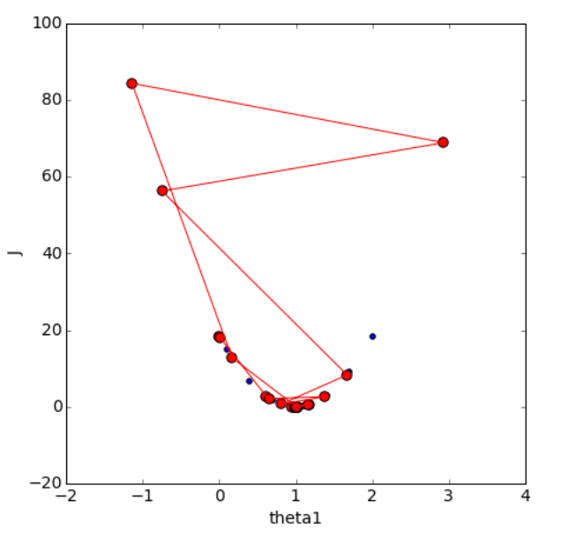
gradient descent: learning rate
Machine Learning Methods for Biomedical Data (D012554)

Slide 14



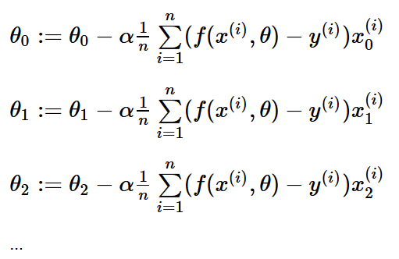


linear regression
model:
cost function:
Goal:
Learning: 1. start with some
2. change to reduce
3. repeat 2. until convergence
Machine Learning Methods for Biomedical Data (D012554)

Slide 15
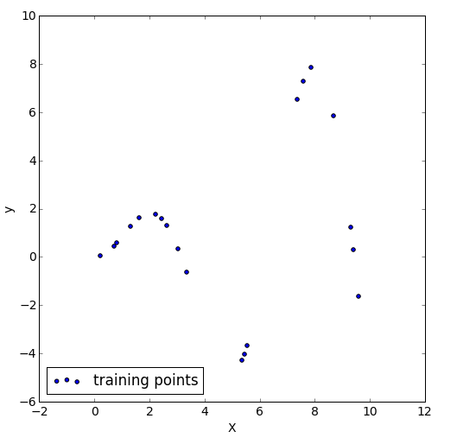

non-linear regression
Does y vary linearly with X?
Can we fit a non-linear model? Yes
Or we could add polynomial transformations of the features.
Machine Learning Methods for Biomedical Data (D012554)

Slide 16
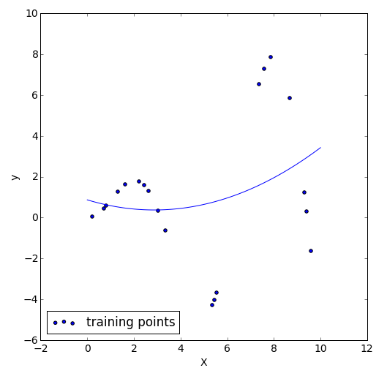
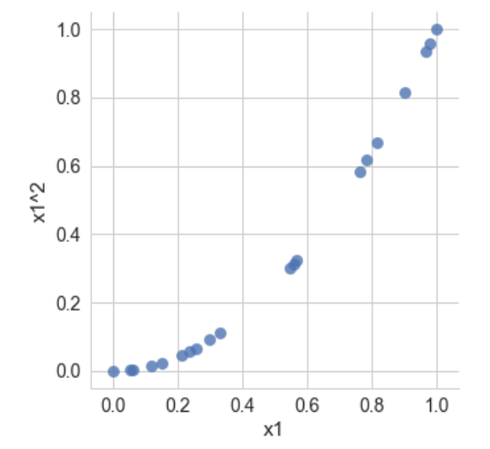
non-linear regression
Does y vary linearly with X?
Can we fit a non-linear model? Yes
Or we could add polynomial transformations of the features.
Machine Learning Methods for Biomedical Data (D012554)

Slide 17
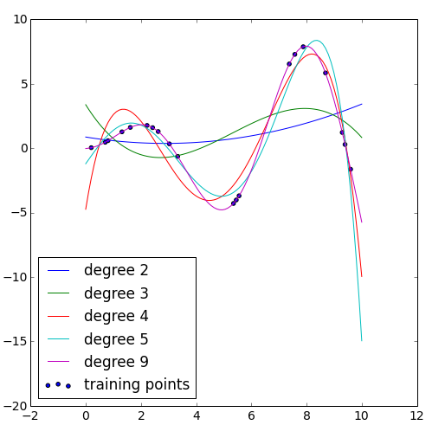
non-linear regression
Machine Learning Methods for Biomedical Data (D012554)

