Slide 1
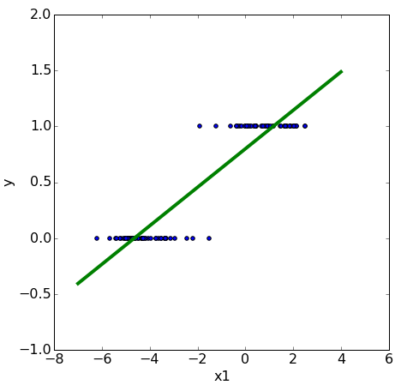


classification
We need to make
assumptions
about the
model
that generated the data.
linear relationship
linear model
Machine Learning Methods for Biomedical Data (D012554)

Slide 2
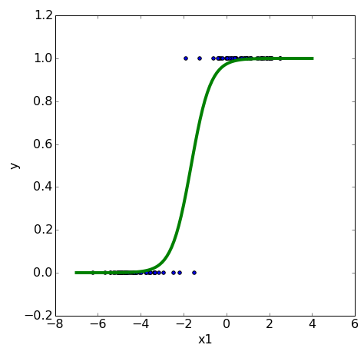

logistic regression
We need to make
assumptions
about the
model
that generated the data.
linearly separable
logistic model
Machine Learning Methods for Biomedical Data (D012554)

Slide 3


logistic regression
Machine Learning Methods for Biomedical Data (D012554)

Slide 4
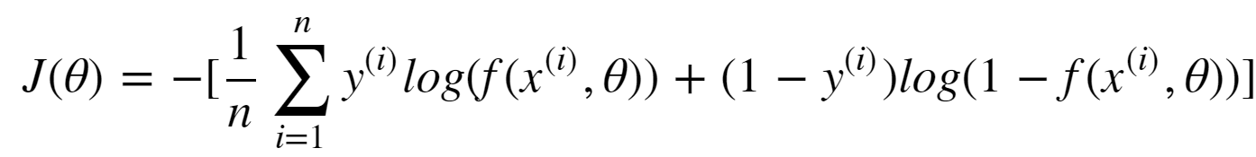
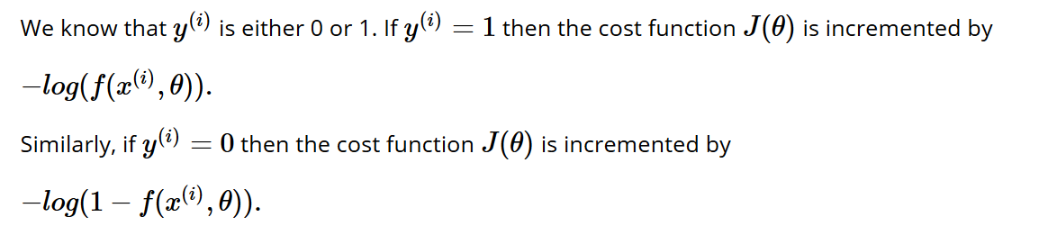
logistic regression: cost (loss function)
Machine Learning Methods for Biomedical Data (D012554)

Slide 5
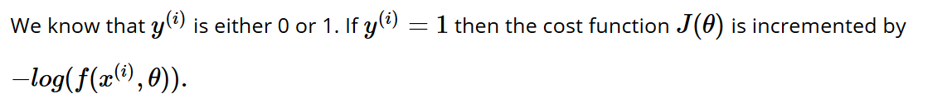
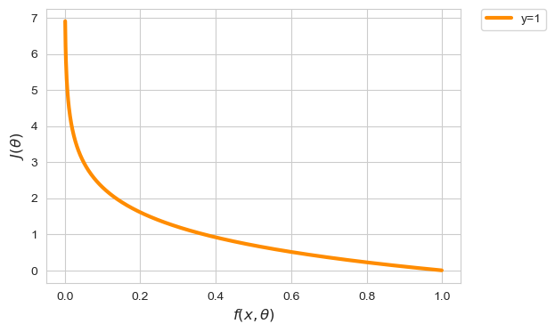
logistic regression: cost (loss function)
Machine Learning Methods for Biomedical Data (D012554)
Notes:
X-as is predictie
Y-as is cost van predictie indien y == 1

Slide 6
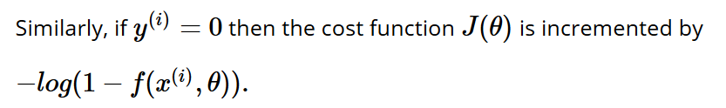
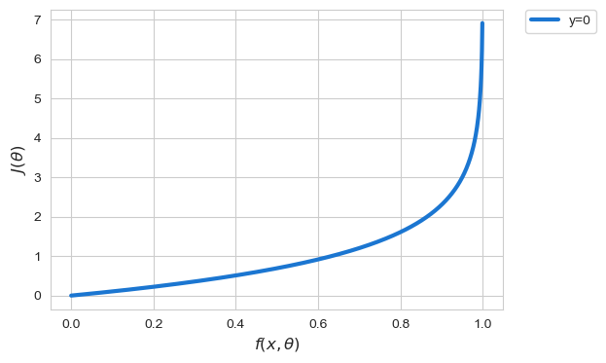
logistic regression: cost (loss function)
Machine Learning Methods for Biomedical Data (D012554)

Slide 7

logistic regression
Fit a logistic model
to the data set such that the cost function
is minimal using gradient descent
Machine Learning Methods for Biomedical Data (D012554)
Notes:
Also convex!

Slide 8
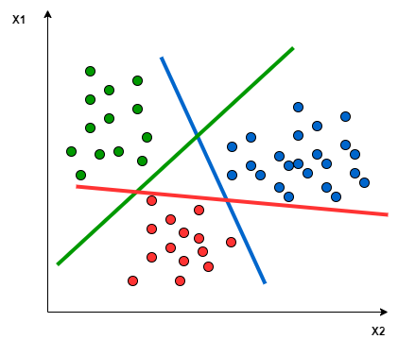
multiclass classification: one-against-all
Fit a binary classifier for each class.
Each binary classifier computes a probability prediction.
The class with the highest probability is predicted.
Machine Learning Methods for Biomedical Data (D012554)

