Slide 1
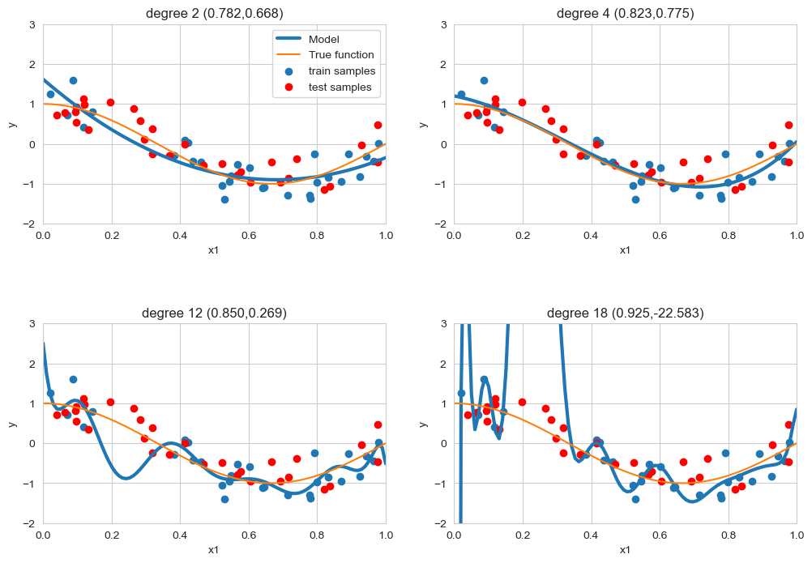

model regularization
label noise
feature noise
feature relevance
relatively small train sets
don’t try to fit the data perfectly
don’t try to use all features
notice how R² on the train set does increase with d
Machine Learning Methods for Biomedical Data (D012554)

Slide 2





regularized linear regression
cost function
regularized cost function
Machine Learning Methods for Biomedical Data (D012554)

Slide 3

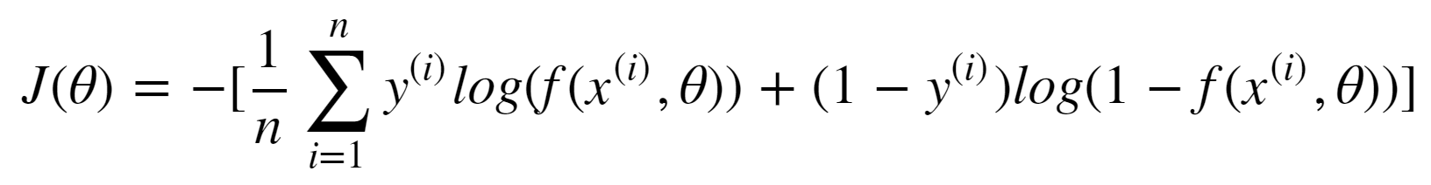
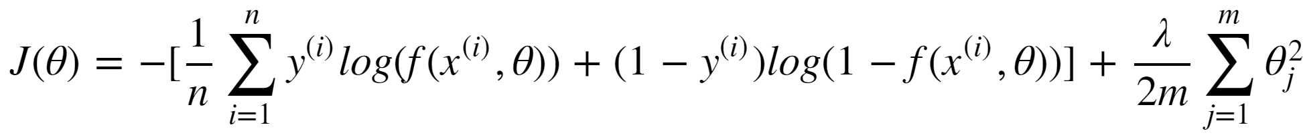
regularized logistic regression
cost function
regularized cost function
Machine Learning Methods for Biomedical Data (D012554)

Slide 4
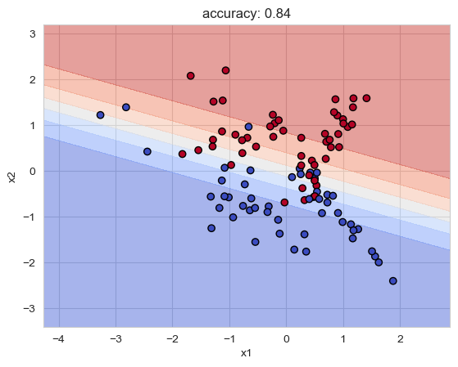
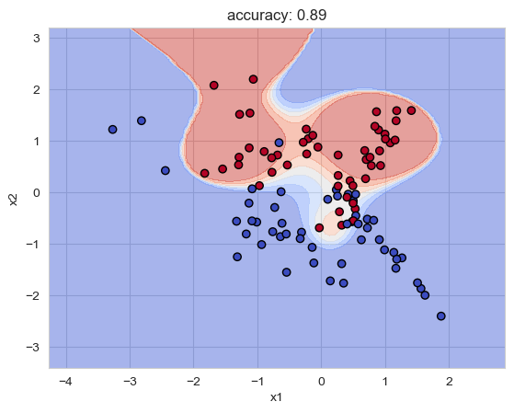
model regularization
Machine Learning Methods for Biomedical Data (D012554)

Slide 5
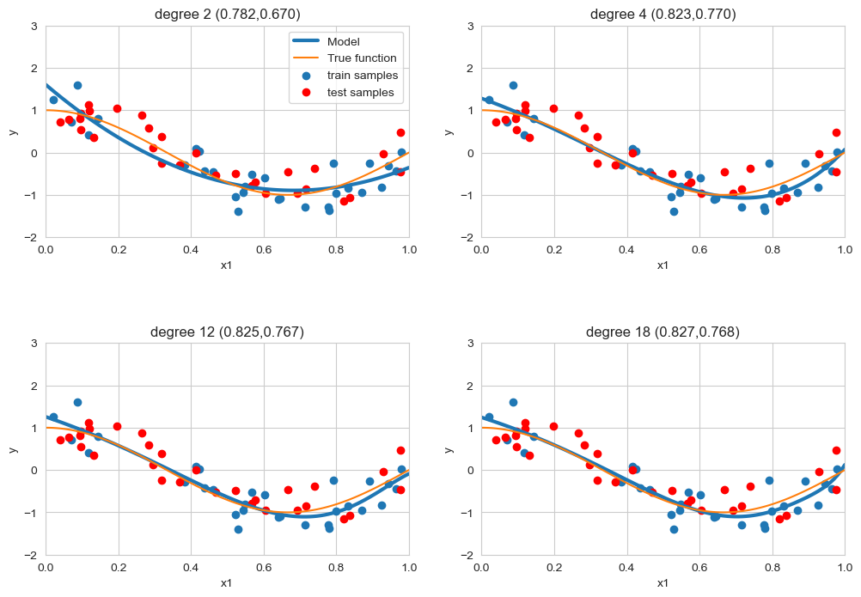
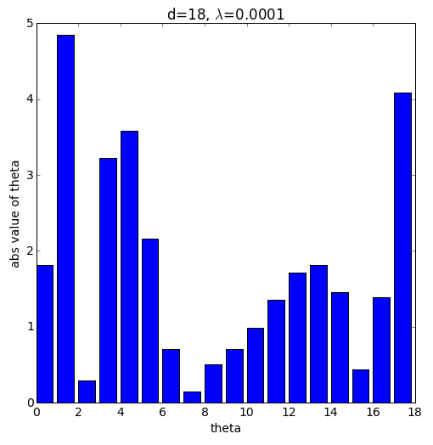
regularized linear regression
Machine Learning Methods for Biomedical Data (D012554)

Slide 6
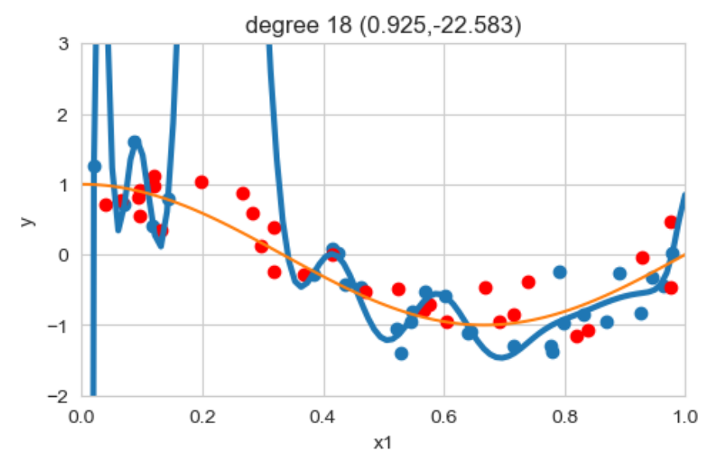
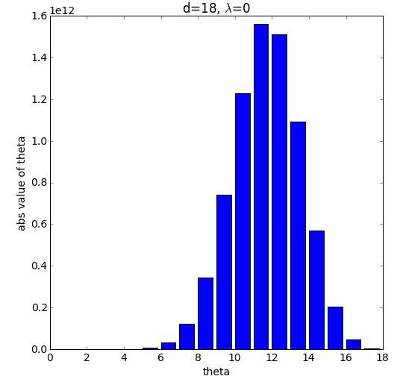
regularized linear regression
Machine Learning Methods for Biomedical Data (D012554)

Slide 7
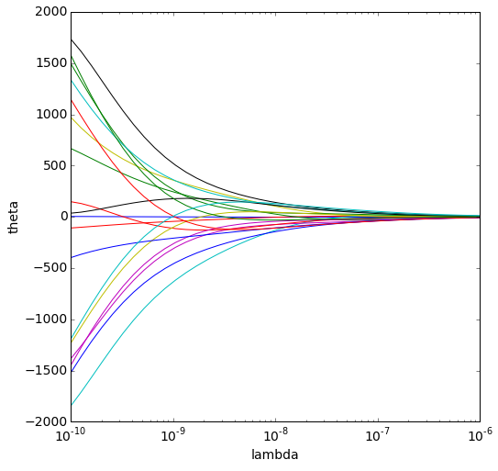
regularized linear regression
high complexity
low complexity
Machine Learning Methods for Biomedical Data (D012554)

