Slide 1
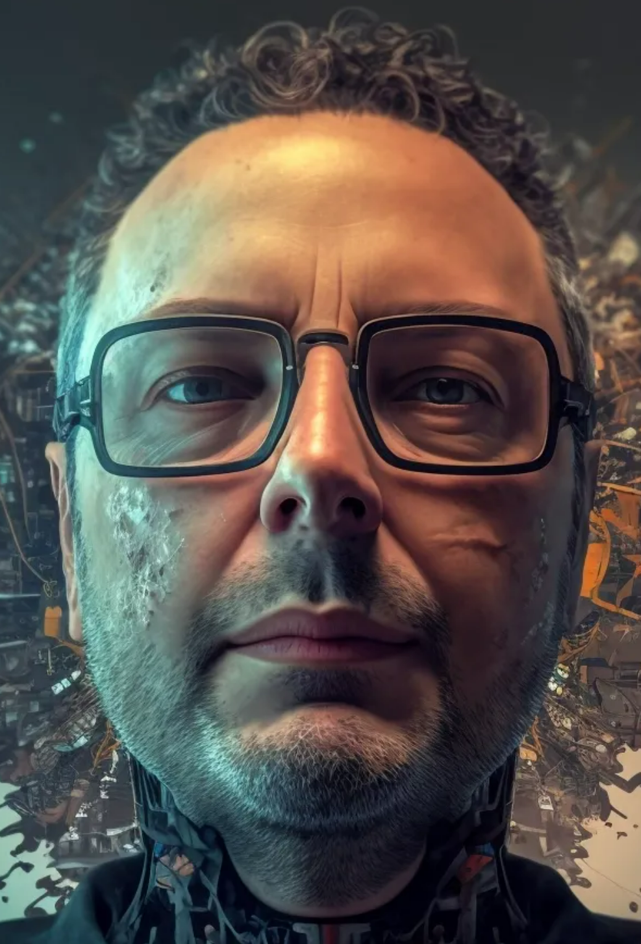

deep generative models
midjourney bot (2023)
Machine Learning Methods for Biomedical Data (D012554)

