Slide 1


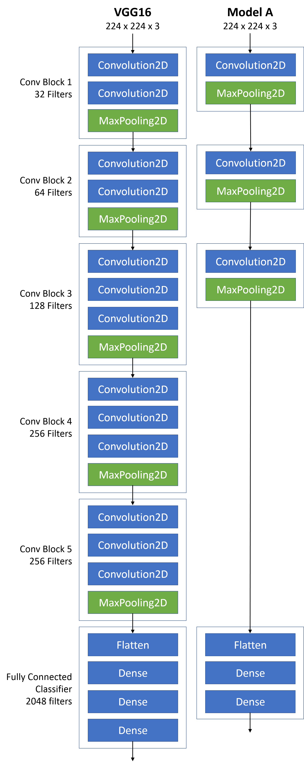
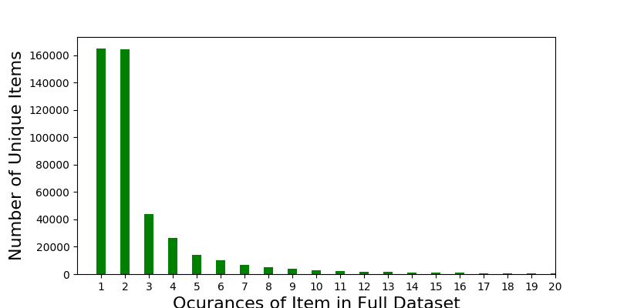
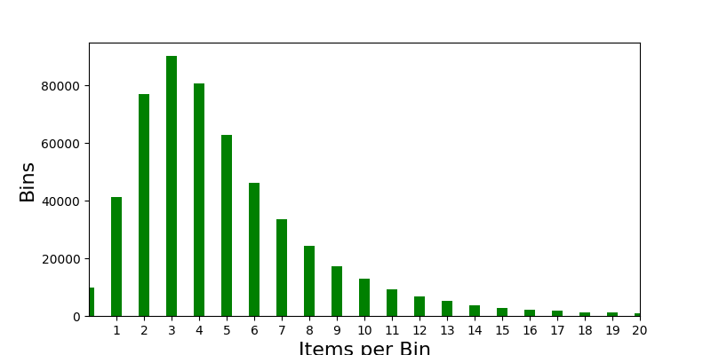
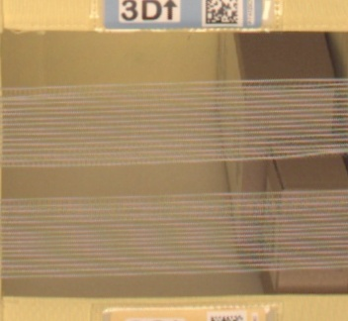
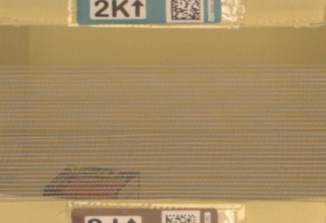



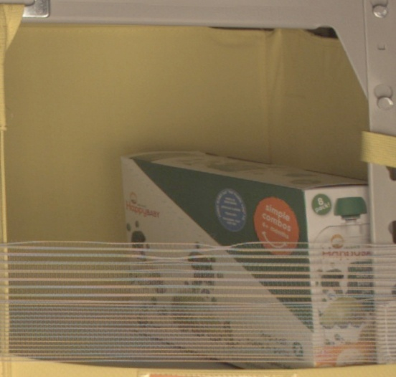
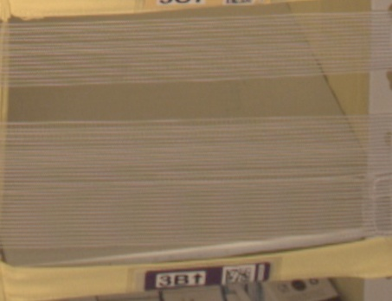
Inventory Classifier using Convolutional Neural Net
David Andresky
Galvanize Data Science Immersive
Background
Challenges
Model
Results
Poor image quality
Overlapping items or occluded items
No definitive object class to train on
In the world of manufacturing and distribution, optimizing warehouse capacity and utilization can result in savings of overhead costs and better organizational efficiency.
When an operations manager has good insights into space utilization, she can improve efficiency and cost through space consolidation allowing for a reduction in space or re-purposing of space to accommodate growth and other organizational needs.
Empty Bin Detection
Model | Optimizer | Epochs | Loss | Accuracy
A | Adam | 10 | 0.116 | 0.979
 | RMSProp | 10 | 0.206 | 0.940
 | SGD | 10 | 0.123 | 0.962
Counting 0 to 5 Objects
Model | Optimizer | Epochs | Loss | Accuracy
A | Adam | 20 | 1.792 | 0.168
 | RMSProp | 20 | 1.612 | 0.280
 | SGD | 20 | 1.232 | 0.455
VGG16 | RMSProp | 20 | 1.807 | 0.164
 | SGD | 40 | 1.214 | 0.465
Objectives
Class imbalance
Analyze image to determine if a storage location is empty
Analyze image to determine if a storage location is under utilized by counting the number of items stored
P(0) = 0.027
P(1) = 0.110
P(2) = 0.205
P(3) = 0.260
P(4) = 0.219
P(5) = 0.172
Future Goals
Data
Extend counting to 10 objects and explore larger number of filters
NLP to develop small set of item classes and categorize items in bins according to these classes
Amazon Bin-Image Dataset
~536k storage bin images
~460k unique items depicted
Methods
The inputs to my CNN models are 224 x 224 RGB images. The only pre-processing consists of resizing and rescaling. To avoid class imbalance, all empty bin images are selected, then an equal number of images are randomly selected from the remaining classes. The holdout images are used for demonstration.
Images are passed through a stack of Conv layers with filters using a small receptive field(3x3) and stride of 1. Each Conv layer is followed by a RELU activation layer and each block is followed by a 2x2 pooling layer. A dropout is applied to each layer to avoid over-fitting.
Model A is designed for the empty bin use case. A VGG16 variant is developed for counting items in a bin.
Contact
dandresky@gmail.com
https://github.com/dandresky
https://www.linkedin.com/in/david-andresky/
References
Simonyan, K., Zisserman, A. Very Deep Convolutional Networks for Large Scale Image Recognition. arXiv:1409.1556, 2014
Zou, W., Wang, X ., Sun, M., Lin, Y. Generic Object Detection with Dense Neural Patterns and Regionlets. Stanford, 2014

