Slide 1
U-NET CNN from scratch combined with stable diffusion models for clothing inpainting
Denis Andris
4th year student, TUCN

Slide 2
Agenda
Introduction
Datasets
Architecture
Architecture explanation
Demo
Final project and Q&A

Slide 3
Introduction
Developed an end-to-end Virtual Try-On Pipeline that automates the detection and replacement of fashion garments in static images
Original components: Clothing segmentation -> Based on the U-NET CNN
Reused components: SD-XL Inpainting 0.1 -> latent text-to-image diffusion model capable of generating photo-realistic images given any text input, with the extra capability of inpainting the pictures by using a mask.

Slide 4
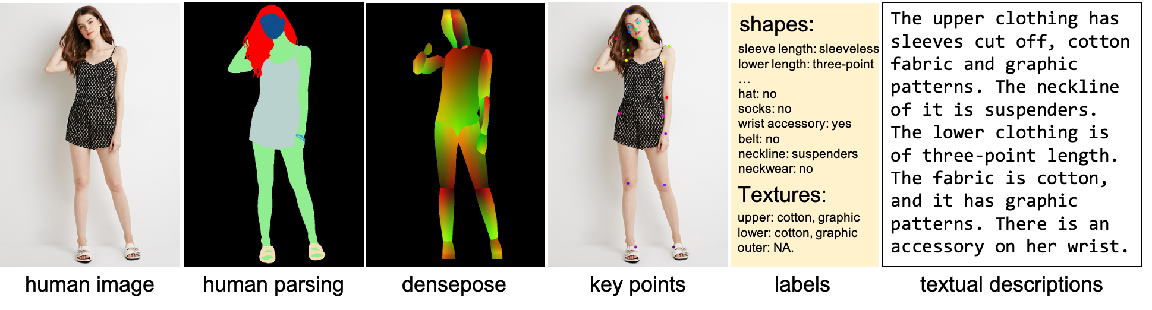
Datasets: DeepFashion-MultiModal
DeepFashion-MultiModal is a large-scale high-quality human dataset with rich multi-modal annotations.
It contains 44,096 high-resolution human images, including 12,701 full body human images.

Slide 5
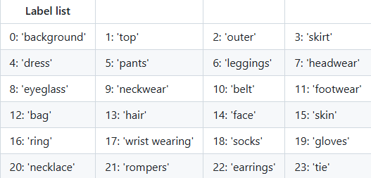
Datasets: Human Parsing Labels
Mask labels are defined as follows:

Slide 6
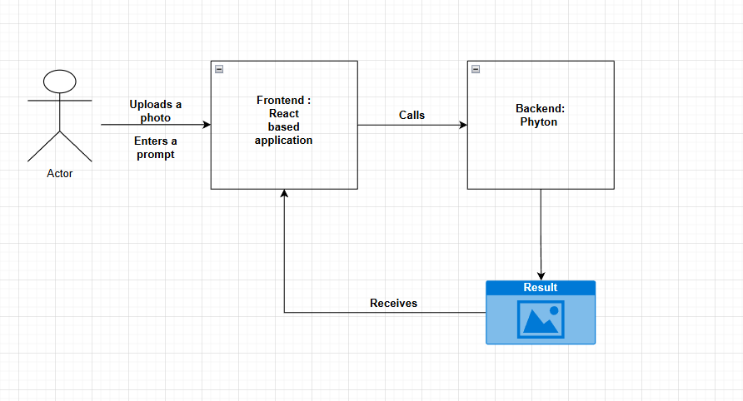
Architecture
---
ss

Slide 7
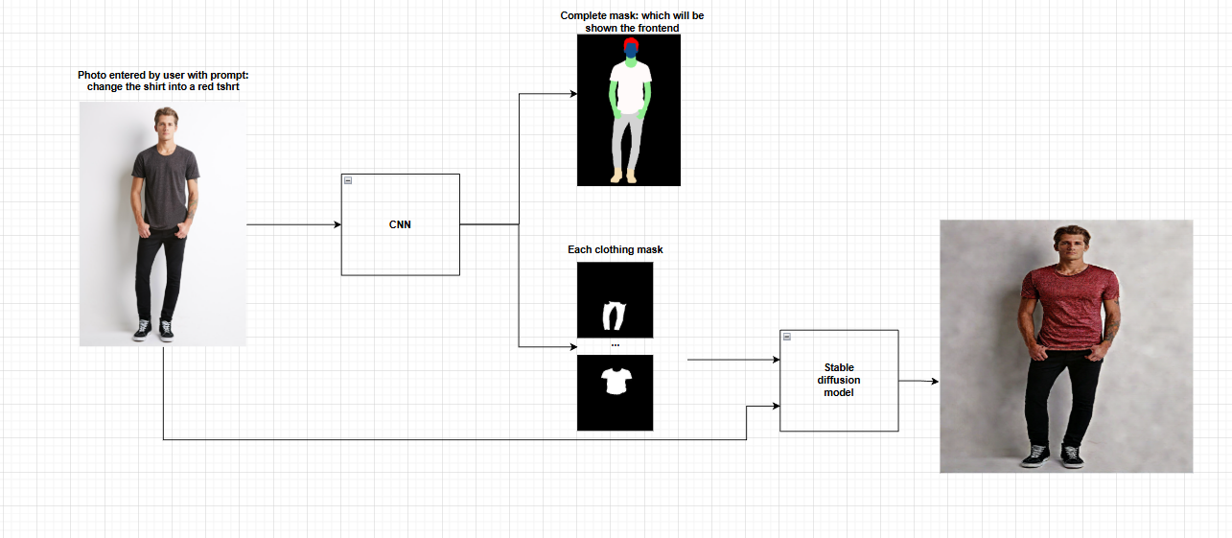
Architecture: Backend
ss

Slide 8
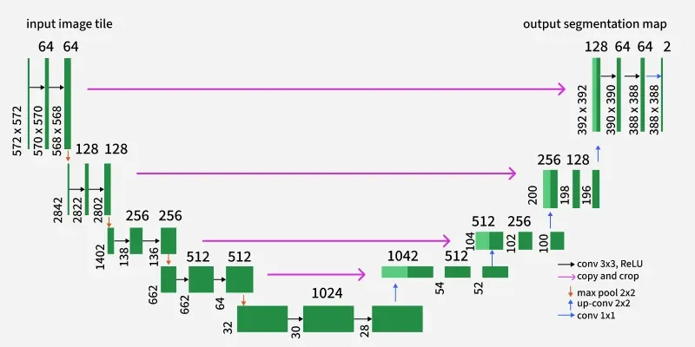
U-NET Architecture
ss

Slide 9
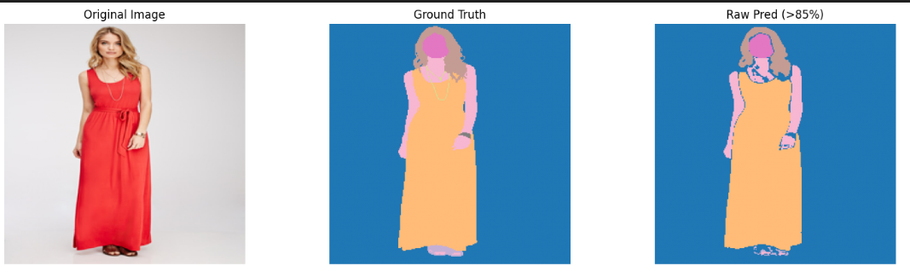
Uncompleted mask
Small dataset -> Unable to learn all patterns
Weak PC -> Cannot work with higher resolutions or more epochs

Slide 10
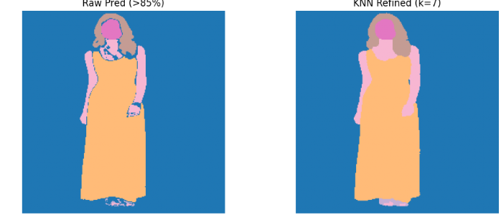
Solution: KNN

Slide 11
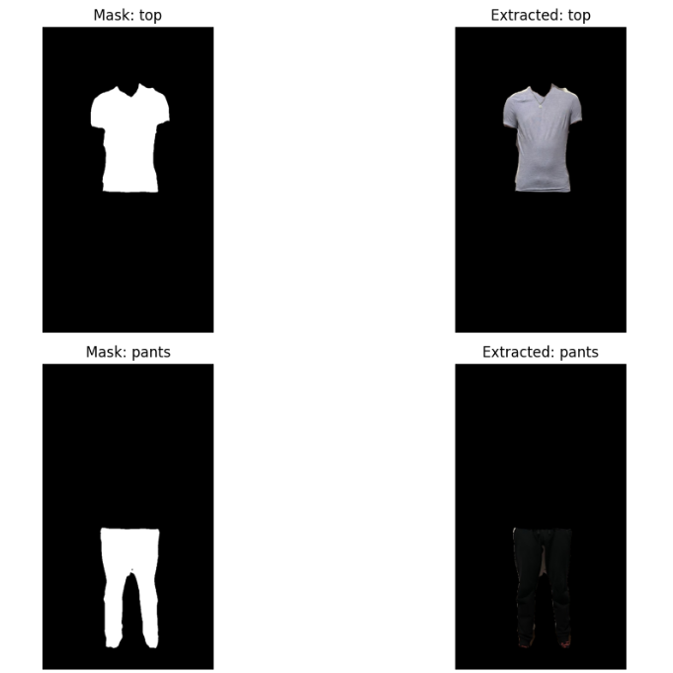
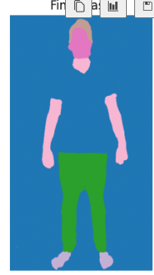
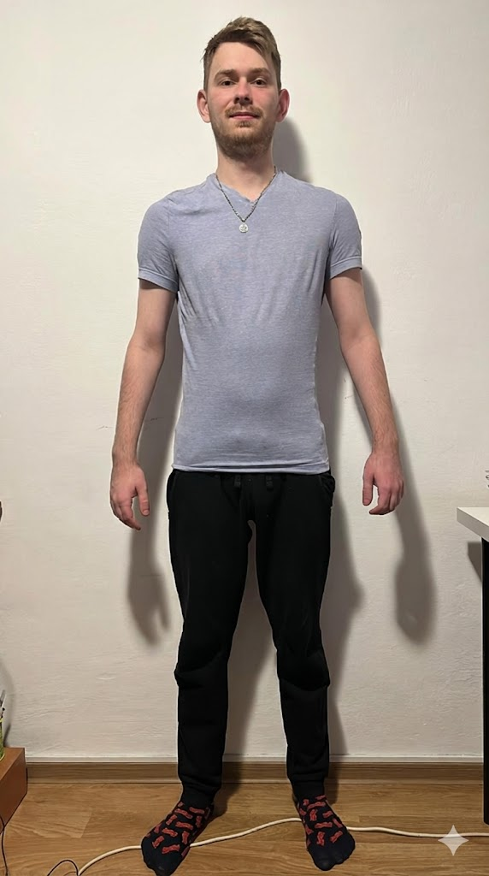
Demo

Slide 12
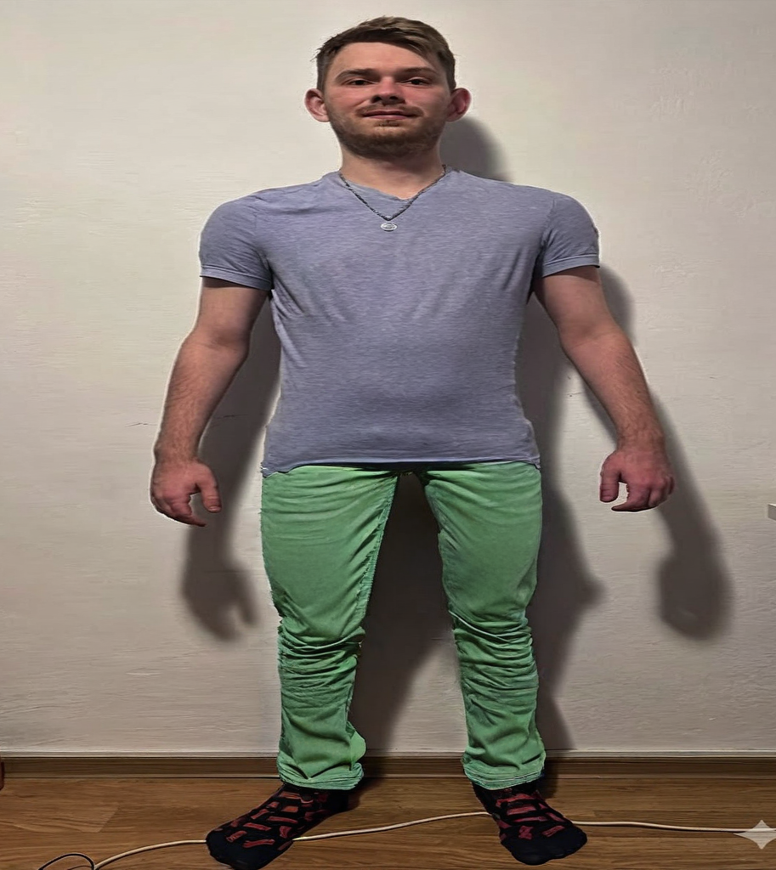
Demo
img_path = "output_masks/unnamed/original_image.jpg"
mask_path = "output_masks/unnamed/pants_mask.png"
prompt = "simple green jeans, high quality, made of cotton"

Slide 13
Final projects
Drawbacks
  Small database -> maybe change it
  I am not patient -> I do not like to wait for the model to train
  The model cannot learn hard patterns( eg: floral dresses) and only likes simple, white background
Future improvements:
  Graphs with loss and accuracy for better visualization of the results
  React interface for user experience
  Exploring another stable diffusion models, if I can train it on a better PC

Slide 14
Thank you

