Slide 1
Rhetorical classiﬁcation of anchor text for citation recommendation
Daniel Duma, Maria Liakata, Amanda Clare, James Ravenscroft and Ewan Klein
danielduma@gmail.com
Notes:
I think I should start with a summary of what I’m trying to do and what I did during the first year.

Slide 2
Context-Based Citation Recommendation (CBCR)
“
A variety of coherence theories have been developed over the years [...] and their principles have found application in many symbolic text generation systems (e.g. CITATION NEEDED )
”
(Adapted from Barzilay and Lapata, 2005)
Recommendations
D. Scott, C. S. de Souza. 1990. Getting the message across in RST-based text generation. In R. Dale, C. Mellish, M. Zock, eds., Current Research in Natural Language Generation, 47–73. Academic Press.
R. Kibble, R. Power. 2004. Optimising referential coherence in text generation. Computational Linguistics, 30(4):401–416.
E. H. Hovy. 1987. Generating natural language under pragmatic constraints. Journal of Pragmatics, 11(6), 689-719.
C. B.Callaway, & J. C. Lester. 2002. Narrative prose generation. Artificial Intelligence, 139(2), 213-252.
...
Notes:
So what is Context-Based Citation Recommendation?
Imagine if you will, that you are writing a research paper, and make a statement like thus. Wouldn’t it be helpful if you got instant recommendations of relevant papers inside your text editor?

Slide 3
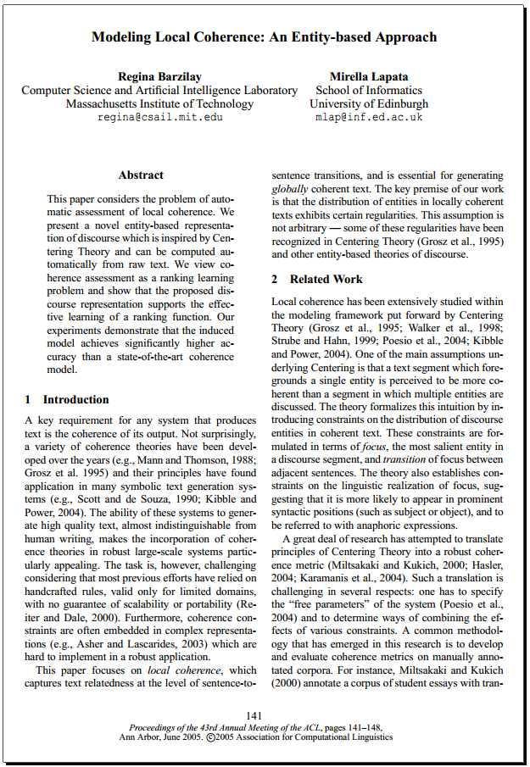
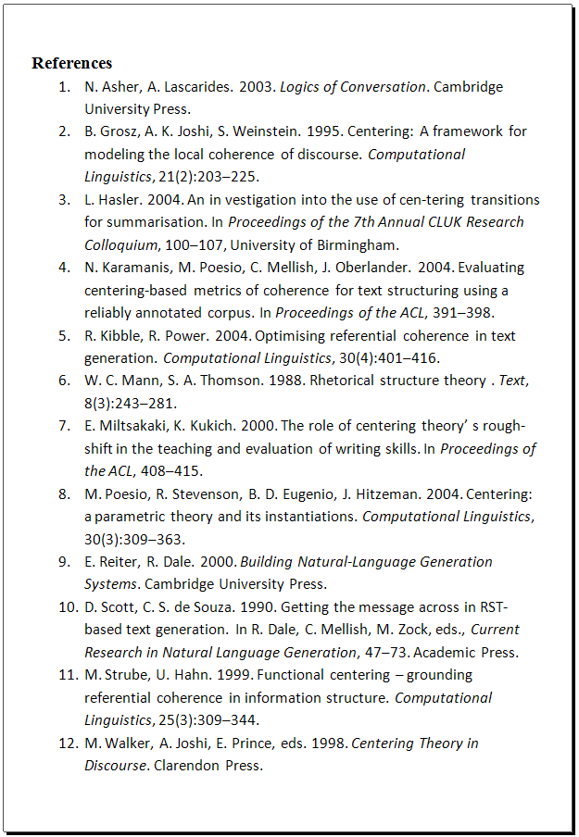
Evaluation: for document d in test set T
Notes:
But first things first: evaluation. How do we know that we’re doing better?
Well, we can take an existing, published paper d in our document collection

Slide 4
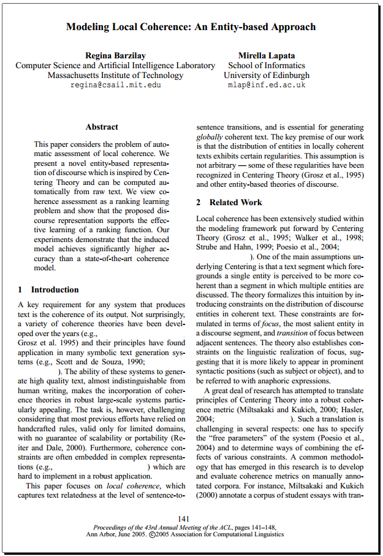
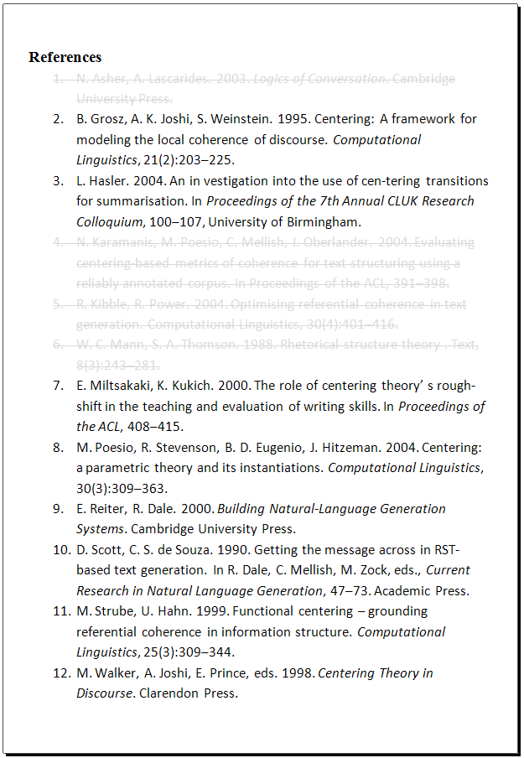
1. Keep only references in document collection
Notes:
We remove the references that are not in the collection

Slide 5
1. Keep only references in document collection
Resolvable citation
Collection-internal references
Notes:
Which leaves us with Collection-internal references on one hand, and resolvable citations on the other, that is, citations that we can link to their original references

Slide 6
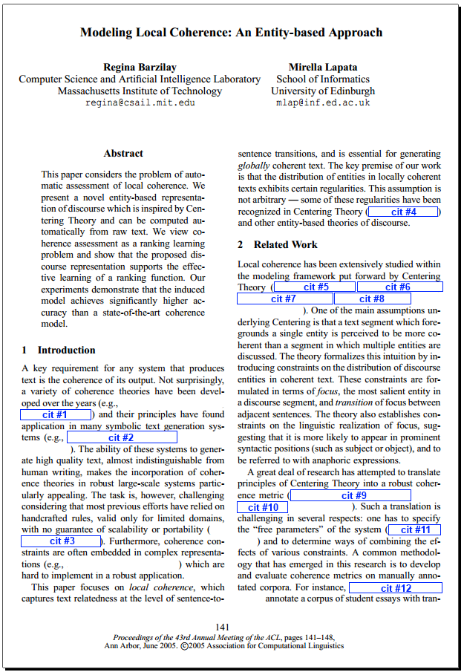
2. Replace resolvable citations with placeholders
Notes:
And we anonymyze those, replacing them with citation placeholder tokens, that is, markers of where we would want to insert a citation

Slide 7
3. Resolve citations
Indexed document collection
For each citation placeholder
Evaluation query
Retrieval
Results ranked by relevance
Original citation
Measure score
Notes:
Then we extract the context around the citation placeholder and the task becomes to match these with the original reference in that place.
Rank references
Task: match each in-line citation in document with its correct reference
Selecting only from references cited in the document
Very strong evidence of human judgment
Author knows about the contents of each paper, chose one over the others
Each citation must be resolved in isolation: no global optimization
Metrics:
Top-1 accuracy, Mean Reciprocal Rank (MRR)
Normalized Discounted Cumulative Gain (NDCG)

Slide 8
Previous work (context-based)
 | Corpus | Indexing | Query generation | Similarity
Tang and Zhang (2009) | 1.6k & 3.3k | Full text (?) | Citing sentence | 2-layer RBM
He et al. (2010) | 450k (CiteSeerX) | Title + abstract, out-link contexts, in-link context (anchor text) | Window (50) | Links in graph (authors, citations) + co-cited probability + cosine distance
Kataria et al. (2010) | 3k & 3k | Full text | Window (30) | PLSA-LDA
He et al. (2012) | 30k | Passage (500, 1000, 2000, 3000), 4/5 overlapping | Citing sentence | Translation model
Duma and Klein (2014) | 9k (ACL Antology) | Full text, title + abstract, passage (1/2 overlapping), anchor text | Window (10-50) | Cosine distance + tf-idf
Huang et al. (2015) | > 1 million (CiteSeerX) | Anchor text (?) | Sentences (3; 1 up, 1 down) | Cosine distance + neural word embeddings
This work | 1 million (PubMed Central OAS) | Anchor text: Index by sentence class (automatically labelled CoreSC) | Sentences (3; 1 up, 1 down) | Cosine distance + tf-idf + per-class weighting based on CoreSC class of citing sentence
Notes:
The task is well defined enough that I can present the previous work in a competitor matrix. I say “context-based” up there because there is much more work on global recommendation, which is mostly using the citation and authoring graph. Here I only show work that tries to recommend citations for specific chunks of text in a document.
There are 4 main drivers/variables in this table:
- Corpus depends on the open access, machine-readable papers out there. Thankfully this is increasing a lot lately
Document representation
Context
I recently found the earliest context-based that goes back to 2009 and was already using a kind of neural network.
There is a lot more related work on summarization, paraphrasing, information extraction

Slide 9
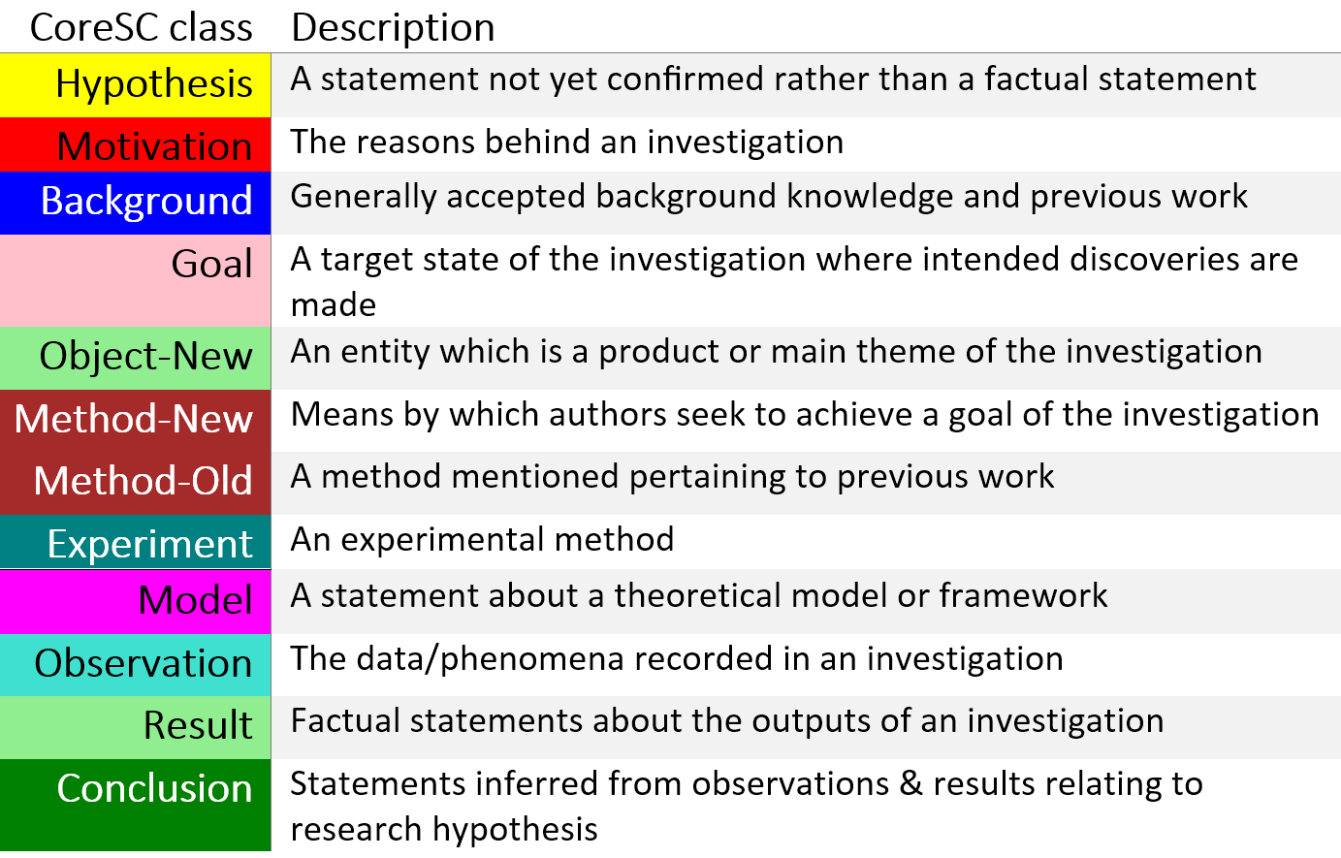
Core Scientific Concepts (Liakata et al., 2010)
SAPIENTA automatic annotation tool. Recently re-evaluated on new PloS One annotated data , 51.9% accuracy.

Slide 10
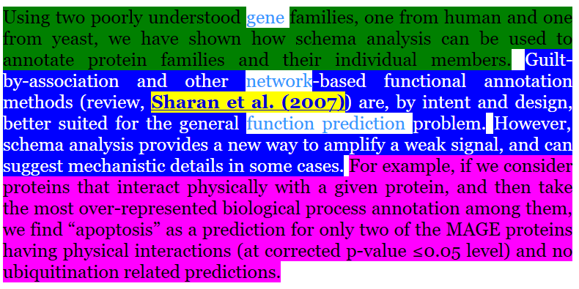
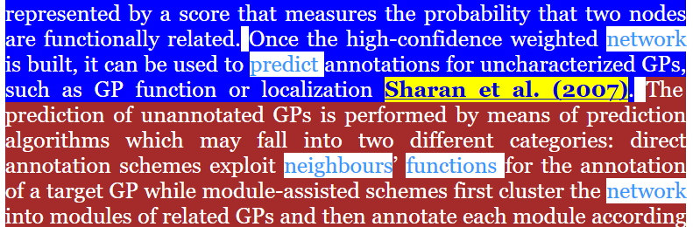
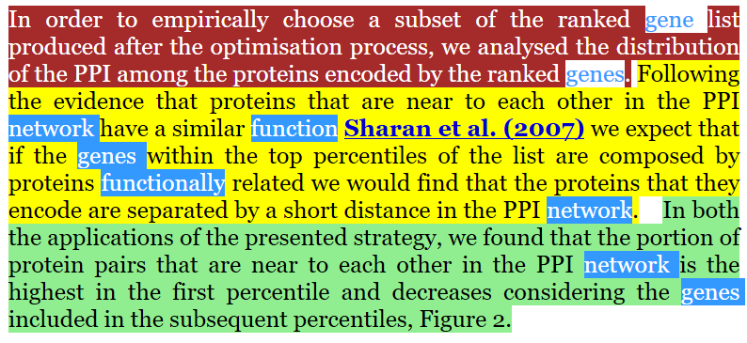
Query rewriting based on citation function
Incoming link contexts (citing paragraphs)
Draft document
Network-based prediction of protein function - Sharan et al. (2007)
Citing context:
Conclusion
Previous work has shown that a gene's function can be predicted by its neighbour genes in networks [CITATION PLACEHOLDER]
Background
Model
…
Keywords:
gene, function, predict, neighbour, network
Background
Query
Method
Citing sentence class: Background
…
Method
Learned weights:
Bac | Con | Hyp | Met | Mod | Res
2 | 0 | 0 | 1 | 0 | 1
Hypothesis
Result

Slide 11


Corpus and experiments
Corpus: PubMed Central Open Access Subset
> 1 million documents, clean hand-authored XML
Annotation: automatic classification of each sentence using the Sapienta classifier (51.9% precision over all classes)
Annotated corpus
> 1 million documents annotated with CoreSC
Document collection
(year < 2015 ~= 950k documents)
Index
Test set for evaluation
(year >= 2015)
Queries
(2800)

Slide 12
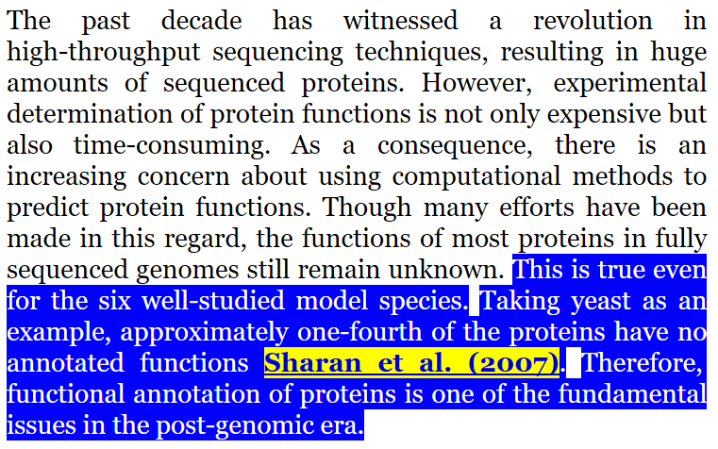
Query generation
Evaluation query
Citing context (1 up, 1 down)
Query terms
Citing sentence
Query type: Bac
Original citation
Ground truth

Slide 13
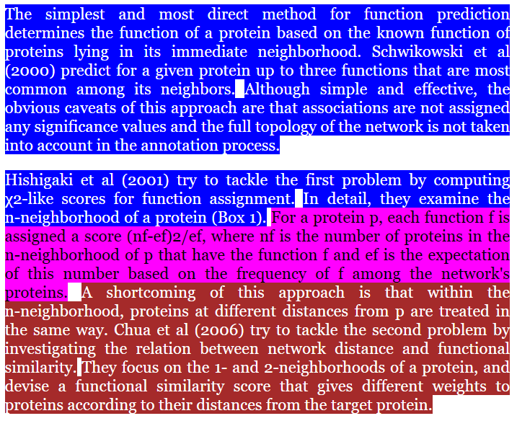
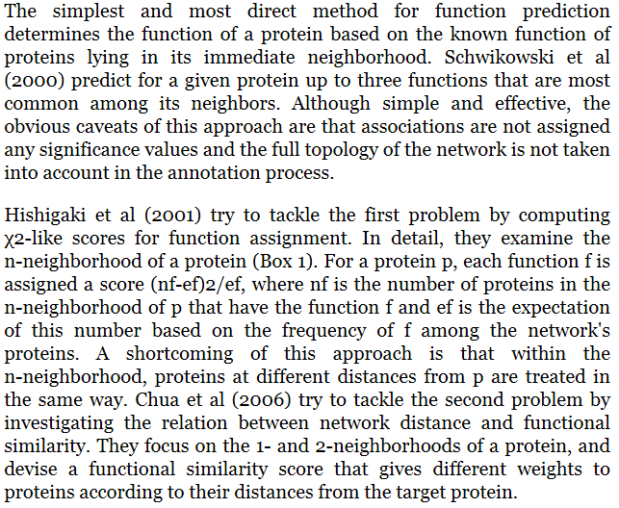
Class-based field indexing
Original document
Document in Lucene index
...
Sharan et al. (2007)
title: Network-based prediction of protein function
pmcid: 1847944
Bac: <vector>
Con: <vector>
Exp: <vector>
Mod: <vector>
Hyp: <vector>
Met: <vector>
...
...
(field: value)

Slide 14
Class-based indexing of incoming link contexts
Test document
Mosca et al. 2009
Sharan et al. (2007) Network-based prediction of protein function
Banks et al.
2008
pmc:1847944
Magi et al.
2012

Slide 15
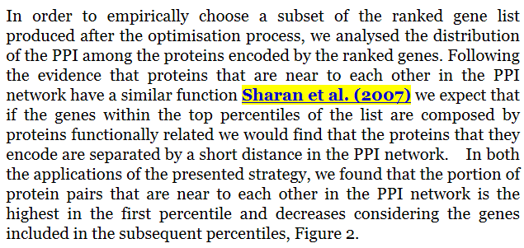
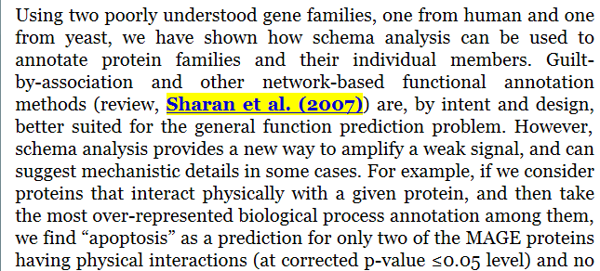
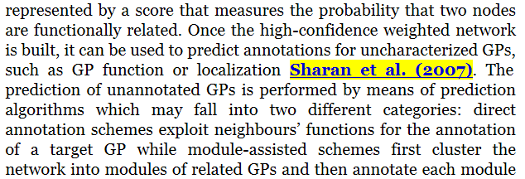
Class-based indexing of incoming link contexts
Mosca et al. 2009
Banks et al.
2008
Magi et al.
2012

Slide 16
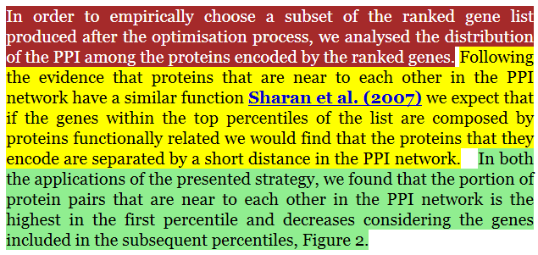
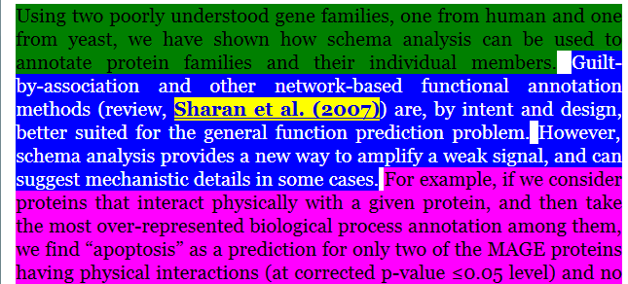
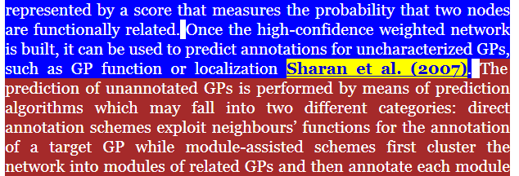
Class-based indexing of incoming link contexts
Annotated incoming link contexts
Document in Lucene index
Sharan et al. (2007)
title: Network-based prediction of protein function
Mosca et al. 2009
pmcid: 1847944
ILC_Met: <vector>
ILC_Hyp: <vector>
ILC_Res: <vector>
ILC_Con: <vector>
ILC_Bac: <vector>
ILC_Exp: <vector>
ILC_Mod: <vector>
...
Banks et al.
2008
(field: value)
Magi et al.
2012

Slide 17
Weight training
Set of weights for each query type
Weights
Indexed document collection
Results ranked by relevance
Bac | 1
Con | 1
Exp | 1
Goa | 1
Hyp | 1
Mod | 1
Res | 1
 | …
Evaluation query
Original citation
Measure score
X
Weight training
Modify weights: -1, 6, -2

Slide 18
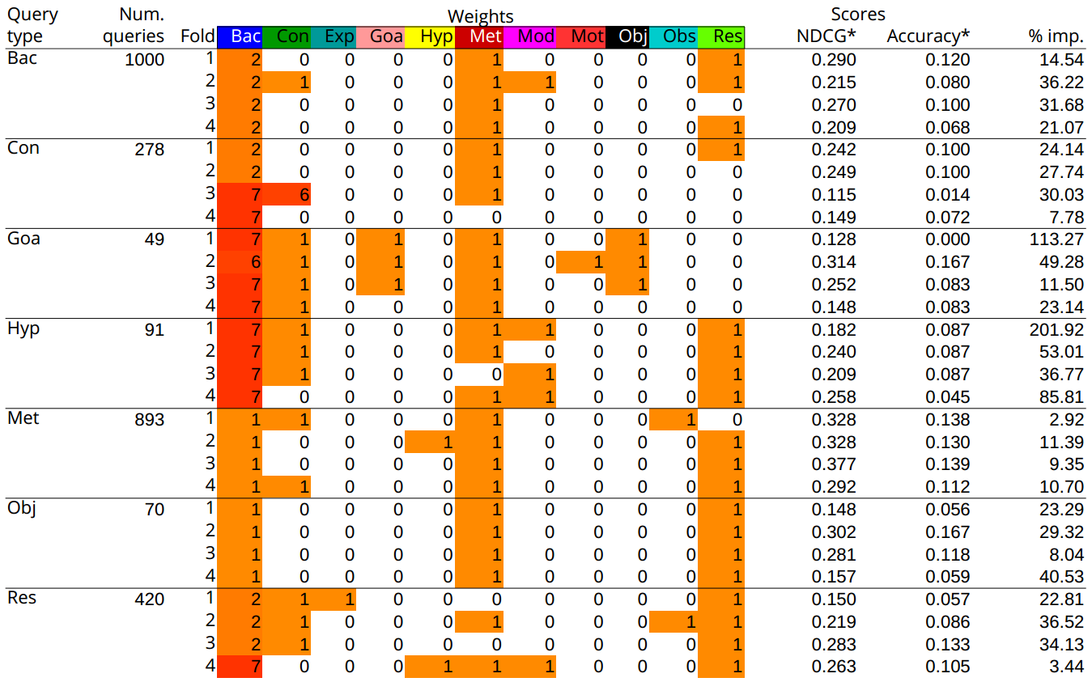
Results
CoreSC class of sentence where citation appears
Best weight values found for each fold during training
Number of queries of this class
Testing scores for each fold
Consistent improvement:
Background, Conclusion, Goal, Hypothesis, Method, Objective, Result
Not consistent:
Experiment, Model, Motivation, Observation

Slide 19
Results of annotated ILCs

Slide 20
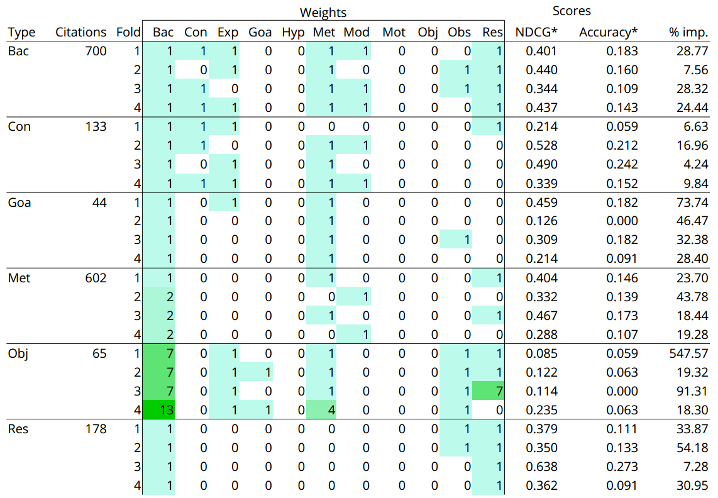
Results of document text indexing

Slide 21
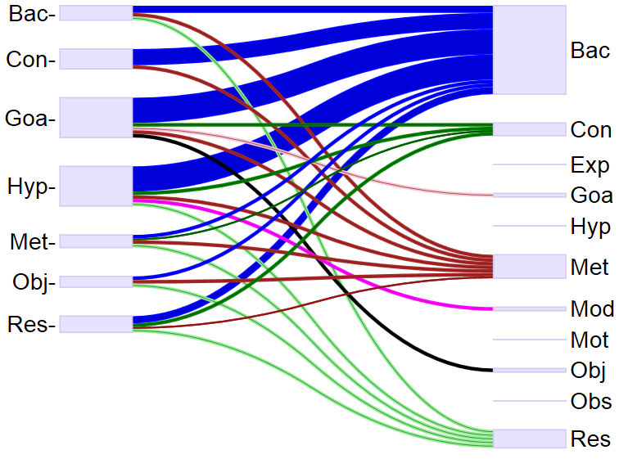
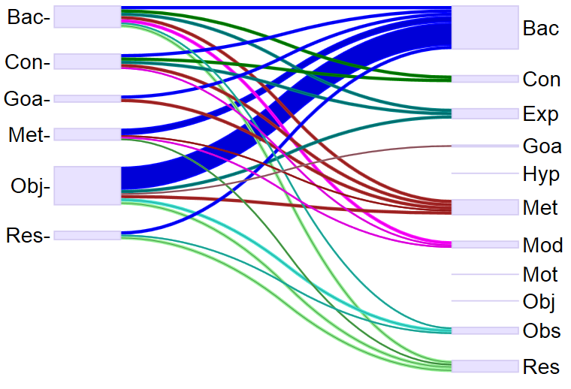
Results comparison
Incoming Link Contexts
Document text
Query type
Cited context
Query type
Cited text

Slide 22
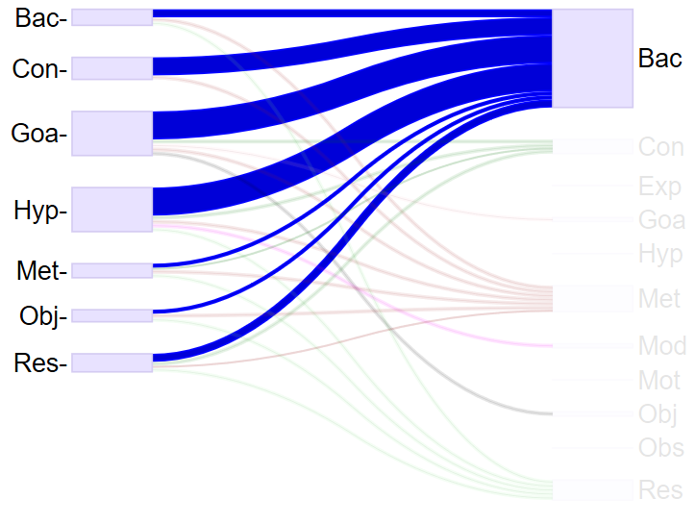
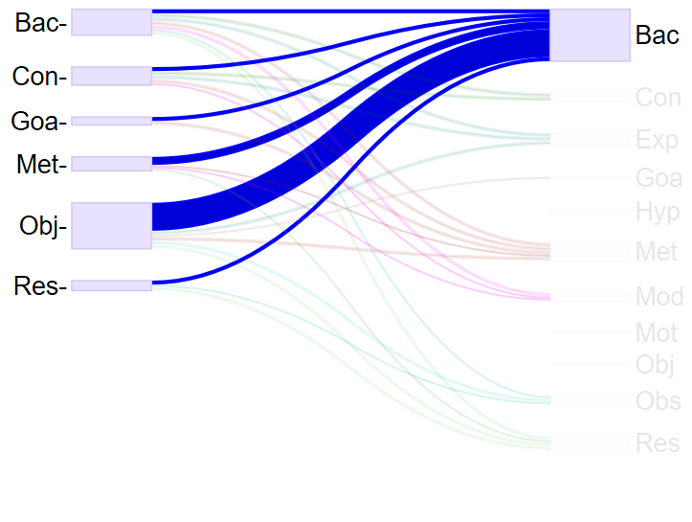
Results comparison
Incoming Link Contexts
Document text
Query type
Cited context
Query type
Cited text

Slide 23
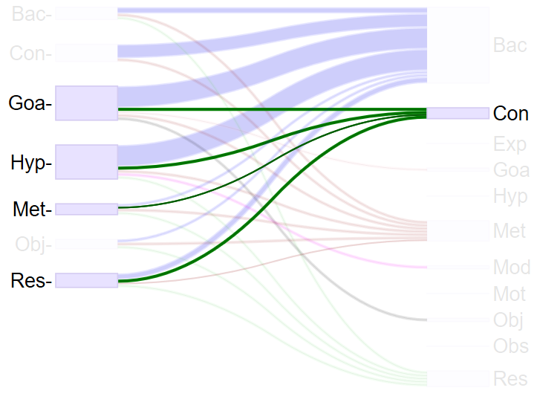
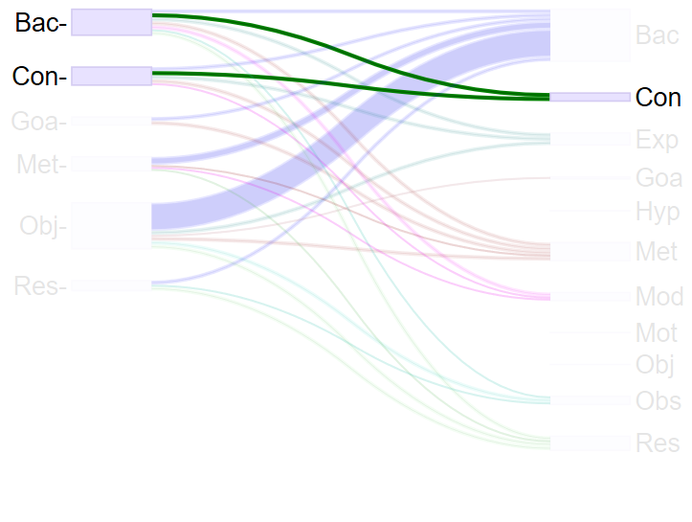
Results comparison
Incoming Link Contexts
Document text
Query type
Cited context
Query type
Cited text

Slide 24
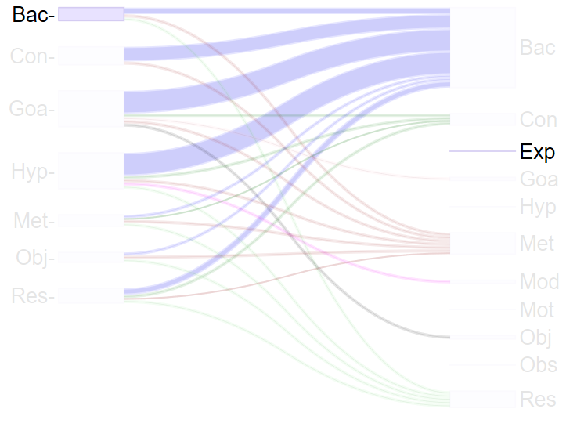
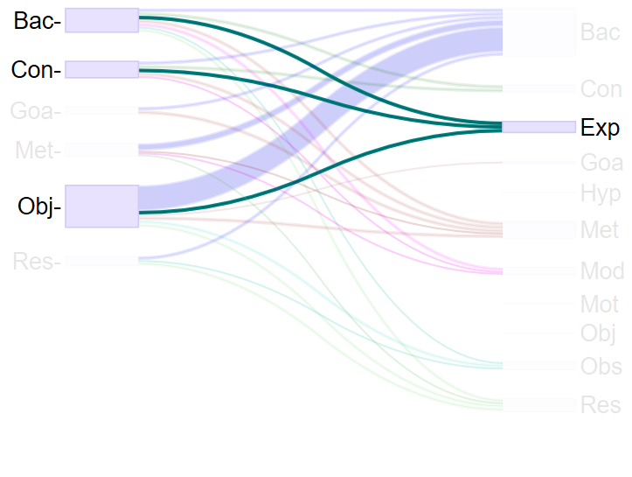
Results comparison
Incoming Link Contexts
Document text
Query type
Cited context
Query type
Cited text

Slide 25
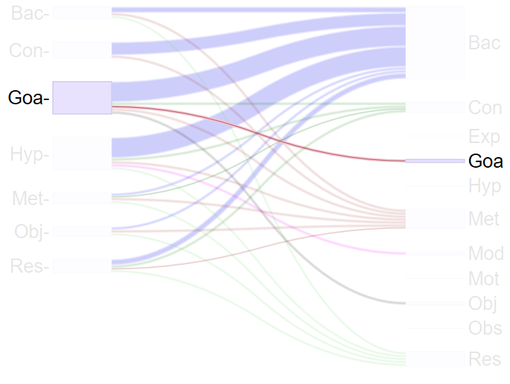
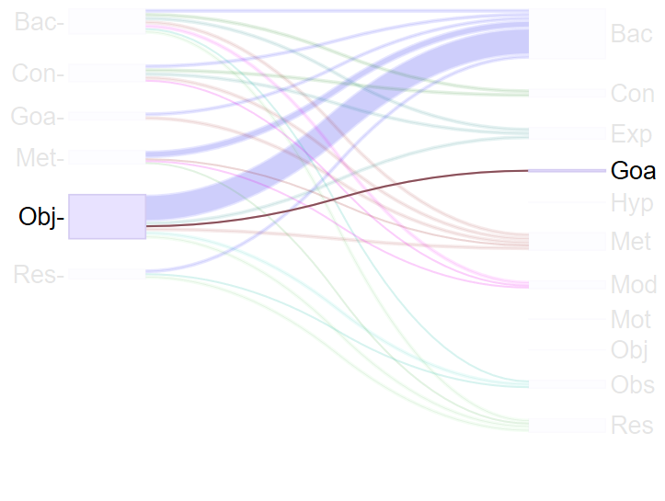
Results comparison
Incoming Link Contexts
Document text
Query type
Cited context
Query type
Cited text

Slide 26
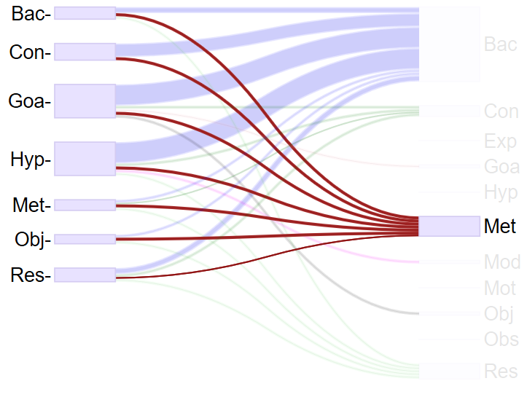
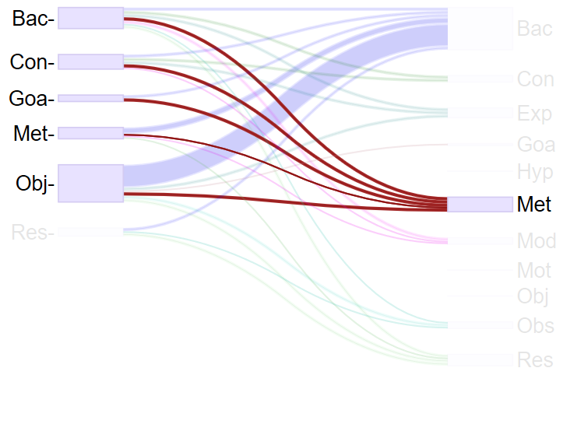
Results comparison
Incoming Link Contexts
Document text
Query type
Cited context
Query type
Cited text

Slide 27
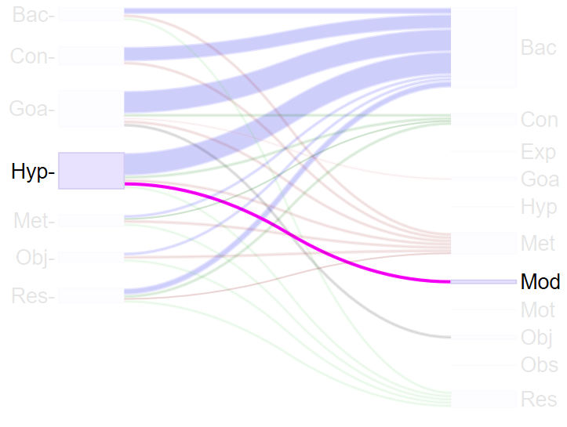
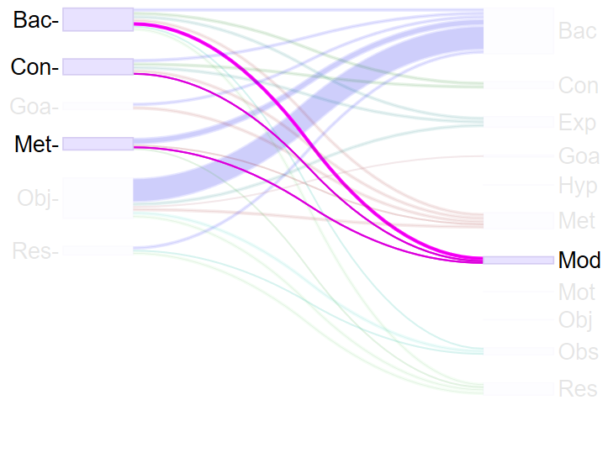
Results comparison
Incoming Link Contexts
Document text
Query type
Cited context
Query type
Cited text

Slide 28
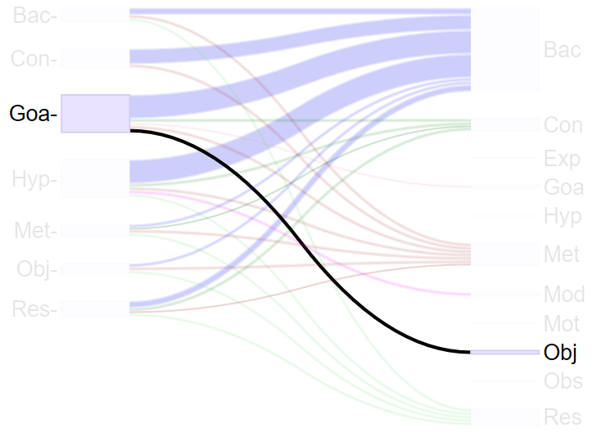
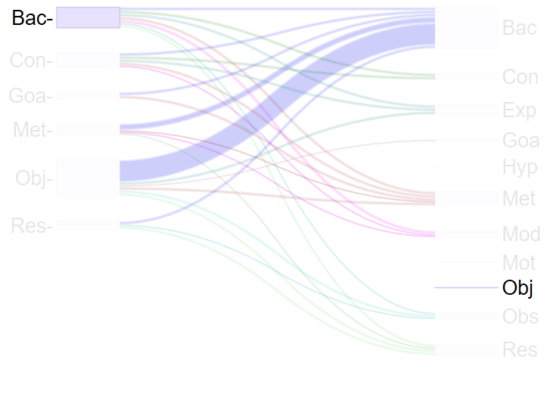
Results comparison
Incoming Link Contexts
Document text
Query type
Cited context
Query type
Cited text

Slide 29
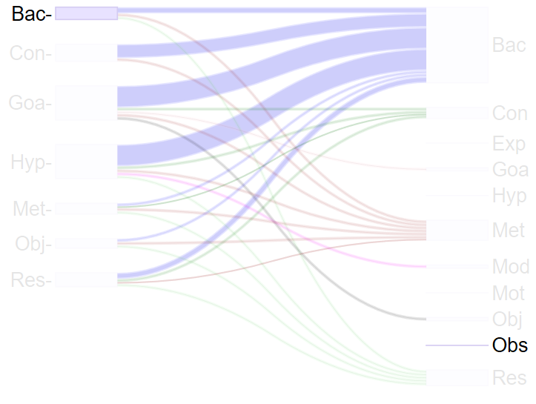
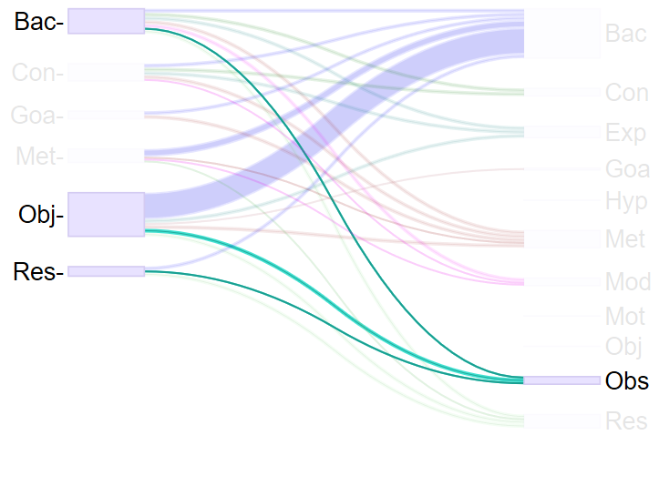
Results comparison
Incoming Link Contexts
Document text
Query type
Cited context
Query type
Cited text

Slide 30
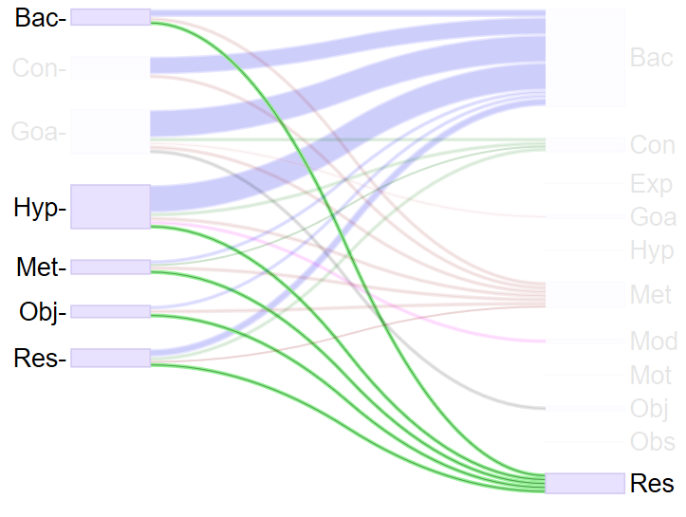
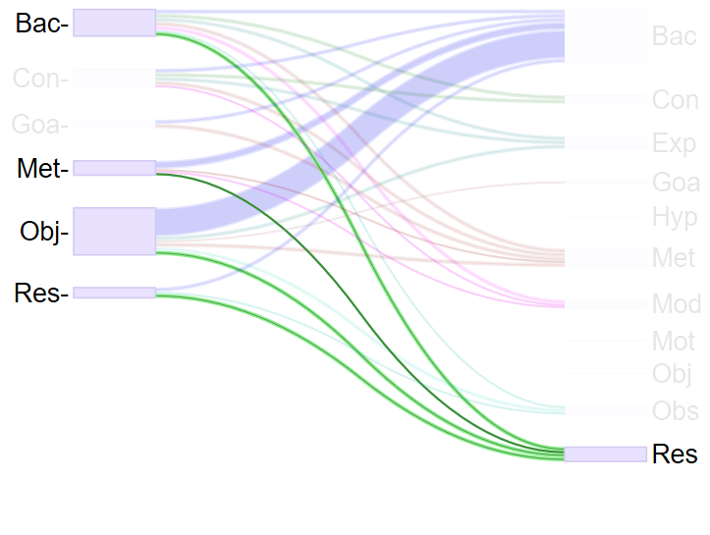
Results comparison
Incoming Link Contexts
Document text
Query type
Cited context
Query type
Cited text

Slide 31
Conclusion
There are consistent links between
CoreSC class of citing sentence and
CoreSC class of sentence in the incoming link contexts
CoreSC class of sentence in the document contents
These links can be exploited to increase relevance of recommendations
Compare with a standard bag-of-words approach
Combine weights for the classes of sentences in the documents and in the incoming link contexts to those documents
Test on other domains and classification schemes (e.g. AZ + ACL)
Gaussian Processes for weight training
Future work

Slide 32
Thank you.
Questions?

Slide 33
References
Duma, D., & Klein, E. 2014. Citation Resolution: A method for evaluating context-based citation recommendation systems. In Proceedings of the 52nd Annual Meeting of the Association for Computational Linguistics.
Qi He, Jian Pei, Daniel Kifer, Prasenjit Mitra, and Lee Giles. 2010. Context-aware citation recommendation. In Proceedings of the 19th international conference on World wide web, pages 421–430. ACM.
W. Huang, Z. Wu, P. Mitra, and C. L. Giles. Refseer: A citation recommendation system. In Digital Libraries (JCDL), 2014 IEEE/ACM Joint Conference on, pages 371–374. IEEE, 2014.
M. Liakata, S. Saha, S. Dobnik, C. Batchelor, and D. Rebholz-Schuhmann. Automatic recognition of conceptualization zones in scientiﬁc articles and two life science applications. Bioinformatics, 28(7):991–1000, 2012.
M. Liakata, S. Teufel, A. Siddharthan, and C. R. Batchelor. Corpora for the conceptualisation and zoning of scientiﬁc papers. In LREC, 2010.

