Slide 1


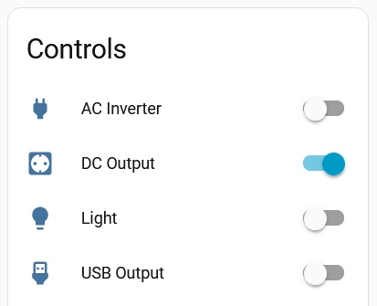
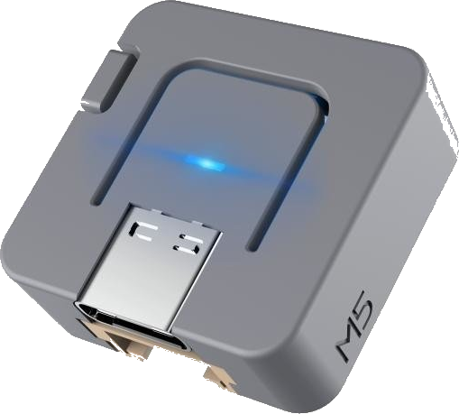
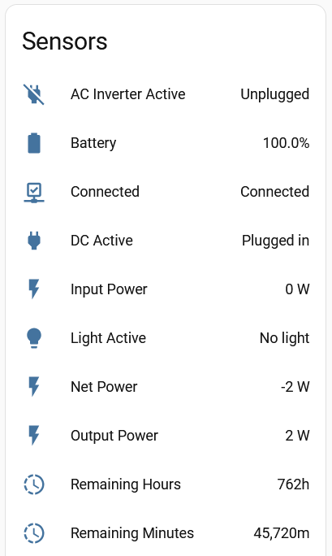

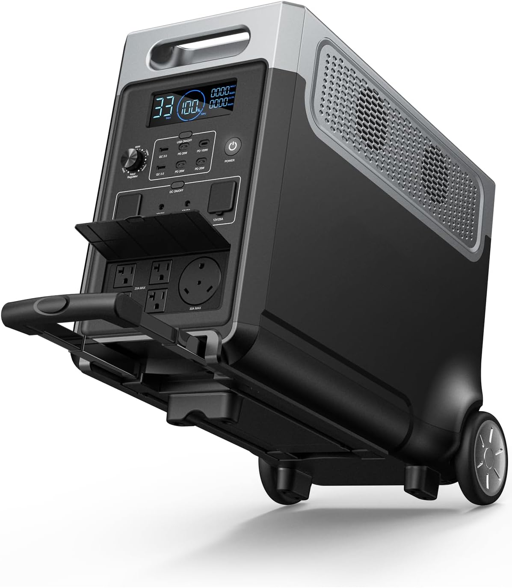
ESP32
Device
Home
Assistant
Fully local
Battery
Management
FOSSiBOT
SYDPOWER
AFERIY

Slide 2
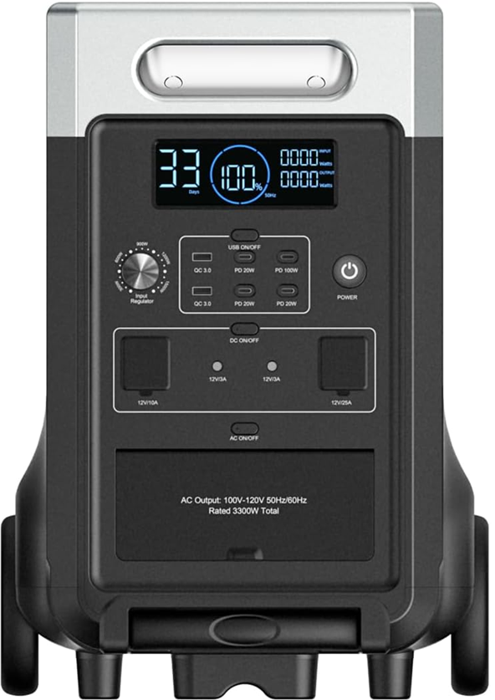
Press the button to
toggle a function.
Toggle USB
Toggle DC
Toggle AC
Toggle Light
(In back)

