Slide 1
Titanic Survival Prediction Project
CSE 351 Project
Dane Meister & Michael Lieberman

Slide 2
Team Contributions
Dane Meister
Data Cleaning & Preprocessing
Feature Engineering
EDA & Visualizations
Documentation & Presentation
Michael Lieberman
Model Experimentation
Cross-Validation & Metrics
Evaluation & Tuning
Documentation & Presentation

Slide 3
Project Objective
Explore the Titanic dataset to predict survival using ML.
Analyze passenger attributes such as gender, age, and class.
Apply data cleaning, feature engineering, EDA, and train ML models.
Compare Logistic Regression, KNN, and SVM.

Slide 4
Data Cleaning
Filled missing Age using Title-based medians
Fare: median fill + log transform + outlier clipping (99th percentile)
Embarked: filled with most common value ('S')
Dropped Cabin (sparse), Ticket, Name
Combined train and test for uniform cleaning

Slide 5
Feature Engineering
Extracted Title from Name (e.g., Mr, Miss)
Binned Age into AgeGroup
Created FamilySize and IsAlone features
Created HasCabin indicator
Encoded categorical: Sex, Embarked, Title

Slide 6
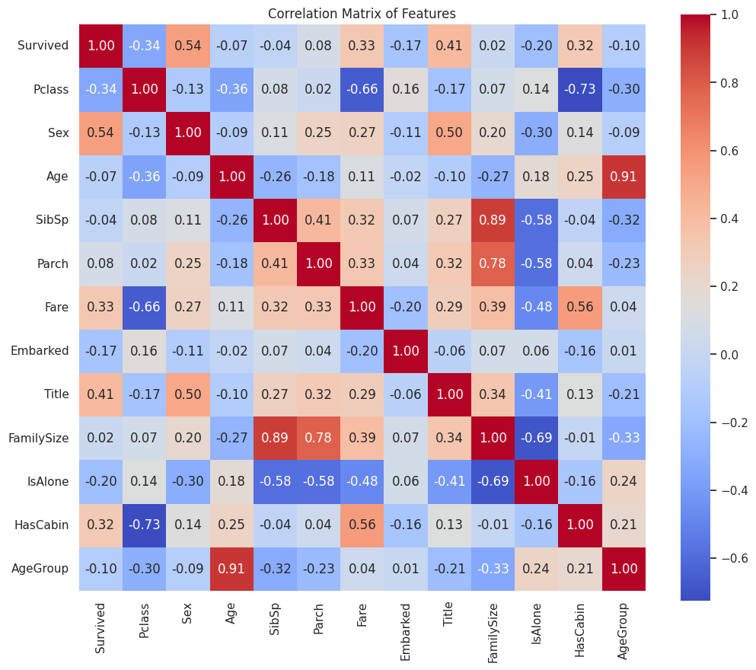
Exploratory Data Analysis (EDA)
Females and 1st Class had much higher survival rates
Being alone reduced survival
Children had higher survival than adults
Strong predictors: Sex, Title, Fare, HasCabin, Pclass

Slide 7
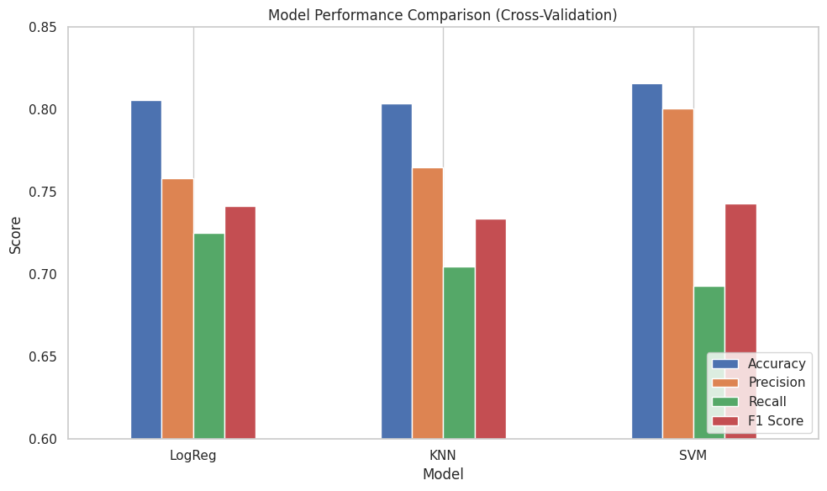
Model Evaluation Results
All models evaluated with 5-fold cross-validation:
Logistic Regression
Accuracy: 80.6%
F1 Score: 0.741
KNN (k=5)
Accuracy: 80.4%
F1 Score: 0.734
SVM (RBF)
Accuracy: 81.6%
F1 Score: 0.743

Slide 8
Conclusion & Insights
SVM performed best overall, especially in precision
Logistic Regression had highest recall (good for sensitivity)
KNN performed competitively
Key insights:
Social class, gender, and family status matter
Feature engineering significantly improved model quality
Future work: tuning, ensembling, scaling

