Slide 1

HomeWifiawayfromHome
A Wifi switch

Slide 2
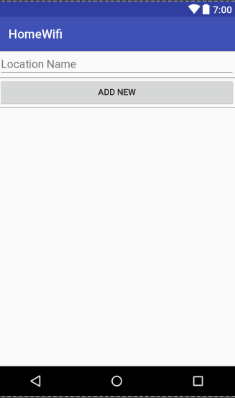
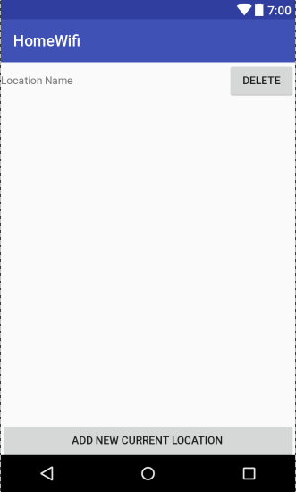
Wifi is on when you’re home.
Have locations that turn wifi on when you’re there

Slide 3
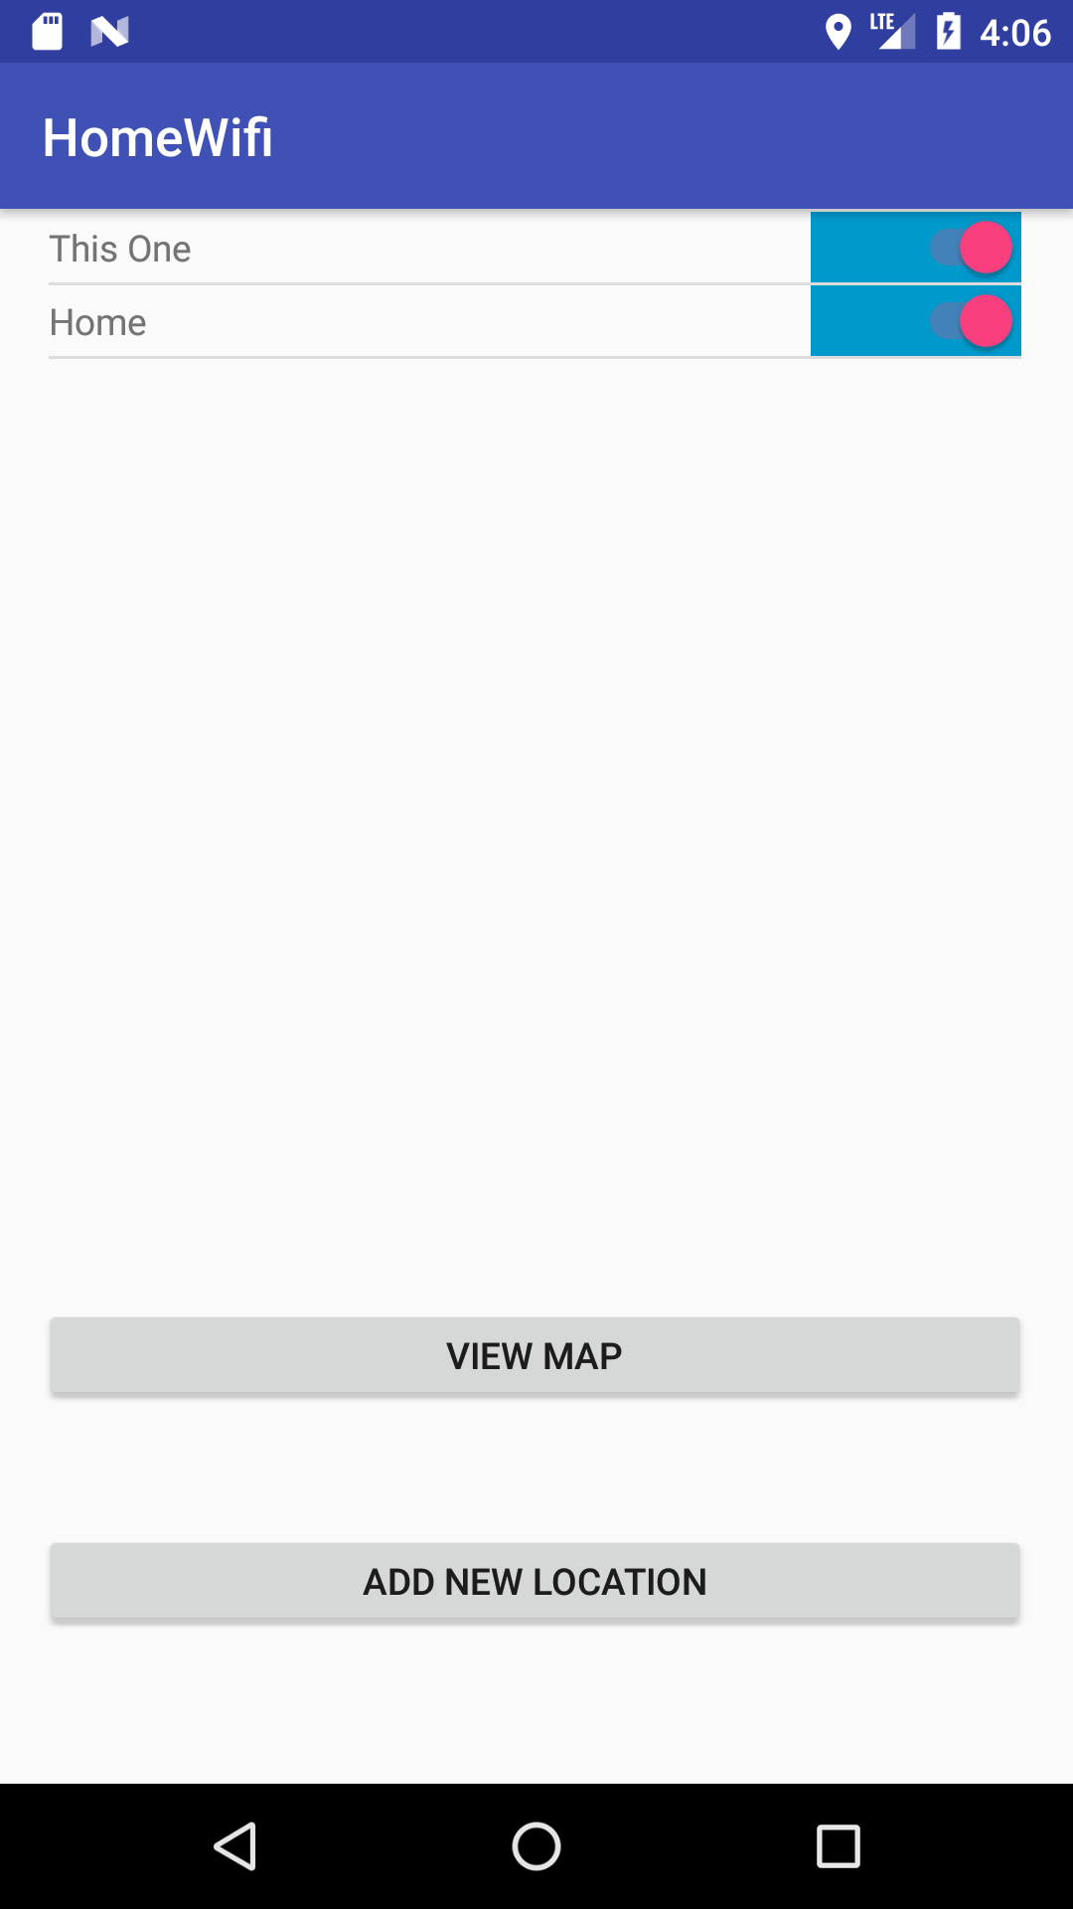
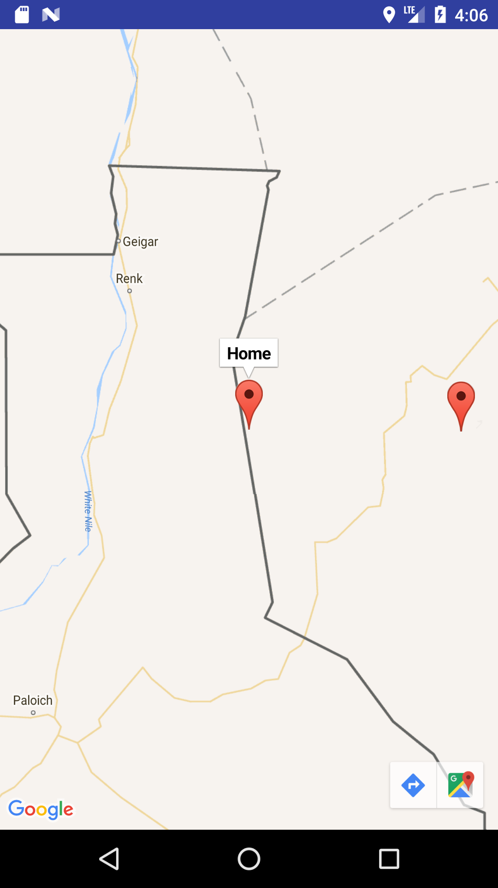

Slide 4
Manifest
<uses-permission android:name="android.permission.ACCESS_FINE_LOCATION" /> <uses-permission android:name="android.permission.ACCESS_WIFI_STATE" /> <uses-permission android:name="android.permission.CHANGE_WIFI_STATE" />

Slide 5
Key Components
LocationManager
LocationListener
WifiManager

Slide 6
onLocationChanged
Checked if wifi is connected
Checked if any item in locations matched the current one.
Connect otherwise disconnect.

Slide 7
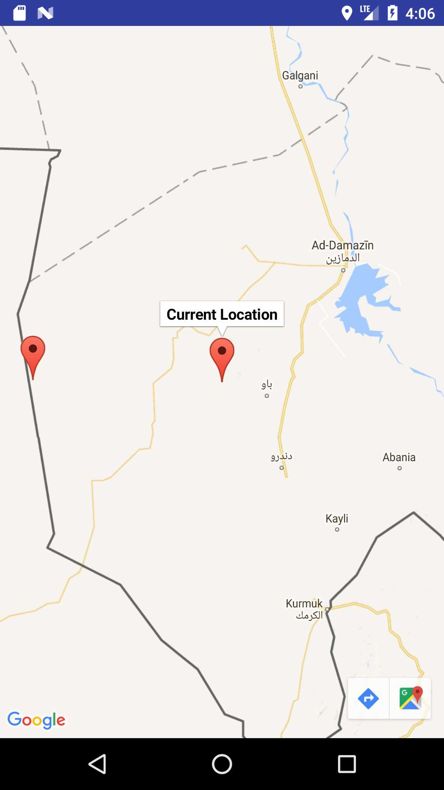
Maps
Basically self working once you log in

Slide 8
//Checks to see android version to ensure the right check is done. if(Build.VERSION.SDK_INT < 23){ // Doesn't have the better permission check locationManager.requestLocationUpdates(LocationManager.GPS_PROVIDER, 0, 0, locationListener); } else { // checks if there is permission and if not asks for it. if (ContextCompat.checkSelfPermission(this, Manifest.permission.ACCESS_FINE_LOCATION) != PackageManager.PERMISSION_GRANTED){ ActivityCompat.requestPermissions(this, new String[]{Manifest.permission.ACCESS_FINE_LOCATION}, 1); } else { //Otherwise find out where we are and put a marker on the map there. locationManager.requestLocationUpdates(LocationManager.GPS_PROVIDER, 0, 0, locationListener); Location lastKnowLocation = locationManager.getLastKnownLocation(LocationManager.GPS_PROVIDER); LatLng currentLocation = new LatLng(lastKnowLocation.getLatitude(), lastKnowLocation.getLongitude()); mMap.clear(); mMap.addMarker(new MarkerOptions().position(currentLocation).title("Current Location")); mMap.moveCamera(CameraUpdateFactory.newLatLng(currentLocation)); //moves camera to current location } }

Slide 9
@Override public void onRequestPermissionsResult(int requestCode, @NonNull String[] permissions, @NonNull int[] grantResults) { super.onRequestPermissionsResult(requestCode, permissions, grantResults); if (requestCode == 1 ){ if(grantResults.length > 0 && grantResults[0] == PackageManager.PERMISSION_GRANTED){ if (ContextCompat.checkSelfPermission(this, Manifest.permission.ACCESS_FINE_LOCATION) == PackageManager.PERMISSION_GRANTED) { locationManager.requestLocationUpdates(LocationManager.GPS_PROVIDER, 0, 0, locationListener); } } } }

Slide 10
Gotchas
Named Location class Location
Sqlite
FINE location

Slide 11
Future Development
Check to see if there within location range
01
Delete locations
02
Toggle locations on and off
03

