Slide 1

THERAPEACE: A PHYSICAL AND OCCUPATIONAL THERAPIST FINDER AND APPOINTMENT SYSTEM
Members:
cANete, jude nino
Centillas, tiffany
Echavez, Daniela
Lopez, francis chino

Slide 2

Rationale of the Study
The system helped the therapists find their designated clients easily, and also served as an addition to their income as freelancers.

Slide 3
Statement of the Problem
General Objective
The study aimed to develop theraPeace: A Physical and Occupational Therapist Finder and Appointment System.
Specific Objectives
Specifically, the study aimed to:
- Determine the booking process with the clients and therapists.
- Design and develop the following modules:
* User Module * Booking Module
* Finder Module * Chat Module
- Test and evaluate the system.
- Deploy the system.

Slide 4







Significance of the Study

Slide 5
Scope and Limitations
SCOPE
Mandaue and Cebu City
Physical and Occupational Therapists
Bridges client and therapist
LIMITATION
??

Slide 6
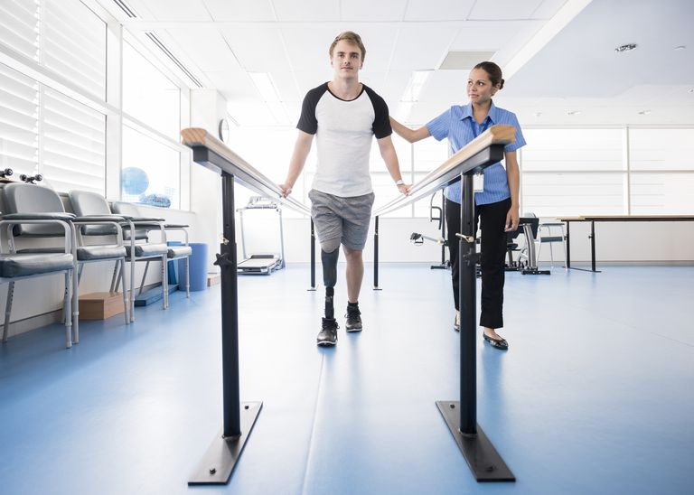

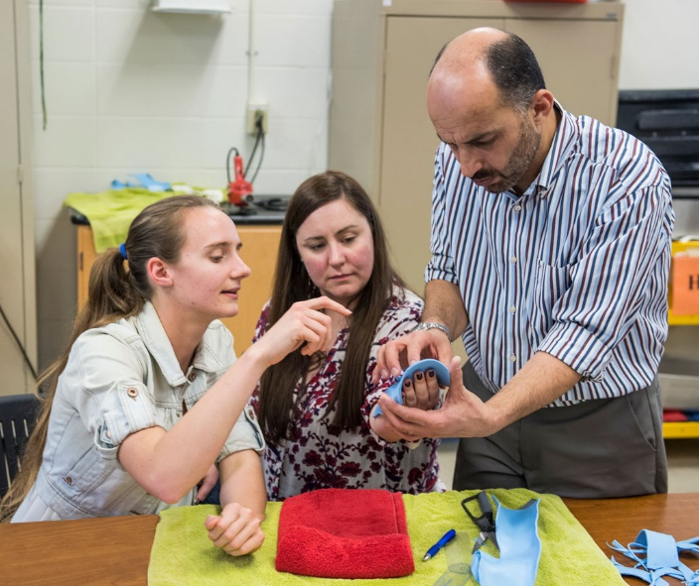
Related Systems

Slide 7

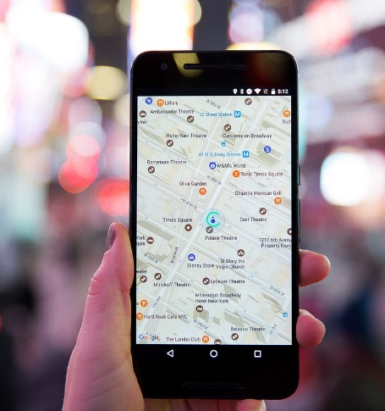


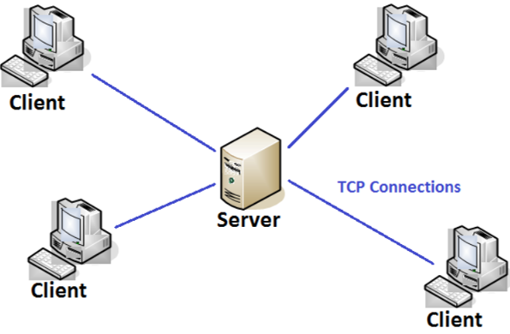
Technical Background

Slide 8
Design and Methodolgy

Slide 9
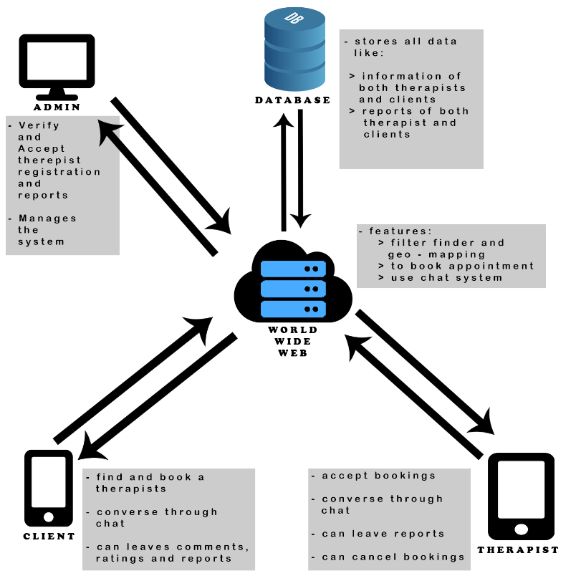
Conceptual Framework

Slide 10
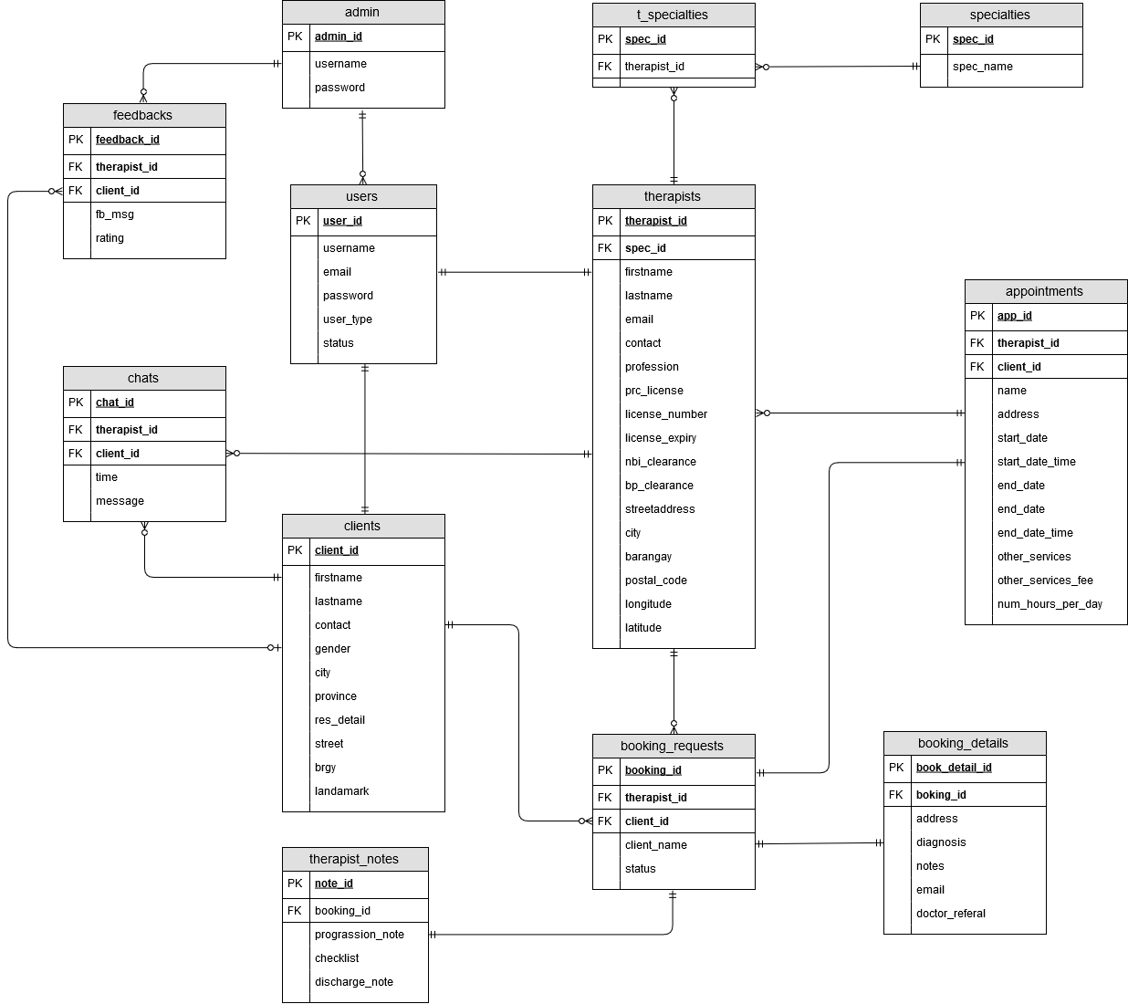
Entity Relationship Diagram

Slide 11
Development Model
start
Requirement Gathering
System Design
Develop Prototype
Improve Prototype
Evaluate Prototype
Improve Development
Development
stop
Maintenance
Evaluation
Testing

Slide 12
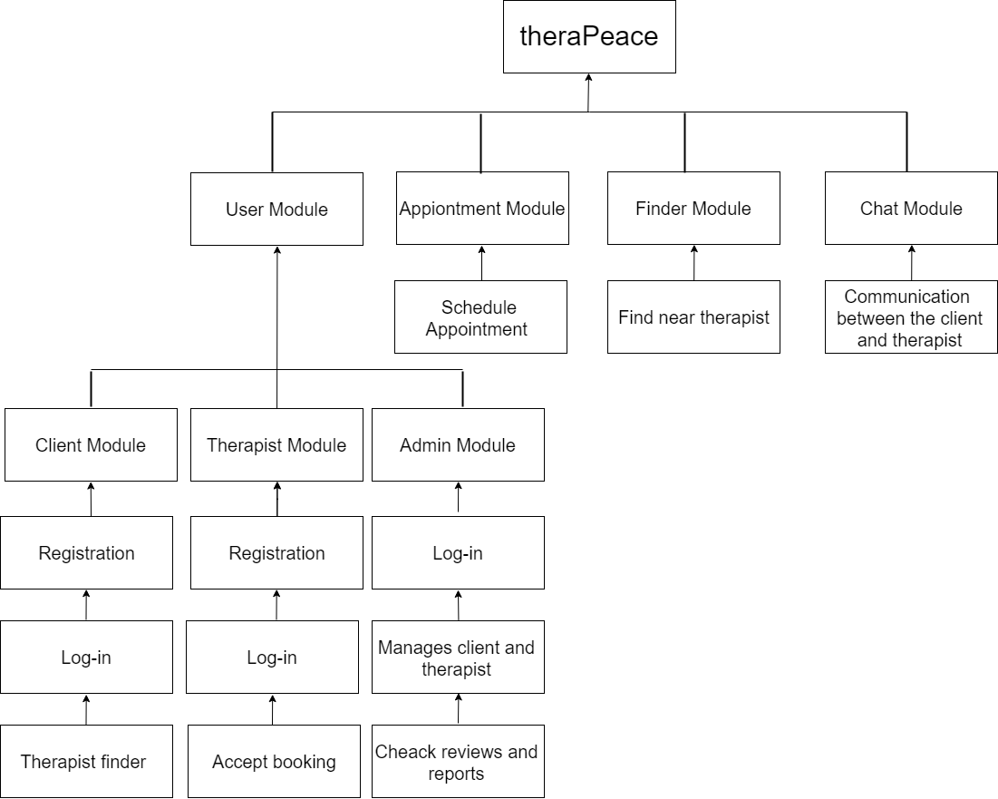
Development Approach

Slide 13
Result and Analysis

Slide 14
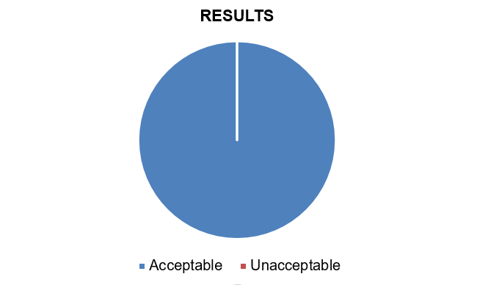
Result and Analysis
Black Box Testing: THERAPEACE

Slide 15
Result and Analysis (cont.)
Criteria | Weighted Average | Interpretation
Functionality | 3.6 | Acceptable
Reliability | 3.9 | Acceptable
Usability | 3.8 | Acceptable
Efficiency | 3.6 | Acceptable
Maintainability | 3.7 | Acceptable
Support and Manuals | 4 | Acceptable
TOTAL | 3.77 | Acceptable
Average Score Interpretation
4.1 – 5.0 = Very Acceptable
3.1 – 4.0 = Acceptable
2.1 – 3.0 = Moderately Acceptable
1.0 – 2.0 = Not Acceptable
Average Score: 3.77 Acceptable

Slide 16
Result and Analysis (cont.)

Slide 17
Conclusion and Recommendation
Conclusion
The findings of the results from the system were evaluated with an overall rating of 3.77, which interpreted the system as acceptable.
Recommendation
Make more features to be available to the therapist and clients such as easy transactions between the two (2) users:
Have the clients pay on debit or credit cards to promote cashless transactions
Have the clients’ payments be covered by insurance.

Slide 18
END

