Slide 1


Best Carris Espaço Navegante in the Lisbon Metropolitan Area
Individual Project
Big Data Tools and Analytics
Daniel Enriquez

Slide 2

Motivation: the waiting queue lines are long to get the public transportation card.
Research Question: What's the best Carris Espaço Navegante in the Lisbon Metropolitan Area.
Big Data Tools and Analytics Best Carris Espaço Navegante in the Lisbon Metropolitan Area 1/8

Slide 3
Methodology
Big Data Tools and Analytics Best Carris Espaço Navegante in the Lisbon Metropolitan Area 2/8

Slide 4

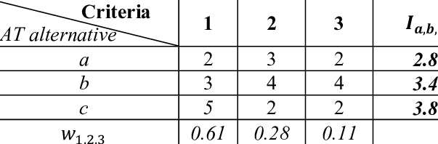
Decision theory: Multiple-Criteria Decision Analysis (MCDA). Specifically, the Weighted Sum Model (WSM).
Note. Adapted from Brown, A., & Bauer, A. M. (2016).
Big Data Tools and Analytics Best Carris Espaço Navegante in the Lisbon Metropolitan Area 3/8

Slide 5



Data Sources
Secondary data sources:
I don’t collect the data.
Access the data trough API.
Carris Metropolitana. (2024). Carris Metropolitana API (Beta).
Google. (n.d.). Work with review data.
Big Data Tools and Analytics Best Carris Espaço Navegante in the Lisbon Metropolitan Area 4/8

Slide 6
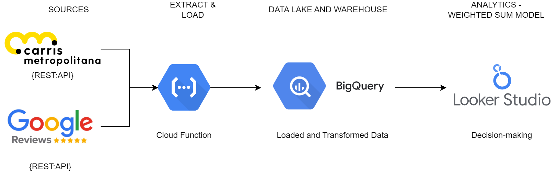
ELT Pipeline Diagram
Big Data Tools and Analytics Best Carris Espaço Navegante in the Lisbon Metropolitan Area 5/8

Slide 7
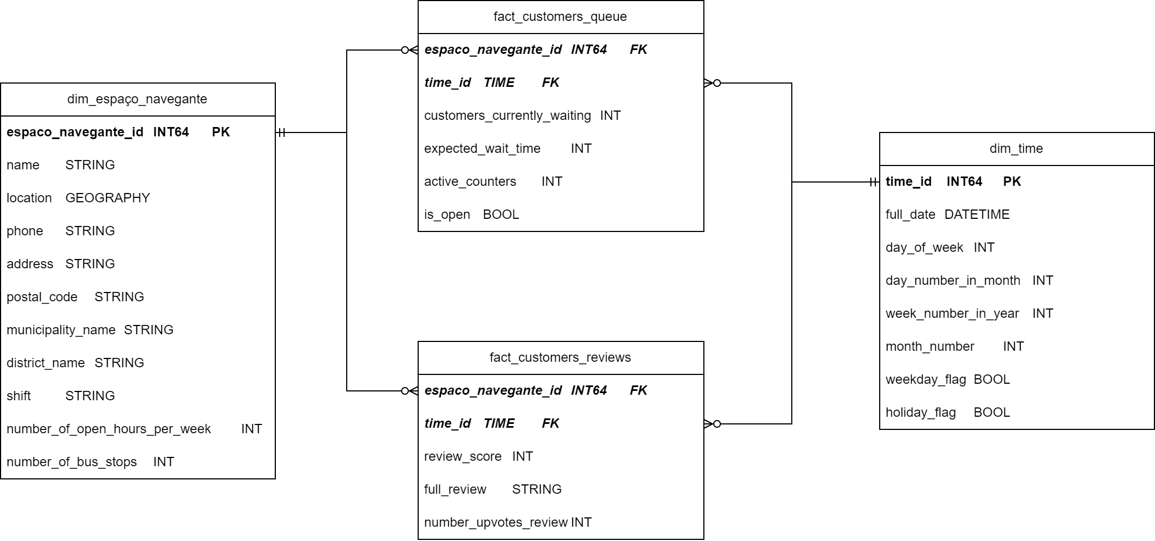
Data Mart
Big Data Tools and Analytics Best Carris Espaço Navegante in the Lisbon Metropolitan Area 6/8

Slide 8
Decision Criteria for Weighted Sum Model:
Average Expected Wait Time in Rush Hour
Number of Open Hours per week
Number of Bus Stops
Average Rating on Google Reviews
Big Data Tools and Analytics Best Carris Espaço Navegante in the Lisbon Metropolitan Area 7/8

Slide 9
Limitations
Time Span Discrepancy: Google Reviews cover a longer time span compared to the Carris table, making direct comparisons challenging due to differing granularity.
Review Verification: Reviews are not verified, leading to a broader range of complaints beyond customer service issues or waiting times.
Big Data Tools and Analytics Best Carris Espaço Navegante in the Lisbon Metropolitan Area 8/8

Slide 10



GitHub Repository
Big Data Tools and Analytics Best Carris Espaço Navegante in the Lisbon Metropolitan Area

Slide 11
References
Brown, A., & Bauer, A. M. (2016). Remotely designed appropriate technology for emergency disaster response in Nepal. Procedia engineering, 159, 275-283.
Carris Metropolitana. (2024). Carris Metropolitana API (Beta). GitHub. https://github.com/carrismetropolitana/api
Google. (n.d.). Work with review data. Google My Business API. Retrieved March 18, 2024, from https://developers.google.com/my-business/content/review-data
Big Data Tools and Analytics Best Carris Espaço Navegante in the Lisbon Metropolitan Area

