Slide 1

Assessment of the Implementation of BIPV/T in the Canadian housing Stock: Suggested Parameters
JOSÉ A. CANDANEDO

Slide 2
Outline
1. General comments.
2. Recommended physical parameters for BIPV/T.
3. BIPV/T air flow rates.
4. Description: System A.
5. Description: System B.

Slide 3
1. General Recommendations
Although many combinations are possible, we should prefer simple to complex systems.
Let’s not get stuck in minor details. Inevitably, in a study such as this, we will face unknowns: let’s make reasonable assumptions (which will be stated, of course, in the final report) and move on.
Inevitably, the system will not be appropriate for some constructions (e.g., lack proper orientation).
Let’s not focus in “optimal” solutions at this point. There is always room for improvement.
Important: we should include auxiliary equipment (pumps, fans, etc.).

Slide 4
Update of scenarios discussed (Bart/Jose)
A. Use of air-to-water heat exchanger for heat delivery – preferred option for renovations.
B. BIPV/T Assisted Heat Pump with thermal storage tank and a radiant floor heating – preferred option for new constructions.
  Requires improved building envelope.

Slide 5
2. BIPV/T Roof Physical Parameters
BIPV/T covers the entire surface of any south-facing roof, or near south-facing roof (within ±30° of due South). The slope of the roof should be greater than 30°.
  Justification: It wouldn’t be sensible to install a BIPV roof on a different orientation.
Amorphous silicon PV panels rather than monocrystalline or polycrystalline PV.
Gap height = 5 cm between the roof membrane and the PV.

Slide 6
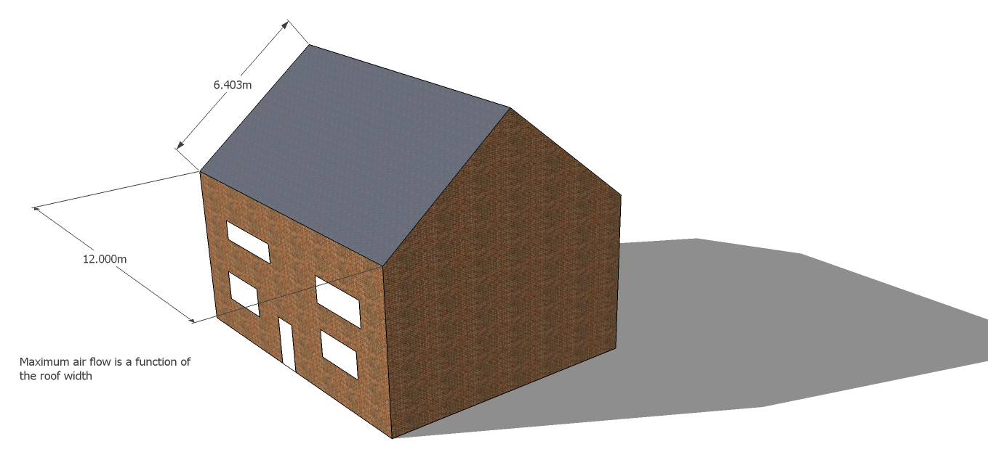
3. Air flow rates
Suggested maximum flow rate (MFR): 80 CFM per linear meter of roof width. A 12-m wide roof, will have a maximum air flow rate of 960 CFM. In this way, the air flow rate will increase depending on the available cross-section area.
The roof should be at least 3 m long in the air flow direction. Otherwise, it makes little sense to install a BIPV/T.

Slide 7

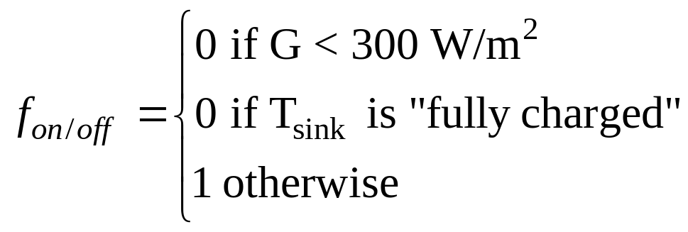
3. Air flow rates: control
The flow rate will be a fraction of the MFR, depending on: solar radiation and temperature of the “heat sink” (water in the AHU coil or the water in the TES tank).
G: solar radiation on the roof slope in W/m².
Fan on/off signal

Slide 8
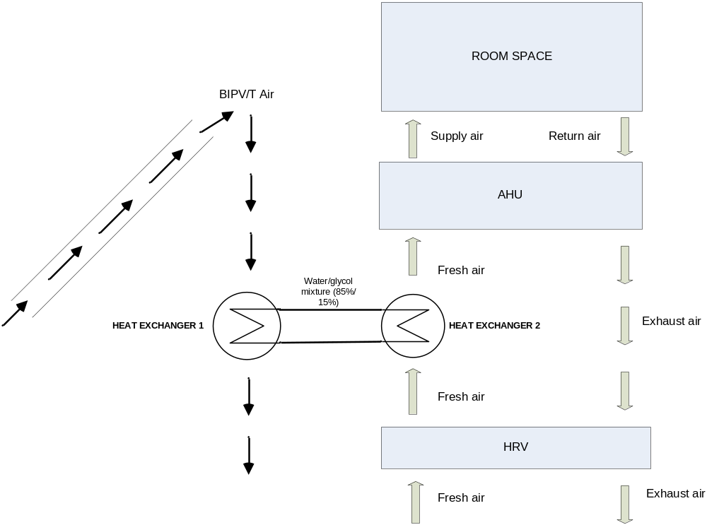
4. System A Description

Slide 9
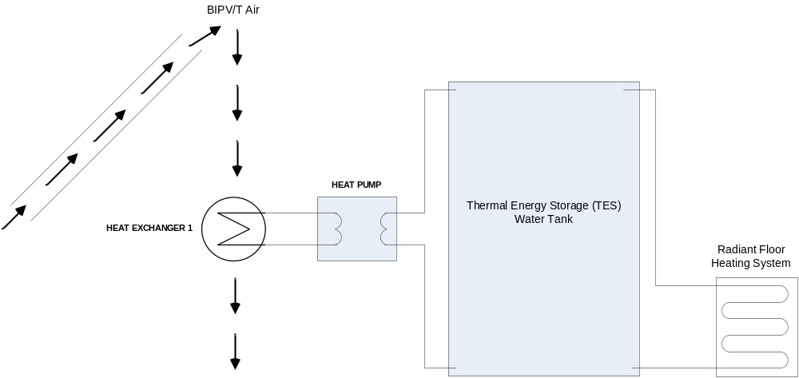
5. System B Description

Slide 10
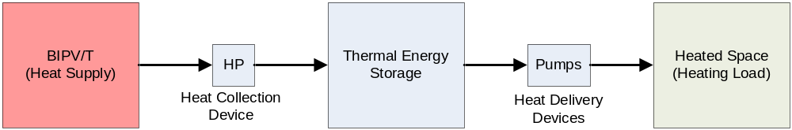
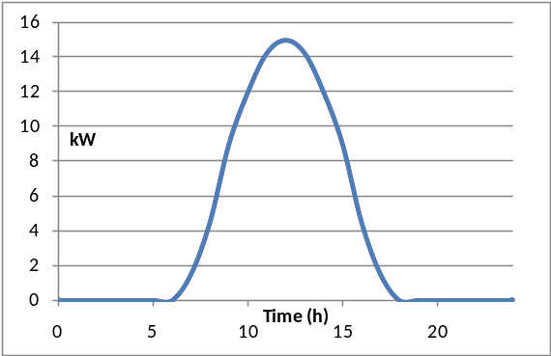
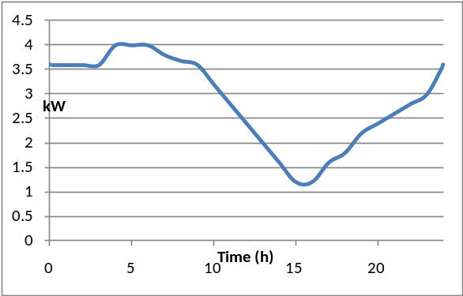
Heat Pump Selection
Important: the heating capacity of the HP does not need to match exactly the heating load of the house.
The reason for that is that the heat pumps are not intended as a supply system: they are the heat extraction system from the BIPV/T. The TES tank provides the link to help us match when the energy is available and when it is needed.
Area under the curve = 97.5 kWh
Area under the curve = 72 kWh
Area recoverable with HPs (9 am to 3 pm)= 85.5 kWh

Slide 11
Heat Pump Selection
Suggested Heat Pumps:
  Waterfurnace EW020:
    Nominal heat output: 20 kBTU/hr (1.67 tons or 6 kW), in reality more like 25-35 kBTU/hr (7.3 to 10 kW) with a BIPV/T system, because of the higher source temperatures.
  Waterfurnace EW030:
    Nominally 30 kBTU/hr (2.5 Tons or 9 kW), in reality more like 35-50 kBTU/hr (10 to 14.6 kW).
  Waterfurnace EW042:
    Nominally 42 kBTU/hr (3.5 Tons or 12.3 kW), in reality more like 50-70 kBTU/hr (14.6 kW to 20 kW)
It is unlikely that a house will need a bigger heat pump. If it needs one, then some serious retrofitting is needed!
Lookup tables or simple correlations based on Manufacturers data. No need for a full thermodynamical model of the heat pump. Runtimes might become a problem.

Slide 12
Heat Pump Selection
The ideal thing would be to carry out a complete study of solar radiation availability, roof size and heating load for each building to select the heat pump and the TES tank size.
Realistically, we can’t do that.
I would suggest:
  (a) using the BIPV/T roof size to choose the heat pump.
  (b) using the heat pump capacity and a rough estimate of the heating load to select the TES tank.

Slide 13
Heat Pump Selection
I suggest:
This assumes that 15% of the incident radiation can be recovered as heat with temperatures that are high enough (> 5 °C)
For example, a 50 m² roof would have a 7.5 kW heat pump. In this case, it would be a EW020. A 70 m² would produce up to 10.5 kW of heat recoverable with a heat pump (EW030).
If we are in between two heat pump sizes, we should go for the lowest one, to avoid operation at partial load.

Slide 14
Selecting the Tank Size
We shouldn’t be scared of a big tank, of the order of thousands of liters, in a new construction.
We should go for low temperatures (I would recommend 25-40 °C), rather than high ones, because of significantly better COPs. This would require bigger tanks.

Slide 15
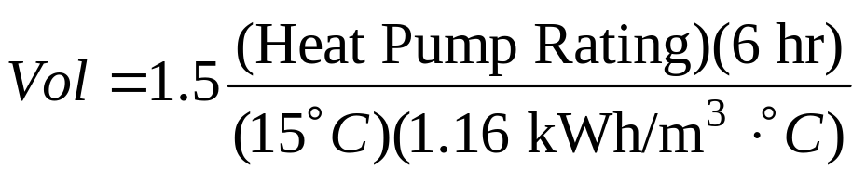
Tank Size Selection
To estimate the tank size, we will use the pump rating.
This formula assumes 1.5 days to charge the tank, 6 hours of daily operation and a temperature fluctuation of 15 degrees. The other number is the specific heat of water.
For example, a 10 kW heat pump should probably be associated with a 5.2 m³ tank.

