Slide 1

BIPV/T Solar Assisted Heat Pump Systems For Residential Heating Applications:
ESP-r Model Development
  Bart Lomanowski
  Simulation Tools Group, Sustainable Buildings and Communities
  March 4, 2010

Slide 2
Objective
1/34
Develop an integrated BIPV/T heat pump model in ESP-r in support of SBRN Theme 4 research objectives
Potential uses of model:
  Optimization of BIPV/T systems
  Building stock modeling
  Early design stage performance assessment

Slide 3
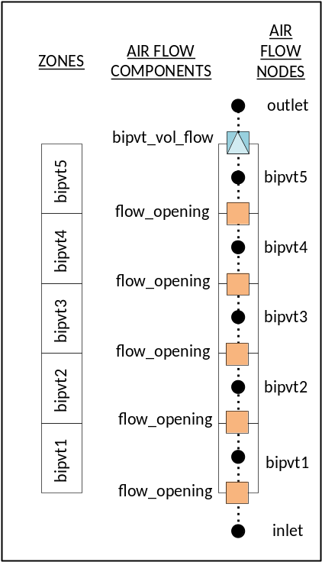
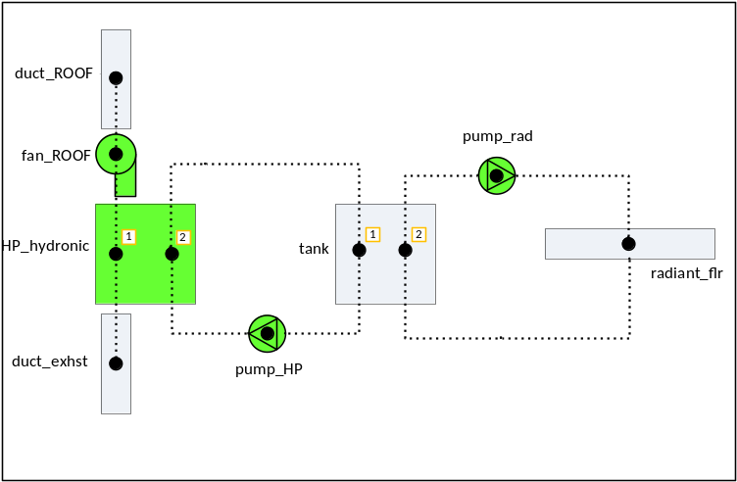
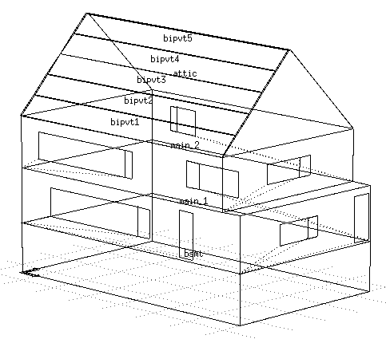
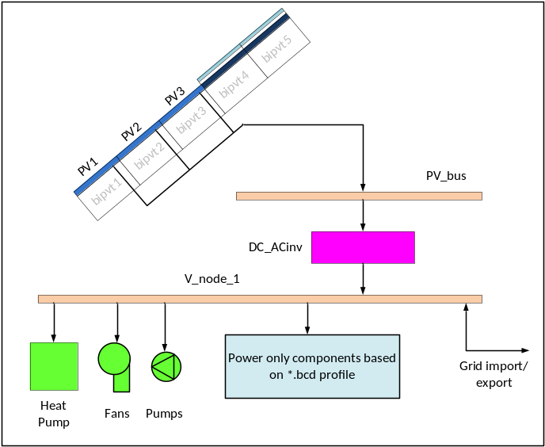
Plant Network
ESP-r Integrated BIPV/T Model
2/34
Air Flow Network
Elec. Network
Building Fabric

Slide 4
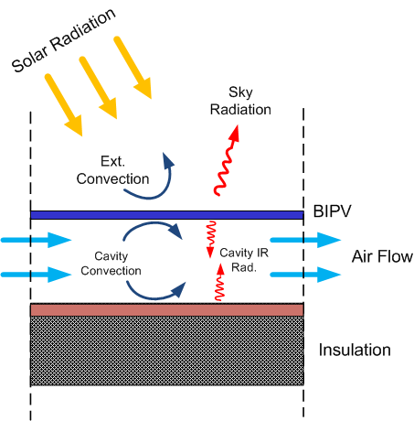
BIPV/T Roof
3/34

Slide 5
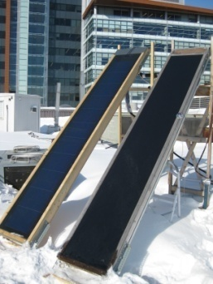
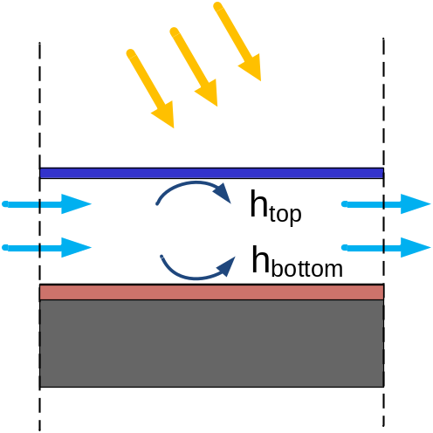
4/34
Heat Transfer Correlations
Framing effects increase Nu_{top} and Nu_{bottom} by ~30%
image: L. Candanedo, Concordia U.

Slide 6

ESP-r Roof Air Flow Model
5/34
Pressure driven air-flow network
Dynamic mass balance performed at each node
Coupled to building air zones
Implemented L. Candanedo’s convective heat transfer correlations

Slide 7
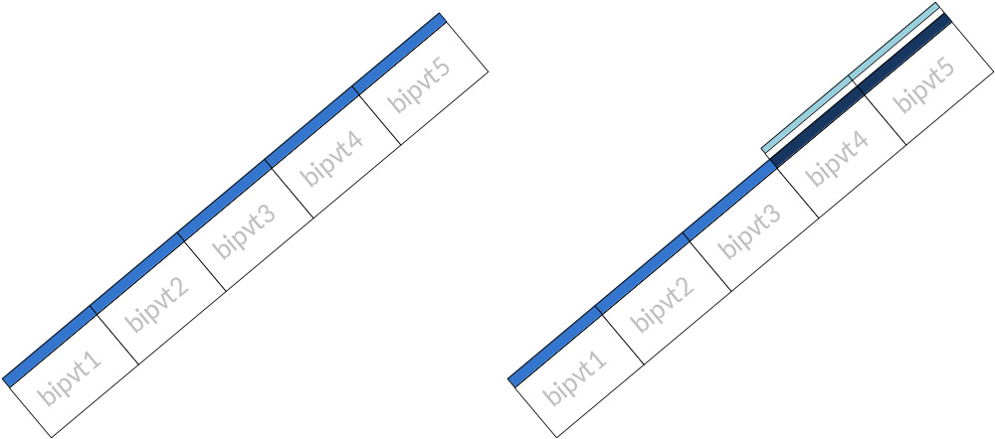
BIPV/T Collector
6/34
Glazed Absorber
BIPV
vs.
BIPV

Slide 8
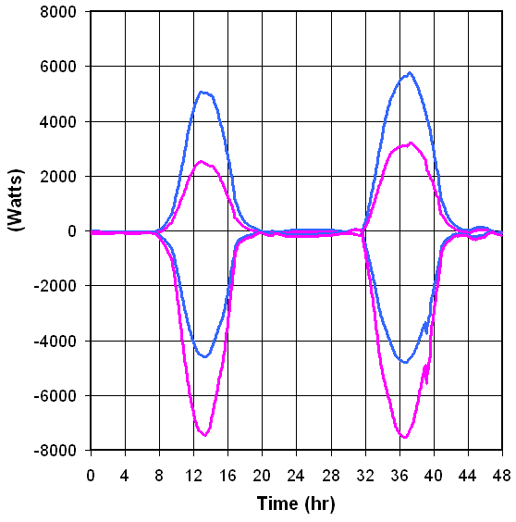
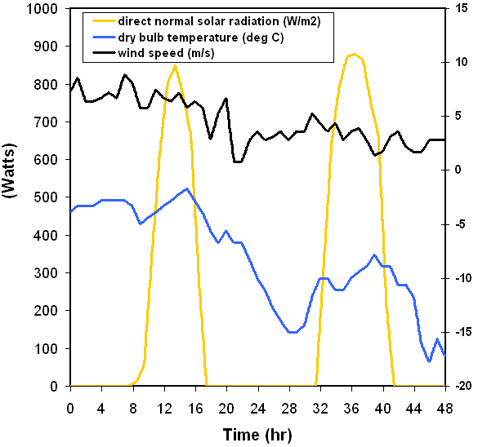
7/34
Roof Internal Gains vs. External Losses
  Constant roof flow: 1000 CFM
  bipvt5 Roof section
BIPV + Glz. Abs.
BIPV

Slide 9
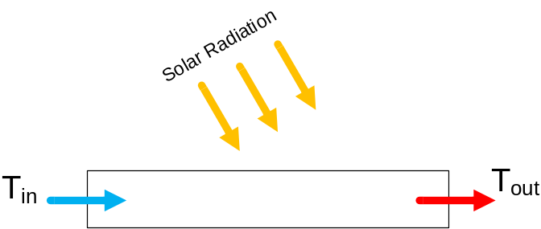
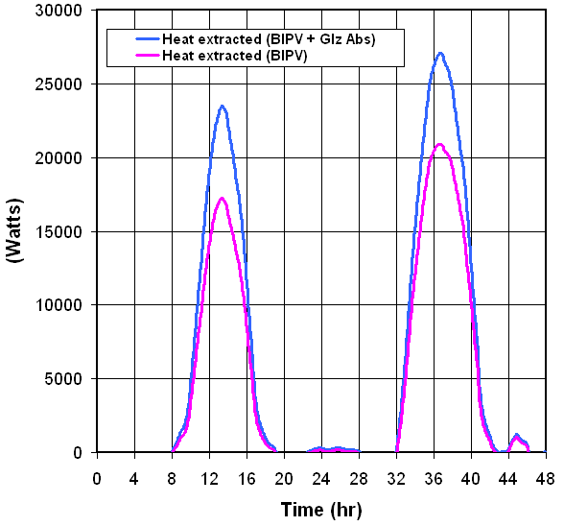
8/34
Heat Extracted
HE = m c_{p} ΔT
  Large thermal output during sunny periods
  Low grade heat

Slide 10
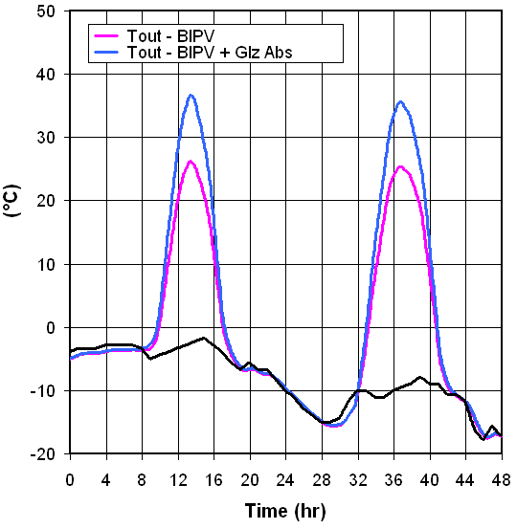
9/34
Roof Outlet Temperature
  10°C boost from glazed absorber sections

Slide 11
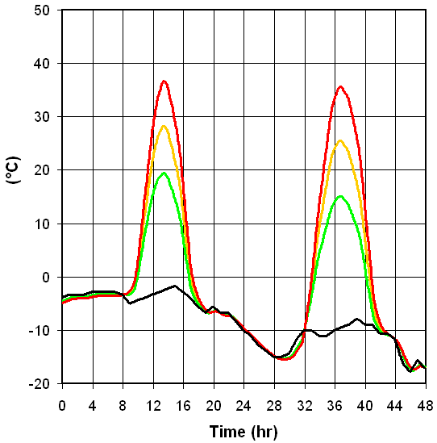
10/34
T_{out} vs. Flow Rate
  Flow rate largely dictated by heat pump operating requirements
1000 CFM
1500 CFM
2000 CFM

Slide 12
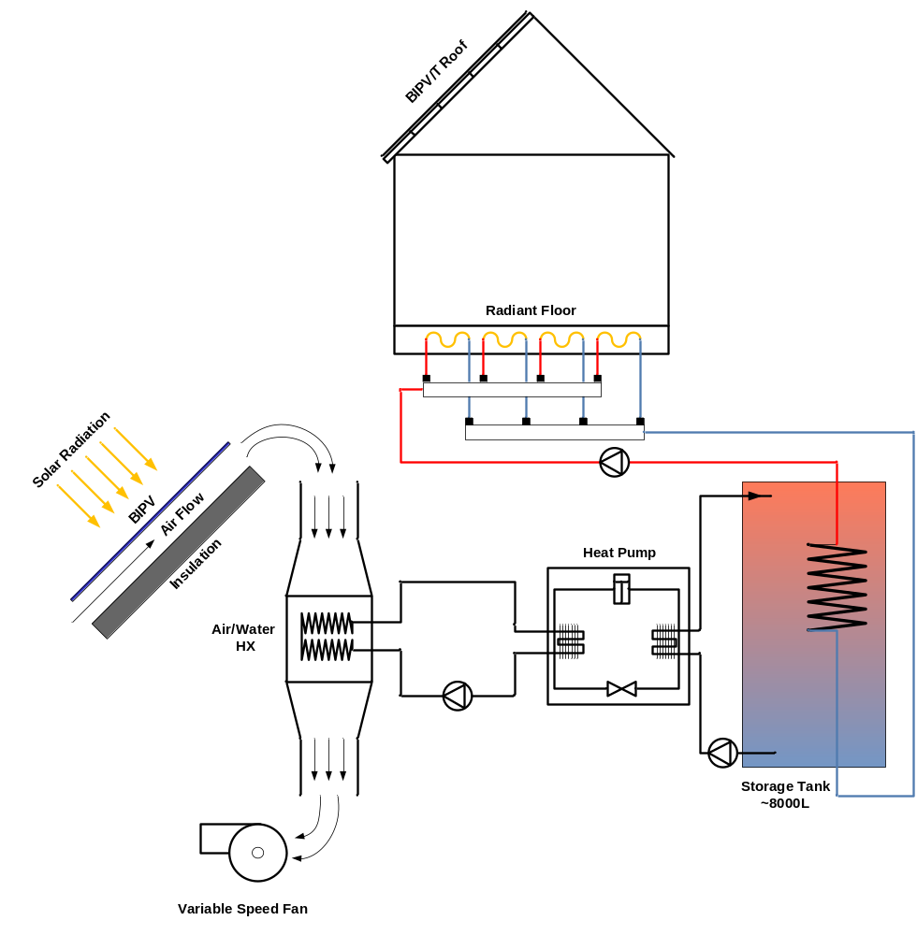
Radiant Floor Heating System – Hydronic HP
11/34

Slide 13
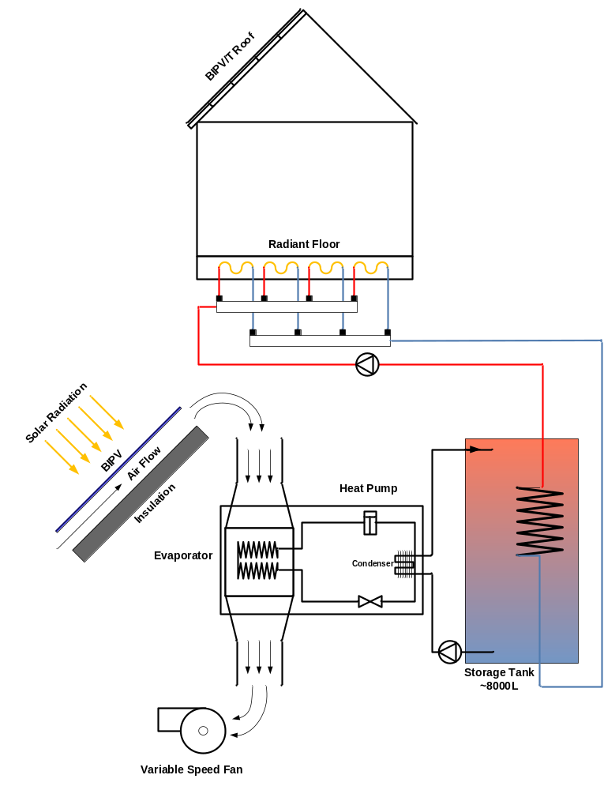
Radiant Floor Heating System – Air source HP
12/34

Slide 14
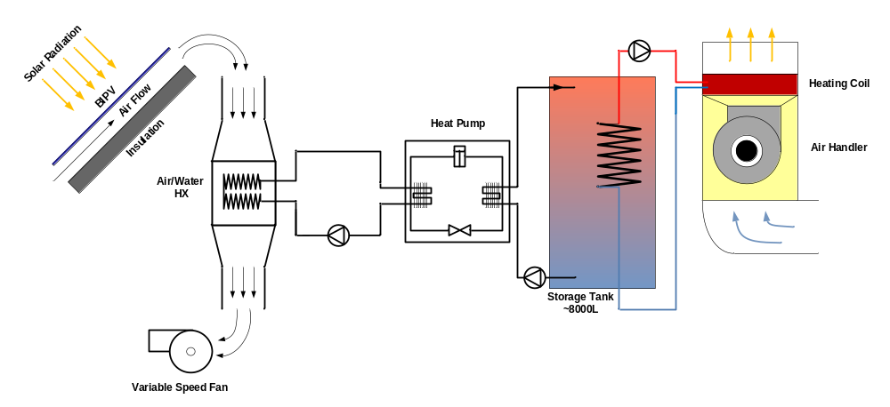
Air Handler Heating Coil System – Hydronic HP
13/34

Slide 15
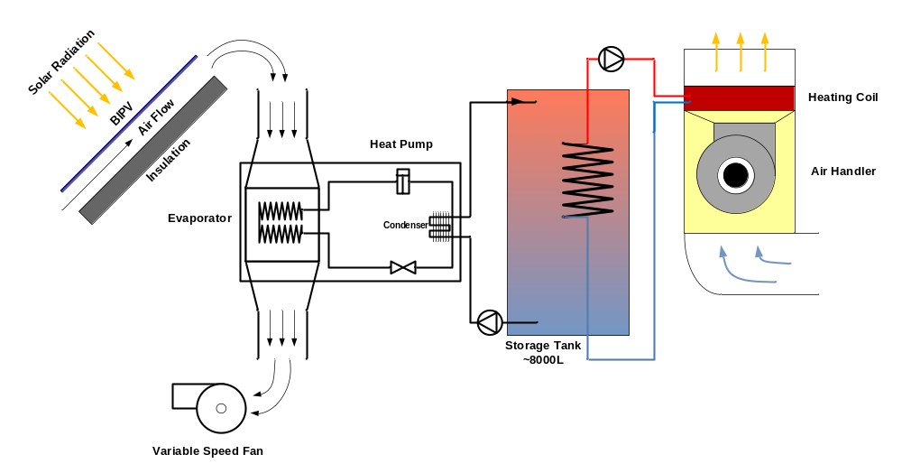
Air Handler Heating Coil System – Air Source HP
14/34

Slide 16

15/34
Thermal reservoir:
Why thermal storage?
  Roof supply coincident with low heat demand on sunny days, especially for solar sensitive envelopes
  Charge during the day and coast through the night
How much storage?
  Depends on house heat loss characteristics, sqft, etc.
  Large volumes – 5 to 10 m³ for 24 hr charge cycle
What storage temperature range?
  Depends on heat delivery method
  Lower (~30-40°C) for radiant floor system
  Higher (~45-55°C) for air handler heating coil
  Achieve higher COPs with lower tank temperatures

Slide 17
16/34
Radiant floor:
Large heat exchange area but restricted to low temperatures (direct contact with occupants)
Requires insulated and air-tight envelope
Better suited for new construction
Slab floor:
  Provides thermal mass for passive solar
  More difficult control – need to anticipate passive solar heating to prevent overheating

Slide 18

17/34
Heating coil:
Limited heat exchange area
Requires higher water temperatures (lower COPs)
Better suited for retrofit applications
Higher AHU flow rates required to deliver heat at lower temperatures
e.g., Typical boiler/heating coil system:
  Coil entering water temp.: 65-80°C
  Air supply: 45-50°C at 1000 CFM
e.g., Heat pump system:
  Coil entering water temp.: 45-55°C
  Air supply: 30-35°C at 2000 CFM?
Considerations: noise, fan power AHU size

Slide 19

18/34
Hydronic HP:
Typical application - ground source HP
  Operating cutoff EST (entering source temperature): -1°C
HP heat extracted, output capacity, power and COP a function of:
  EST, ELT, source flow, load flow
  Tabulated manufacturer’s data available
Air/water HX
  ΔT between roof supply air and EST is strong function of air flow rate (i.e., higher flow rate results in smaller ΔT)
  BUT, higher roof flow rates lead to lower roof outlet T
  Major limitation in HP operation
  2 HP system improves operating point
    minimum roof outlet T = ~ 10°C

Slide 20
19/34
Air-source HP:
Capable of operating at low source air temperatures (~ -15°C, -20°C)
Require large air flow rates (e.g., 15 kW nominal heating capacity ASHP requires ~2300 CFM)
Results in lower roof outlet temperatures (see slide 10) BUT reduces dependence on backup heat
Large flow rates require higher fan power (fan laws: power proportional to flow rate cubed)

Slide 21
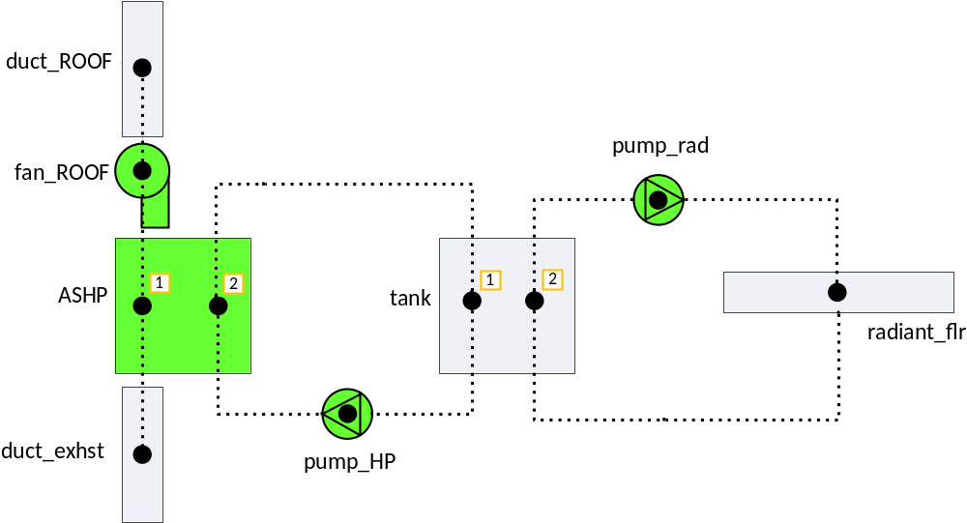
Plant Network
20/34
Duct component connected to bipvt5 thermal zone (uppermost roof zone)
1 node radiant floor component embedded into node of floor slab construction.
2 node stratified tank component with single immersed HX coil.
2 node air-source heat pump component. Performance based on interpolation of manufacturer’s data tables.

Slide 22
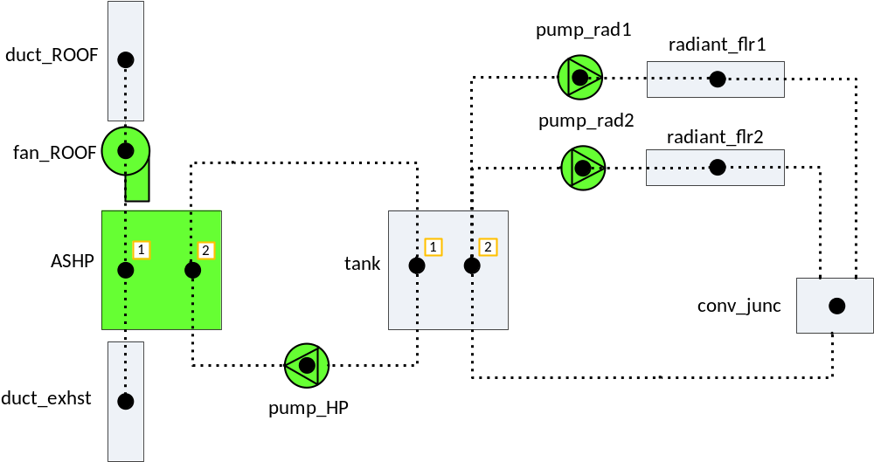
Plant Network - Variations
21/34

Slide 23
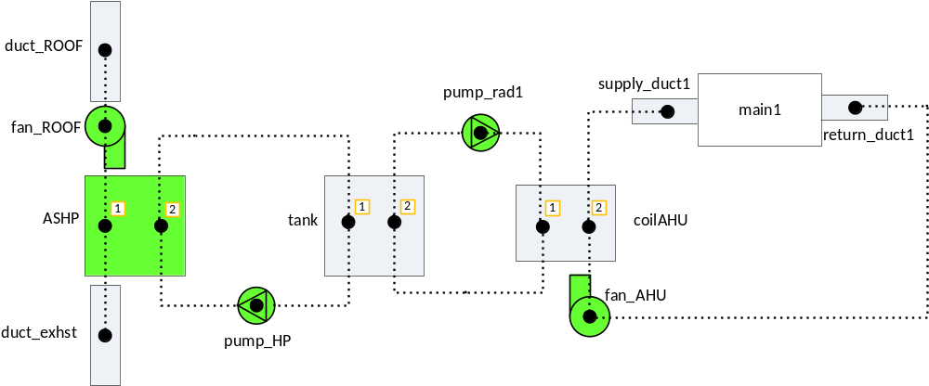
Plant Network - Variations
22/34
Supply and return ducts connected to thermal zone main1
Air/water HX component

Slide 24
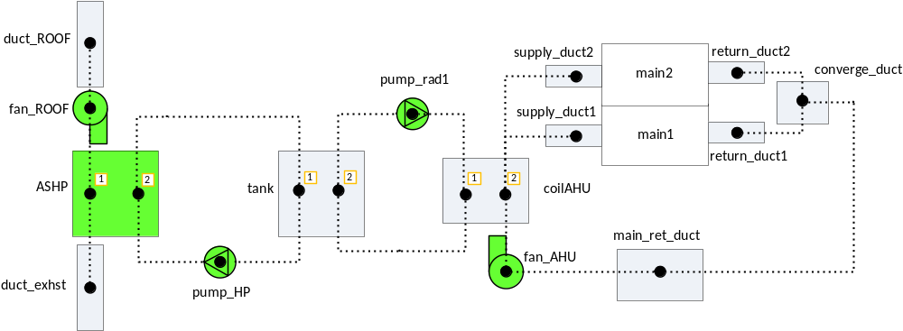
Plant Network - Variations
23/34
Supply and return ducts connected to thermal zones main1 and main2

Slide 25
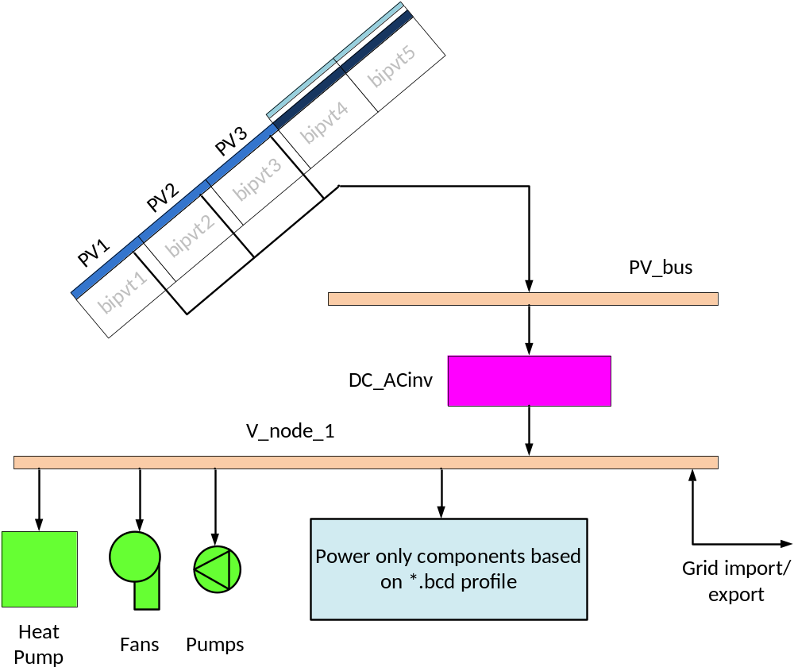
Electrical Network
24/34
PV components embedded into building fabric. PV output based on WATSUN model
Plant components connected to electrical network

Slide 26

Control
25/34
ON/OFF state controlled by pump_HP
ON/OFF state controlled by thermostat in main1 zone
ON/OFF state controlled by tank temp. setpoints
ON/OFF state controlled by pump_HP and roof air flow. If inlet air < cutoff T then turn on backup heat.

Slide 27
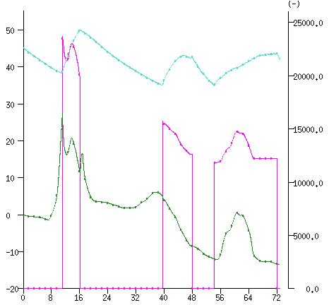
Control
26/34
Charge window
Inlet air temp.
HP Output
Tank temp.
Primary control: tank high and low temperature setpoints
Charge window – 6 am to midnight
If sunny, begin charging even if tank temp. is above low setpoing
If tank temp. falls below low setpoing outside of charge window, pre-charge tank (1-2°C) until main charge cycle begins
Considerations:
  higher tank temp. degrades COP
  low tank temp. may not meet heating load
  Charge to higher tank temp. when sunny to take advantage of higher capacity / COP
(°C)
(Watts)
Time (hr)

Slide 28
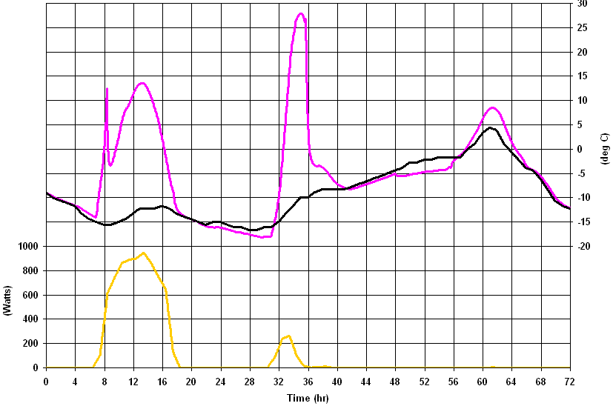
Sample Output: Solar Assisted vs. Non-Assisted HP
27/34
Weather – January, Toronto CWEC climate file
Stagnation Temp.
Roof Outlet Temp.
Ambient Temp.
Direct Normal Solar Radiation
(W/m²)

Slide 29
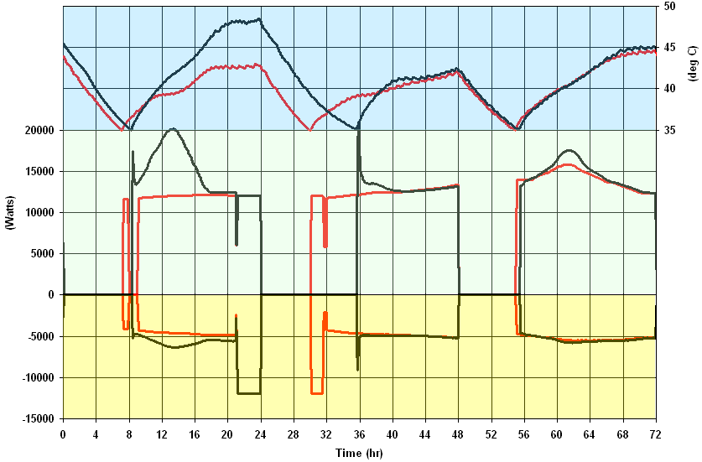
Sample Output: Solar Assisted vs. Non-Assisted HP
28/34
Non-Assisted
Solar Assisted
Tank Temp.
HP Output
Power

Slide 30
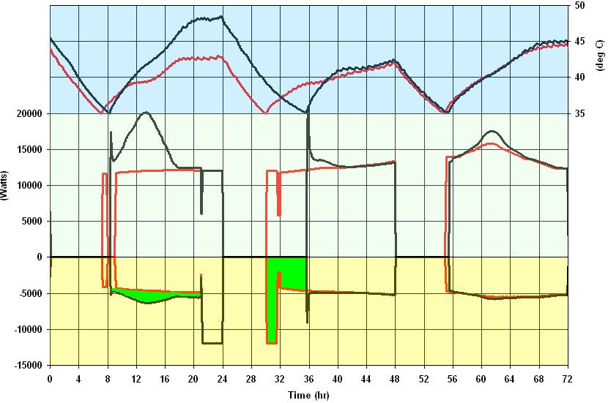
Sample Output: Solar Assisted vs. Non-Assisted HP
29/34
Non-Assisted
Solar Assisted
Tank Temp.
HP Output
Power
Added elec. energy
Saved elec. energy

Slide 31
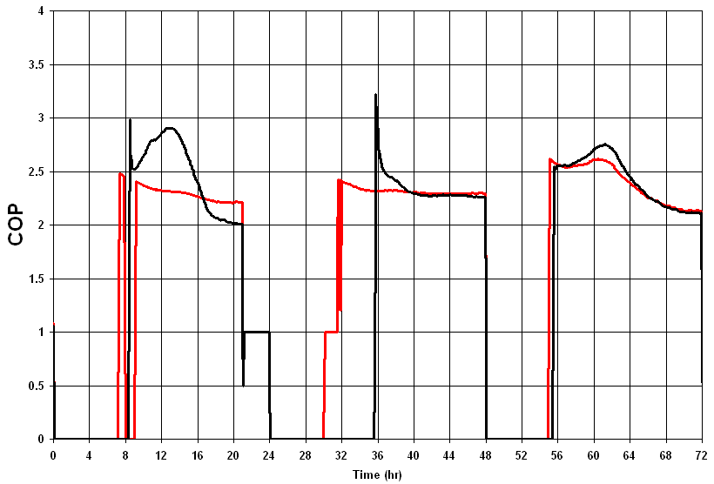
Sample Output: Solar Assisted vs. Non-Assisted HP
30/34
Non-Assisted
Solar Assisted

Slide 32
Sample Output: Solar Assisted vs. Non-Assisted HP
31/34
Non-Assisted
Solar Assisted
roof temp. 25°C above ambient
Higher tank temp. degrades COP

Slide 33
Seasonal Performance
32/34
Next stage: implement BIPV/T - HP model with CHREM model
Perform seasonal energy assessment on sample houses which fit criteria (e.g., orientation, roof type, roof size, roof slope)
What is the benchmark? Non-assisted ASHP? Conventional heating systems?

Slide 34
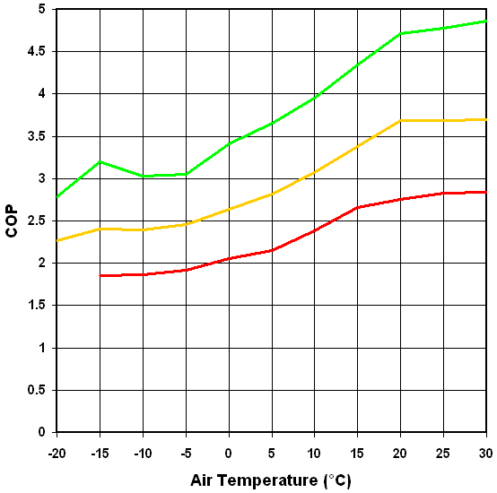
Seasonal Performance
33/34
35°C
50°C
Heating water temperature
65°C
Crude estimate can be made from manufacturer’s performance data

Slide 35
Questions?

