Slide 1
Web Application Architecture
@Jakub Daněk (Yoso Czech s.r.o.) 2020
Analyst & Software Architect
http://danekja.org (GitHub & LinkedIn links)
http://yczech.cz

Slide 2
Motivation
SW development project consists of many unknowns at the beginning
  "… with proper design, the features come cheaply. This approach is arduous, but continues to succeed."
    Dennis Ritchie
Many developers made this experience
  → best practices, paths to follow

Slide 3
Contents
Elementary design principles
  Code organization
    Single responsibility, Separation of concerns, Encapsulation, DRY
  Dependencies and their expression
    Inversion of control, Dependency injection
Web Application Architectures
  Monolithic application, microservices
  Application layers, common patterns
  Cross-cutting concerns, Aspect-oriented programming

Slide 4
TL;DR;
12-factor architecture by Adam Wiggins
https://12factor.net/

Slide 5
Elementary Design Principles

Slide 6
Separation of Concerns
Code dealing with different work should be kept separate
Increases
  Testability
  Reusability
  Readability
Example: for user registration, implementation of input validation is irrelevant
Example files: soc_bad.example, soc_good.example
Same principle applies on class, package, module, universe level!

Slide 7
Single Responsibility Principle
Specifically for object-oriented design:
A class should have one, and only one, reason to change.
  If class has multiple responsibilities
    → each responsibility has own specifications
    → change of one responsibility specification (= reason to change the class) may impact ability of the class to fulfil the others
      → fragile design
Src: Robert C. Martin, The Single Responsibility Principle

Slide 8
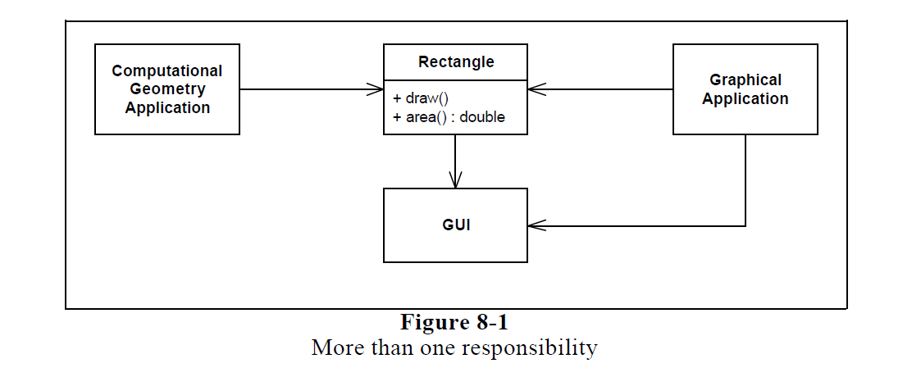
Single Responsibility Principle
Src: Robert C. Martin, The Single Responsibility Principle

Slide 9
Single Responsibility Principle
Problems with this design:
Computational application depends on GUI library through Rectangle
If Graphical application requires Rectangle to change, it may force rebuild (test, deployment) of the Computational application
Src: Robert C. Martin, The Single Responsibility Principle

Slide 10
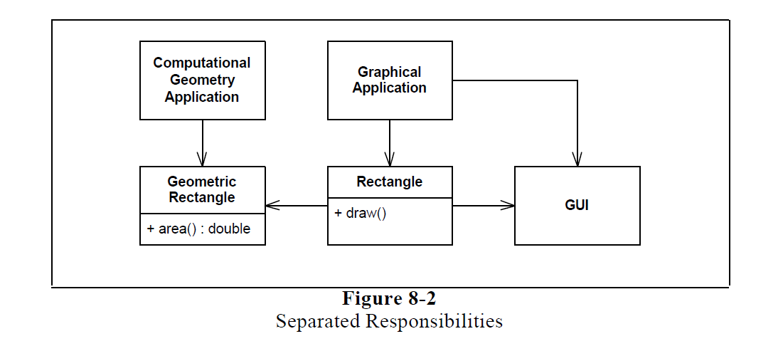
Single Responsibility Principle
Src: Robert C. Martin, The Single Responsibility Principle

Slide 11
Encapsulation
Prevent direct access to internal state of object/module
  Note encapsulation is not an OOD-related principle only
State read/change should happen only through well-defined public interfaces
  Class/module owns its state and should control how it is changed
  Auto-generating getters and setters breaks encapsulation quite often!
Examples: enc_bad.example, enc_good.example

Slide 12
Don´t Repeat Yourself (DRY)
DRY says that every piece of system knowledge should have one authoritative, unambiguous representation.
Dave Thomas
System knowledge consists of
  Code, database schemas
  Test cases and scenarios
  Documentation
  …
Src: https://www.artima.com/intv/dry.html

Slide 13
Don´t Repeat Yourself (DRY)
Multiple representations of single piece of information
  → you have to update them all when changes happen
  → awful lot of work to do
  → or they end up out of sync with each other
Src: https://www.artima.com/intv/dry.html

Slide 14
Don´t Repeat Yourself (DRY)
Authoritative representation = change only that and generate the other required representations automatically, if needed
  Example: Database schema
    Authoritative representation: UML data model
    Derivative representations generated from the UML model: SQL DDL scripts
    Example files: dra_model.pdf, dra_ddl.sql
Src: https://www.artima.com/intv/dry.html

Slide 15
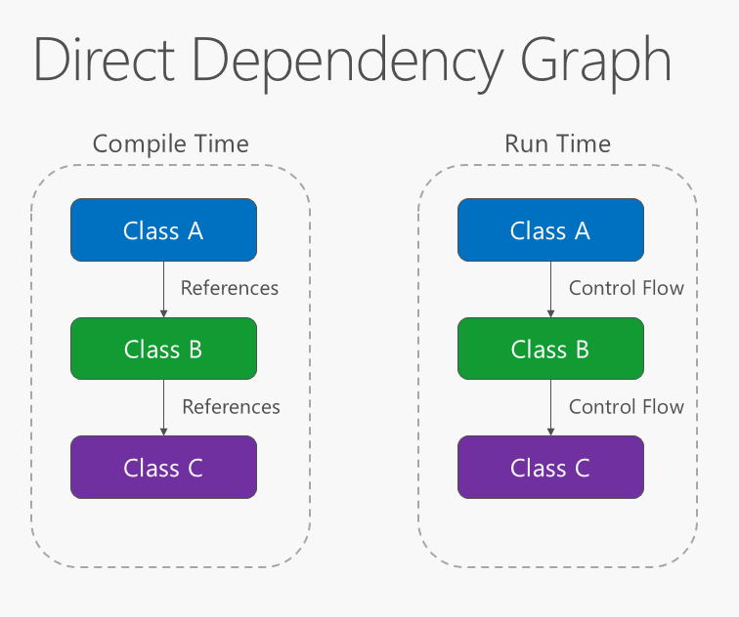
Dependency Inversion – Direct Dependencies
Src: https://docs.microsoft.com/cs-cz/dotnet/standard/modern-web-apps-azure-architecture/architectural-principles

Slide 16
Dependency Inversion – Direct Dependencies
Direct dependencies mean tight coupling between Class A and Class B
  It makes difficult to replace one implementation of Class B with another
    Changes in class A would be necessary
  → Higher level parts of system depend on the lower parts
Higher level abstractions should not depend on implementation details.

Slide 17
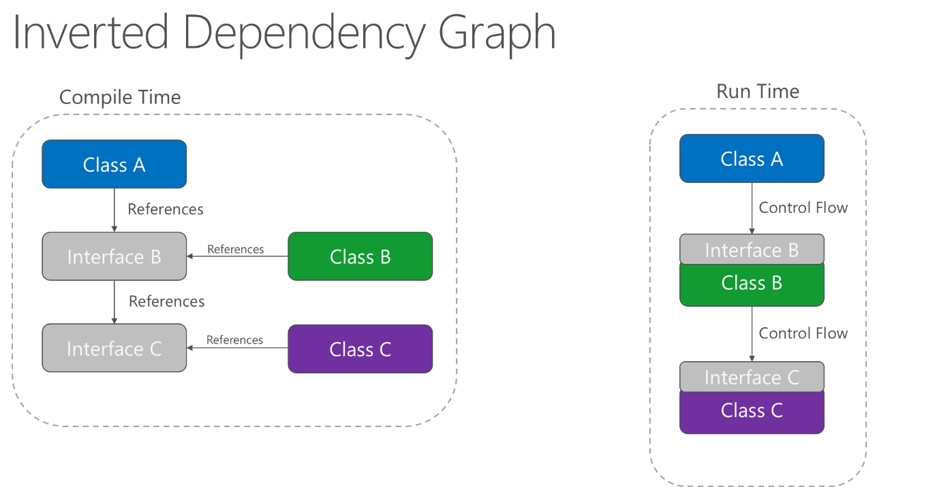
Dependency Inversion
Src: https://docs.microsoft.com/cs-cz/dotnet/standard/modern-web-apps-azure-architecture/architectural-principles

Slide 18
Dependency Inversion
Both high- and low- level modules depend on/implement abstractions (interfaces)
  → loose coupling between modules
  → easy to replace one implementation with another
    Implementation does not impact the world beyond its interface

Slide 19
Explicit Dependencies
Applications/modules/classes should advertise required dependencies for proper functionality
Solutions on several layers:
  Installation – e.g. Linux packaging system
  Build – Maven, Gradle (both Java), npm (node.js), setuptools/pip (python), etc.
  Code – constructor/function parameters

Slide 20
Explicit Dependencies
Explicit code dependencies
  Neither functions, classes nor methods should depend on a particular global state
  Functions should always take all required dependencies as arguments
  Classes should take all required dependencies as constructor parameters
    In other words object must be in initialized, consistent state after constructor call
    Optional parameters can be set via setters, but the class code must be functional even if they remain unset!
Example: explicit_dep.example

Slide 21
Sidestep: Inversion of Control
Generic term expressing that our code is not in control of program flow: some other code (e.g. a framework) is in control
Common use-cases: dependency injection, window GUIs
Common misconception: inversion of control == dependency injection
  Dependency injection represents the IoC concept, but not the other way around
  See the example by Martin Fowler: ioc.example

Slide 22
Sidestep: Inversion of Control
Example of lack of IoC causing trouble
  Internet Payment Gate - API for creating payments and connection to banks
    each payment must have system-wide unique identifier
    API expects consumer to generate the unique identifier
    ok as long as there is only single consumer (we know all the generated IDs)
    when multiple: how do they ensure uniqueness, if they don´t know the IDs generated by others?

Slide 23
Sidestep: Inversion of Control
Example of lack of IoC causing trouble (solutions)
  Inversion of Control
    from consumer point of view: IoC means the payment gate generates the identifier
  or give each consumer own identifier space
    identifier must be unique within consumer´s space
    requires authentication - you must be able to identify consumers

Slide 24
Dependency Injection
Main idea: separate code for populating objects with their dependencies
  Configuration either in code or text (XML) file
  This code is commonly provided by so called DI Containers (such as Spring, EJB, PicoContainer)
Result: replacing dependencies requires change at one place (the configuration) instead of all places of use

Slide 25
Dependency Injection - Constructor
Dependencies are injected via constructor
→ classes have to explicitly declare their dependencies
Preferred for mandatory dependencies
Example: di_constructor.example

Slide 26
Dependency Injection - Setter
Dependencies are injected via setters
→ classes have to provide setters for their dependencies
Preferred for optional dependencies
Example: di_setter.example
  You can see the examples are very similar. The difference is mainly conceptual.

Slide 27
Dependency Injection - Attribute
Dependencies are injected directly to attributes
→ classes don’t have to provide setters for their dependencies
Works with some DI containers, but hides the dependencies from their users
  → consider it to be an anti-pattern and avoid
  Sometimes it can be useful though (e.g. when writing tests)
Example: di_attribute.example

Slide 28
Service Lookup
Dependency resolution approach alternative to dependency injection.
Main idea: there is an all-knowing object (service locator) which can retrieve any instance we need.
We still need to keep reference to the service locator
Example with Spring: servicelookup.example

Slide 29
Dependency Injection vs Service Lookup
DI uses Inversion of Control principle, Service Lookup does not
Dependency Injection can be more difficult to debug (more complicated implementation)
Service Lookup forces dependency on the service locator
  That is especially a problem when writing a library which others should use
Service Lookup is less flexible, but easier to implement

Slide 30
Sources + Additional Reading
Robert C. Martin: Principles of OOD http://www.butunclebob.com/ArticleS.UncleBob.PrinciplesOfOod
Microsoft .NET Guide: Architectural Principles
https://docs.microsoft.com/en-us/dotnet/standard/modern-web-apps-azure-architecture/architectural-principles
Martin Fowler: Inversion of Control Containers and the Dependency Injection pattern
https://martinfowler.com/articles/injection.html

Slide 31
Common Web Application Architectures

Slide 32
Important aspects
How is the application deployed – 1,2,3,n processes/servers?
  Impacts difficulty of horizontal scaling
  Impacts difficulty of deployment updates
How the application looks from the outside world
  Impacts how applications can be integrated
Development constraints
  Used technologies, development team allocation

Slide 33
Monolithic Web Application
Your typical application:
  UI component – e.g. HTML + CSS + JavaScript running in browser
  Server application with some kind of web-service API
    Handles all the functionality → monolith (even though it has a web-service API!)
  Database server for storing data – e.g. MariaDB, MongoDB, OracleSQL, etc.

Slide 34
Monolithic Web Application
Example: Accounting application
  The server handles the following actions:
    User authentication
    Invoice processing
    Salaries
    Document printing
    Tax returns
    Company/Customer management
    Payment orders
    …

Slide 35
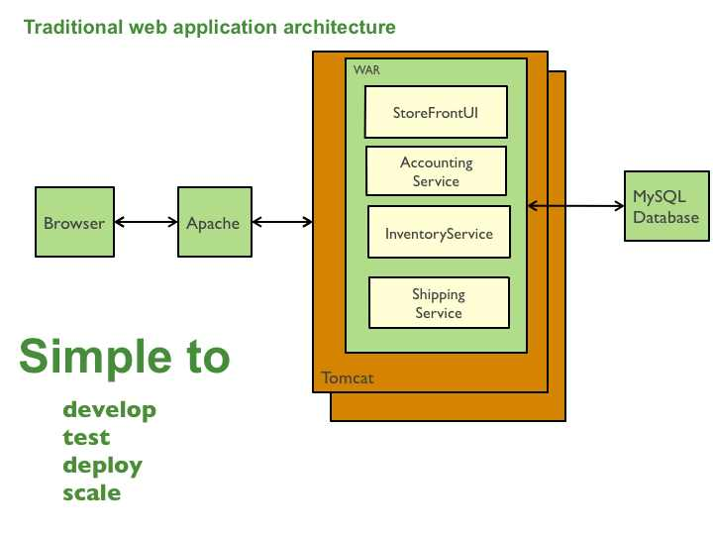
Monolithic Web Application
Src: https://microservices.io/patterns/monolithic.html

Slide 36
Monolithic Web Application
Main pros
  Easy to load into IDE – just one project
  Easy to deploy – one archive/folder which is uploaded to the server runtime
  Simple scaling – running multiple copies
    sort-of, state is always an issue (more on that later)
Works nicely until the application grows, then...

Slide 37
Monolithic Web Application
Main cons (when the application is large)
  Large codebase is difficult to understand – especially for new team members
    → decline of code quality over time
    applications written in languages with dynamic typing suffer even more

Slide 38
Monolithic Web Application
Main cons (when the application is large)
  Long start-time for VMs (e.g. Java, .NET) – wasted time during development and problems with deployment up-time
    languages without VMs do not suffer from this, obviously
  Note: there has been a lot of progress in the field of making Java start faster
      quarkus.io
      micronaut.io

Slide 39
Monolithic Web Application
Main cons (when the application is large)
  Scaling is not so easy anymore
    Cannot scale just portions which are heavily used
    Various resource requirements by different parts of the application

Slide 40
Monolithic Web Application
Main cons (when the application is large)
  Problems with scaling development
    People influence each other with their work → big coordination costs
  Fixed technology stack
    Whole application must be written in the same technology
    Upgrades to newer framework versions are difficult due to size and amount of people involved
    Change of framework means rewriting a lot of code (not a common use-case, though)

Slide 41
Service-Oriented Architecture
Attempt on solving issues with monolithic applications
Or a corporate buzzword…
Nowadays almost useless term:
  Many people understand SOA as many different things
    Google “SOA” and see for yourselves
  Read: https://martinfowler.com/bliki/ServiceOrientedAmbiguity.html
So instead of wasting time on SOA, let’s define what we mean by service here and continue...

Slide 42
Service-Oriented Architecture
Services should:
  Be a black box for their consumers
  Have a clear agreement on how-to communicate with them (client-service contract)
  Be loosely-coupled – services need to know only contract to communicate with each other → no direct, implementation-specific dependencies
  Be stateless – service either responds to client with a value or an error message

Slide 43
Service-Oriented Architecture
Services communicate by sending messages:
  direct calls
  Message queues (“middle-man”)
Many different protocols
  HTTP, WebSocket, SOAP, AMQP, MQTT, Stomp ...

Slide 44
Service-Oriented Architecture
Increases complexity due to integrations
  Remote calls change the rules of engagement
    even correct code can result in failure - connection breaks, the other service goes down for one reason or other
    in public environment, we have to ensure we know to who the application is talking (establishing trust, encryption)
    remote calls are difficult to debug (you always have multiple processes)

Slide 45
Service-Oriented Architecture
Increases complexity due to integrations
  order of service start-up may matter
  services need to be able to recover from their dependencies going down
  performance flaws become more obvious on remote calls
  setting-up development environment requires more effort
    not so much with containers, luckily (more on those later)

Slide 46
Service-Oriented Architecture
Increases complexity due to integrations
→ Monolithic applications integrated via web-service API are not a good SOA
  Issues with monolithic architecture remain
  Additional complexity of service integrations

Slide 47
Microservices
One application split into several small services
  Each runs as separate process on either same, or more often on different (virtual) server
Based on Unix concept of “Do One Thing and Do It Well”
Each service handles one small well-defined area of functionality

Slide 48
Example:
Monolithic Web Application
Src: https://microservices.io/patterns/monolithic.html

Slide 49
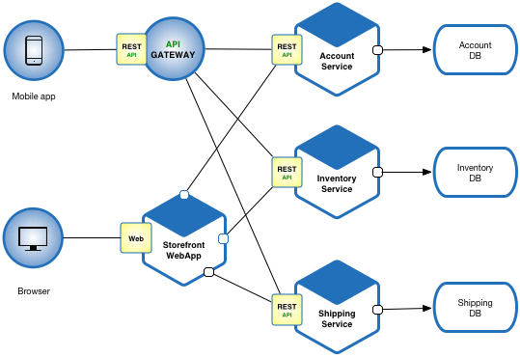
Example:
Microservices
Src: https://microservices.io/patterns/microservices.html

Slide 50
Microservices
Main pros
  Each service is relatively small
    Easy to develop (also for new team members)
    Easy to test individual functionality
  Fast deployment – small services start faster
  Flexible horizontal scalability – you scale only those services which you need
  You don´t need to take down entire application for updates

Slide 51
Microservices
Main pros
  Easy to scale development
    Teams can take responsibility of a service → limited interference
  Each service can be implemented using different technology
  Relatively easy technology upgrades and refactoring due to limited scope of services

Slide 52
Microservices
Main cons
  Relatively difficult to deploy due to distributed nature
    Industry standard development tools are only slowly adapting from monolith applications to microservice pattern
    Containers (Docker) help a lot with that
    → increased maintenance costs
  Integration testing required – and expensive

Slide 53
Microservices
Main cons
  Use-cases that span across multiple services present a challenge
    Require coordination of multiple teams
    Transaction handling is difficult in distributed environment
  Possible increased resource costs
    Each service should have own datastore
    Each service process usually runs on own VM
    Each service requires own runtime which may have significant overhead (e.g. JVM)

Slide 54
Monolith vs Microservices
Each has its uses
Monolith is easier to develop and maintain as long as the application remains relatively small
Complexity of microservice distributed deployment does not pay off for small applications
But for large projects, the microservices allow better scalability, testing, and decrease complexity of individual code packages
  And for languages without static type system, microservices are almost a necessity

Slide 55
Sources + Additional Reading
Microservice Architecture:
https://microservices.io/index.html
ASP.NET Guide: Common Application Architectures
https://docs.microsoft.com/en-us/dotnet/standard/modern-web-apps-azure-architecture/common-web-application-architectures
Martin Fowler: Microservices
https://martinfowler.com/articles/microservices.html

Slide 56
Common Web Application Design Principles
"If you think good architecture is expensive, try bad architecture."
- Brian Foote and Joseph Yoder

Slide 57
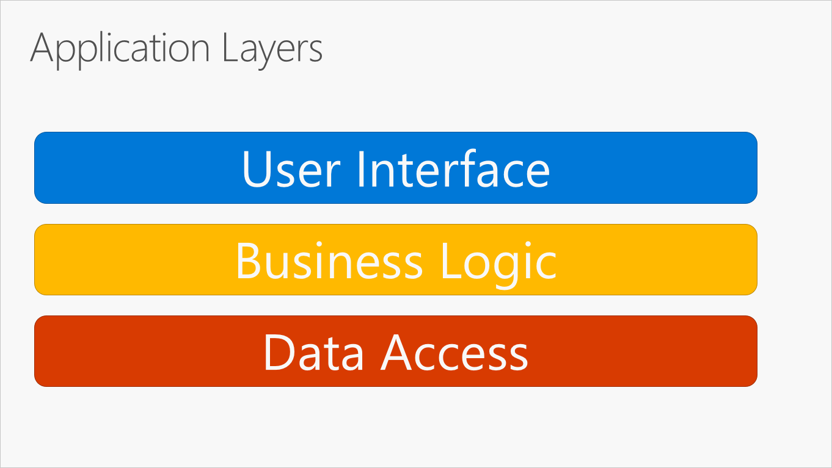
Application Layers
Application code is separated into “layers” by its responsibilities (separation of concerns)
Src: https://docs.microsoft.com/en-us/dotnet/standard/modern-web-apps-azure-architecture/common-web-application-architectures

Slide 58
Application Layers
Layers encapsulate functionality inside application
Layers communicate via interface
→ easier management and replacement
  e.g. MySQL storage replaced by MongoDb
→ easier testing
  e.g. replace real database access with mocks for unit tests

Slide 59

Application Layers – Clean Architecture
Different schema, same concept
Src: https://8thlight.com/blog/uncle-bob/2012/08/13/the-clean-architecture.html

Slide 60
Application Layers – Clean Architecture
Main rule: dependencies are always from the outside inwards
Src: https://8thlight.com/blog/uncle-bob/2012/08/13/the-clean-architecture.html

Slide 61
Application Layers – Clean Architecture
Entities: Generic rules shared across whole system
Src: https://8thlight.com/blog/uncle-bob/2012/08/13/the-clean-architecture.html

Slide 62
Application Layers – Clean Architecture
Use Cases: application-specific rules, control data flow to/from entities and invoke their functions
Src: https://8thlight.com/blog/uncle-bob/2012/08/13/the-clean-architecture.html

Slide 63
Application Layers – Clean Architecture
Interface adapters: convert data from entities/use cases into format for external systems – UI, web services, databases
Src: https://8thlight.com/blog/uncle-bob/2012/08/13/the-clean-architecture.html

Slide 64
Application Layers – Clean Architecture
Frameworks and drivers: external frameworks and tools, databases, etc. You only connect those to your system.
Src: https://8thlight.com/blog/uncle-bob/2012/08/13/the-clean-architecture.html

Slide 65
Application Layers – Clean Architecture
More layers as needed. The concept is what is important here!
Src: https://8thlight.com/blog/uncle-bob/2012/08/13/the-clean-architecture.html

Slide 66
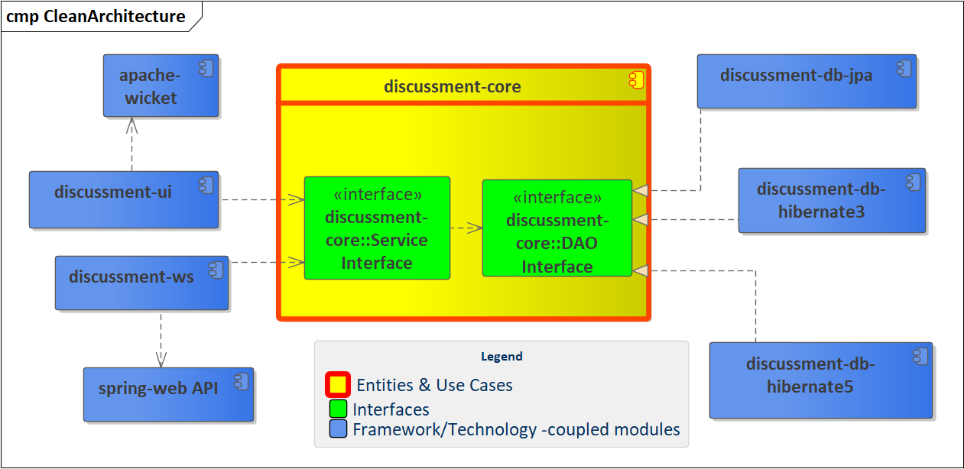
Application Layers – Clean Architecture (Example)

Slide 67
Application Layers – Clean Architecture
Simple Example: Discussment library
https://github.com/danekja/discussment
Important things to check:
  Inner references in core module (Service classes reference – depend on – the entities)
  Core module provides interfaces for DAOs (Dependency Inversion)
  Concrete DAO implementations depend on Core
  UI module depends on Core

Slide 68
Application Layers – Clean Architecture
Simple Example: Discussment library
Incomplete implementation of Clean Architecture:
entities and use-cases in single module
  -> database modules depend on logic implementation in use-cases
  better: separate module for entities and interfaces
    you always have to consider the extra costs
    quality packaging and separation of concerns allows for easy extraction into separate module later, if ever needed

Slide 69
Application Layers – Clean Architecture
Simple Example: Discussment library
Incomplete implementation of Clean Architecture:
UI and WebService modules have direct dependency on underlying technologies
  quite common in Java presentation-layers
  difficult to solve with the way frameworks have been designed
  opinion: does not really matter

Slide 70
Application Layers
Realization of separation of concerns principle and encapsulation on code level
Dependency paths go from upper/outer layers to lower/inner layers
  Commonly implemented via dependency inversion principle
Allows reuse of inner parts on multiple outer places
  e.g. application logic can be called from:
    Web UI
    Smartphone app via web services
    Test framework during unit tests

Slide 71
Application Layers
Common layers
  Presentation layer
  Application logic layer
  Data Access layer
Common cross-cutting concerns
  Security
  Transactions
  Logging

Slide 72
Data Layer
Responsibilities:
  HOW the data are stored (format)
    Relational schema, rules for documents in document databases, file format, etc.
  Mapping between internal application format (entities) and storage format (SQL, BSON)
  The actual READ/WRITE functionality

Slide 73
Business Layer
Responsibilities:
  Realize application functionality
  Change state of entities
  Trigger data storage access

Slide 74
Presentation Layer
Responsibilities:
  Accept input from user
  Call application functions
  Present result to user

Slide 75
Further reading
Robert C. Martin, Clean Architecture Overview
https://8thlight.com/blog/uncle-bob/2012/08/13/the-clean-architecture.html
Robert C. Martin, Clean Architecture, Prentice Hall; 1 edition (September 20, 2017), ISBN-13: 978-0134494166
(yep, the book)
Brian Foote, Joseph Yoder: Big Ball of Mud, Fourth Conference on Patterns Languages of Programs,PloP 97
http://www.laputan.org/mud/mud.html#BigBallOfMud
Alistair Cockburn, Hexagonal Architecture
https://web.archive.org/web/20180822100852/http://alistair.cockburn.us/Hexagonal+architecture
Jeffrey Palermo, Onion Architecture
https://jeffreypalermo.com/2008/07/the-onion-architecture-part-1/
ASP.NET Guide: Common Application Architectures
https://docs.microsoft.com/en-us/dotnet/standard/modern-web-apps-azure-architecture/common-web-application-architectures

Slide 76
Common Web Application Design Patterns

Slide 77
Common WebApp Design Patterns
The following sections discuss commonly used design patterns
Exact definitions of these patterns vary based on source, technology...
→ remember the principle of separating concerns
→ always consider the best approach to solving your goal
→ do not focus on following a pattern just for the sake of following a pattern

Slide 78
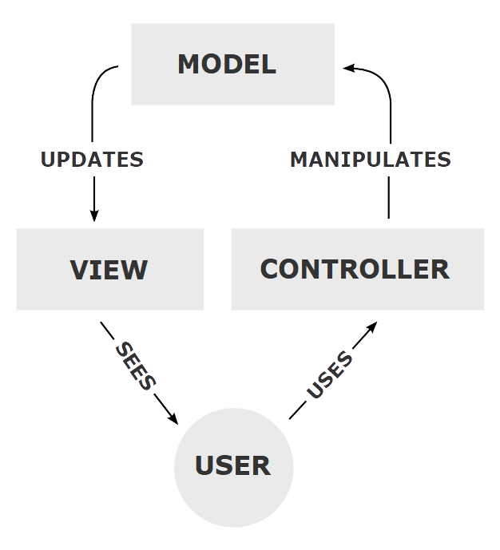
Model-View-Controller
Terminology
  Model – data and application logic
  View – displays data from model
  Controller – handles input events
Originally from Smalltalk-80 GUI
Many flavours in web applications
Img src: https://en.wikipedia.org/wiki/Model%E2%80%93view%E2%80%93controller

Slide 79
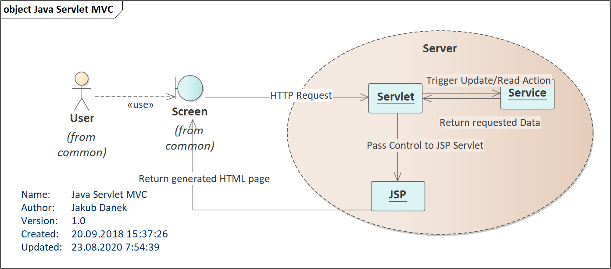
Model-View-Controller
Java JSP: whole MVC on the server

Slide 80
Model-View-Controller
Java JSP: whole MVC on the server
Differences to basic MVC schema:
  Model (services) do not directly inform view (JSP) about changes – controller does that
    Instead, new View is generated for each request in form of HTML page
    → notifications about Model change are not necessary
  JSP is the actual View, HTML page is its output
  Note: Both Controller and View are implemented as Servlets (remember what servlet container does with JSPs?)

Slide 81
Model-View-Controller
AJAX/SPA: Part/Full application in browser
Terminology: These terms are not limited to MVC!
  AJAX = Advanced JavaScript and XML
    Technology which allows updating html directly in browser without the need to get whole HTML page from the server
  SPA = Single Page Application
    Application which run fully in browser and view changes are handled by JavaScript manipulation of DOM (i.e. technically it is still only one HTML page)
    Data are received from the server, but HTML is generated in browser

Slide 82
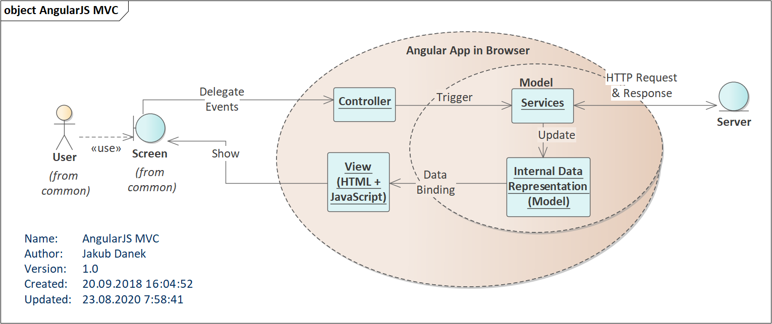
Model-View-Controller
AJAX/SPA: Part/Full application in browser

Slide 83
Model-View-Controller
AJAX/SPA: Part/Full application in browser
  Controller handles input events (link/button click, input changes) and delegates to model for action
  View observes the model data for change
  → when data change, view updates itself

Slide 84
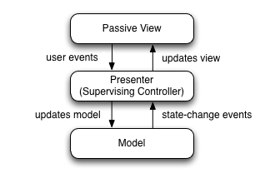
Model-View-Presenter
Breaks connection between Model and View
Presenter is a Controller which also serves as direct mediator between View and Model
Img src: https://en.wikipedia.org/wiki/Model%E2%80%93view%E2%80%93presenter

Slide 85
Model – View - Presenter
View consists of individual Widgets
  Widget can be a:
    Button
    Input field
    Set of input fields
    A form
Each Widget has own Presenter which handles its events and sets the data it shows

Slide 86
Model – View - Presenter
Presenters form a hierarchy:
  Page Presenter
    Menu presenter (handles View changes)
    Form Presenter (handles form submit actions)
      Input fields presenters
      Submit button presenters (handles e.g. when the button is enabled)
Presenter receives user input event, delegates to Model and then updates the View with result

Slide 87
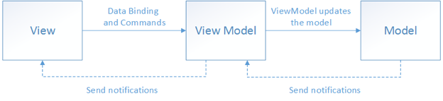
Model – View - ViewModel
Another way of breaking coupling between Model and View
Originally introduced by Microsoft for its ASP.NET/WPF frameworks
Img src: https://docs.microsoft.com/cs-cz/xamarin/xamarin-forms/enterprise-application-patterns/mvvm

Slide 88
Model – View - ViewModel
ViewModel provides
  Data for View
    Converts data from internal Model into format which is suitable for display
  Commands
    Reactions to user input – commands are mapped to button clicks, input changes etc.
Img src: https://docs.microsoft.com/cs-cz/xamarin/xamarin-forms/enterprise-application-patterns/mvvm

Slide 89
Model – View - ViewModel
Communication with View:
  Via DataBinding and Notifications – View is notified about data change in ViewModel via events and updates itself
Communication with Model
  ViewModel calls Model functions to trigger application logic
→ ViewModel forms both data and functional interface between View and Model
Img src: https://docs.microsoft.com/cs-cz/xamarin/xamarin-forms/enterprise-application-patterns/mvvm

Slide 90
Model – View - ViewModel
ViewModel is a way to realize Clean Architecture on presentation layer
  ViewModel itself can be technology independent
Img src: https://docs.microsoft.com/cs-cz/xamarin/xamarin-forms/enterprise-application-patterns/mvvm

Slide 91
Model – View - * Comparison
 | MVC | MVP | MVVM
User Input | Controller handles all user input and calls Model/changes View | Widgets pass user input to their respective presenter, which calls Model/changes View | Actions in View mapped to Commands in ViewModel. Commands call Model/trigger View change
View Updates | View observes the model and updates itself when notified | Presenter updates View when Model changes | View observes ViewModel data and updates itself when notified
View – Model communication | Yes, View observes Model | No | No

Slide 92
Model – View - Whatever
Many different opinions on exact definition of these patterns
Each application implements them in their own flavour
→ Do not worry about terminology too much
Important things to take away:
  Separate your presentation and application logic
  There are multiple paths for such separation
  Follow guidelines and best practices for your chosen technology as well as internal team rules
    → same structure everywhere → easier to navigate through new project

Slide 93
WebApp Design Patterns Sources
Mike Potel, MVP
http://www.wildcrest.com/Potel/Portfolio/mvp.pdf
Martin Fowler, GUI Architectures
https://martinfowler.com/eaaDev/uiArchs.html
Martin Fowler, Observer Synchronization
https://martinfowler.com/eaaDev/MediatedSynchronization.html
DrDobbs, MVC Paradigm in Smalltalk
http://www.drdobbs.com/tools/the-mvc-paradigm-in-smalltalkv/184408445
Microsoft MVVMhttps://docs.microsoft.com/cs-cz/xamarin/xamarin-forms/enterprise-application-patterns/mvvm

Slide 94
Cross-Cutting Concerns

Slide 95
Cross Cutting Concerns
Certain functionality is required on all layers
  Security – user authorization
    Presentation layer – to decide if user can see particular page/view
    Application layer – to decide if user can invoke particular action/read data
  Logging – technical, debug logs, audit logs
    Everywhere to log what the application/user are doing
  Transactions
    Application and Data layer to ensure atomicity of actions – we will talk more about this in the persistence lecture

Slide 96
Cross Cutting Concerns
Certain functionality is required on all layers
  naive implementation introduces dependencies into all layers
    expensive to change
    Clutters implementation with unrelated code
    Difficult to test

Slide 97
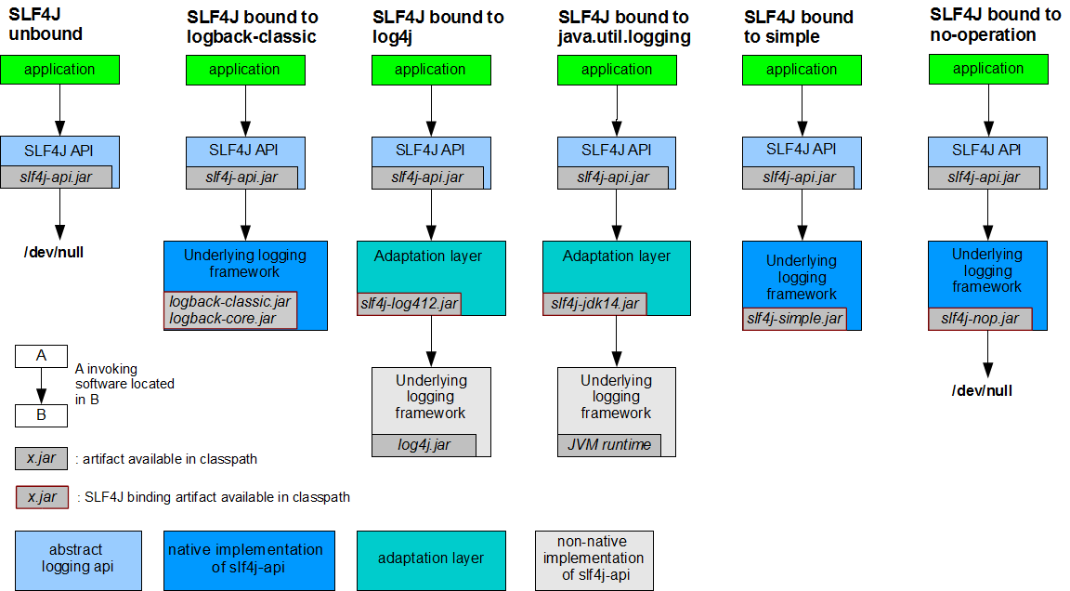
Cross Cutting Concerns
Approach 1 – API dependency and configuration
Src: https://www.slf4j.org/manual.html

Slide 98
Cross Cutting Concerns
Approach 1 – API dependency and configuration
  Commonly used with logging facades
  Application depends on interface, not implementation
  Allows to call logging API at any place of your code
  Changing logger implementation requires only:
    Replace logger implementation library
    Provide new configuration
  Actual application code does not need to change

Slide 99
Cross Cutting Concerns
Approach 2 – Aspect-Oriented Programming (AOP)
What is an Aspect?
  A module (typically a class) that contains code which would be otherwise called/duplicated among multiple classes
  Technologies implementing AOP ensure that the Aspect code is executed when particular method is called (and other conditions apply)
    e.g. logging aspect could for each method call of any class in our application’s business layer log: timestamp, user, method and class name, input parameters
    e.g. security aspect could check that all methods from our business layer are called only if user has been authenticated

Slide 100
Cross Cutting Concerns – AOP Example
//no aspect
Class UserManager {
AuthenticationManager auth;
User addRoleToUser(User user, Role role) {
//throws unauthorized exception on fail
auth.checkCurrentUserHasRole(Roles.ADMIN);
        //attach role to user, save etc
        ...
}
}

Slide 101
Cross Cutting Concerns – AOP Example
//with aspect
Class UserManager {
User addRoleToUser(User user,
Role role) {
    //attach role to user, save etc
      ...
}
}
//with aspect
@Aspect
Class AuthAspect {
  AuthenticationManager auth;
  @Before("execution(* UserManager.add*(..))")
public void doAdminCheck() {
auth.checkCurrentUserHasRole(Roles.ADMIN)
}
}

Slide 102
Cross Cutting Concerns - AOP
Terminology:
  Join Point – place of program execution at which the cross-cutting code is run
    Commonly is a method execution (but not exclusively)
      This course focuses on method execution only
  Pointcut – predicate expressing whether action should be executed at certain join point
    e.g. execution(* UserManager.add*(..))

Slide 103
Cross Cutting Concerns - AOP
Terminology:
  Advice – action taken by aspect – joins pointcuts and the actual code to be executed
    e.g. @Before("execution(* UserManager.add*(..))")
    public void doAdminCheck(){…}
  Types of Advices
    The aspect code can be executed at several places in respect to the particular join point:
      Before
      After
        After returning (with the return value)
        After throwing (with the exception thrown by the method)
      Around (meaning part of aspect code is executed before and part is executed after the actual join point)

Slide 104
Cross Cutting Concerns - AOP
Terminology:
  Weaving – process of linking aspects to the advised code
  Types of Weaving
    Compile time
    Load time
    Runtime

Slide 105
Cross Cutting Concerns - AOP
Compile-time weaving
  Accomplished by custom compiler
    Analyses code, searches for aspects and pointcuts
    Creates modified version of classes which contain the relevant code
  Issues:
    Custom compiler required
    Debugging tools might have issues with mapping program execution to source code

Slide 106
Cross Cutting Concerns - AOP
Load-time weaving
  Accomplished by custom class loader
    Analyses binaries, searches for aspects and pointcuts
    Creates and loads modified version of classes which contain the relevant code
  Issues:
    Custom class loader required
    Debugging tools might have issues with mapping program execution to source code

Slide 107
Cross Cutting Concerns - AOP
Run-time weaving
  Accomplished by creating proxies of the classes by subclassing
    References to proxies are used instead of the actual objects
    Proxies contain the aspect’s code and invoke the original methods
  Pros:
    The original classes remain intact at runtime
  Issues:
    Bigger memory footprint due to creating subclasses and their instances
    It is difficult/impossible to use pointcuts pointing at private methods

Slide 108
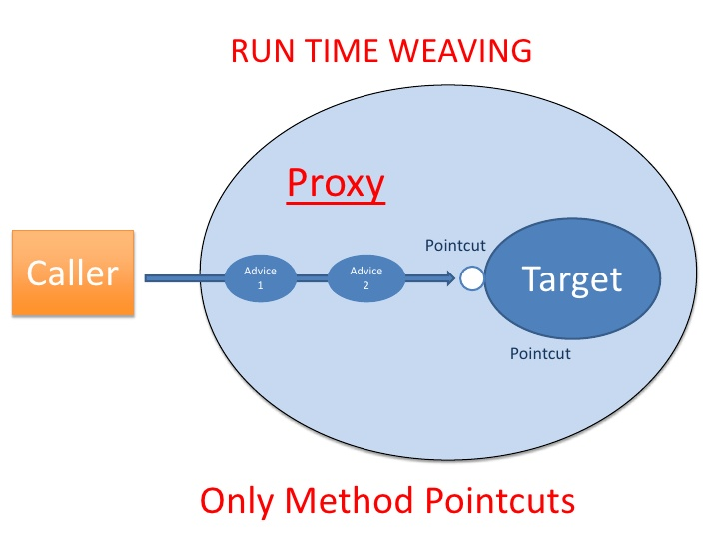
Cross Cutting Concerns - AOP
Src: https://www.slideshare.net/rohitsghatol/aspect-oriented-prog-with-aspectj-spring-aop/40

Slide 109
Cross Cutting Concerns – Sources & Reading
https://docs.jboss.org/aop/1.1/aspect-framework/userguide/en/html_single/index.html
http://www.eclipse.org/aspectj/doc/released/progguide/starting-aspectj.html
https://docs.spring.io/spring/docs/5.0.9.RELEASE/spring-framework-reference/core.html#aop
https://www.slideshare.net/rohitsghatol/aspect-oriented-prog-with-aspectj-spring-aop

