Slide 1

Financial Indicators of US Stocks Multiple Machine Learning Analysis
Team Members
Allen Wong
Christine Guo
LaNaya Johnson
Michael Danenberg
Executive summary
The aim of our project is to see if financial indicators that are present in 10-K
filings of public companies can be used to predict the stock performance at
the end of the year. We will compare the results using different machine learning
models and techniques.
Datasets to Be Used
- 200+ Financial Indicators of US stocks from kaggle.com

Slide 2
Dataset
Features data: contains over 200 financial indicators that are present in the 10-K filings of public companies
Target data: contains a 2019 PRICE VAR [%] that gives the percent price variation for the year
Target data: also contains a Class column which is 1 if price variation is positive for the year
Precision vs. Recall
Because we are predicting stock prices, precision will be more important than recall because the cost of acting is high, but the cost of not acting is low.
Data Cleaning
Dealing with rows and columns with too many NaNs or zeros
SimpleImputer or IterativeImputer to fill in missing values
Dropping redundant columns
Scaling data by using StandardScaler or MinMaxScaler

Slide 3
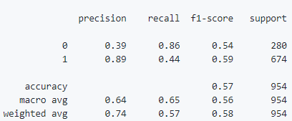
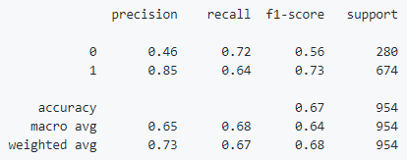
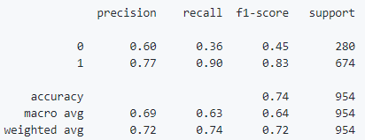
Results and Conclusions
Deep Neural Network classification model
SVM SVC model
AutoGluon model

Slide 4
Next Steps
Establish a threshold where we would ignore the small positives in order to focus on capturing the values with a higher margin
Add information such as periods of inflation, global economy, as well as unemployment levels etc. in order to paint a more accurate picture
Look into tensorflow layers programmatically to find an optimal model
Spend more time with correlated columns and eliminate highly correlated columns to reduce redundancy
Put additional work on regression models
Backtest our models using data from other years

