Slide 1
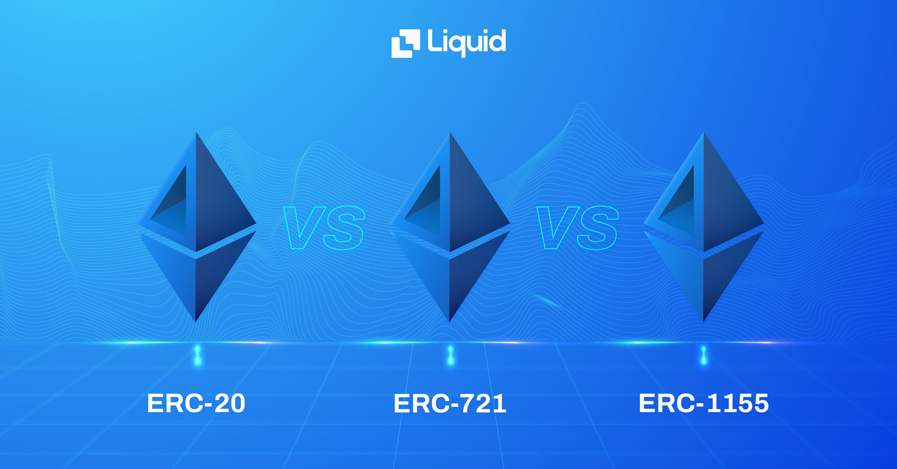
“The ERC-1155 token can do the same functions as an ERC-20 and ERC-721 token, and even both at the same time. And best of all, improving the functionality of both standards, making it more efficient, and correcting obvious implementation errors on the ERC-20 and ERC-721 standards.”
“The ERC-20 introduces a standard for Fungible Tokens, in other words, they have a property that makes each Token be exactly the same (in type and value) of another Token.”
“The ERC-721 introduces a standard for NFT, in other words, this type of Token is unique and can have different value than another Token from the same Smart Contract, maybe due to its age, rarity or even something else like its visual. Wait, visual?”

Slide 2
