Slide 1
PROJECT PROPOSAL · 2026
Hierarchical Latent
Reasoning Architecture
A model that thinks in latent thoughts — chunk-level vectors deliberated by a
recurrent loop, then decoded to language by a separate module.
JEPA-Reasoner
HRM-Text
Thought Gestalt
Parcae
Composing four architectures whose problems compose — into one that thinks before it speaks.

Slide 2
THE PROBLEM
Today's LLMs reason in the same tokens they speak
One representation is forced to do two incompatible jobs — and the coupling has three costs.
Compounding fragility
Reasoning tangled with expression
No self / input boundary
Autoregression conditions on its own sampled output. One wrong token pollutes the context and corrupts every step of reasoning that follows.
The act of thinking and the act of wording it share the same weights and states — the model cannot deliberate without committing to surface tokens.
Nothing structurally separates “the user asserted X” from “I concluded X.” They collapse into one latent — the exact substrate sycophancy exploits.
The goal: decouple reasoning from expression, make deliberation a real compute dial, and give the model a place to hold a belief that isn't just the user's.
The Problem
02 / 11

Slide 3
LITERATURE REVIEW
Four papers, four different fixes — none combines them
JEPA-Reasoner
HRM-Text
Reasons in latent space; a separate Talker head reads latents out to tokens.
Dual-timescale recurrence: a fast L-module refines locally, a slow H-module holds context.
→ Ablation: the Talker is a pure readout — useless without good latents.
→ Looping beats width, FLOP-for-FLOP — depth as a compute source.
Thought Gestalt
Parcae
Generates one sentence at a time, cross-attending to a memory of prior sentence vectors.
Stabilizes looped transformers by constraining the spectral norm of the loop's injection.
→ Gradient flows back through memory — fixes reversal-curse gaps.
→ Test-time looping scales as a predictable, saturating exponential.
The gap. Each paper fixes one failure in isolation. No prior work composes them — and naively combining latent SSL, un-detached memory, and a looped recurrence creates new interaction failures that none of the source papers ever had to face.
Literature Review
03 / 11

Slide 4
PROPOSED SOLUTION
The full pipeline: two lanes, one thought loop
Input enters read-only — only the thought loop writes self-state. Each finished thought is remembered, then spoken.
INPUT LANE
CHUNK ENCODER
read-only · two-tier context
SaT-Capped chunker → chunk cₜ → 192-d thought latent
Raw tokens
INNER HRM LOOP · SELF LANE
current turn · full fidelity
cross-attend · read-only
L
L
L
H
Input-lane encoder
fast L ×3 → slow H ×1 · Parcae-stable · adaptive depth · writes self-state
bidirectional
write thought zₜ (SELF)
Aged gestalts
recall · aged gestalts
GESTALT MEMORY — one store
prior turns · compressed
FIFO · role-tagged · ungated gradient · O(1) recall
z1
z2
z3
…
SELF = this loop's thoughts USER/SYSTEM = aged input
The same gestalt memory's USER/SYSTEM slots, recalled — not a second store.
raw tokens · exact quotes
TALKER → output tokens
Role tags USER·SELF·SYSTEM · never writes self-state
autoregressive · sampling noise can't leak back into reasoning
generation flow · writes self-state
read-only cross-attention / recall
Proposed Solution · Pipeline
04 / 11

Slide 5
TRAINING
Two losses, staged so nothing collapses
No component can be trained from a random init — each mechanism needs the previous one stable, so training walks a curriculum.
ONE SHARED ENCODER, TWO LOSSES
THE CURRICULUM — STAGES A → F
Nothing trains from a random init — each stage's stability unlocks the next.
chunk cₜ
Ground the Talker
latent → decodable text
A
SHARED CHUNK ENCODER
B
Inner HRM loop
fixed depth · detached mem
C
Un-detach memory
grad reaches past thoughts
HRM loop
→ Talker → NLL
SSL proj head
→ cos vs EMA(cₜ₊₁)
D
Self-supervised loss
JEPA cos vs EMA target
RECONSTRUCTION
decode the same chunk
SELF-SUPERVISED
predict the next chunk
E
Adaptive depth (ACT)
halting · compute dial
always-on anchor
secondary · 0.1× · EMA 0.996
F
Chatbot fine-tune
two-lane · role tags
Credit assignment: truncated BPTT warms up 2 → 5 steps (inner loop, then memory).
Training
05 / 11

Slide 6
PROPOSED SOLUTION
What this does differently, in plain language
01
Deliberate, then decode
Each thought is a bounded recurrent “think” — not one forward pass. Sampling noise from the Talker can never leak back into reasoning.
02
Compute becomes a dial
Adaptive halting spends more loop iterations on hard thoughts, fewer on filler. Parcae's constraint makes more looping predictably help, not add noise.
03
Context at O(1), not O(n)
Prior thoughts persist in a fixed-size gestalt memory that gradients still reach — long-range recall without a growing KV-cache.
04
A self / input boundary
Two lanes: user input can only be attended to; the reasoning loop alone writes self-state. The model can hold a belief distinct from the user's.
Proposed Solution
06 / 11

Slide 7
PRELIMINARY FINDINGS
A working end-to-end prototype — and one sharp result
A from-scratch reference implementation runs the full A→F curriculum on real text and generates decodable output. Building it surfaced a real, non-obvious pathology.
BEFORE → AFTER THE FIX
The SSL-collapse pathology
Validation loss, D/E
Sharing one chunk encoder between the reconstruction loss and the self-supervised latent loss collapses the latent: the encoder emits a near-constant vector for every chunk (cosine → 0.996), perfectly satisfying SSL while carrying no information.
8.26
→
~7.8
regressed
held flat
Latent representation
Why it's dangerous
cos 0.996
→
std ~0.25
Silent — SSL→0 looks exactly like success
collapsed
healthy
Propagating — a shared encoder spreads the damage
Reconstruction ppl
Absorbing — the EMA target is a stable dead end
~3360
→
~3136
broken run
fixed run
The fix: reconstruction is the always-on anchor; SSL demoted to its own head + variance floor + a collapse monitor.
Preliminary Findings
07 / 11

Slide 8
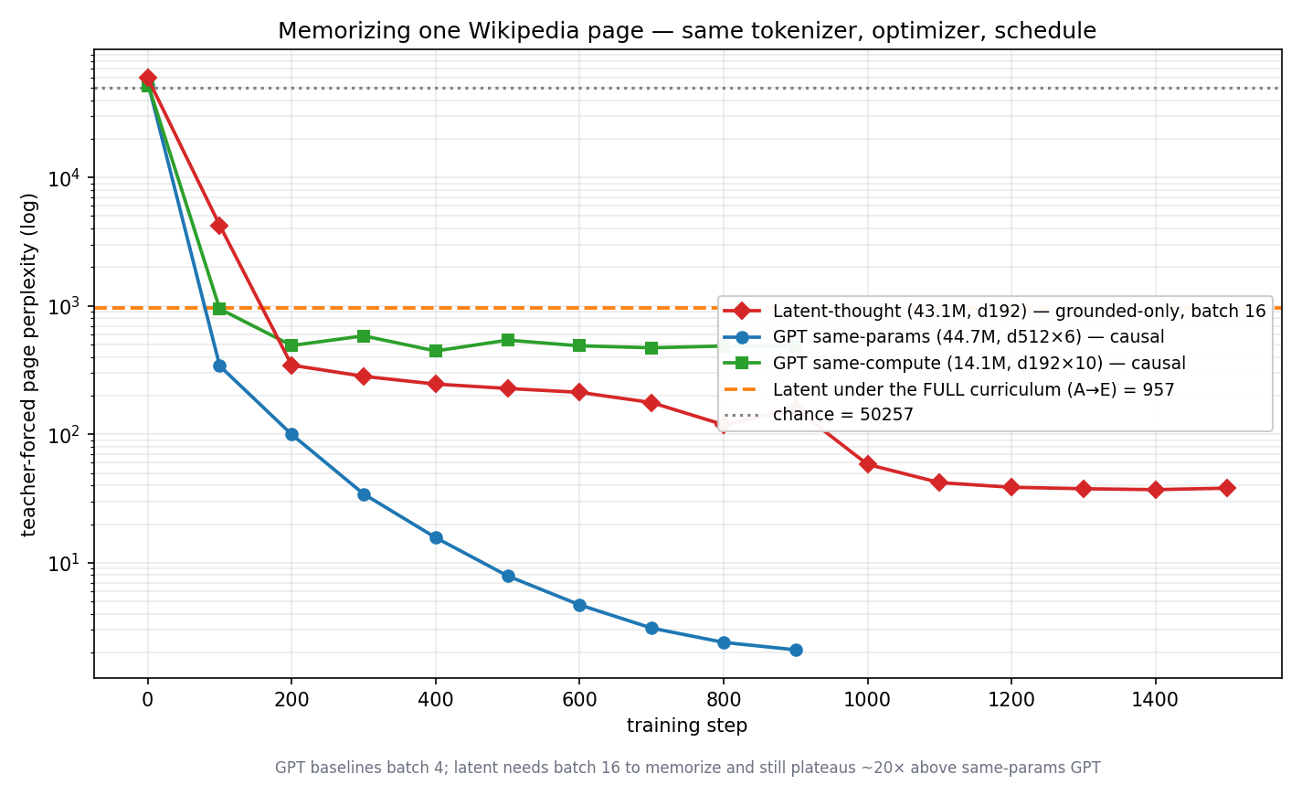
BASELINE COMPARISON
Ahead of a width-matched GPT, behind a param-matched one
Memorizing one Wikipedia page — same gpt2 tokenizer, optimizer & schedule (the latent needs 4× the batch to memorize); only the architecture differs.
WHAT IT SHOWS
Beats the width-matched GPT
The 14.1M same-compute GPT (d=192) plateaus at ≈ 487; the latent, same width, memorizes to ≈ 38.
A param-matched GPT is more efficient
The 44.7M same-params GPT reaches ≈ 2; the latent floors at ≈ 38 — the 192-d thought bottleneck caps exact reconstruction — and only at 4× the batch.
The SSL cost is visible
Under the full A→E curriculum the latent model sits at ≈ 957: self-supervision trades page-fit for generalization.
Chance ≈ 50,257. One-page memorization isn't the goal — the payoff shows only at scale.
Baseline Comparison
08 / 11

Slide 9
SUCCESS METRICS
Three signals decide whether it works
1
2
3
DECODABILITY
REPRESENTATION HEALTH
COMPUTE SCALING
Reconstruction
perplexity
latent_std
collapse monitor
Loss vs. loop
iterations
Can the Talker faithfully rebuild a chunk from its latent? The anchor metric — it cannot be gamed by a degenerate latent.
Per-dimension latent variance, logged every eval. Must stay above the floor — the tripwire that would catch any SSL collapse early.
Does more test-time looping help along Parcae's predictable, saturating curve? Confirms depth is a real, monotone compute dial.
Success Metrics
09 / 11

Slide 10
PLAN
Curriculum milestones, then risks
The architecture can't be trained from a random init — each mechanism needs the previous one stable. That staging is the roadmap.
Stages A–D verified on real text (≈1.5M tokens) · E–F wired but not yet scaled → next: a GPU shakedown before the first large run
A
B
C
D
E
F
Ground the Talker
Inner HRM loop
Un-detach memory
Add SSL loss
Adaptive depth
Chatbot fine-tune
latent → text
fixed depth
cross-thought grad
collapse fix here
ACT halting
two-lane / roles
TOP RISKS & MITIGATIONS
SSL collapse returns at scale
No large run has been done
Risk Hyperparameters were tuned on a 1.5M-token smoke run.
Risk Everything is verified at smoke/offline scale; a global LR cosine starves late stages.
Mitigation Reconstruction stays the always-on anchor; separate SSL head + variance floor + latent_std monitor catch any recurrence early.
Mitigation Per-stage warmup→cosine schedule; short GPU shakedown to confirm throughput and health before committing to a long run.
Plan
10 / 11

Slide 11
SUMMARY
Think first.
Speak second.
One architecture that separates reasoning from expression, turns deliberation into a tunable compute dial, and keeps a self / input boundary — with a working prototype and a de-risked path to scale.
Hierarchical Latent Reasoning Architecture · Project Proposal

