Slide 1
SECURE INTERNET RELAY CHAT

Slide 2
What is it
Secure Internet Relay Chat is a multiplatform application for secure and anonymous communication
Support for instant text messaging and file transfer

Slide 3
Security is our top priority
We use AES₂₅₆ symetric cryptography for client communication over the network
RSA with key length 2048 for distribution of symetric keys and communication with server

Slide 4
Anonymity
Without registration
You can be anyone
Leaves no traces after you disconnect

Slide 5
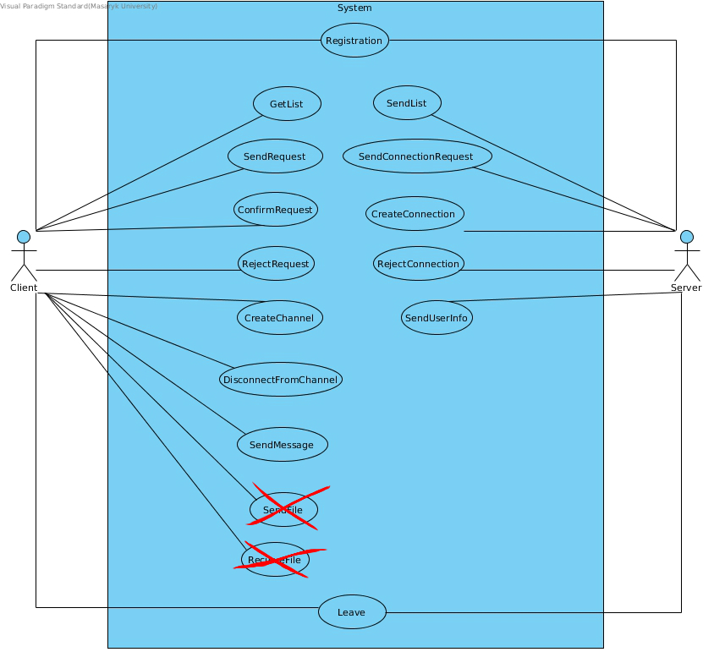

Slide 6
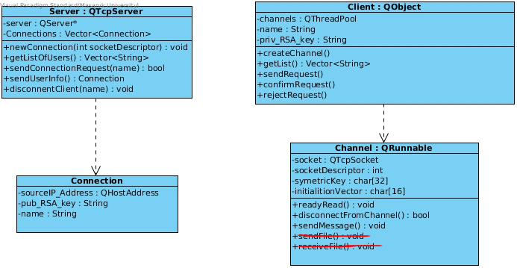

Slide 7


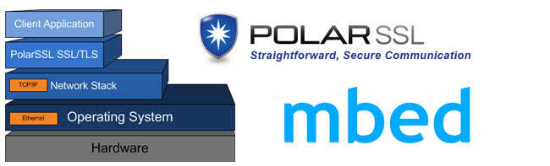
Used Technologies

