Slide 1
پروژه سیستم نهفته
موضوع: ردیاب هوشمند خودرو
دانشجو: هلنا دانش
بهار 1404

Slide 2
Target
To design a low-cost, low-power smart car GPS that detects accidents and can be used to send SOS messages in case of danger.

Slide 3
Specification
Features:
- Real-time GPS tracking
- Emergency SOS alert via button
- Automatic accident detection via accelerometer
- SMS notification using GSM

Slide 4
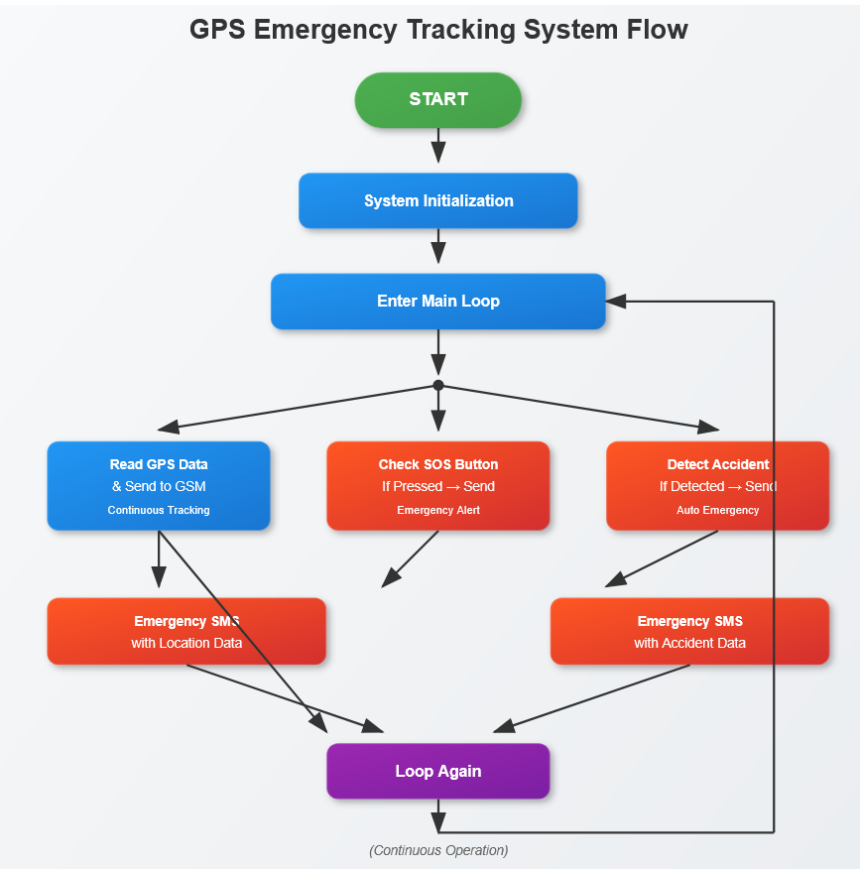
Algorithm

Slide 5
Hardware Components:
Microcontroller: ATmega328P
GPS Module: NEO-6M
GSM Module: SIM800L
Accelerometer: ADXL345 (I2C)
Power: 18650 Battery + TP4056 +AMS1117 + MT6308
Communication: UART, I2C

Slide 6
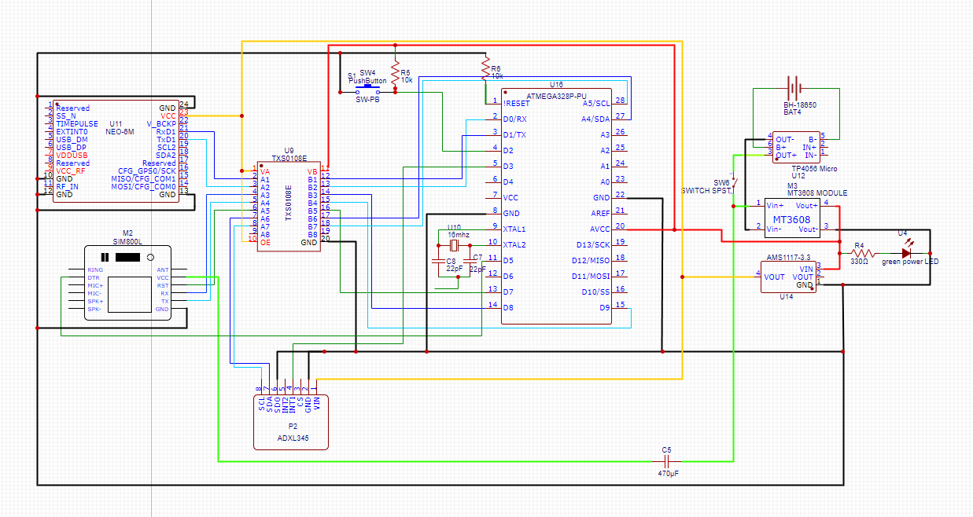
Schematic

Slide 7
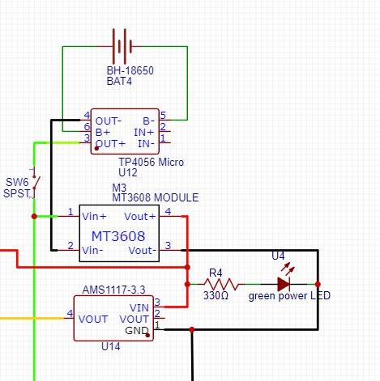
Power
Use TP4056 for charging Battery
Connect battery outputs to MT3608 to boos voltage from 3.7V to 5V
Use AMS1117 to get 3.3V for components
An LED that indicates circuit is ON.
A SPST Switch for turning device On/Off

Slide 8
Connection Protocols
GPS and GSM modules uses UART protocol for connection, so we connect RT, RX pins together.
ADXL345 uses I2C protocol, we need to connect SDA and SCL pins.

Slide 9
Components Voltages
AtMega328 : 5V (From Voltage booster)
GPS (NEO6-M): 3.3V (From AMS1117)
GSM (SIM800L) : 3.7 V (From Battery)
ADXL345: 3.3V (From AMsS1117)
Because they use different voltages to communicate, we need to use level shifter (TXS0108E) for connecting them together

Slide 10
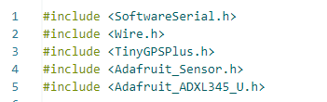
Software
Used Libraries:
SoftwareSerial for GSM and GPS
TinyGPS++ for parsing NMEA
Adafruit ADXL library for acceleration

Slide 11
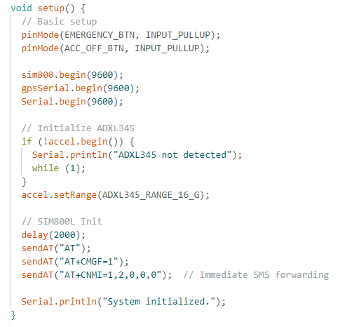
Software functions
Boot components
Send test signals, to make sure.

Slide 12
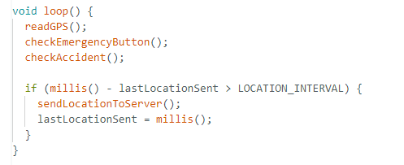
Loop:
Read GPS to get location
Check if SOS button is pressed.
Check if Accident accrued.
Send location to server.

Slide 13
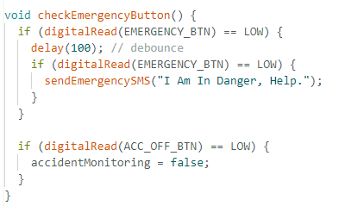
SOS Button:
If button is pressed, send a help message to predefined contacts.

Slide 14
Faced Challenges
Voltage Compatibility: Ensuring proper voltage alignment between the battery and various components to avoid instability or damage.
Data Synchronization: Managing reliable data communication between multiple modules (GPS, GSM, accelerometer) over UART and I2C protocols.
Power Efficiency: Selecting components with low power consumption to optimize battery life and ensure long-term operation.

Slide 15
Thank You

