Slide 1
pizza_bot
Link to github Repository: GitHub
Links to trello board / project management tools: Trello Board
You MUST provide evidence showing how the problem has been decomposed, how the components have been developed and trialled, and of how they have been assembled and tested to create a final, working outcome.

Slide 2
Relevant Implications
Explain the relevant implications here. Please watch this video to learn how to do this.
Notes:
Explain the relevant implications here. Then as you work, develop your code, discuss how the implications are being met.

Slide 3
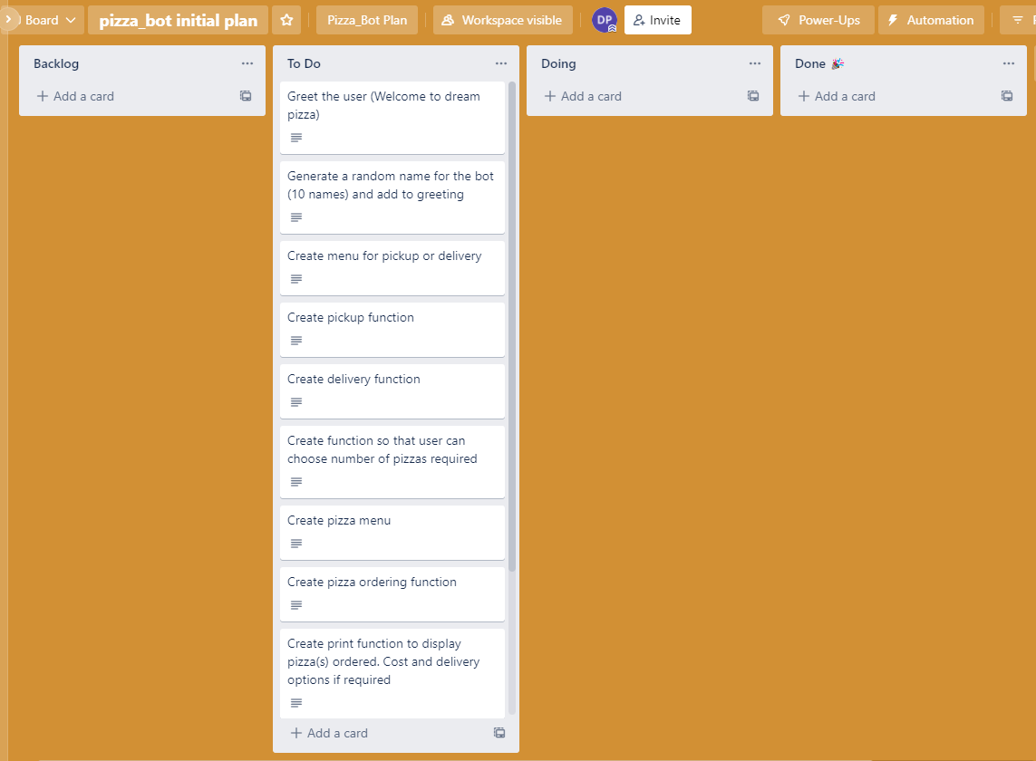

Decomposition
Notes:
Paste screenshots of your initial Trello board / task decomposition on this slide. If you have a long list, you might need to break it up into several columns. Delete this instruction when you are done.

Slide 4
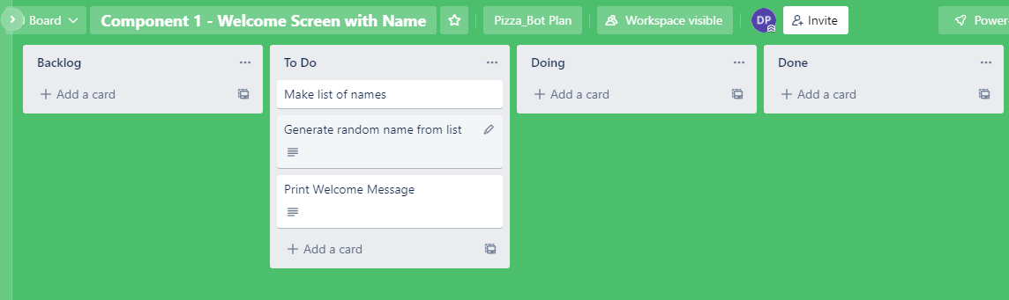
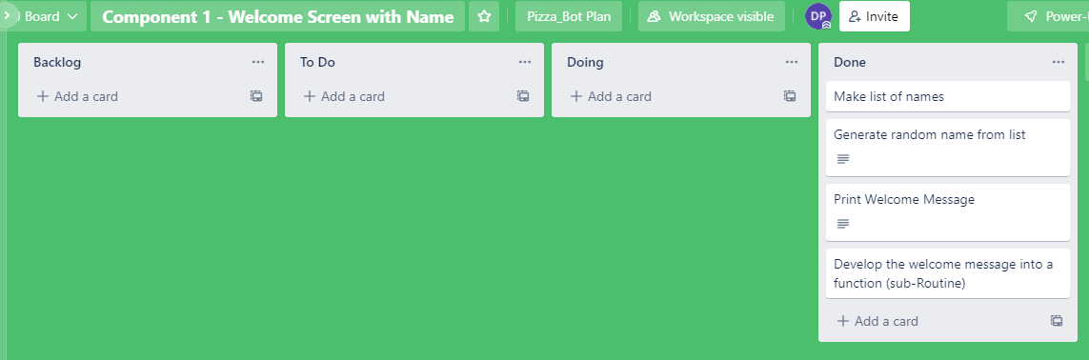
Component 1 (Trello screenshot) version 1 version 2

Slide 5
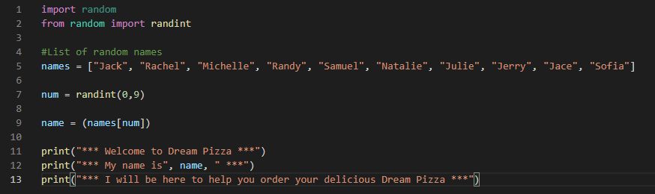

Component 1 - Test Plan (and screenshot)
Test Case | Expected Values
Run program | Print Welcome message with random name from list of names – runs correctly

Slide 6
Component 1 version 2 - Test Plan (and screenshot)
Test Case | Expected Values
Run program | Main and welcome run correctly. Welcome message prints with random name

Slide 7
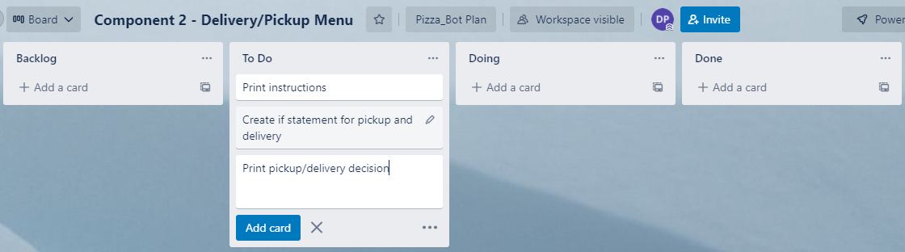
Component 2 (Trello screenshot)

Slide 8
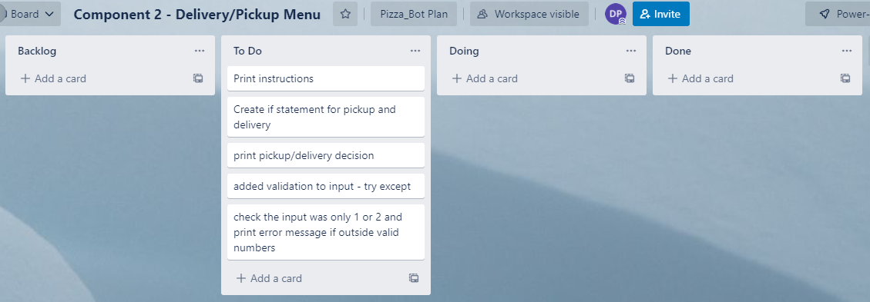
Component 2 Version 2 (Trello screenshot)

Slide 9
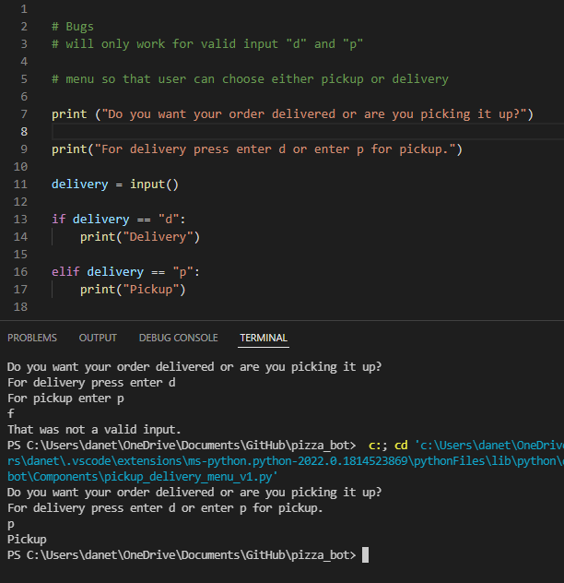
Component 2 version 1 - Test Plan (and screenshot)
Test Case | Expected Values
Run program | Enter p program prints pickup Enter d program prints delivery Enter invalid program stops

Slide 10
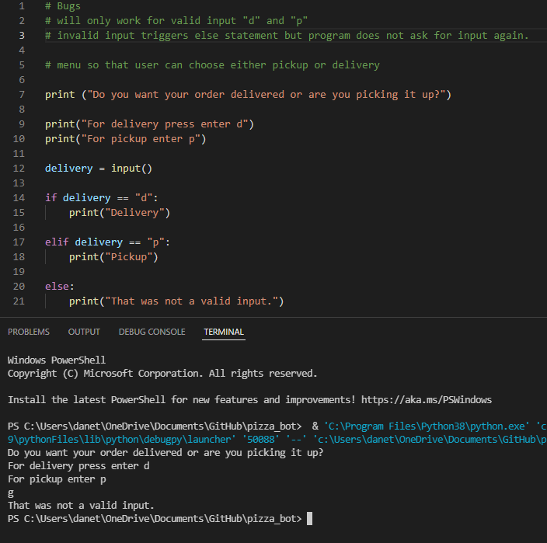
Component 2 version 2 - Test Plan (and screenshot)
Test Case | Expected Values
Run program | Enter p program prints pickup Enter d program prints delivery Enter invalid prints error message

Slide 11
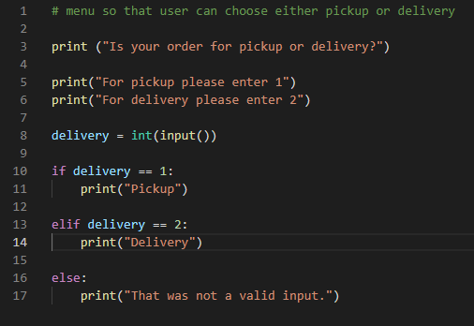
Component 2 version 3 - Test Plan (and screenshot)
Test Case | Expected Values
Run program | Enter 1 program prints pickup Enter 2 program prints delivery Enter invalid program displays value error

Slide 12
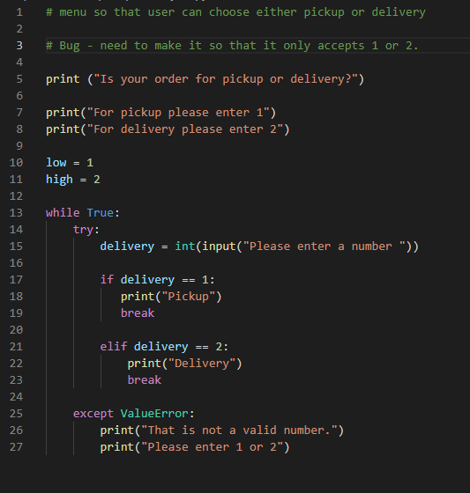
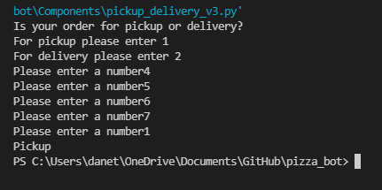
Component 2 version 4 - Test Plan (and screenshot)
Test Case | Expected Values
Run program | Enter 1 program prints pickup. Enter 2 program prints delivery. Enter invalid prints error message. Enter no. other than 1 or 2 does not work

Slide 13
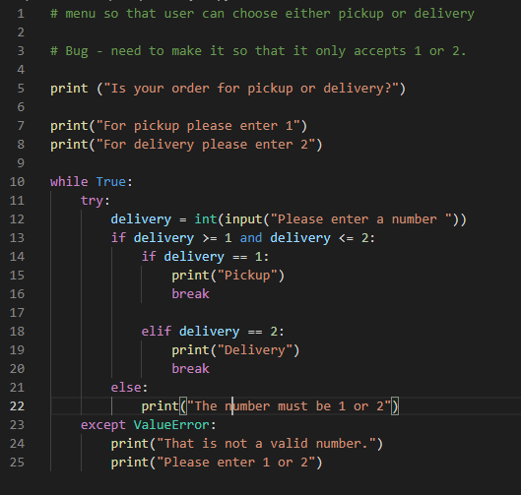
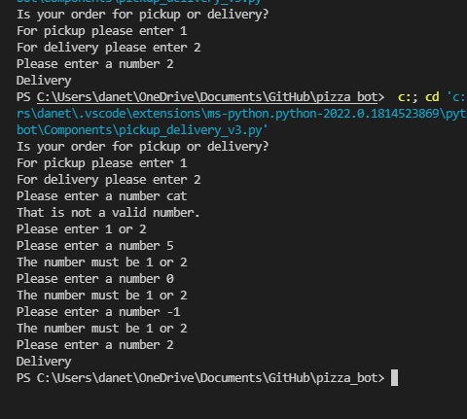
Component 2 version 5 - Test Plan (and screenshot)
Test Case | Expected Values
Run program | Enter 1 program prints pickup. Enter 2 program prints delivery. Enter invalid entry - error message asks for input again. Enter no. other than 1 or 2 – error messages asks for entry again

Slide 14
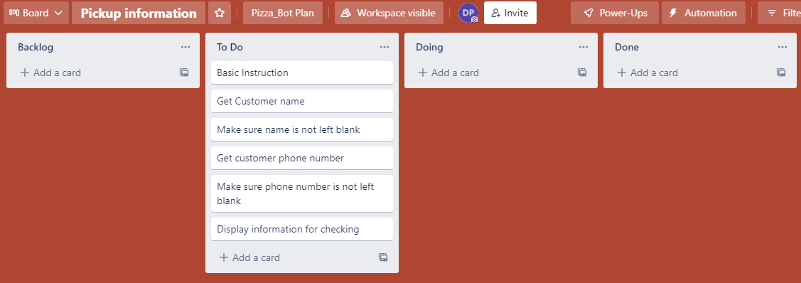
Component 3 Pick up info (Trello screenshot)

Slide 15
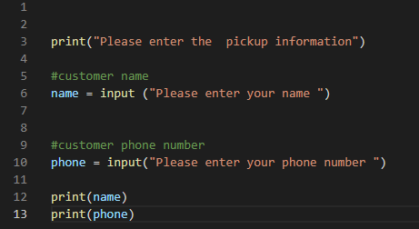
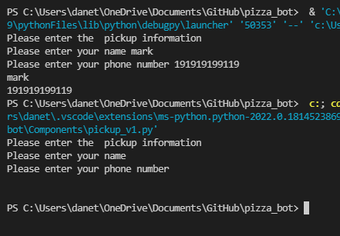
Component 3 v1 - Test Plan (and screenshot)
Test Case | Expected Values
Input name Input phone number Left input blank | Printed name correctly Printed phone number correctly Accept blank and printed blank input

Slide 16
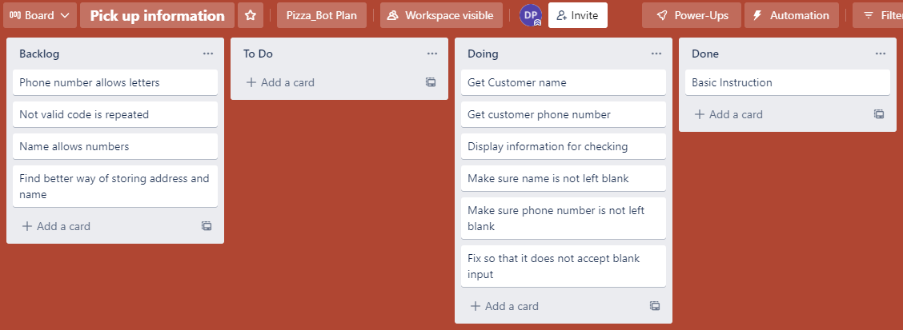
Component 3 Pick up info v2 (Trello screenshot)

Slide 17
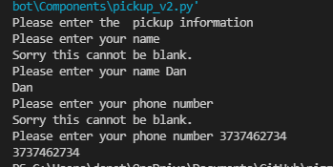
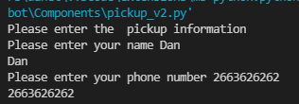
Component 3 v2 - Test Plan (and screenshot)
Test Case | Expected Values
Input name Input phone number Left input blank | Printed name correctly Printed phone number correctly Prints “Sorry this cannot be blank” – goes back to input

Slide 18
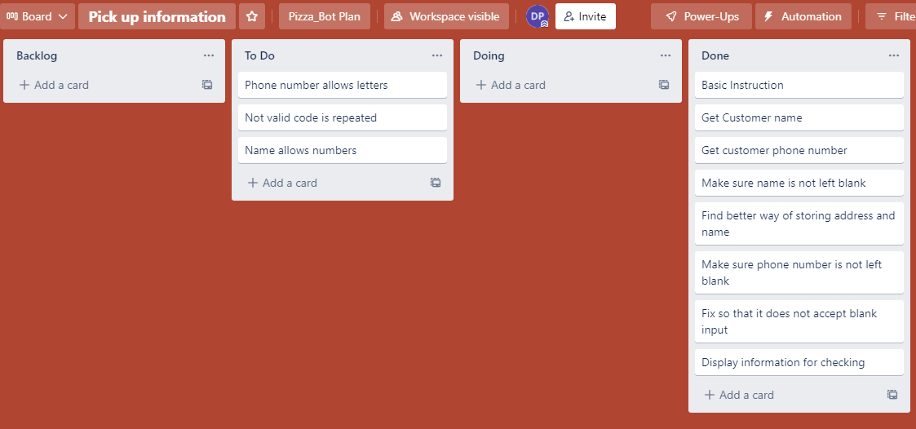
Component 3 Pick up info v3 (Trello screenshot)

Slide 19
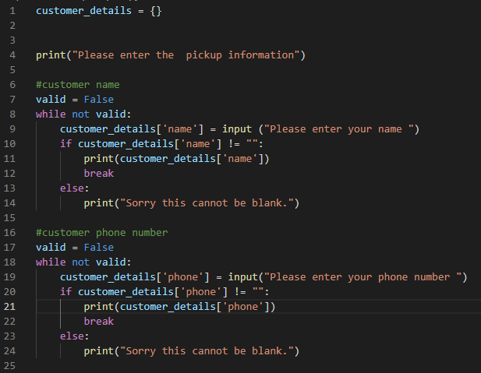
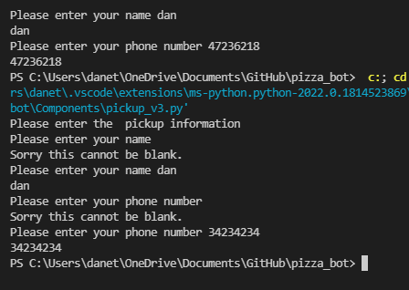
Component 3 v3 - Test Plan (and screenshot)
Test Case | Expected Values
Input name Input phone number Left input blank | Printed name correctly Printed phone number correctly Prints “Sorry this cannot be blank” – goes back to input

Slide 20
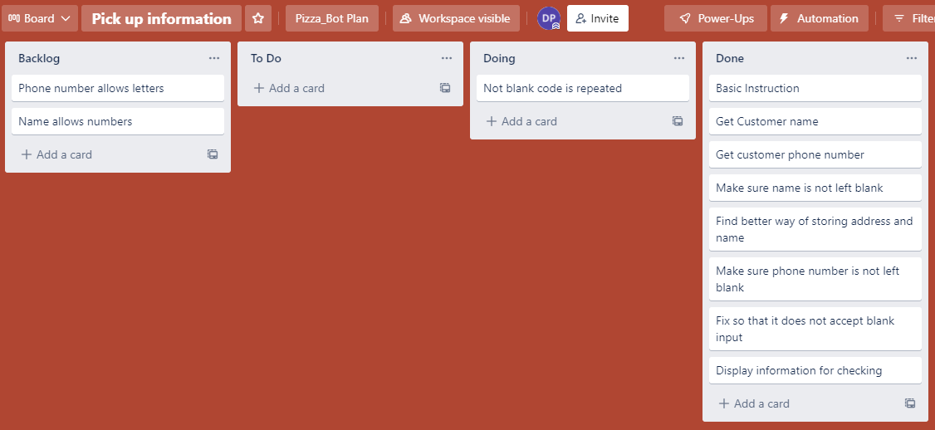
Component 3 Pick up info v4 (Trello screenshot)

Slide 21
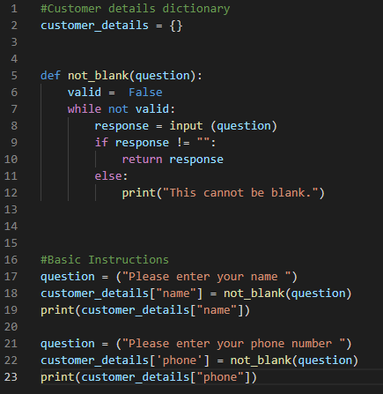
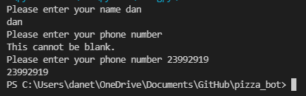
Component 3 v4 - Test Plan (and screenshot)
Test Case | Expected Values
Input name Input phone number Left input blank | Printed name correctly Printed phone number correctly Prints “Sorry this cannot be blank” – goes back to input

Slide 22
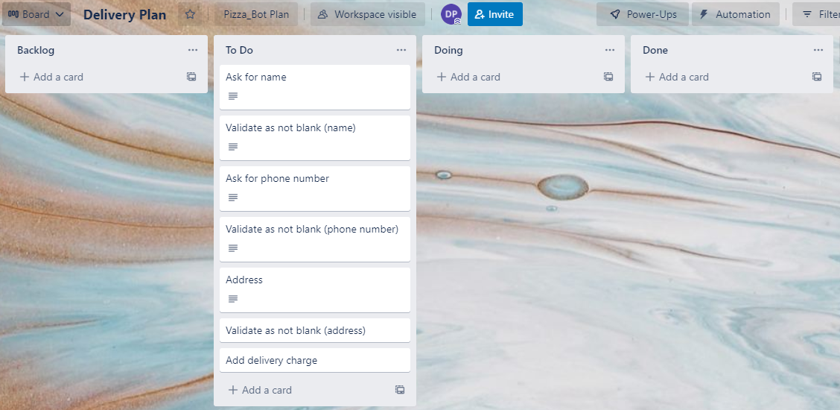
Component 4 Delivery info (Trello screenshot)

Slide 23
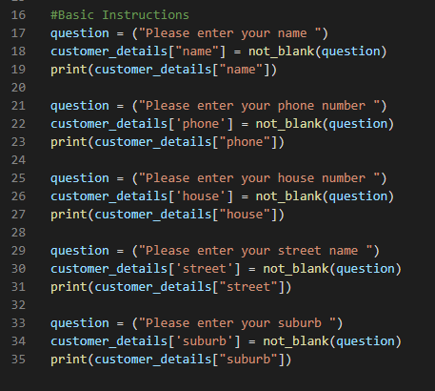
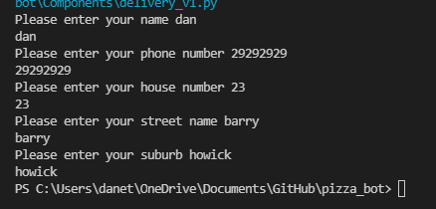
Component 4 v1 - Test Plan (and screenshot)
Test Case | Expected Values
Input name Input phone number Input house number Street name Suburb name Left input blank | Printed name correctly Printed phone number correctly Accept blank and printed blank input Printed street name Printed suburb name Asked for input again

Slide 24
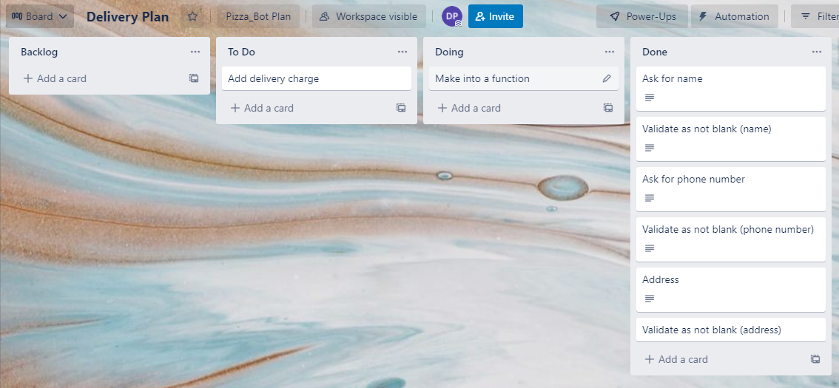
Component 4 Delivery info version 2

Slide 25
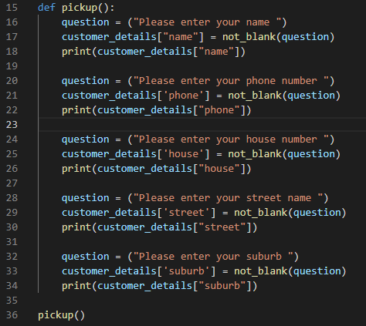
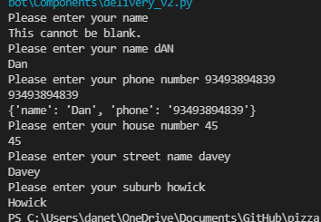
Component 4 v2 - Test Plan (and screenshot)
Test Case | Expected Values
Input name Input phone number Input house number Street name Suburb name Left input blank | Printed name correctly Printed phone number correctly Printed house number Printed street name Printed suburb name Asked for input again

Slide 26
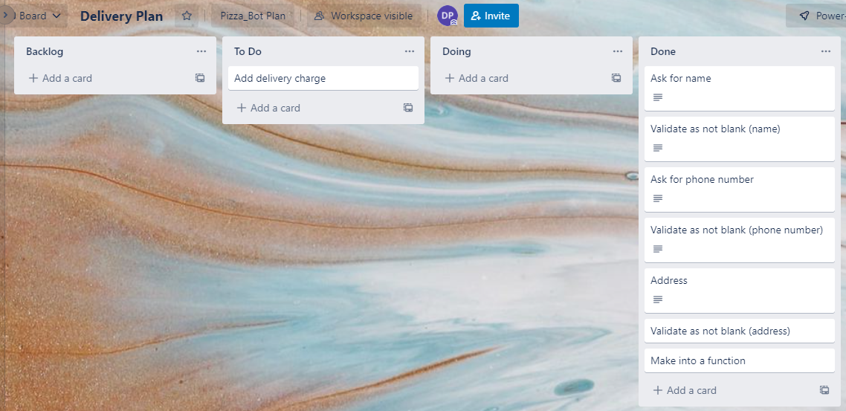
Component 4 Delivery info version 2

Slide 27
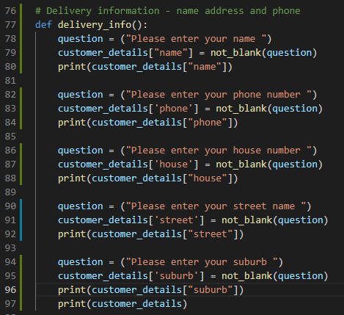
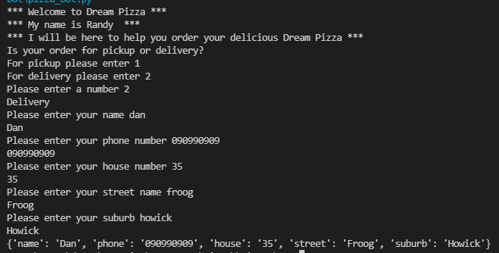
Component 4 v2 - Test Plan (and screenshot)
Test Case | Expected Values
Input name Input phone number Input house number Street name Suburb name Left input blank | Printed name correctly Printed phone number correctly Printed house number Printed street name Printed suburb name Asked for input again

Slide 28
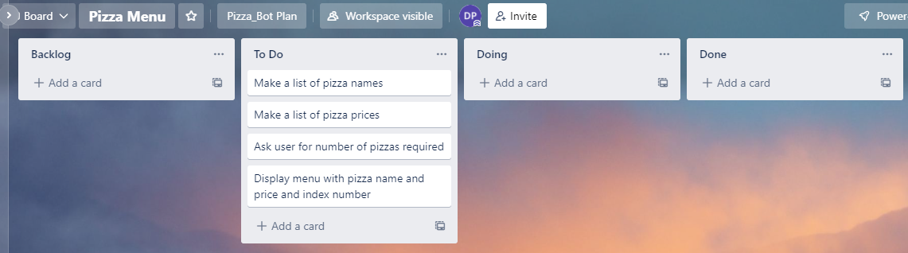
Component 5 Pizza Menu version 1

Slide 29
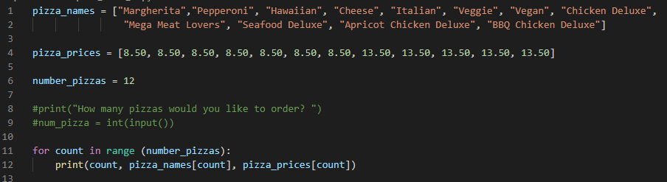
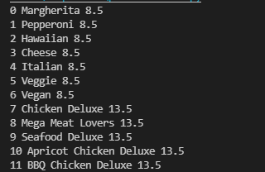
Component 5 Pizza Menu v1
Test Case | Expected Values
Run file | Printed a list with index number, pizzas and prices

Slide 30
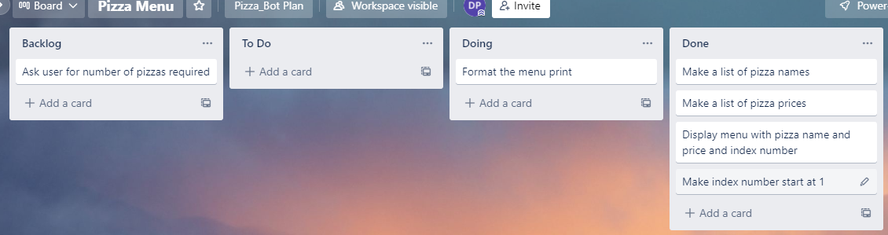
Component 5 Pizza Menu version 2

Slide 31
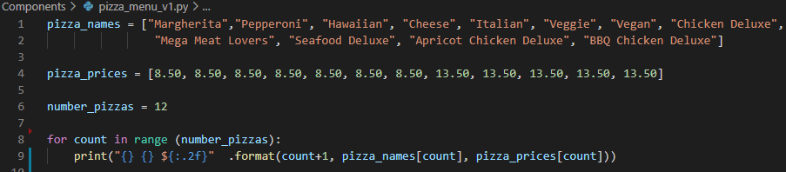
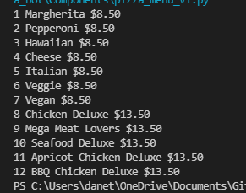
Component 5 Pizza Menu v2
Test Case | Expected Values
Run file | Printed a list with index number, pizzas and prices with price formatted to 2 decimal places and dollar sign. Menu starts at 1.

Slide 32
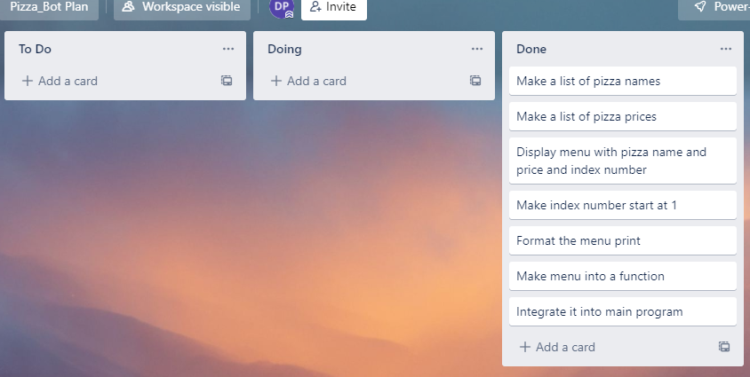
Component 5 Pizza Menu version 3

Slide 33
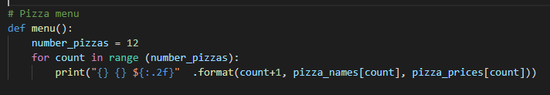
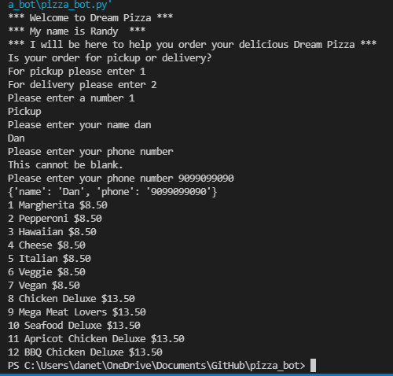
Component 5 Pizza Menu integrated into main program
Test Case | Expected Values
Run file | Printed a list with index number, pizzas and prices with price formatted to 2 decimal places and dollar sign. Menu starts at 1.

Slide 34
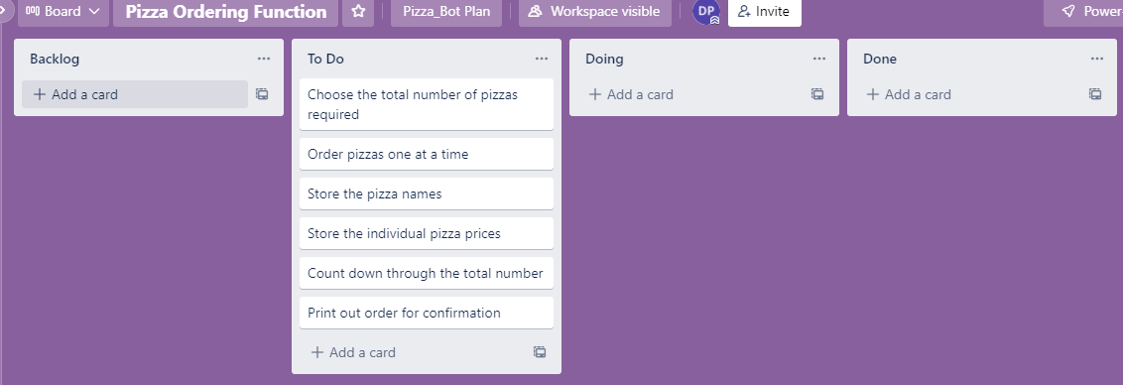
Component 6 Pizza Order v1 (Trello screenshot)

Slide 35
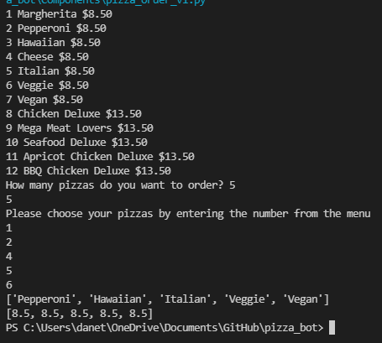
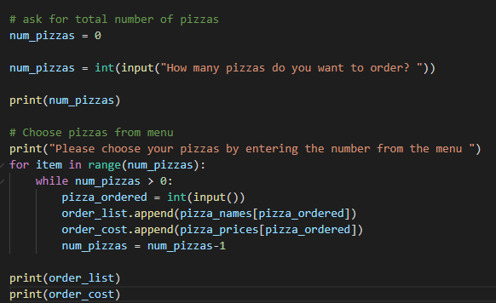

Component 6 Pizza Order v1
Test Case | Expected Values
Enter 5 pizzas Entered ‘cat’ | Stepped through the menu choice 5 times Program broke

Slide 36
Component 6 Pizza Order v2 (Trello screenshot)

Slide 37
Component 6 Pizza Order v2
Test Case | Expected Values
Enter 5 pizzas Entered ‘cat’ | Stepped through the menu choice 5 times Program broke

Slide 38
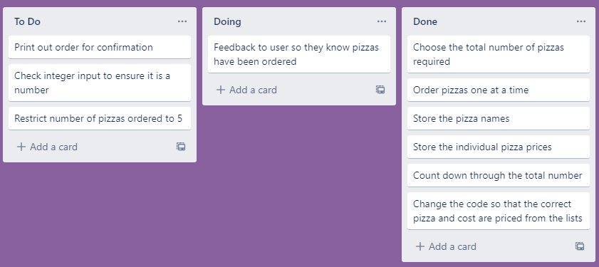
Component 6 Pizza Order v3 (Trello screenshot)

Slide 39
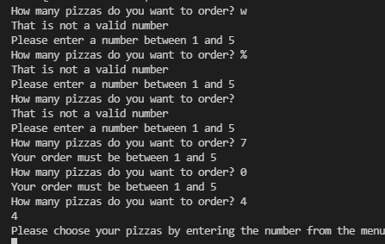
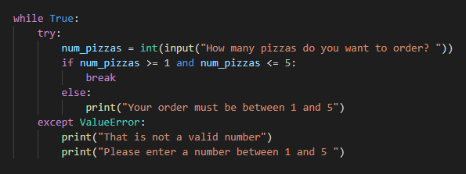
Component 6 Pizza Order v3
Test Case | Expected Values
W % Space 7 0 4 | Not a valid number Not a valid number Not a valid number Must be between 1 and 5 Must be between 1 and 5 Accepted continues to order

Slide 40
Component 6 Pizza Order v3
Test Case | Expected Values
W % Space 7 0 4 | Not a valid number Not a valid number Not a valid number Must be between 1 and 5 Must be between 1 and 5 Accepted continues to order

Slide 41
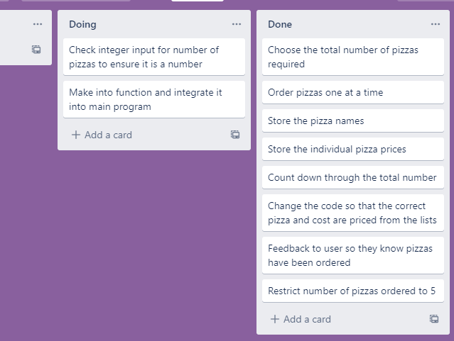
Component 6 Pizza Order v3 (Trello screenshot)

Slide 42


Component 6 Pizza Order v4
Test Case – picking pizza number from menu | Expected Values
W % Space 7 0 4 | Not a valid number Not a valid number Not a valid number Must be between 1 and 5 Must be between 1 and 5 Accepted continues to order

Slide 43

Component 6 Pizza Order v3 (Trello screenshot)

Slide 44

Component 6 Pizza Order v4
Test Case – picking pizza number from menu | Expected Values
W % Space 7 0 4 | Not a valid number Not a valid number Not a valid number Must be between 1 and 5 Must be between 1 and 5 Accepted continues to order

Slide 45
Version Control Evidence
Your version control evidence should go here. This could be in the form of annotated screenshots which show you you managed this process or you could make a brief screencast explaining how you implemented version control.
Notes:
Your version control evidence should go here. This could be in the form of annotated screenshots which show you you managed this process or you could make a brief screencast explaining how you implemented version control.

Slide 46
Discusses how the information from planning, testing and trialling of components assisted in the development of a high-quality outcome
Notes:
Discusses how the information from planning, testing and trialling of components assisted in the development of a high-quality outcome

