Slide 1

Team Name : Gram Sathi
Team Leader Name : < Your Name >
Problem Statement : AI for Rural Innovation & Sustainable Systems

Slide 2
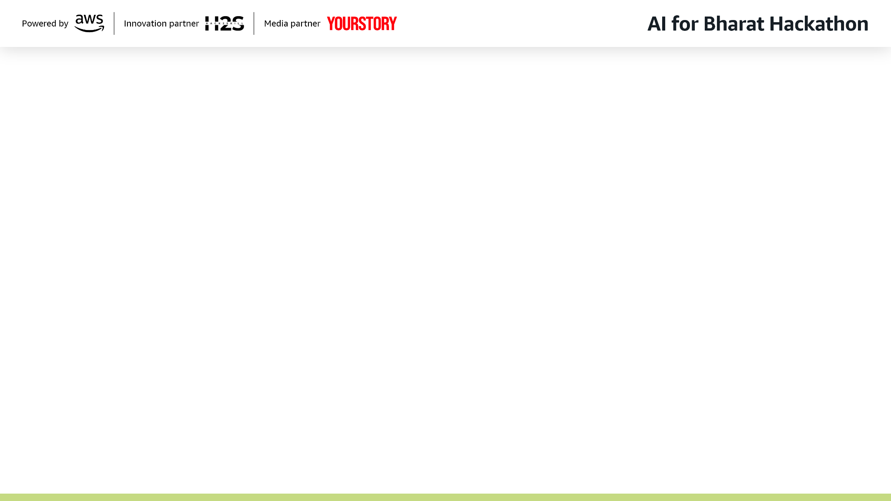
Brief about the Idea
GRAM SATHI — AI for 300 Million Indians Who Can't Use AI
THE PROBLEM:
300M+ Indians have no smartphone, no internet, no apps.
Yet they grow the food that feeds 1.4 billion people.
85% of farmers are small/marginal. Every existing AI solution excludes them.
THE INSIGHT:
But every one of them has a phone number.
India processes 5 billion missed calls daily — it's the most instinctive digital action.
THE SOLUTION:
One missed call. Free of cost. AI calls you back.
Farmer speaks in their language → AI agent fetches live mandi prices, weather,
government scheme eligibility → responds via voice. No app. No internet.
No smartphone. Just your voice.
< IMAGE: Split illustration — Left side (greyed out): Smartphone with AI chat app crossed out with a red X. Right side (vibrant): A farmer holding a basic feature phone to his ear, smiling, with speech bubbles showing mandi prices in Hindi. Large '300M+' stat overlaid. Background: rural Indian landscape. >

Slide 3
Why Everything Else Fails — And Why We Don't
WHAT EXISTS TODAY vs GRAM SATHI:
Farmer.Chat, KisanGPT, AgroTalk, Bharat-VISTAAR → ALL need a smartphone + internet
Gram Sathi → Works on a ₹500 Nokia. Zero cost. Zero internet. Zero literacy needed.
HOW IT SOLVES THE PROBLEM:
Step 1: Farmer dials our number, hangs up (₹0 — missed call)
Step 2: AI detects missed call, calls back in 5 seconds (we pay)
Step 3: AI agent speaks in farmer's language (22 languages, auto-detected)
Step 4: Agent pulls LIVE data — mandi prices, weather, scheme eligibility
Step 5: Farmer gets actionable answer. Profile saved. Next call is smarter.
3 USPs THAT MAKE THIS UNBEATABLE:
1. Missed Call = Our Interface — We didn't invent a new behavior. We hijacked
the most instinctive digital action in India (5B missed calls/day).
2. Agentic AI, Not a Chatbot — 5 tool-calling agents on Amazon Bedrock fetch
real-time data. Two LLM inferences per tool call. Not hallucinated advice.
3. 22 Languages, Zero Menus — Sarvam AI auto-detects language from first sentence.
No 'Press 1 for Hindi'. Just speak naturally.
< IMAGE: Before/After split visual — Left side (red/grey tones): Frustrated farmer traveling 20km to mandi, waiting at block office, asking input dealer. Right side (green/blue tones): Same farmer at home with feature phone — speech bubbles showing live prices, weather alerts, scheme matches. Arrow from left to right labeled 'One Missed Call'. >

Slide 4
Features
🌾 LIVE MANDI PRICES
Real-time prices from 1,266 mandis via eNAM/data.gov.in.
Best mandi recommendation. Price trend alerts.
🌧️ WEATHER INTELLIGENCE
5-day hyperlocal forecast. Rainfall, temp, humidity.
Severe weather warnings (hailstorm, frost, heatwave).
📋 SCHEME MATCHER (Amazon Q)
Auto-matches farmer profile against 1,000+ govt schemes.
PM-KISAN, PMFBY, Ayushman Bharat + state schemes.
🌱 CROP ADVISORY
Season & weather-aware sowing, irrigation, pest advice.
Region-specific recommendations.
🧠 SMART FARMER PROFILE
Remembers state, district, crops, land size across calls.
Call 5 is instantly personalized. No re-explaining.
🔔 PROACTIVE ALERTS
AI CALLS THE FARMER — weather warnings before storms,
price spikes, scheme deadlines. Without being asked.
🗣️ 22-LANGUAGE VOICE AI
Auto-detects language. No menus. No 'Press 1 for Hindi'.
Sarvam AI + Bhashini. Voice-first, zero-UI.
📊 MONITORING DASHBOARD
Real-time call logs, user analytics, query insights.
For NGOs, govt officials, FPOs to track adoption.
< IMAGE: Hub-and-spoke diagram — Phone icon at center, 8 feature bubbles radiating outward (Mandi Prices, Weather, Schemes, Crop Advisory, Smart Profile, Proactive Alerts, 22 Languages, Dashboard). Each bubble has a small icon and 3-word label. Dark background, glowing connections. >

Slide 5
Process Flow — From Missed Call to AI Response
USER JOURNEY (6 Steps):
❶ MISSED CALL → Farmer dials Gram Sathi number, hangs up (₹0 cost)
❷ WEBHOOK → Exotel detects missed call, fires POST to our server
❸ CALLBACK → Server calls farmer back in 5 seconds via Exotel outbound API
❹ VOICE INPUT → Farmer speaks naturally in any language (Sarvam ASR auto-detects)
❺ AI PROCESSING → Bedrock Claude processes intent, calls tools (prices/weather/schemes)
❻ VOICE RESPONSE → AI responds with real data in farmer's language (Sarvam TTS)
STREAMING PIPELINE (Why it's fast — ~1.5s response time):
Each stage streams to the next CONCURRENTLY, not sequentially:
Exotel Audio → Sarvam ASR (300ms) → Bedrock Claude + Tools (800ms) → Sarvam TTS (200ms)
Filler phrases ('Haan ji, dekhti hoon...') play while LLM processes = 0.5s perceived wait
< IMAGE: Horizontal storyboard / comic strip with 6 panels — Panel 1: Farmer with feature phone dialing. Panel 2: Phone ringing back (Gram Sathi Calling...). Panel 3: Speech bubble in Hindi 'Gehu ka bhav batao'. Panel 4: Gears/brain processing with eNAM + IMD + MyScheme logos. Panel 5: Speaker icon 'Gehu 1950 rupay per quintal'. Panel 6: Next morning — phone ringing with weather warning cloud. Arrows connecting each panel left to right. >

Slide 6
Wireframes & Interface Mockups
Gram Sathi has TWO interfaces:
1. FARMER INTERFACE = The Phone Call (Zero UI)
No screens. No buttons. No app. The voice conversation IS the interface.
2. ADMIN DASHBOARD = Streamlit Web App (for NGOs/Govt)
Call logs, farmer profiles, query analytics, alert management.
< IMAGE: Phone call mockup — Simple phone screen showing: 'Gram Sathi - Call Active 00:47'. Speech bubbles: Farmer asks 'Tamatar ka bhav kitna hai aaj?' AI responds 'Lucknow mandi mein tamatar aaj 1,800 rupaye per quintal. Kanpur mein 2,100 hai — wahan bechein toh zyaada fayda hoga.' Show this as a clean phone UI wireframe. >
< IMAGE: Streamlit dashboard wireframe showing 4 panels — Top-left: Live Call Monitor (active calls with transcripts). Top-right: Farmer Profiles (table with name, state, crops, total calls). Bottom-left: Query Analytics (bar chart — 40% prices, 30% weather, 20% schemes, 10% crop advice). Bottom-right: Proactive Alerts queue (pending weather warnings). Use clean wireframe style with placeholder data. >

Slide 7
System Architecture
< IMAGE: Full system architecture diagram — Top: Farmer icon with phone → Exotel Cloud (ExoPhone, WebSocket, Callbacks). Middle: FastAPI Backend box containing: Telephony Gateway, Voice Pipeline (ASR→LLM→TTS shown as streaming arrows), Agent Layer, Tool Execution Layer. Bottom-left: Amazon Bedrock (Claude) icon. Bottom-center: Amazon Q Business (Scheme KB) icon. Bottom-right: External APIs (data.gov.in, IMD, eNAM) icons. Side: PostgreSQL + Redis databases. Use AWS architecture diagram style with official AWS service icons. >
END-TO-END ARCHITECTURE:
FARMER (any phone) → Missed Call → EXOTEL (Cloud Telephony)
→ WebSocket 8kHz PCM audio → FASTAPI BACKEND
VOICE PIPELINE (streaming, concurrent):
Exotel Audio → Sarvam ASR (WebSocket) → Amazon Bedrock Claude
→ Tool Execution → Sarvam TTS (WebSocket) → Exotel Audio Out
TOOL LAYER:
data.gov.in (mandi prices) | IndianAPI (weather) | Amazon Q (schemes)
DATA LAYER:
PostgreSQL (profiles, logs) | Redis (cache, sessions) | HuggingFace (scheme data)

Slide 8
Technology Stack
☁️ AWS SERVICES (Hackathon Required)
Amazon Bedrock — Claude LLM (ap-south-1 Mumbai)
Function calling / tool use for live data retrieval
Amazon Q Business — Government scheme knowledge base
1,000+ schemes from MyScheme.gov.in ingested
Kiro IDE — Spec-driven development
📞 TELEPHONY
Exotel — Indian cloud telephony (₹1000 free trial)
Missed call detection, outbound callbacks, WebSocket audio
🗣️ VOICE AI
Sarvam AI Saaras v3 — ASR, 22 languages, <1s latency
Sarvam AI Bulbul v3 — TTS, 11 languages, 30+ voices
Bhashini — Government language platform (fallback)
⚙️ BACKEND
Python + FastAPI — Async, WebSocket support
Pipecat — Open-source voice pipeline framework
PostgreSQL — User profiles, call logs
Redis — Caching, session state, rate limiting
📊 DATA SOURCES
data.gov.in API — Daily mandi prices (3000+ markets)
IndianAPI.in — Weather forecasts (free)
MyScheme.gov.in — HuggingFace dataset (1000+ schemes)
📈 DASHBOARD
Streamlit — Call logs, analytics, user profiles
🚀 DEPLOYMENT
Docker + AWS EC2 (ap-south-1) — Low latency in India

Slide 9
Estimated Implementation Cost
HACKATHON / MVP COST (100 calls/day):
Exotel Telephony (100 calls × 2 min × ₹2/min) ₹400/day ~₹12,000/month
Sarvam AI ASR (3.3 hrs/day × ₹30/hr) ₹100/day ~₹3,000/month
Sarvam AI TTS (~100K chars/day) ₹50/day ~₹1,500/month
Amazon Bedrock Claude (200 inferences/day) ₹100/day ~₹3,000/month
AWS EC2 (t3.medium, ap-south-1) ₹100/day ~₹3,000/month
PostgreSQL + Redis (RDS + ElastiCache) ₹50/day ~₹1,500/month
data.gov.in, IndianAPI, Bhashini FREE FREE
─────────────────────────────────────────────────────────────────────────
TOTAL (MVP) ~₹800/day ~₹24,000/month
COST PER FARMER INTERACTION: ~₹8 per call (2 min avg)
VALUE PER FARMER INTERACTION: ₹100-1000+ (better prices, scheme access)
HACKATHON FREE TIER:
Exotel trial: ₹1,000 free | Sarvam AI: ₹1,000 free | AWS hackathon credits: TBD
Total hackathon cost: Effectively ₹0 with free tiers

Slide 10
Impact & Scalability
IMMEDIATE IMPACT:
• 300M+ feature phone users can access AI for the first time
• Farmers save 15-20% income lost to price information asymmetry
• ₹2.4 lakh crore in unclaimed govt schemes become discoverable
• Proactive weather alerts prevent crop losses worth thousands per farmer
SCALABILITY:
• Zero marginal distribution cost — no app store, no downloads
• One phone number scales to all of India (Exotel handles routing)
• Sarvam AI + Bhashini cover 22 Indian languages — same system
• Farmer profiles improve with every call — network effect on intelligence
• Government integration ready: AgriStack, ONDC, eNAM, PM-KISAN
THE VISION:
'Every farmer in India, one missed call away from AI.'
If we reach 1% of rural India = 3 million farmers.
At ₹8/call, 3M farmers × 30 calls/year = ₹72 crore annual cost.
Value created: ₹3,000+ per farmer per year = ₹900+ crore value.
< IMAGE: India map visualization — Heat map showing rural population density. Concentric circles expanding from one phone icon at center, reaching outward across India. Stats overlaid: '300M+ reach', '22 languages', '1,266 mandis', '1,000+ schemes'. Arrow showing growth trajectory from MVP (100 farmers) to Scale (3M farmers). >

Slide 11

GRAM SATHI
One missed call. Zero cost. Real data. Their language.
LIVE DEMO:
Watch us call a farmer right now.
Team: < Your Team Name >
Theme: AI for Rural Innovation & Sustainable Systems
Built with: Amazon Bedrock | Amazon Q | Exotel | Sarvam AI
< IMAGE: Phone icon with incoming call animation. Text overlay: 'Gram Sathi calling...' in Hindi script. >

