Slide 1
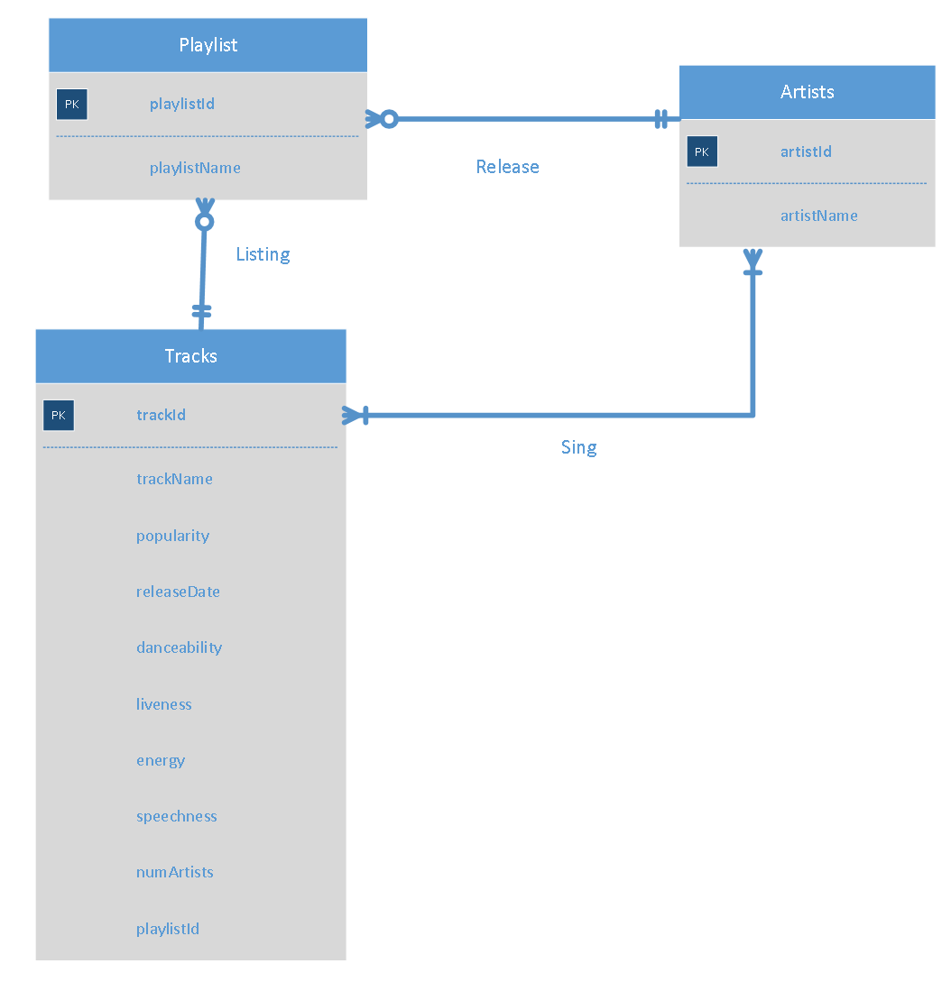
Conceptual Database Design :ERD

Slide 2
Relational Schema
Playlist (playlistId, playlistName)
Artists (artistId, artistName, numArtists, playlistId)
Tracks (trackId, trackName, popularity, releaseDate, danceability, liveness, energy, speechness, playlistId)
Sings(artistId, trackId)

Slide 3
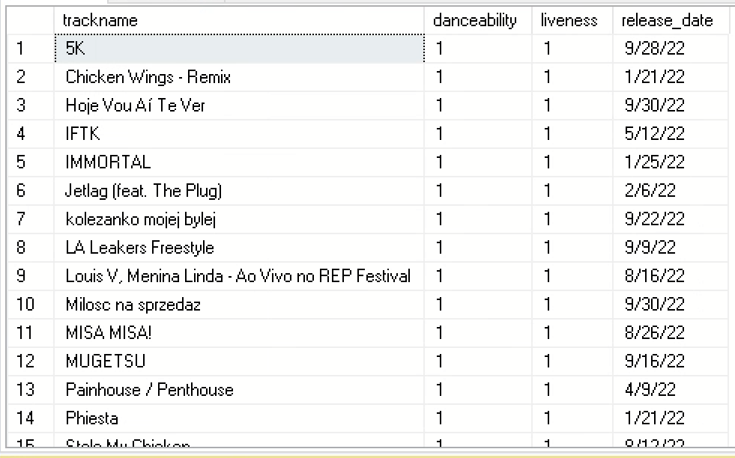
Application 1: The songs released in 2022 that are danceable
SELECT trackname, danceability, liveness, release_date
FROM Track
WHERE danceability = 1 AND release_date LIKE '%22'
ORDER BY trackname ASC

Slide 4
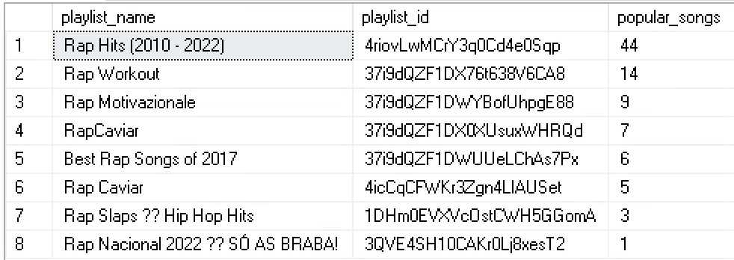
Application 2: The total number of songs with a popularity greater than 80 from each playlist
SELECT p.playlist_name, t.playlist_id, COUNT(popularity) AS popular_songs
FROM Track t, Playlist p
WHERE t.playlist_id = p.playlist_id AND popularity > 80
GROUP BY p.playlist_name, t.playlist_id
ORDER BY COUNT(popularity) DESC

Slide 5
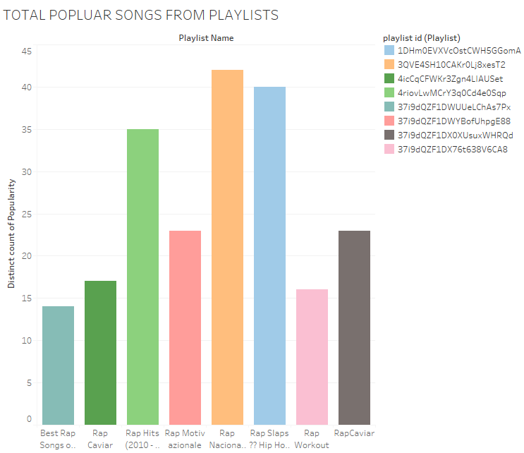
Tableau Application #2

Slide 6
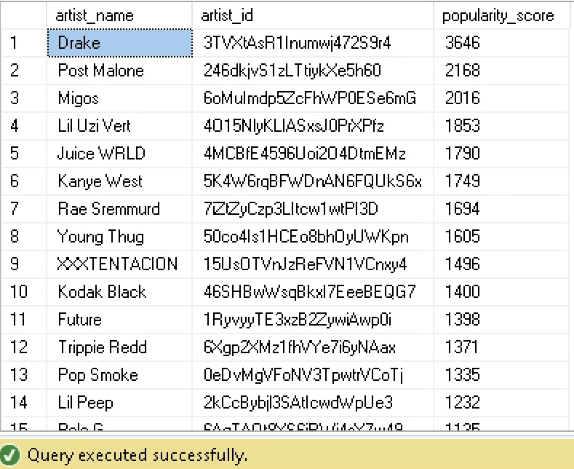
Application 3: Top 25 of the total song popularity score above 60 of rappers over time
SELECT TOP(25) DISTINCT a.artist_name, a.artist_id, COUNT(popularity) AS popularity_score
FROM Track t, Artist a
WHERE t.playlist_id = a.playlist_id AND popularity > 60
GROUP BY a.artist_name, a.artist_id
ORDER BY COUNT(popularity) DESC

Slide 7
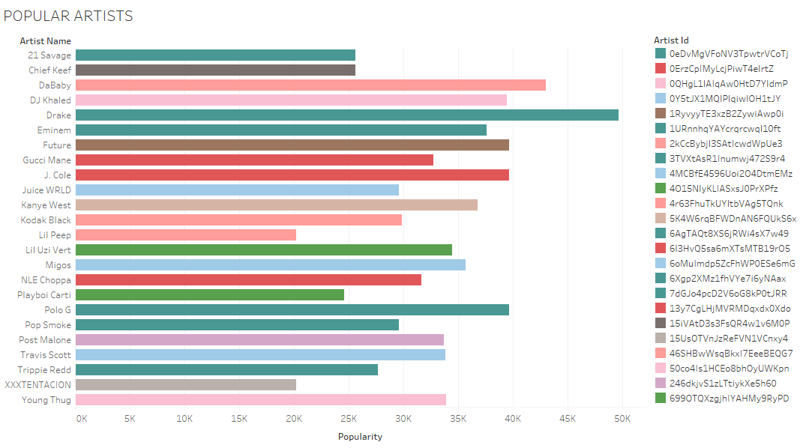
Tableau Application #3

