Slide 1
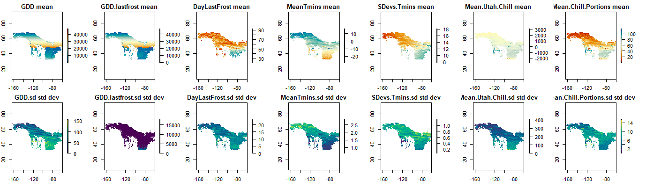
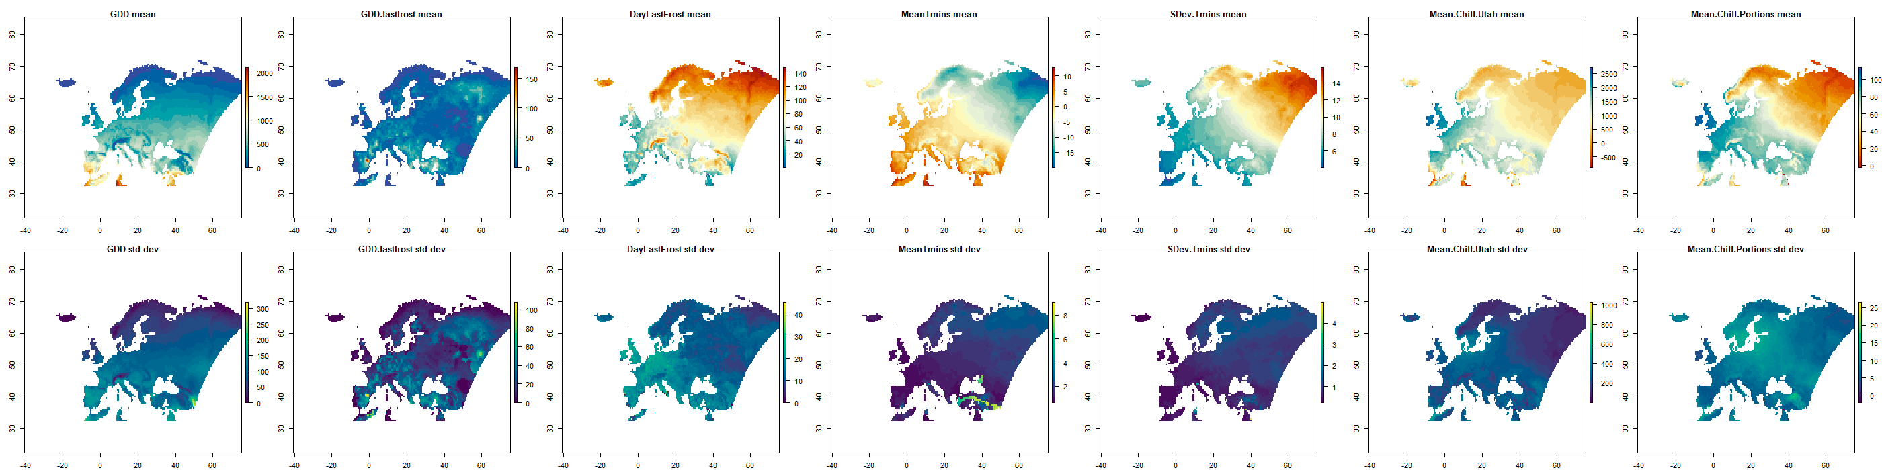
Range Update
18 March 2021

Slide 2
Project components
Data: so fresh and so clean
Hypothesis: Climatic variation increases secondary cue reliance
Metrics of variation and their relationships to each other:
GDD to last frost
STV
Range area (extent?) (“Rapoport’s rule”)
Intra. Vs. Interspecific
Modeling
Outline

Slide 3
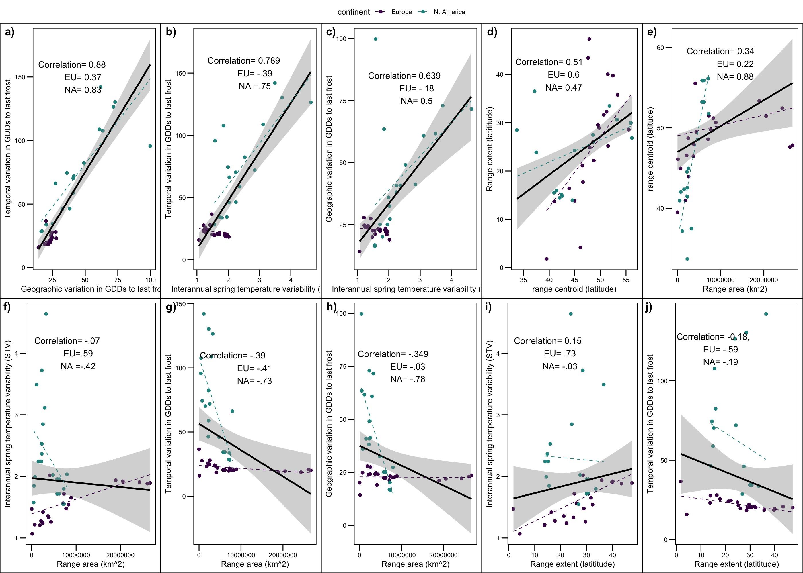

Slide 5
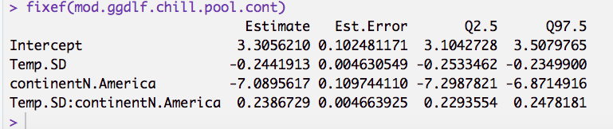
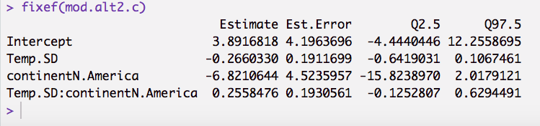
“Sequential model”
“Measurement error model”

Slide 6
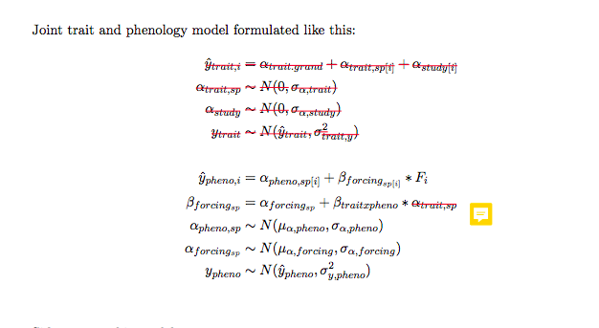
In our model, this parameter is data (the climate variable of interest)

Slide 7
The 1 parameter and 3 parameter models converge but answers are different than the previous modeling techniques (clim betas positive for all 3 cues).
Next step, run on fake data
Decide how to deal with the continental differences.
Write up

