Slide 1
Brocade SAN
交换机配置
北京建银科技发展中心
2007年11月
高新田

Slide 2
SAN基础
光纤通道连接类型
点对点 --直接连接存储（2个设备）
Arbitrated Loop --仲裁环（128个设备）
Fabric --交换式（16,000,000个设备）

Slide 3
SAN基础
光纤通道FC-2端口类型
设备（节点）端口
  N_Port =Fabric直接连接设备
  NL_Port =Loop连接设备
交换机端口
  E_Port =扩展端口（交换机到交换机）
  F_Port =Fabric端口
  FL_Port =Fabric Loop端口
  G_Port =普通（Generic）端口
  U_Port =通用（Universal）端口
Notes:
G_Port可以转化为E_port或者F_Port
U_Port是用于描述端口自动监测的术语

Slide 4
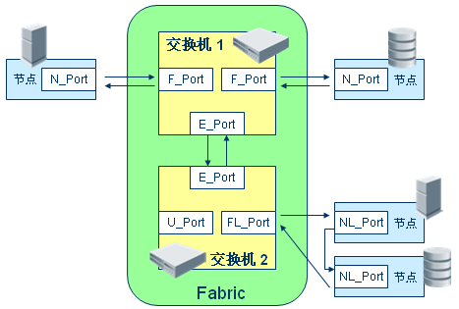
SAN基础
Fabric端口

Slide 5
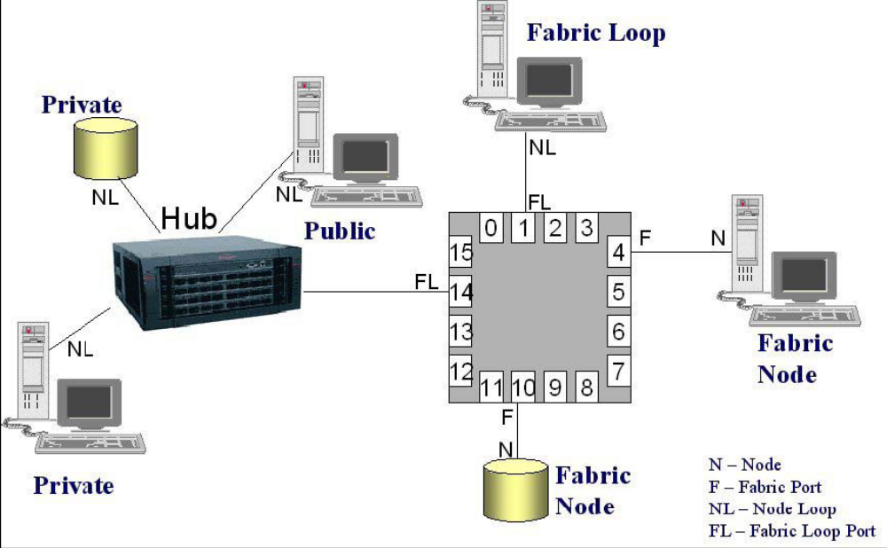
SAN基础
Fabric端口

Slide 6
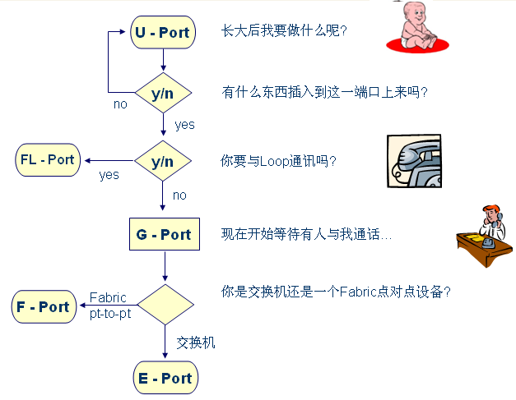
SAN基础
交换机端口智能初始化过程

Slide 7
内容
        初始化配置交换机
        交换机管理
        Zone配置
        Trunk配置
        交换机维护

Slide 8
初始化配置交换机
配置IP地址
  switch:admin> ipaddrset
  Ethernet IP Address [10.77.77.77]: 10.64.119.7
  Ethernet Subnetmask [10.77.77.76]: 255.255.240.0
  Fibre Channel IP Address [0.0.0.0]:
  Fibre Channel Subnetmask [0.0.0.0]:
  Gateway IP Address [10.64.112.1]:
  IP address being changed...
  Committing configuration...Done.
  switch:admin>ipaddrshow
  switch:admin>hashow
Notes:
Repeat isaddrset if available multiple CP （Control Processor）

Slide 9
初始化配置交换机
配置IP地址
1. 准备好IP地址、子网掩码、主机名、网关地址等:
2. 以admin用户登录交换机.
3. 输入ipaddrset 命令.
4. 选择要配置的CP:
  Enter 2 to configure CP 0 (slot 5)
  Enter 3 to configure CP 1 (slot 6)
5. 根据提示输入准备好IP地址、子网掩码、主机名、网关地址等
6. 输入ipaddrshow命令确认输入无误
7. 输入hafailover 命令激活CP.
8. 在另一个CP上重复以上步骤1-6.
Notes:
Hafailover命令使standby CP激活

Slide 10
初始化配置交换机
Login Switch
Telnet (确认网络连接OK)
默认的用户名、密码：admin/password，第一次连接时系统自动提示更改密码，CTRL+C忽略。
passwd命令改变密码
设置恢复密码（启动交换机，出现提示时按ESC，根据提示操作）
  Warning：Do Not Forget the Recovery Password

Slide 11
初始化配置交换机
Switchname设置交换机名称

Slide 12
初始化配置交换机
管理License
使用命令licenseadd激活一个License
  switch:admin> licenseadd “key”
使用命令licenseshow确认License已经被添加
  switch:admin> licenseshow
  1A1AaAaaaAAAA1a:
  Web license
  Zoning license
  SES license
  Security license
  Fabric Watch license

Slide 13
初始化配置交换机
View Switch Function
switch:admin> switchshow
switchName: switch
switchType: 42.1
switchState: Online
switchMode: Native
switchRole: Subordinate
switchDomain: 1
switchId: fffc01
switchWwn: 10:00:00:60:69:e2:09:be
AD Feature: Not Active
Current AD: 0
zoning: ON (bot_cfg)
switchBeacon: OFF
blade4 Beacon: OFF
blade8 Beacon: OFF
FC Router: OFF
FC Router BB Fabric ID: 1
Index Slot Port Address Media Speed State Proto
===================================================
[output truncated]
80 8 0 035000 id N4 No_Light
81 8 1 035100 id N4 No_Light
82 8 2 035200 id N4 No_Light
83 8 3 035300 id N4 No_Light
84 8 4 035400 id N4 No_Light
85 8 5 035500 id N4 No_Light
86 8 6 035600 id N4 No_Light
87 8 7 035700 id N4 No_Light
88 8 8 035800 id N1 Online F-Port 10:00:00:00:c9:25:3d:43

Slide 14
初始化配置交换机
View Switch Function
switch:admin> chassisshow
  Display all Field Replaceable Units (FRU).
switch:admin> slotshow

Slide 15
初始化配置交换机
Verify Fabric Connectivity
  switch:admin> fabricshow
  Switch ID Worldwide Name Enet IP Addr FC IP Addr Name
  -------------------------------------------------------------------------
  1: fffc01 10:00:00:60:69:80:04:5a 192.168.186.61 192.168.68.193 "switch61"
  3: fffc03 10:00:00:60:69:10:9c:29 192.168.186.175 0.0.0.0 "switch175"
  4: fffc04 10:00:00:60:69:12:14:b7 192.168.174.70 0.0.0.0 "switch70"
  5: fffc05 10:00:00:60:69:45:68:04 192.168.144.121 0.0.0.0 "switch121"
  6: fffc06 10:00:00:60:69:00:54:ea 192.168.174.79 192.168.68.197 "switch79"
  7: fffc07 10:00:00:60:69:80:04:5b 192.168.186.62 192.168.68.194 "switch62"
  8: fffc08 10:00:00:60:69:04:11:22 192.168.186.195 0.0.0.0 >"switch195"
  9: fffc09 10:00:00:60:69:10:92:04 192.168.189.197 192.168.68.198 "switch197"
  10: fffc0a 10:00:00:60:69:50:05:47 192.168.189.181 192.168.68.181 "switch181"
  11: fffc0b 10:00:00:60:69:00:54:e9 192.168.174.78 192.168.68.196 "switch78"
  15: fffc0f 10:00:00:60:69:30:1e:16 192.168.174.73 0.0.0.0 "switch73"
  33: fffc21 10:00:00:60:69:90:02:5e 192.168.144.120 0.0.0.0 "switch120"
  44: fffc2c 10:00:00:60:69:c0:06:8d 192.168.144.121 0.0.0.0 "switch121"
  97: fffc61 10:00:00:60:69:90:02:ed 192.168.144.123 0.0.0.0 "switch123"
  98: fffc62 10:00:00:60:69:90:03:32 192.168.144.122 0.0.0.0 "switch122"
  The Fabric has 15 switches
  switch:admin>

Slide 16
初始化配置交换机
连接设备到交换机
Poweroff需要连接的设备
无法Poweroff的，使用portdisable命令先禁用端口
再次Poweron设备或者启用端口后，等待设备Login Fabric

Slide 17
初始化配置交换机
保存交换机配置
保存硬拷贝：
  Switch:admin>licenseshow
  Switch:admin>configshow
  Switch:admin>ipaddrshow
保存到ftp服务器上
  configupload ["host","user","file"[,"passwd"]]

Slide 18
内容
        初始化配置交换机
        交换机管理
        Zone配置
        Trunk配置
        交换机维护

Slide 19
交换机管理
Domain ID
显示Domain ID：
  switch:admin> fabricshow
  Switch ID Worldwide Name Enet IP Addr FC IP Addr Name
  -------------------------------------------------------------------------
  3: fffc43 10:00:00:60:69:10:60:1f 192.168.64.187 0.0.0.0 "sw187"
  2: fffc42 10:00:00:60:69:00:05:91 192.168.64.60 192.168.65.60 "sw60"
  1: fffc41 10:00:00:60:69:00:02:0b 192.168.64.180 192.168.65.180 >"sw180"
  0: fffc40 10:00:00:60:69:00:06:56 192.168.64.59 192.168.65.59 "sw5"
  The Fabric has 4 switches
  Group ID Token
  -----------------
  0: fffb01 40:05:00:00:10:00:00:60:69:00:00:15

Slide 20
交换机管理
Domain ID
设置Domain ID：
  以admin用户登录交换机
  switch:admin>switchdisable
  switch:admin>configure
  提示输入Domain ID时，输入新ID
  继续配置其他参数或者CTRL+D不改变其他参数
  switch:admin>switchenable

Slide 21
交换机管理
查看Firmwaare版本：
  switch12k:admin> firmwareshow
  Local CP (Slot 5, CP0): Active
  Primary partition: v4.0.2
  Secondary Partition: v4.0.2
  Remote CP (Slot 6, CP1): Standby
  Primary partition: v4.0.2
  Secondary Partition: v4.0.2
  switch12k:admin>

Slide 22
交换机管理
交换机时间
date “MMDDhhmmYY”命令
tsclockserver [ipaddr]
  这里ipaddr是NTP服务器的地址
  switch:admin> tsclockserver
  LOCL
  switch:admin> tsclockserver "132.163.135.131"
  switch:admin> tsclockserver
  132.163.135.131
  switch:admin>

Slide 23
交换机管理
显示Fabric设置
        switch:admin> configshow
        RSCN.end-device.TransmissionMode:0
        alpaList:1
        boot.device:fei
        boot.file:/usr/switch/firmware
        boot.gateway.ipa:192.168.147.172
        boot.ipa:192.168.147.172:ffffff00
        boot.mac:10:00:00:60:69:80:04:22
        boot.name:ter172
        boot.server.ipa:
        boot.server.name:host
        boot.user:user
        diag.loopID:125
        diag.mode.burnin:0
        diag.mode.burnin.1.name:switchess.sh
        diag.mode.burnin.level:0
        diag.mode.esd:0
        diag.mode.lab:28
        switch:admin>

Slide 24
交换机管理
备份Fabric配置
    switch:admin> configupload
    Server Name or IP Address [host]: 192.168.15.42
    User Name [user]: johndoe
    File Name [config.txt]: config-switch.txt
    Password:xxxxx
    Upload complete
    switch:admin>

Slide 25
交换机管理
恢复Fabric配置
  switch:admin>switchdisable
  switch:admin> configdownload
  Server Name or IP Address [host]: 192.168.15.42
  User Name [user]: johndoe
  File Name [config.txt]: config-switch.txt
  Password:
  *** CAUTION ***
  This command is used to download a backed-up configuration
  for a specific switch. If using a file from a different
  switch, this file's configuration settings will override
  any current switch settings. Downloading a configuration
  file, which was uploaded from a different type of switch,
  may cause this switch to fail.
  Do you want to continue [y/n]: y
  download complete..
  switch:admin>reboot

Slide 26
交换机管理
在线帮助
help command
diagHelp
  Print diagnostic help information
fwHelp
  Print Fabric Watch help information
licenseHelp
  Print license help information
perfHelp
  Print Performance Monitoring help information
routeHelp
  Print routing help information
trackChangesHelp
  Print Track Changes help information

Slide 27
内容
        初始化配置交换机
        交换机管理
        Zone配置
        Trunk配置
        交换机维护

Slide 28
Zone配置
特定的命令
cfgcreate
  创建Zoning配置
  cfgcreate "cfgName", "member; member“
  switch:admin> cfgcreate "Test_cfg", "redzone; bluezone; greenzone“
  这里的成员为zone名称

Slide 29
Zone配置
特定的命令
cfgshow
  显示Zone配置
  语法：cfgshow ["pattern"][, mode]
  不带任何参数的命令会显示所有的Zone配置（Defined and Effective）
Notes:
mode Specify 0 to display the contents of the transaction buffer (the contents of the current transaction), or specify 1 to display the contents of the non-volatile memory. The default value is 0. This operand is optional.

Slide 30
Zone配置
特定的命令
zoneadd
  向现存的Zone中添加成员
  语法：zoneadd "zoneName", "member;member“
    zoneName 指定一个现有的zone名称
    member 指定要添加的成员列表，以“;”分开。可以使用如下值：
      A switch domain and port area number pair. For example, “2, 20”. 使用switchshow命令查看交换机端口号。
      Node or port WWN.
      QuickLoop AL_PA
      Zone alias name
Notes:
To add aliases for three disk arrays to “Blue_zone”:
switch:admin> zoneadd "Blue_Zone", "array3; array4; array5"

Slide 31
Zone配置
特定的命令
zoneshow
  显示Zone信息
  语法：zoneshow ["pattern"][, mode]
  Example： To show all zones beginning with the letters “A” through “C”:
    switch:admin> zoneshow "[A-C]*"
    zone: Blue_zone 1,1; array1; 1,2; array2
  Mode的默认值为0（buffer）

Slide 32
Zone配置
特定的命令
zonecreate
  创建Zone。要使Zone激活，必须使用cfgsave和cfgenable 命令
  语法：zonecreate "zonename", "member;member“
Notes:
member
List of members to be included in zone, in quotation marks, separated by semi-colons.
Can be one or more of the following:
• A switch domain and port area number pair. For example, "2, 20". View the area
numbers for ports using the switchshow command.
• Worldwide names
• QuickLoop AL_PAs
• Zone alias names

Slide 33
Zone配置
特定的命令
alicreate
  创建别名
alidelete
  删除别名
zonehelp
  显示帮助信息

Slide 34
内容
        初始化配置交换机
        交换机管理
        Zone配置
        Trunk配置
        交换机维护

Slide 35
Trunk配置
相关命令
        switchcfgtrunk
        portcfgeport
        portcfgtrunkport
        trunkshow
        trunkdebug

Slide 36
Trunk配置
启用/禁用交换机trunk
switchcfgtrunk mode
  mode为1表示启用、0表示禁用
  switch:admin> switchcfgtrunk 1
  done.
  switch:admin>

Slide 37
Trunk配置
端口类型设置
portcfgeport [slotnumber/]portnumber, mode
  禁止/允许端口成为E_Port
  mode值为1表示允许，0表示禁止，默认值为允许
  switch:admin> portcfgeport 2/3, 0
  Committing configuration...done.
  switch:admin>

Slide 38
Trunk配置
启用/禁用端口trunk
portcfgtrunkport [slotnumber/]portnumber, mode
  mode含义与switchcfgtrunk命令一样
  switch:admin> portcfgtrunkport 1/3, 1
  done.
  switch:admin>

Slide 39
Trunk配置
显示Trunk信息
switch:admin> trunkshow
1: 2 -> 60 10:00:00:60:69:80:4f:85 deskew 16 MASTER
3 -> 61 10:00:00:60:69:80:4f:85 deskew 15
2: 7 -> 39 10:00:00:60:69:80:4f:85 deskew 17 MASTER
6 -> 38 10:00:00:60:69:80:4f:85 deskew 16
5 -> 36 10:00:00:60:69:80:4f:85 deskew 16
4 -> 37 10:00:00:60:69:80:4f:85 deskew 15
3:24 -> 56 10:00:00:60:69:80:4f:85 deskew 16 MASTER
25 -> 57 10:00:00:60:69:80:4f:85 deskew 15
4:29 -> 33 10:00:00:60:69:80:4f:85 deskew 16 MASTER
28 -> 32 10:00:00:60:69:80:4f:85 deskew 15
switch:admin>

Slide 40
Trunk配置
调试Trunk链路
trunkdebug命令报告trunk链路的问题之所在（交换机不支持、缺少License、端口类型不对、etc）
  switch:admin> trunkdebug 3, 4
  port 3 is not E port
  switch:admin>

Slide 41
内容
        初始化配置交换机
        交换机管理
        Zone配置
        Trunk配置
        交换机维护

Slide 42
交换机维护
指示灯状态分析
Left/Lower LED | Stats of Hardware | Recommend Action
No light | No light or signal carrier is detected (cable or media) | Check media and cable
Steady green | Port is online but has no traffic | None
Slow green | Port online but segmented, loopback cable or incompatible switch | Verify correct device is attached to the port
Fast green | Port is in internal loopback | None
Flickering Green | Port is online, traffic is flowing | None
Flashing or steady yellow | POST is running | None
Steady orange | Port is receiving light or signal but is not online | None
Slow orange | Port is disabled | Enable the port
Fast orange | The port is faulty | Reset the switch
Alternating green and yellow | Port is bypassed | Reset the port

Slide 43
交换机维护
指示灯状态分析
Right/Upper LED | Stats of Hardware | Action
No light | Port running at 1 Gbit/sec, or, boot not complete or failed | Verify boot completed
Steady green | Port running at 2 Gbit/sec | None
Slow green | One or more ports failed POST | Check error log
Fast = .25 second interval
Slow = 1 second interval

Slide 44
交换机维护
FRU/Non-FRU设备状态查看
switchstatusshow
  可显示交换机的总体运行状态。屏幕打印状态“Healthy/OK”为正常。如果打印“Marginal/Warning”，视具体情况判定正常或者非正常
psshow、fanshow、tempshow、etc

Slide 45
交换机维护 diagnostics
ramtest --CPU SDRAM test
porttest --Port test
fporttest --Sends ECHO frames to
device’s N_Port receiver
supportshow --Used for support

Slide 46
交换机维护 error log相关
errsavelvlset lvl
  设置保存在persistent error log中的Message severity level
  lvl --Message severity level.
    Critical 1
    Error 2
    Warning 3
    Info 4
    Debug 5
  errsavelvlshow显示保存的消息级别
Notes:
小于等于lvl的message将被保存。

Slide 47
交换机维护 error log相关
errdump | errshow
  -a Display messages from the active error log. This displays the error log messages generated during the current run time cycle.
  -p Display messages from the persistent error log.
  命令区别：前者不分页

Slide 48
交换机维护 error log相关
errclear
  只清除RAM中的error log
  执行这个命令后，不带-p参数的errshow和errdump命令无输出
errclear –p
  只清除persistent error log

Slide 49
The End！
Thank You！

