Slide 1
Saccase (Laser Eyes)
Daniel Fitzgerald

Slide 2
Inspiration
Body
Eyes
device
Science Fiction
Real-World
targeting
action
laser
Coupled
Tracking

Slide 3
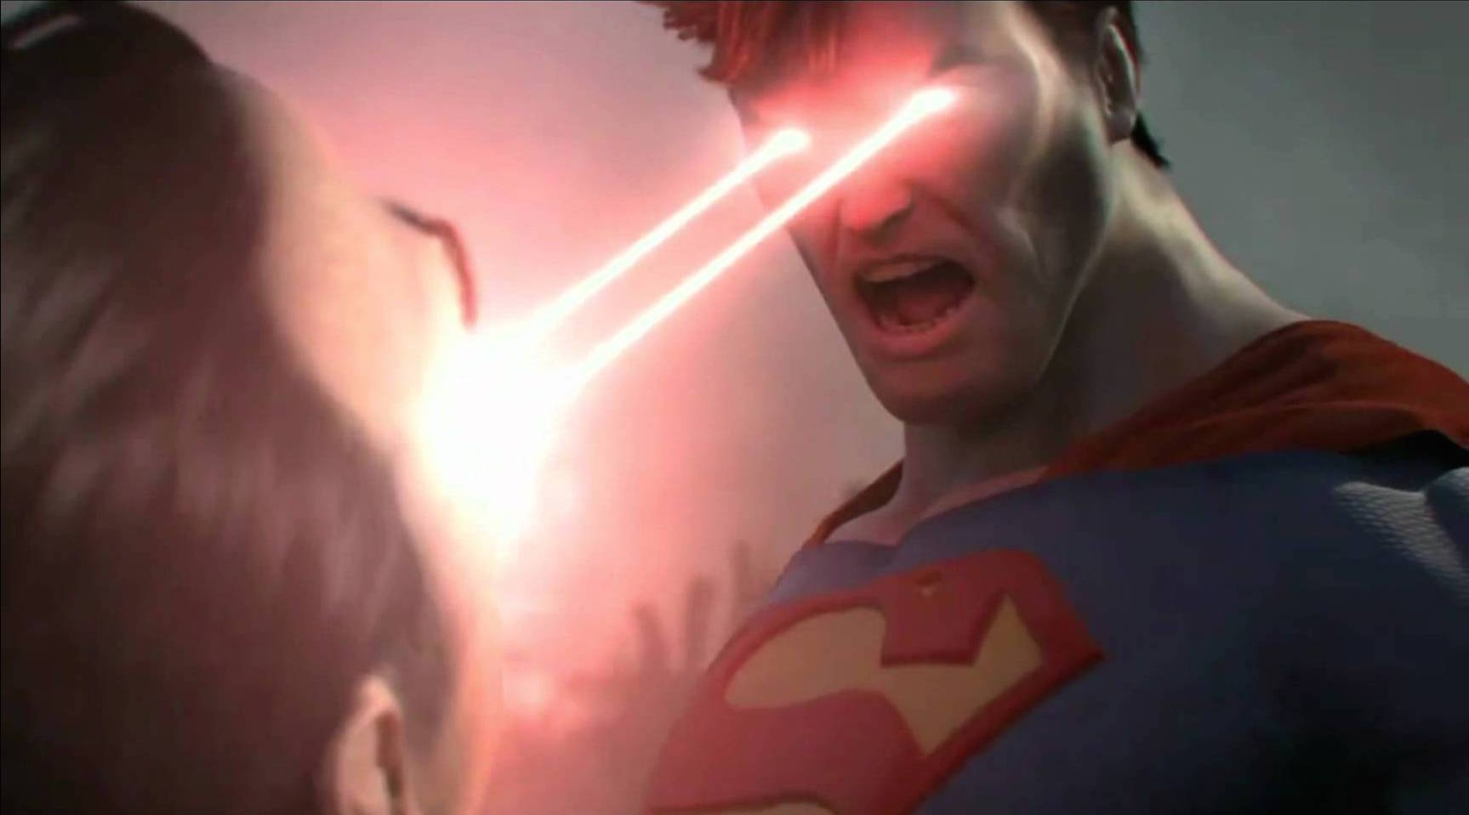
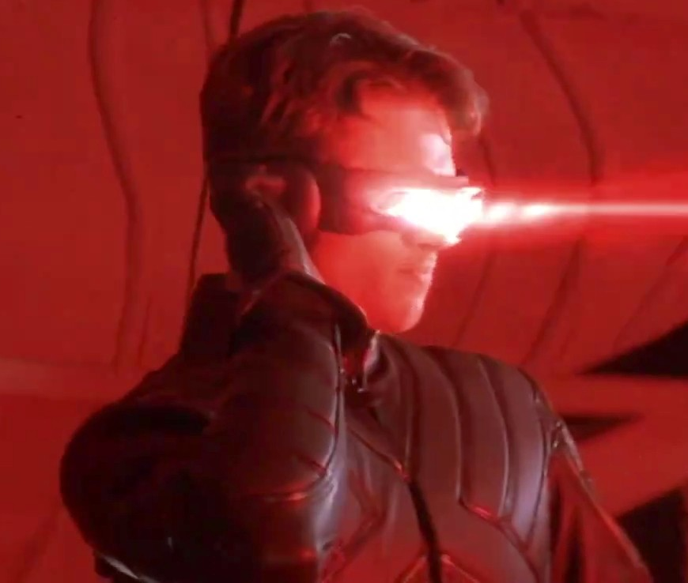
Superman/Cyclopse
Targeting: Eyes
Action: Coupled Laser

Slide 4
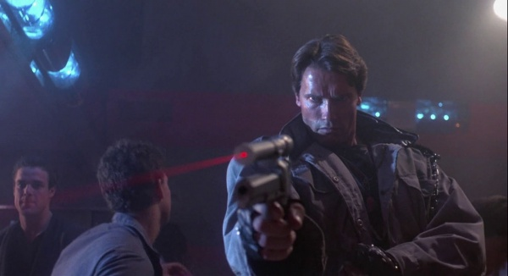
Laser Sights
Targeting: Laser
Action: Coupled Gun

Slide 5
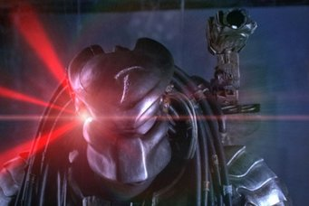
Preditor
Targeting: Laser
Action: Independent Tracking Cannon

Slide 6
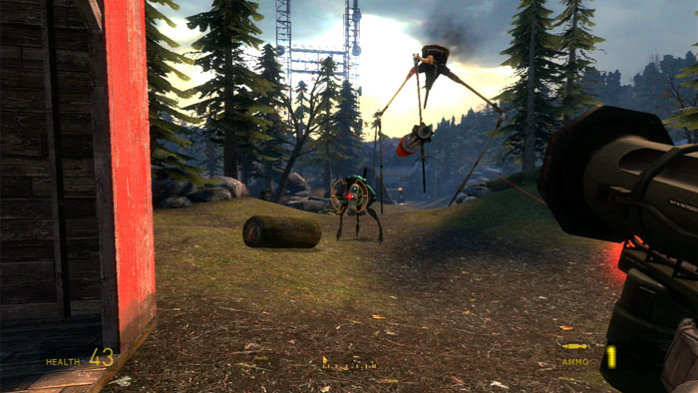
Videogames (Half Life 2)
Targeting: Laser
Action: Independent Tracking Projectile

Slide 7
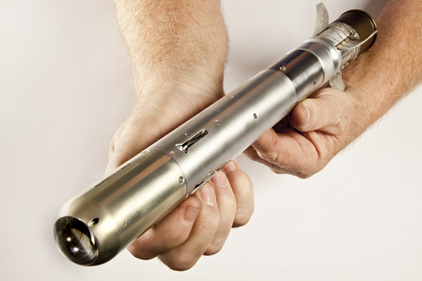
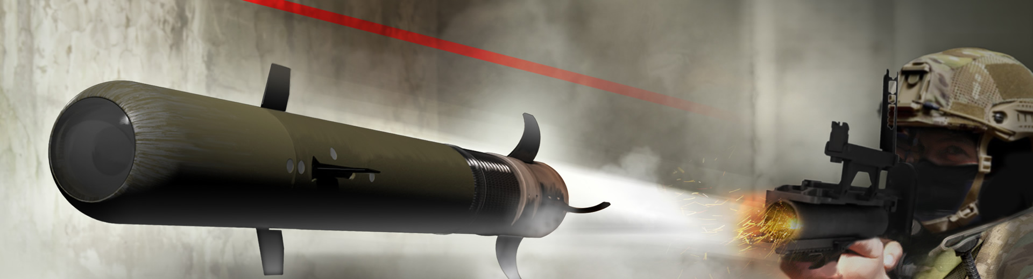
Raytheon: Pike

Slide 8
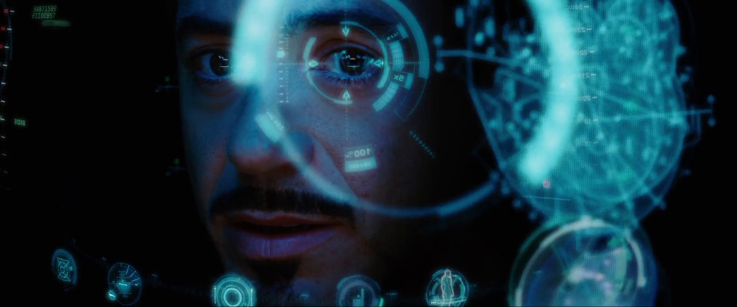
HUD (Iron Man)
Targeting: Eye (?)
Action: Independent Tracking AI

Slide 9
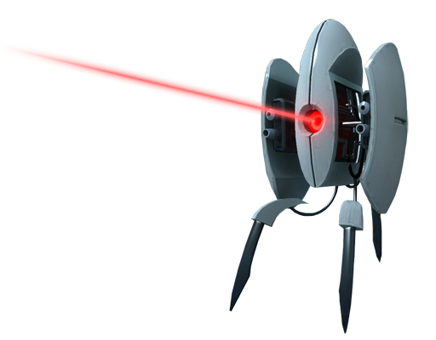
Automatic Sentry Turret
Targeting: ?
Indication: Laser
Action: Coupled Guns

Slide 10
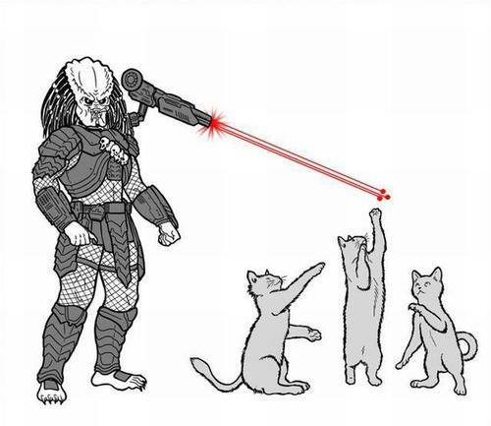
Non-Violent Applications
Targeting: Laser
Action: Independent Tracking Cats

Slide 11
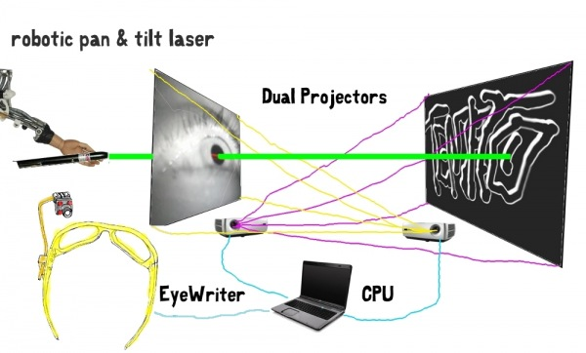
EyeWriter
Targeting: Eye
Indication: Laser
Action: Projection

Slide 12
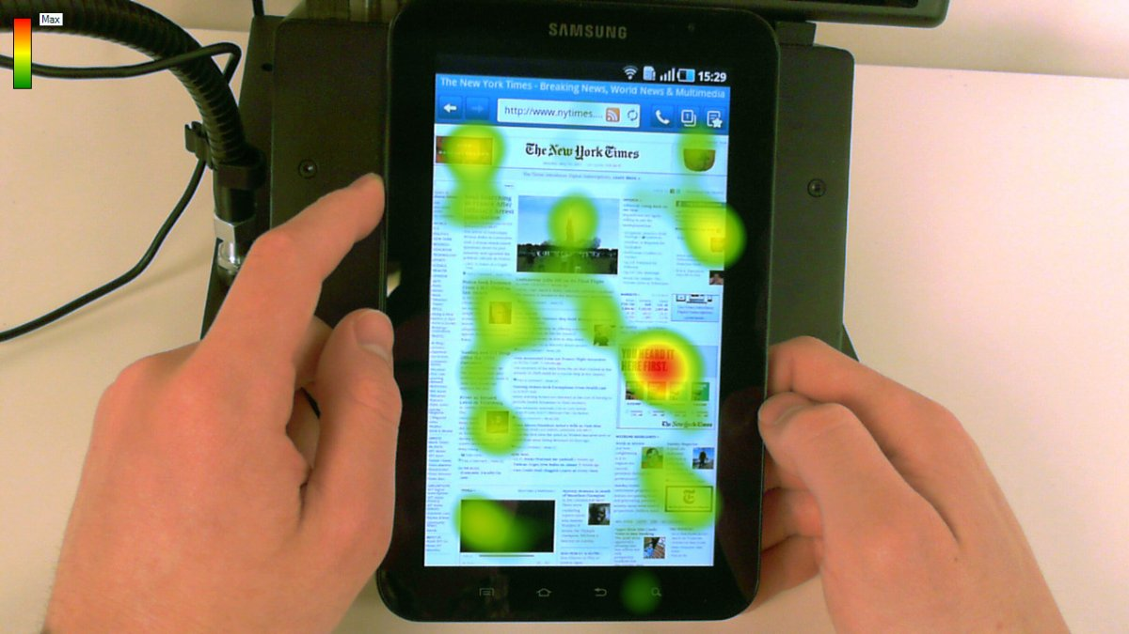
Gaze Heatmaps

Slide 13
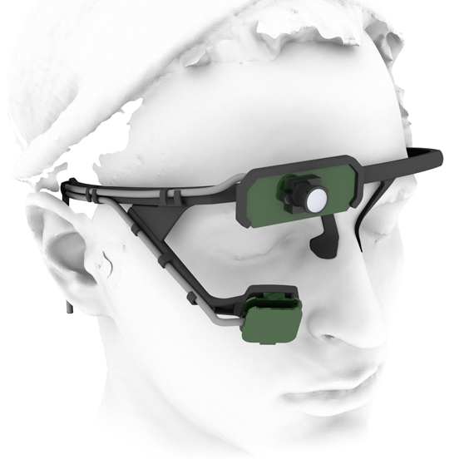
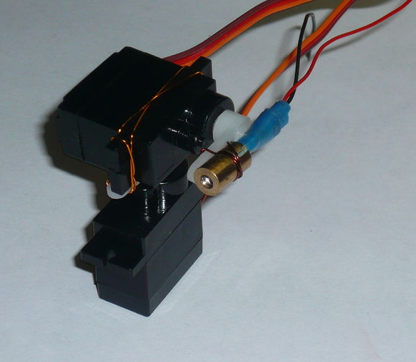
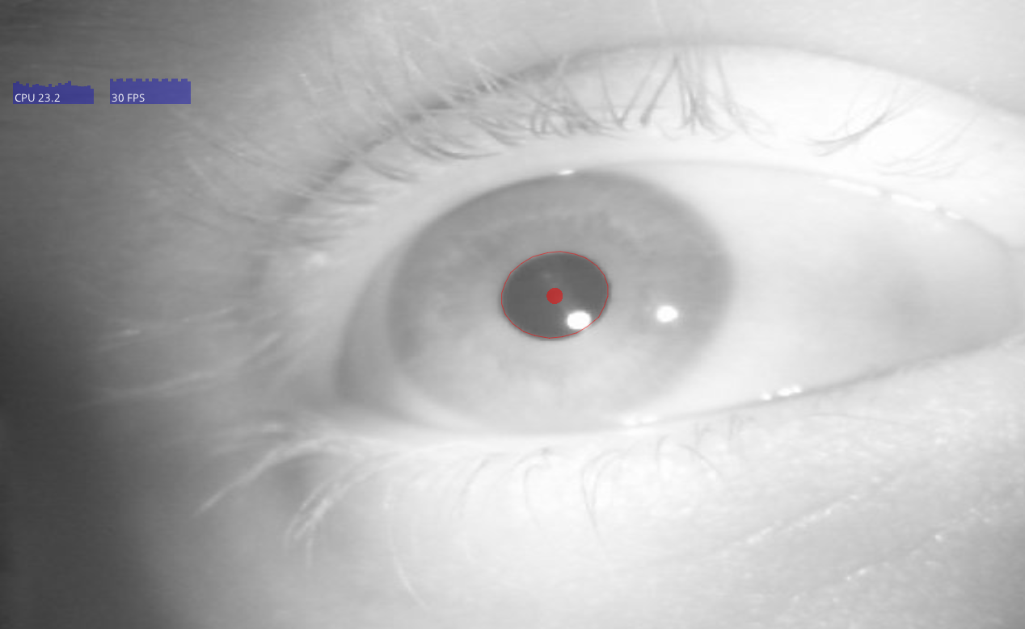
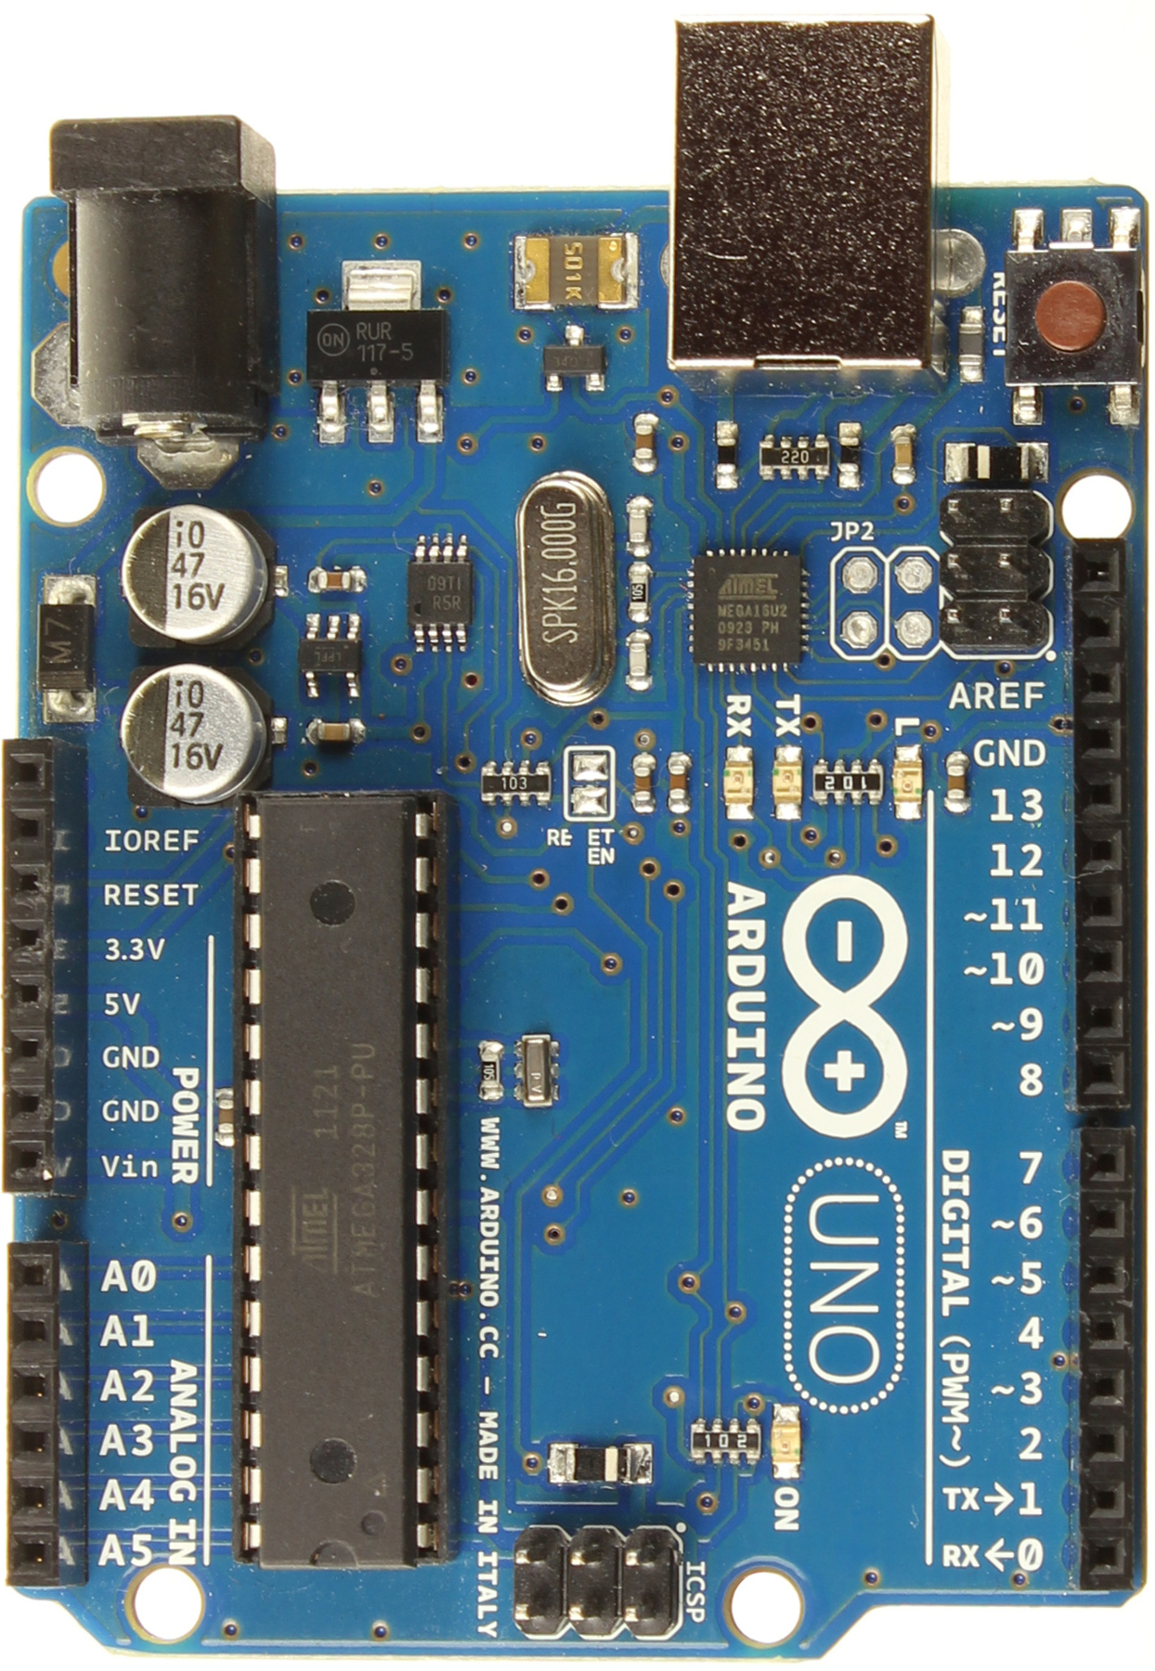
Saccase System
Pupil Eye Tracker
Eye Tracking Software
Arduino
Laser Gimbal

Slide 14
Future Directions

Slide 15
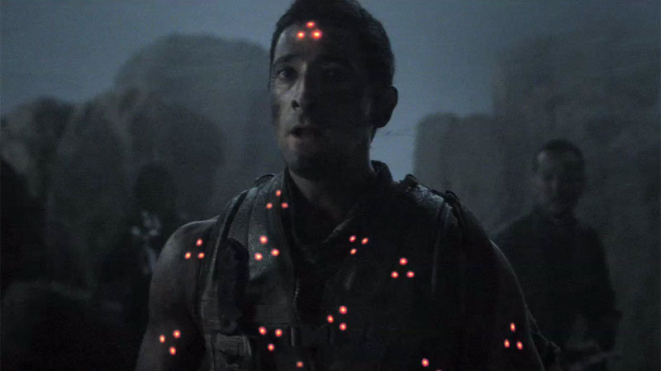
Real-Time Crowd Attention Heat map

Slide 16
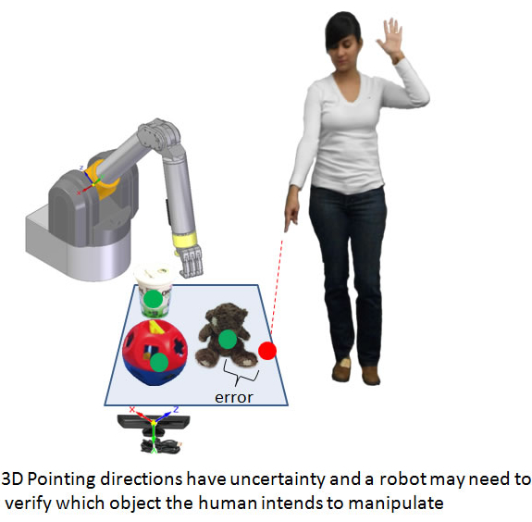
Hands-Free Target Selection

