Slide 1

Making better statistics easier with pcvr
Josh Sumner
Danforth Plant Science Center

Slide 2
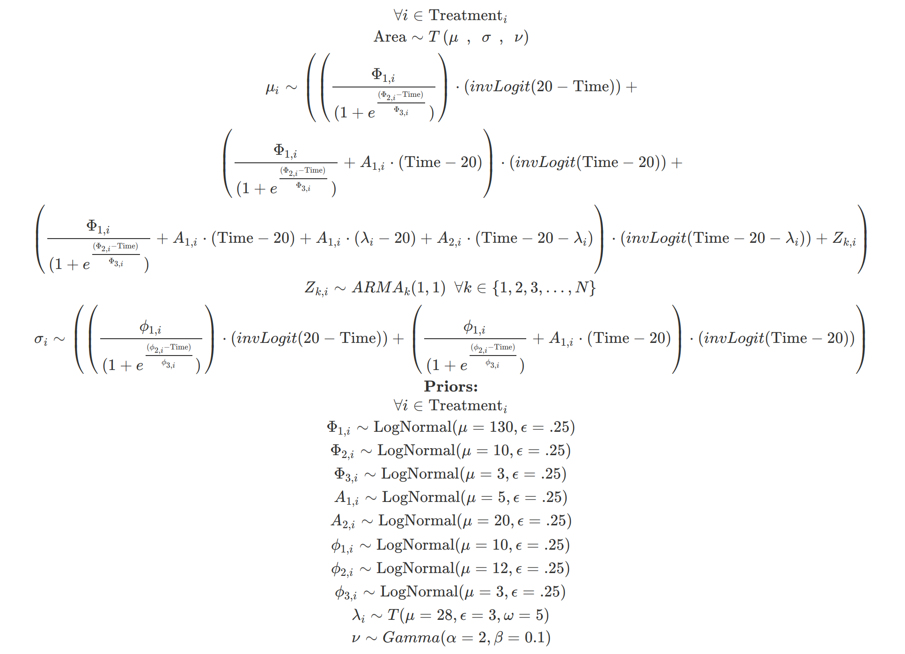
Models can get pretty complicated
Writing complex models ad-hoc is hard.

Slide 3
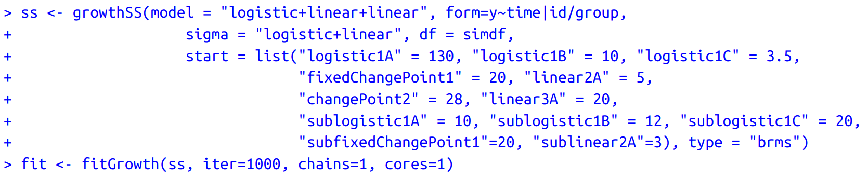
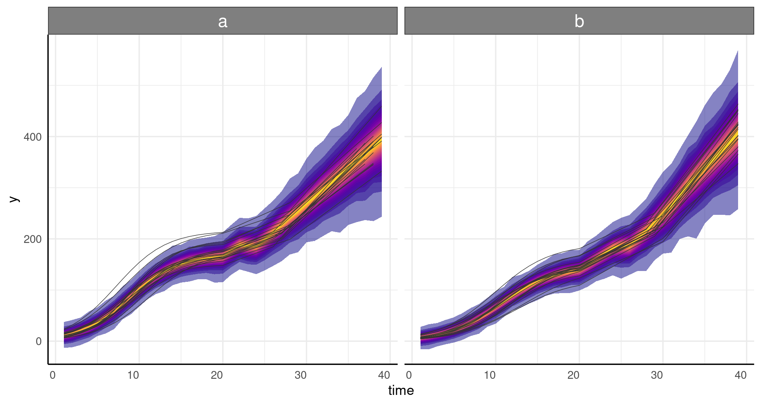

Pcvr makes this easier:
logistic+linear+linear

