Slide 1

pcvr
Josh Sumner
Danforth Plant Science Center

Slide 2
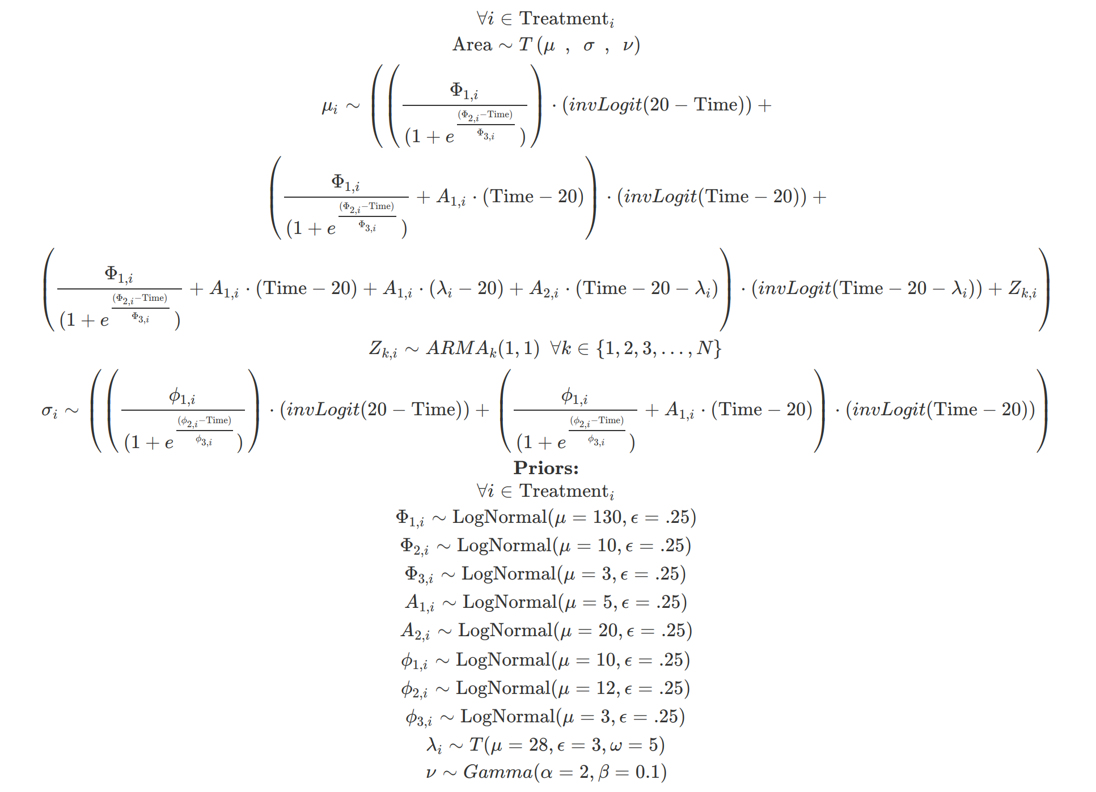
Plants grow, therefore:

Slide 3
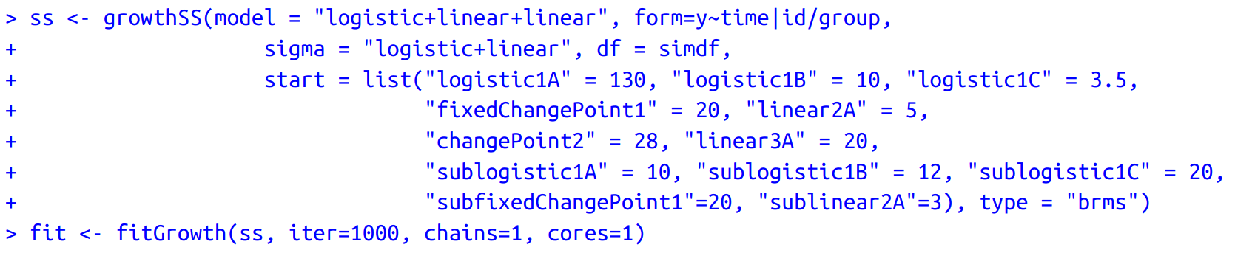

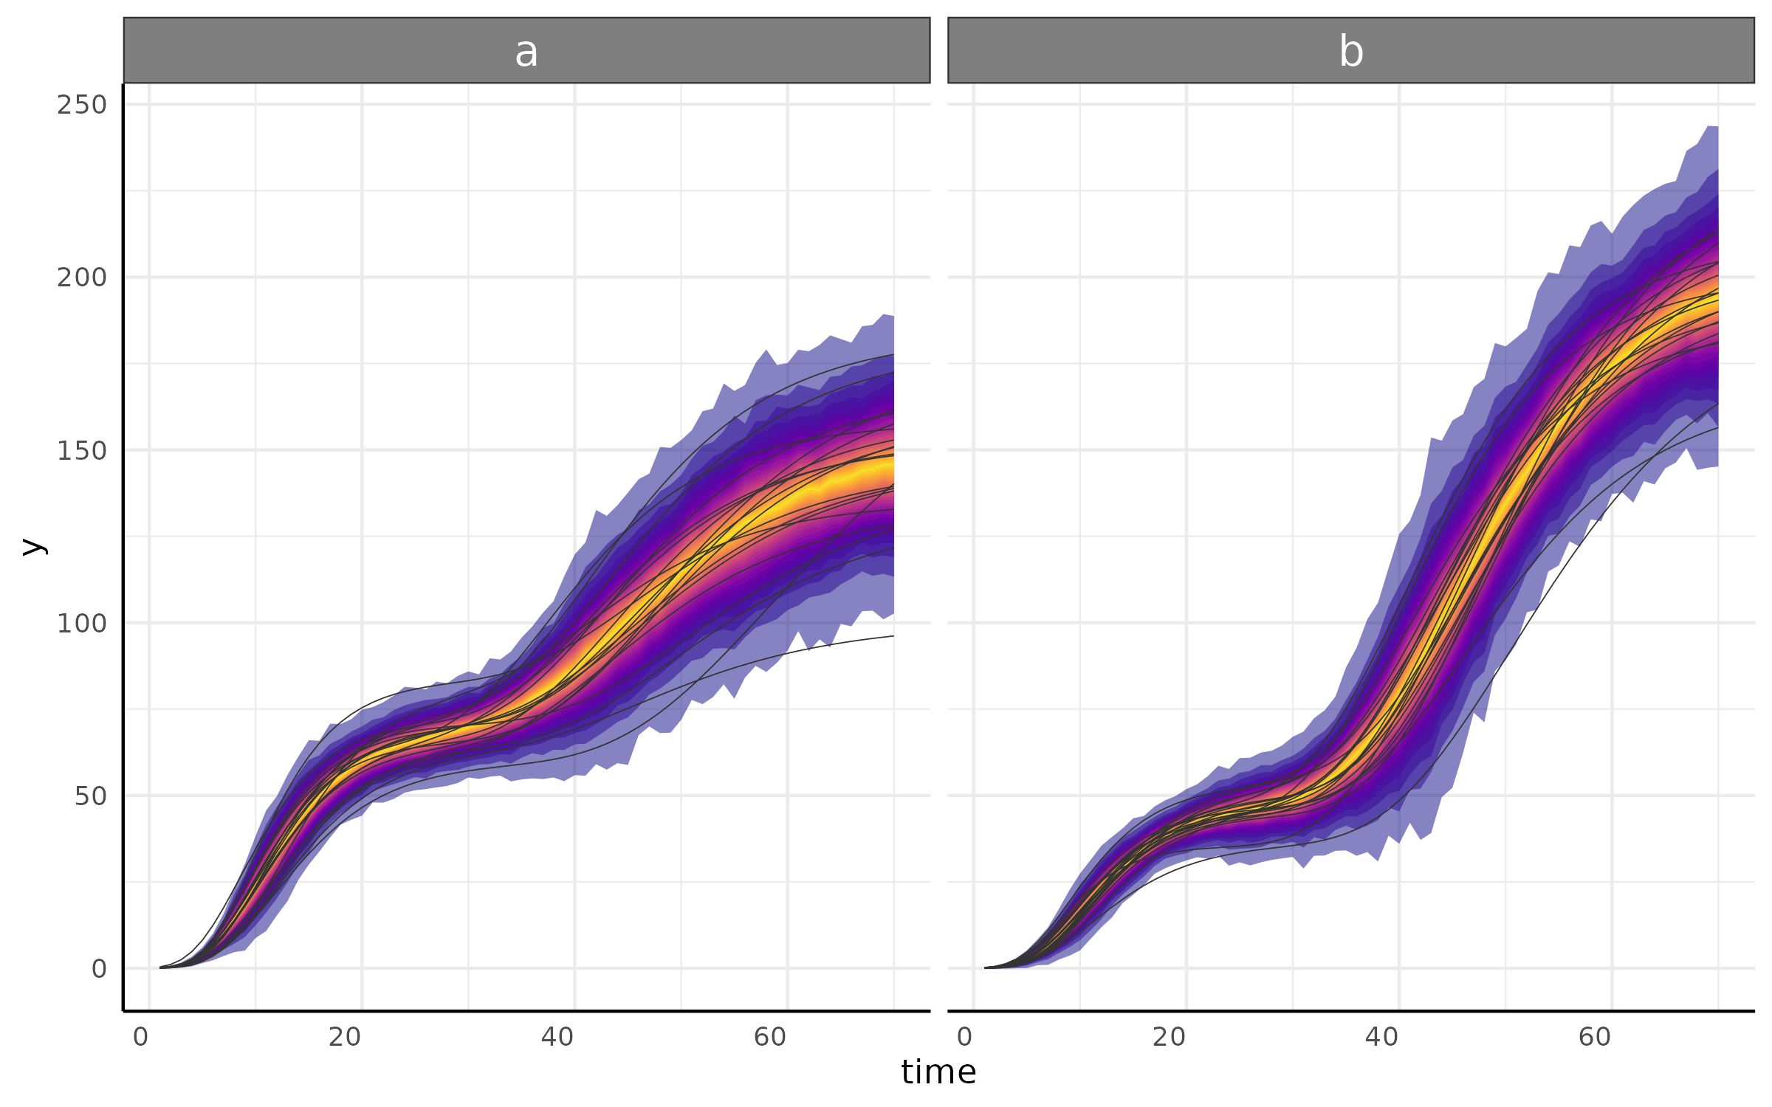
Or in pcvr::

