Slide 1

Case Studies
INSIDER THREATS

Slide 2

Overview
98% of companies reports feeling a level of vulnerability to insider threats
As of 2022, insider threat attacks have risen by over 44% in the past two years, with the average cost per incident reaching over $15 million
Failing to detect insider threats can lead to data loss and system downtime. As a result, companies can face steep costs, including fines, lawsuits, incident mitigation work and reputation damage.

Slide 3
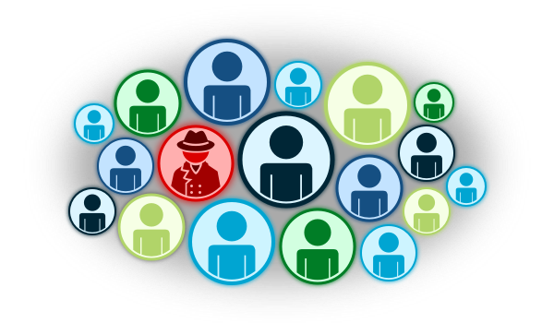
What Is An Insider Threat
A malicious insider is an adversary who operates inside the trusted computing base, basically a trusted adversary
The insider threat is an adversarial model encompassing all possible malicious insiders

Slide 4

Most Dangerous Insiders
Insider Threats typically breach systems either deliberately or accidentally, or through data theft, where an outsider steals an employee’s credentials and uses them to infiltrate the network
The most dangerous insiders are:
Privileged users and administrators
Regular employees
Third-parties and temporary workers
C-level executives who have access to the most sensitive and confidential information

Slide 5


Examples of Insider Threat
Equifax Data Breach - occurred because a single employee failed to follow security warnings and didn’t update the system
Amazon Insider Trading - In 2020, confidential financial data was shared by an employee to their family members in a form of insider trading

Slide 6
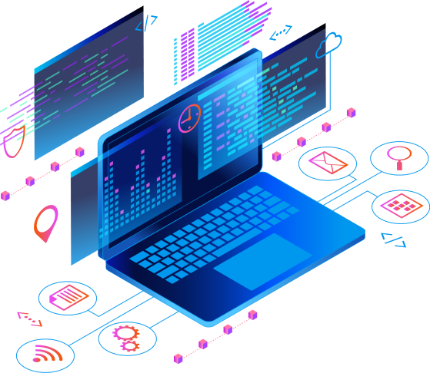
Indicators of Potential Insider Threats
Life Circumstances
Financial Difficulties
Alcohol or substance abuse
Untreated mental health issues
Divorce/Death of a spouse
Unexplained or sudden Affluence
Unreported foreign contact and travel
Extreme, persistent interpersonal behavior
Hostile or Vindictive Behavior
Otherwise unusual behavior

Slide 7
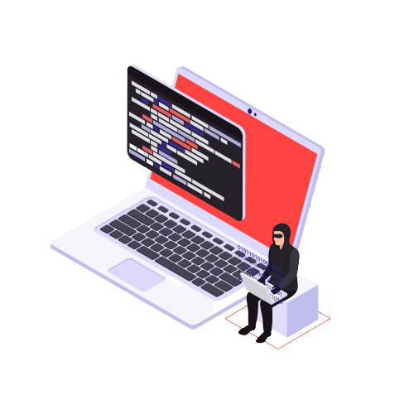
Indicators of Insider Threats
Other Indicators
Unusual Logins
Use or repeated attempted use of unauthorized applications
An increase in escalated privileges
Excessive downloading of data

Slide 8
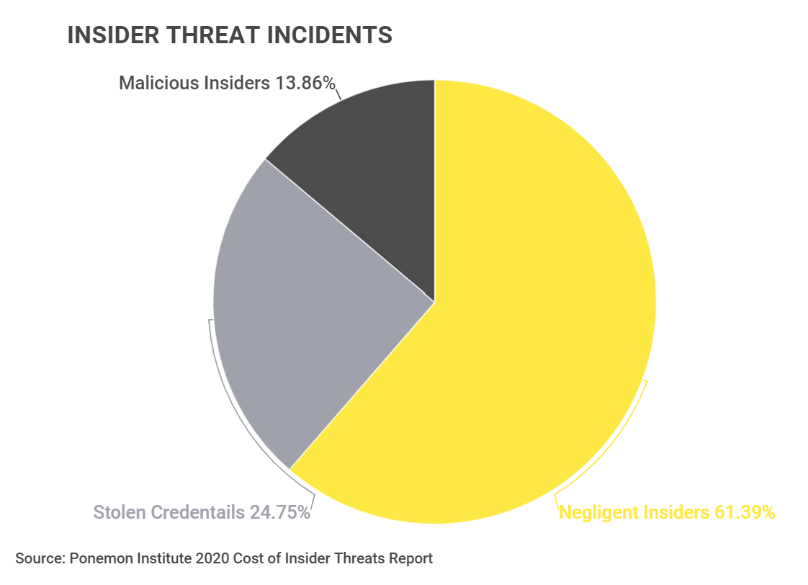
Types of Insider Threat Incidents
Data corruption, deletion, and modification
Leaking sensitive data
Denial of service attacks
Blackmail
Theft of corporate data
Negligence

Slide 9
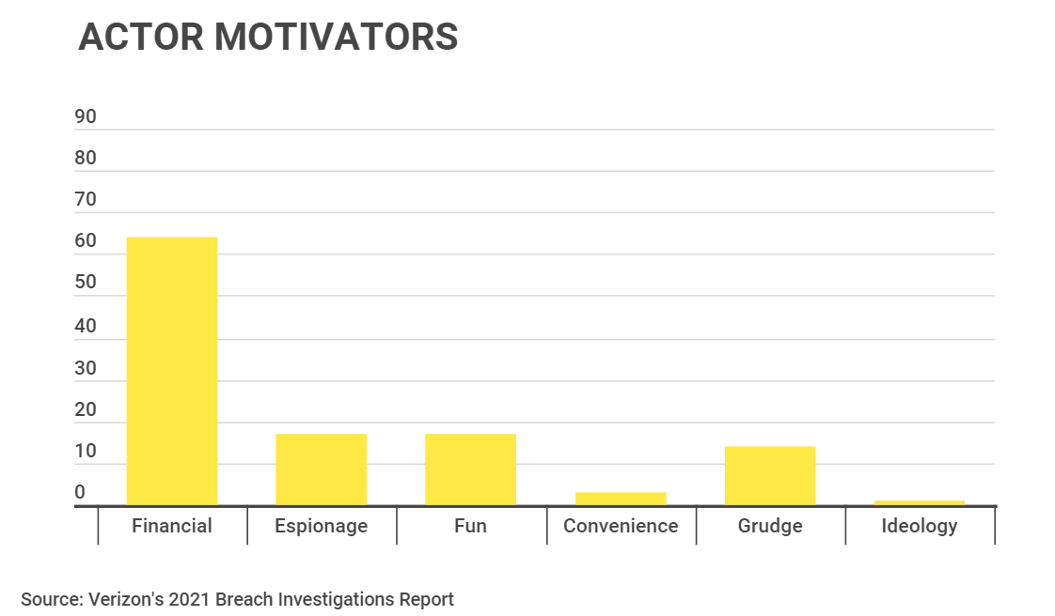
Motivations of an Insider Threat Actor
Financial - 64%
Espionage - 17%
Fun - 17%
Convenience - 3%
Grudge - 14%
Ideology - 1%

Slide 10
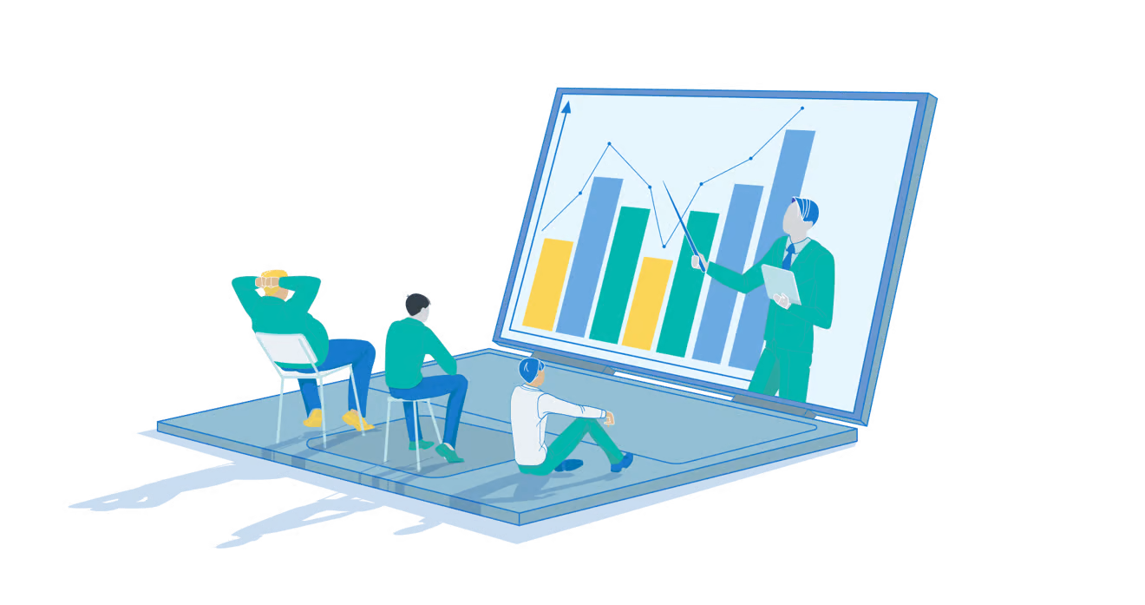
Insider Threat Monitoring
28% of firms report using automation to monitor user behavior
14% of firms don’t monitor user behavior at all
28% of firms only monitor access logs
17% of firms only monitor specific user activity under specific circumstances
10% of firms only monitor user behavior after an incident has occured

Slide 11
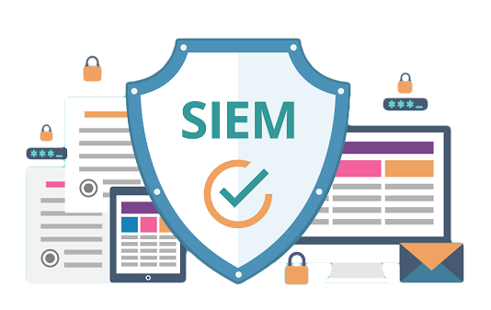
Insider Threat Detection through SIEM
SIEMs collect data across the entire network and enable security teams to easily analyze the data
SIEMs enable real time tracking of security threats across a company’s entire network,and are a foundational platform of Security Operations Centers (SOCs)

Slide 12

Insider Threat Detection through SIEM
SIEMs Provide:
Data storage
Threat intelligence aggregation
Threat detection
Threat Alerts and Notifications
Government Regulation compliance

Slide 13
Resources
https://www.cisa.gov/detecting-and-identifying-insider-threats
https://www.coresecurity.com/blog/five-malicious-insider-threat-indicators-and-how-mitigate-risk
https://dl.dod.cyber.mil/wp-content/uploads/trn/online/disa_cac_2022_final_web/pdf/DISA_CAC2022_InsiderThreat.pdf
https://www.tessian.com/blog/insider-threat-statistics/
https://www.proofpoint.com/us/resources/threat-reports/cost-of-insider-threats#:~:text=As%20the%202022%20Cost%20of,a%20third%20to%20%2415.38%20million.
https://arcticwolf.com/resources/blog/insider-threats-underscore-the-importance-of-managed-siem/

