Slide 1
UK Greenhouse Gas Emissions over the last 30 Years
Data Visualisation Coursework

Slide 2
Abstract
Greenhouse gas emissions data, and energy consumption data, was extracted from excel files sourced from the Office for National Statistics (ONS) website.
Using python and the Matplotlib library, a series of visualisations were produced – showing how energy consumption and greenhouse gas emissions have developed over time.
The visualisations demonstrated:
Emissions and fossil fuel consumption have been falling, with the Utilities industry (electricity and gas) accounting for the greatest amount of the overall decrease.
A strong relationship between fossil fuel consumption and greenhouse gas emissions
The overall transition to renewable energy sources is increasing exponentially. However, the average proportion of energy coming from renewable sources across each industry is increasing only slowly.
Notes:
Talk about problem

Slide 3



Introduction
IPCC special report - keep global warming below 1.5 °C, or else risk climate disaster (IPCC, 2018).
Greenhouse gas emissions from human activities are the most significant contributor to climate change (US EPA, 2022).
The burning of fossil fuels produces the most greenhouse gas emissions (US EPA, 2021).
In this presentation, ONS data on the UK's greenhouse gas emissions and fuel consumption are explored using a variety of visualisation techniques.
Notes:
IPCC Report: https://archive.ipcc.ch/report/sr15/pdf/sr15_citation.pdf or https://en.wikipedia.org/wiki/Special_Report_on_Global_Warming_of_1.5_°C#cite_ref-IPCC_2018_SR15_1-1
US EPA Climate change + ghg: https://www.epa.gov/climate-indicators/greenhouse-gases
US EPA GHG + fossil fuels: https://www.epa.gov/ghgemissions/sources-greenhouse-gas-emissions
Points:
- In 2018, the IPCC published a special report on global warming and the need to keep it below 1.5 °C, or else risk climate disaster (IPCC, 2018).
- According to the US Environmental Protection Agency, greenhouse gas emissions from human activities are the most significant contributor to climate change (US EPA, 2022).
- The human activity which produces the most greenhouse gas emissions is the burning of fossil fuels (US EPA, 2021).
- In this presentation, ONS data on the UK's greenhouse gas emissions and fuel consumption are explored using a variety of visualisation techniques to understand how they have developed over time.

Slide 4
Dataset Description

Slide 5
The Data
Greenhouse gas emissions, and renewable and non-renewable energy consumption data from Office for National Statistics.
Definitions:
CO₂ equivalent – measure used to compare various greenhouse gases on their Global Warming Potential (GWP).
Mega tonnes oil equivalent (Mtoe) – amount of energy produced by burning a mega tonne of oil.
Note: most recent emissions data goes up to 2020, most recent fuel consumption data goes up to 2019
Notes:
What data was used? Where is it from? Any prior definitions or decisions made regarding data to be aware of?
CO₂ equivalent – converts greenhouse gases to equivalent amount of CO₂ required for same GWP.

Slide 6
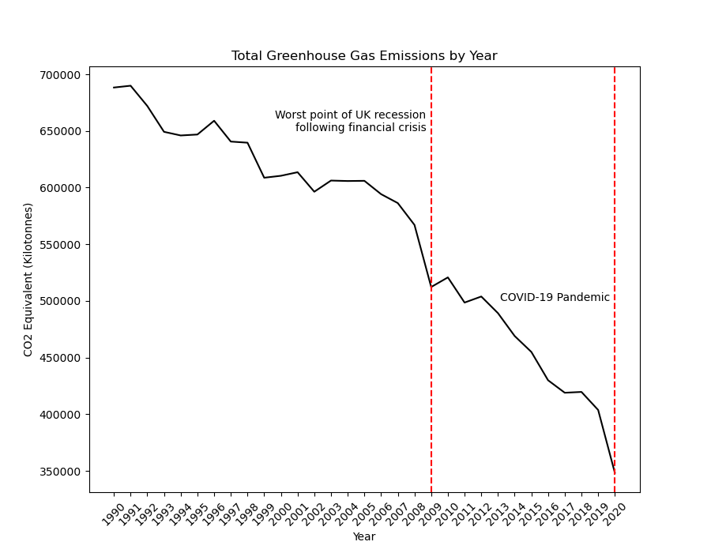
Annual greenhouse gas emissions
Downward trend since 1990
Interestingly, the two sharpest dips happened during financial crises:
2009 recession (ONS, 2022) following 2007/2008 financial crisis
2020 COVID-19 Pandemic
Will have to wait and see whether emissions bounce back.
Notes:
GDP (recession) data: https://www.ons.gov.uk/economy/grossdomesticproductgdp

Slide 7
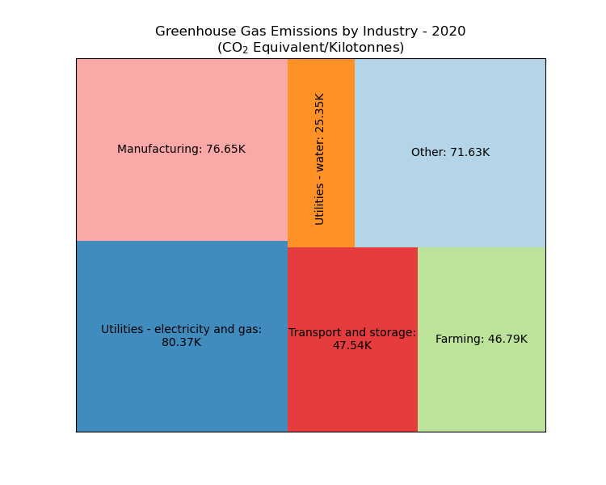
Greenhouse gas emissions 2020 by industry
3 industries make up more than half of total emissions in 2020

Slide 8
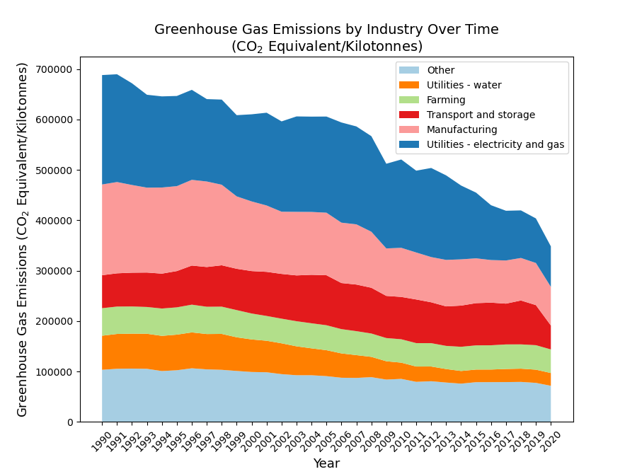
Greenhouse gas emissions by industry over time
Reinforces narrative from line chart.
Overall decrease attributable to the largest emitters.
Smaller emitters show less absolute decrease in emissions.

Slide 9
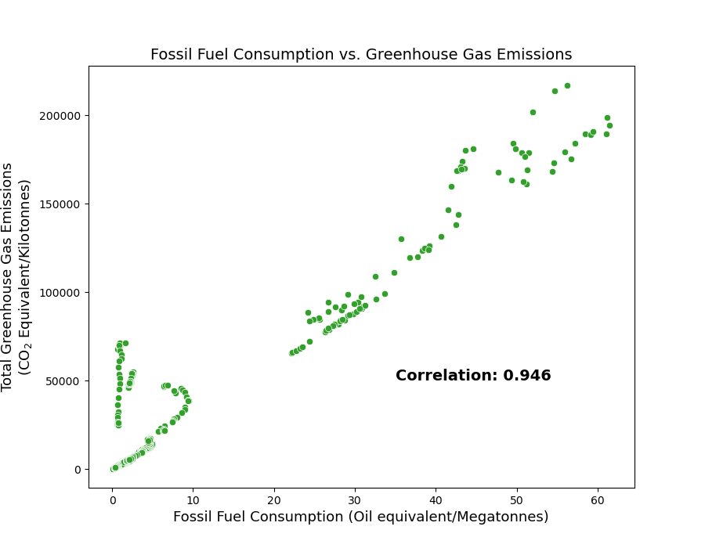
Fossil fuel consumption vs. greenhouse gas emissions
Very strong linear relationship between fossil fuel consumption and greenhouse gas emissions – reinforced by correlation value.
Correlation is not causation. However, fuel (energy) consumption is worth exploring.

Slide 10
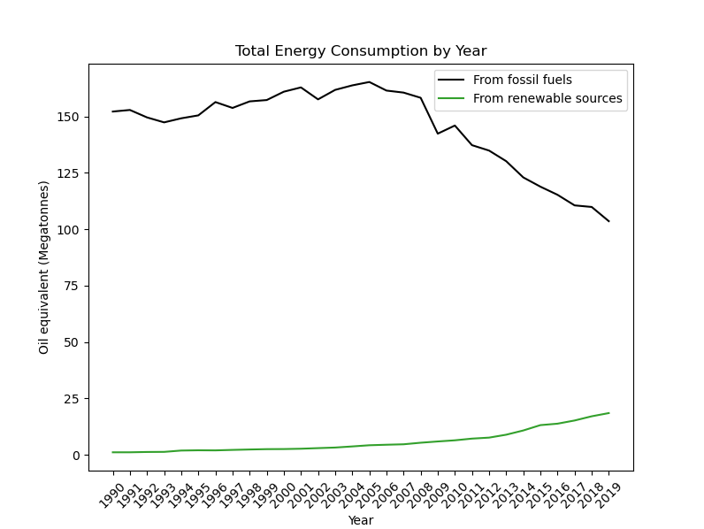
Total energy consumption over time
Decline in fossil fuel consumption like decline in greenhouse gas emissions.
Rise in renewables doesn’t compensate fossil fuel decrease
Fossil fuel consumption continues to decline beyond 2019 (UK GOV, 2022).
Notes:
https://assets.publishing.service.gov.uk/government/uploads/system/uploads/attachment_data/file/1064799/Energy_Trends_March_2022.pdf. Government report link.

Slide 11
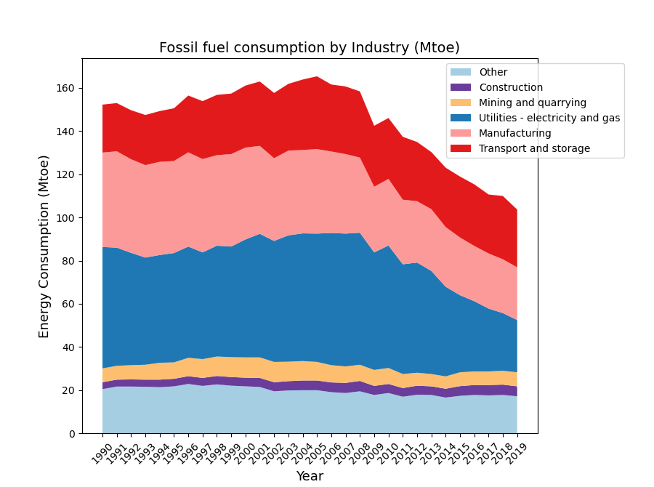
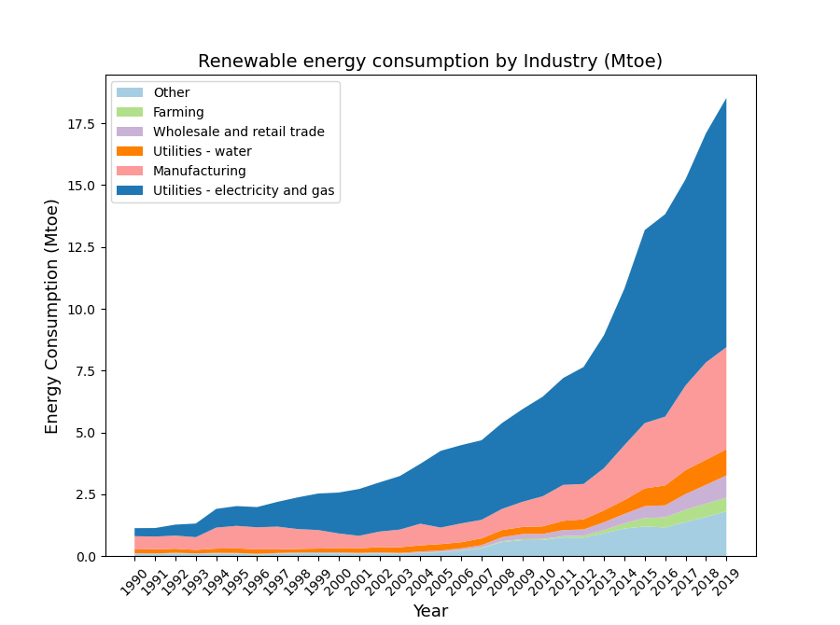
Energy consumption by industry over time.
Notes:
Echoes line chart
Unsurprisingly, industries which appeared in ghg emissions area chart are also appearing here
Large industries: utilities and manufacturing leading the transition to renewables
Transport sector failed to substantially decrease its fossil fuel consumption and isn't adopting renewable sources at the same rate as other large industry

Slide 12
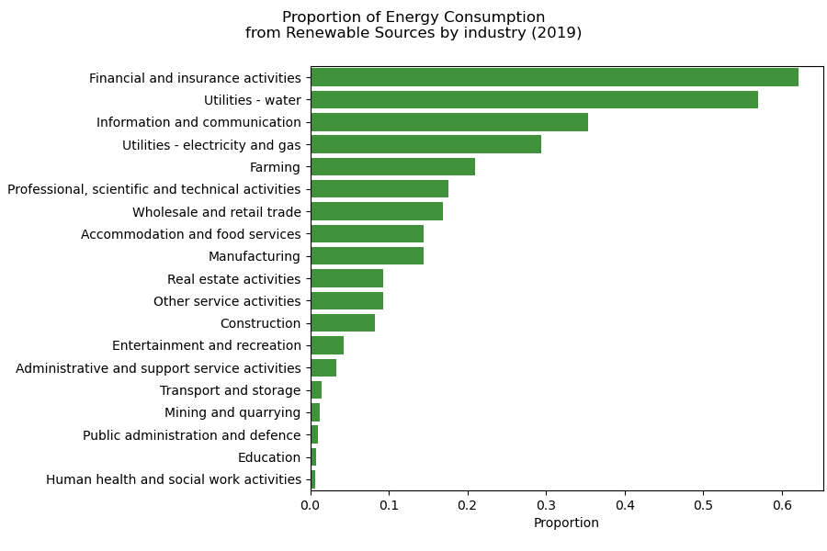
Proportion of energy from renewable sources
Industries with smaller absolute greenhouse gas emissions appear to be ahead.
Demonstrates lack of migration to renewables by the transport industry, shown in previous slide.
Notes:
Assumes that total energy consumption can be found by adding fossil fuel and renewables data (same source). Should the bar chart be sorted?

Slide 13
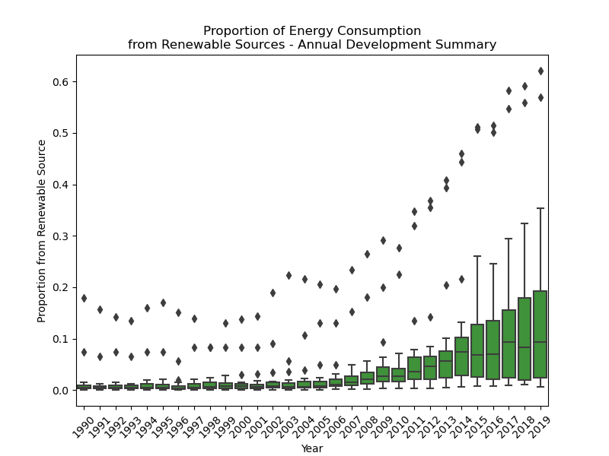
Proportion of energy from renewable sources over time
Mean is gradually increasing, but spread seems to be growing exponentially
Suggesting accelerated transition in some outlier industries.
Notes:
- Shows how the proportion of energy coming from renewable sources has changed over the years.
- Some industries are adapting, others aren’t - leading to larger spread.
- Mean is gradually increasing, but spread seems to be growing exponentially - suggesting accelerated transition in some industries.

Slide 14
Discussion

Slide 15
What did the visualisations need to convey?
Change over time of emissions, energy consumption and renewable energy adoption
Part-to-whole composition of both emissions and consumption
Comparison between values of each industries’ adoption of renewable energy
Relationship between data - fossil fuel consumption and greenhouse gas emissions
Which charts were used, and why?

Slide 16
Line Charts and Box Plots
Line charts
Very clearly shows change over time, with no ambiguity and minimal effort required for understanding of plot.
Clearly show emissions and energy consumption have developed over time.
Box plot
Each time period has box and whiskers plot. Best for showing the distribution of values for multiple time periods.
Shows development of renewable fuel adoption across UK industries.
Notes:
Box plot - serves purpose, is clear, and is simple to interpret, but requires non-trivial level of understanding of how to read graphs and charts.

Slide 17
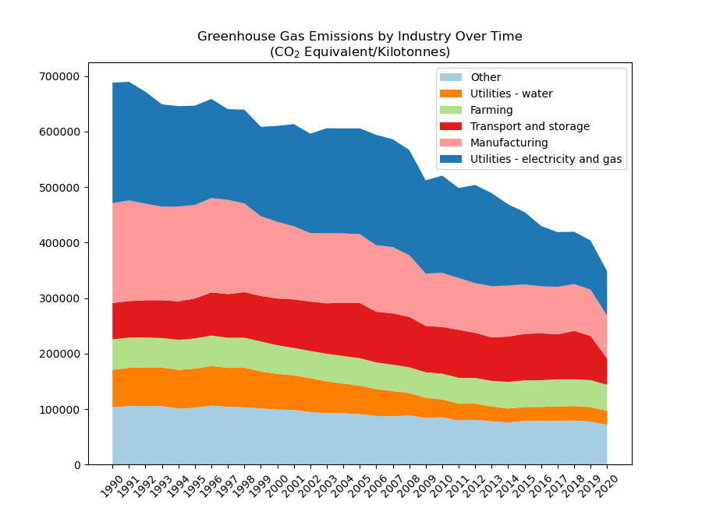
Tree Maps and Area Charts
Tree Maps
Area of sub-boxes proportional to a variable’s value for each industry.
Intuitively shows which industries contribute most to level of greenhouse gas emissions or energy consumption in a particular year.
Area Charts
Effectively a line chart with a shaded region underneath to divide total into sub-groups.
Combines the simplicity of a line chart with the intuitiveness of a tree map.
Used as an extension of tree maps to show how each industry’s contribution to total emissions or consumption developed over time.

Slide 18
Bar Chart
Used for comparing the extent to which renewable energy sources have been adopted by each industry.
Bar charts offer an easy-to-grasp way of comparing numeric values.
Note the horizontal orientation of the chart used – this accommodates the long industry names

Slide 19
Scatter Plot (and single-value chart)
Scatter plots are a standard chart for showing relationships between to variables
Single-value charts are best for reporting individual numbers, instead of plotting them graphically – such a plot would not be meaningful
Combination of scatter plot with single-value chart allows:
Visual assessment of the relationship between fossil fuel consumption and greenhouse gas emissions
Statistic which illustrates the strength of the linear relationship

Slide 20
Brief notes on colour choices
Used colorbrewer tool to select 12 easily distinguishable colours used for different industries across visualisations.
Used green and black to highlight renewable vs fossil fuels.
Used red to highlight key years.

Slide 21
Thank you for listening!

Slide 22
Appendix

Slide 23
Code
GitHub Repository: https://github.com/danful/data_vis_portfolio
Datasets
Greenhouse gas emissions: https://www.ons.gov.uk/economy/environmentalaccounts/datasets/ukenvironmentalaccountstotalenergyconsumptionbyindustry
Fossil fuel energy consumption: https://www.ons.gov.uk/economy/environmentalaccounts/datasets/ukenvironmentalaccountstotalenergyconsumptionbyindustry
Renewable energy consumption: https://www.ons.gov.uk/economy/environmentalaccounts/datasets/ukenvironmentalaccountsenergyconsumptionfromrenewableandwastesources
Colours
Colorbrewer: https://colorbrewer2.org/#type=qualitative&scheme=Paired&n=12

Slide 24
References

Slide 25
IPCC (2018) Global Warming of 1.5 °C. An IPCC Special Report on the impacts of global warming of 1.5 °C above pre-industrial levels and related global greenhouse gas emission pathways, in the context of strengthening the global response to the threat of climate change, sustainable development, and efforts to eradicate poverty. Available at: https://www.ipcc.ch/sr15/ (Accessed: 24 April 2022).
ONS (2021) Atmospheric emissions: greenhouse gases by industry and gas. Available at: https://www.ons.gov.uk/economy/environmentalaccounts/datasets/ukenvironmentalaccountsatmosphericemissionsgreenhousegasemissionsbyeconomicsectorandgasunitedkingdom (Accessed: 2 April 2022)
ONS (2021) Energy use: total. Available at: https://www.ons.gov.uk/economy/environmentalaccounts/datasets/ukenvironmentalaccountstotalenergyconsumptionbyindustry (Accessed: 2 April 2022)
ONS (2021) Energy use: renewable and waste sources. Available at: https://www.ons.gov.uk/economy/environmentalaccounts/datasets/ukenvironmentalaccountsenergyconsumptionfromrenewableandwastesources (Accessed: 2 April 2022)
ONS (2022) Gross Domestic Product: chained volume measures: Seasonally adjusted £m. Available at: https://www.ons.gov.uk/economy/grossdomesticproductgdp/timeseries/abmi/qna (Accessed 20 April 2022)
UK GOV (2022) Energy trends. Available at: https://www.gov.uk/government/collections/energy-trends (Accessed 20 April 2022)
US EPA (2022) Climate Change Indicators: Greenhouse Gases. Available at: https://www.epa.gov/climate-indicators/greenhouse-gases (Accessed: 23 April 2022)
US EPA (2021) Sources of Greenhouse Gas Emissions. Available at: https://www.epa.gov/ghgemissions/sources-greenhouse-gas-emissions (Accessed: 23 April 2022)

