Slide 1
Ordering and Consistent Cuts
Edward Tremel
11/7/2013

Slide 2
Synchronizing Distributed Systems
Time, Clocks, and the Ordering of Events in Distributed Systems
How to agree on an order of events across asynchronous processes
Synchronized concurrent execution of a state machine
Synchronizing clocks across a network
Distributed Snapshots: Determining Global States of Distributed Systems
How to record state of a distributed system without losing information
Determining when a stable property is satisfied
Synchronizing phases of distributed computation

Slide 3
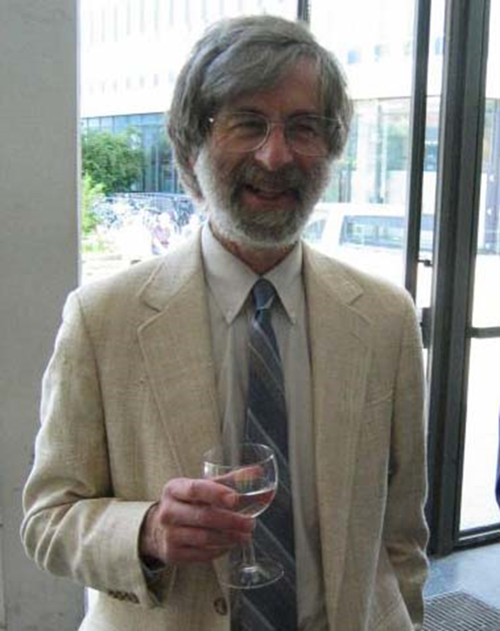
Or: Leslie Lamport Invents Things
Two of the most influential papers in distributed systems
Almost entirely original work by Leslie Lamport
Distributed Systems was still a brand-new field
PODC not until 1982
Notes:
Time, Clocks has only 4 references, 2 of which are physics textbooks
Distributed Snapshots has 11, one of which doesn’t exist

Slide 4
Also Invented by Lamport
Sequential consistency
Bakery algorithm
Mutual exclusion without hardware support
Atomic registers
Byzantine Generals’ Problem
Paxos Algorithm
Temporal Logic of Actions
LaTeX
Notes:
“Atomic register” means the theory and formal construction of atomic registers out of safe registers and regular registers

Slide 5
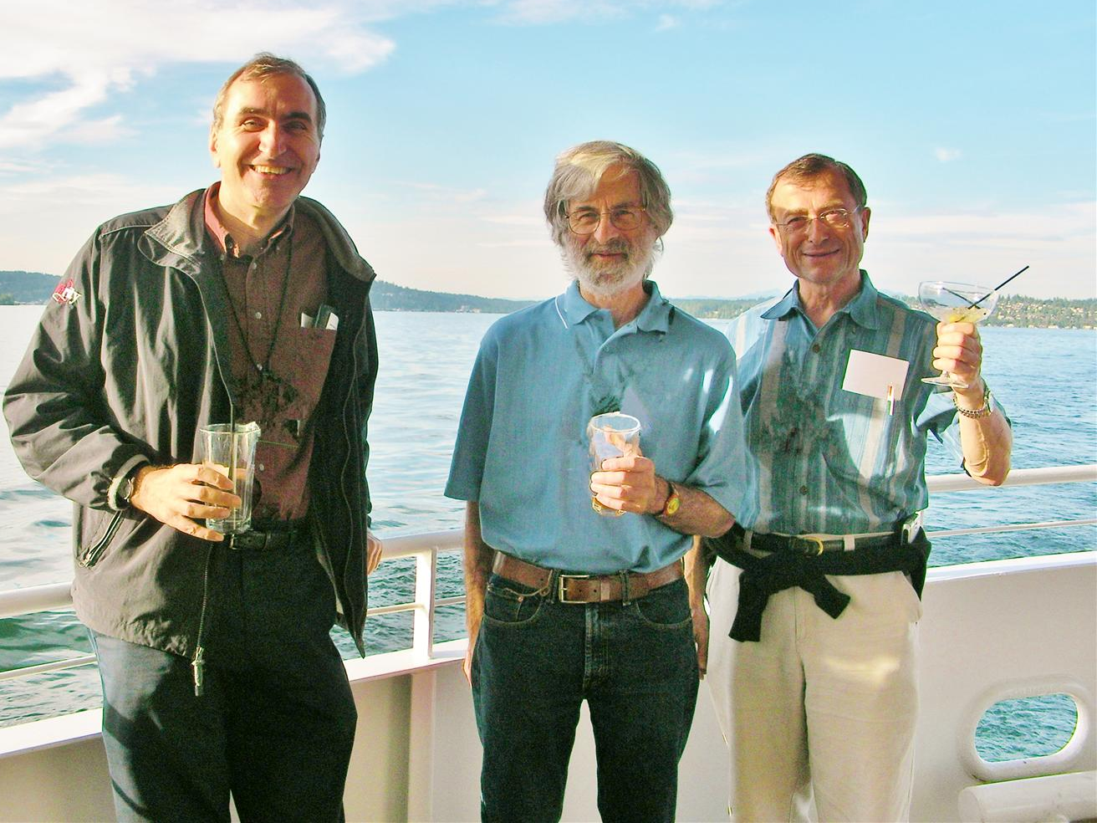
Leslie Lamport chilling on a boat with Andy van Dam
(left: Hector Garcia-Molina, distributed systems researcher)

Slide 6
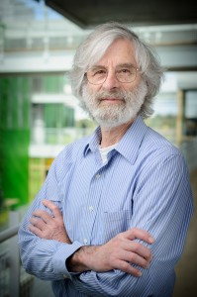
Biographical Highlights
BS in Math from MIT, 1960
MA, PhD in Math from Brandeis, 1972
Taught math at Marlboro College 1965-69
Research in industry
Massachusetts Computer Associates (1970-77)
SRI International (1977-85)
DEC/Compaq (1985-2001)
Microsoft Research (2001-)
Many awards, including 2000 PODC Influential Paper award for Time, Clocks, and the Ordering of Events
Notes:
On his math thesis: “I learned nothing about analytic partial differential equations except what was needed for my thesis research, and I have never looked at them since then.”
After completing math degree, left math for computer science

Slide 7
Time, Clocks, and the Ordering of Events in a Distributed System
Written by Lamport in 1978
Inspired by The Maintenance of Duplicate Databases (Paul Johnson and Bob Thomas)
Database update messages must be timestamped
Updates are ordered by timestamp, not message receive order
Did not account for clock inconsistency
Intended goal: Show how to implement arbitrary distributed state machine
Notes:
“It didn't take me long to realize that an algorithm for totally ordering events could be used to implement any distributed system. A distributed system can be described as a particular sequential state machine that is implemented with a network of processors. The ability to totally order the input requests leads immediately to an algorithm to implement an arbitrary state machine by a network of processors, and hence to implement any distributed system. So, I wrote this paper, which is about how to implement an arbitrary distributed state machine. As an illustration, I used the simplest example of a distributed system I could think of--a distributed mutual exclusion algorithm.”

Slide 8
Setup
Assumption: Distributed systems don’t have a common (physical) clock
Still need to agree on when events happened
Nodes in distributed system have shared state, must apply updates in same order to stay consistent
Examples:
Bank servers at different branches, need to know order of transactions
Distributed database, need to know when value was added or changed
Distributed filesystem, need to know order of writes
Distributed lock manager, need to agree on who got the lock

Slide 9
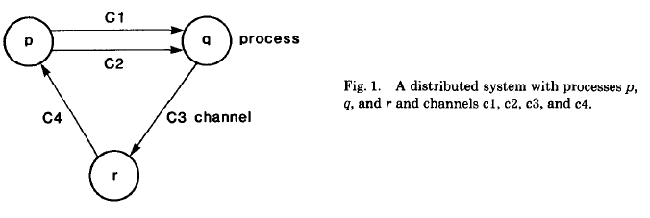
Setup
Assumption: Distributed systems communicate by sending messages over directed channels
No other way to share state between nodes
No Ethernet (shared line)
Basically the same model as microkernel processes
Assumption: Channels are FIFO ordered and reliable

Slide 10
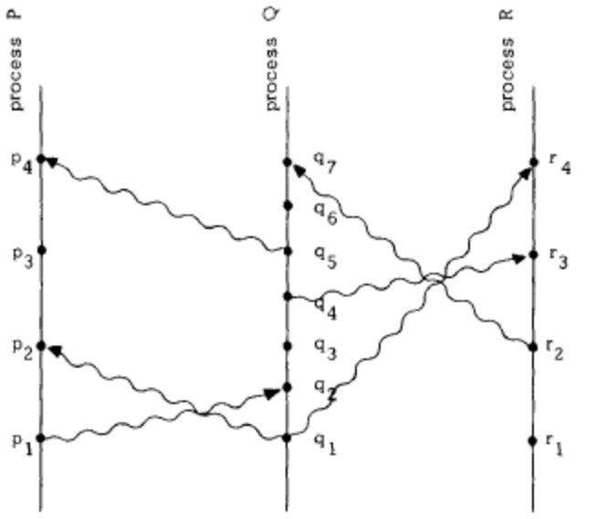
“Happened Before”
Fig. 1 from Time, Clocks, and the Ordering of Events
Notes:
How would you describe order of events in this system? We can see that p1 happened before p2, q3 happened before q4, etc. We also know that p1 had to happen before q2, because a message can’t be received before it is sent. But p3 could come before or after q3, and we wouldn’t be able to tell the difference.

Slide 11
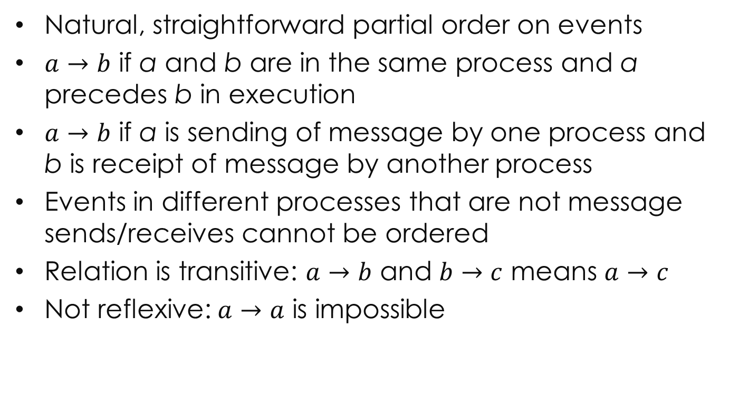
“Happened Before”
Natural, straightforward partial order on events
$a→b$ if a and b are in the same process and a precedes b in execution
$a→b$ if a is sending of message by one process and b is receipt of message by another process
Events in different processes that are not message sends/receives cannot be ordered
Relation is transitive: $a→b$ and $b→c$ means $a→c$
Not reflexive: $a→a$ is impossible

Slide 12
Logical Clocks
Concrete representation of “happened before”
Each process has a clock
Assigns a number to an event
Event = send message, receive message, computation (internal)
Monotonically increasing
If a and b are events in process i and a comes before b, then C_{i}(a) < C_{i}(b)
If a is the sending of a message by process i, and b is the receipt of the message by process j, then C_{i}(a) < C_{j}(b)

Slide 13
Visualizing Clock Ticks
Figs. 2 and 3 from Time, Clocks, and the Ordering of Events

Slide 14
Synchronizing Clocks
C₁
1
2
3
7
8
p₁
T_{m}=2
T_{m}=6
p₂
C₂
1
2
3
4
5
6
7
Clock increments between events
Every message sent with timestamp of sending process
When process receives message, it must advance its clock to greater than message’s timestamp

Slide 15
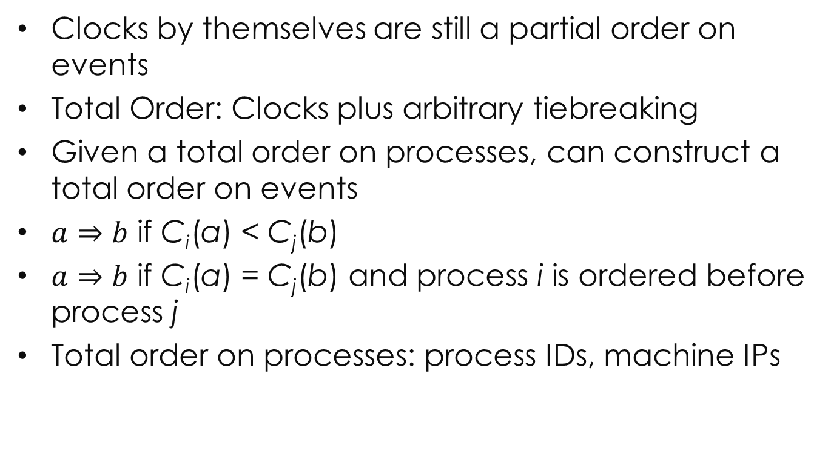
Ordering Events
Clocks by themselves are still a partial order on events
Total Order: Clocks plus arbitrary tiebreaking
Given a total order on processes, can construct a total order on events
$a⇒b$ if C_{i}(a) < C_{j}(b)
$a⇒b$ if C_{i}(a) = C_{j}(b) and process i is ordered before process j
Total order on processes: process IDs, machine IPs
Notes:
Happened Before is the only way to order events in distributed system without clocks

Slide 16
State Machine Replication
Each process keeps its own copy of the state
Processes send messages with commands
Command messages are cached and acknowledged
A process can execute a command when it has learned of all commands issued before that command’s timestamp
Progress guaranteed because communication channels are reliable and FIFO
State machine replication without reliable channels: much harder problem, also solved by Lamport

Slide 17
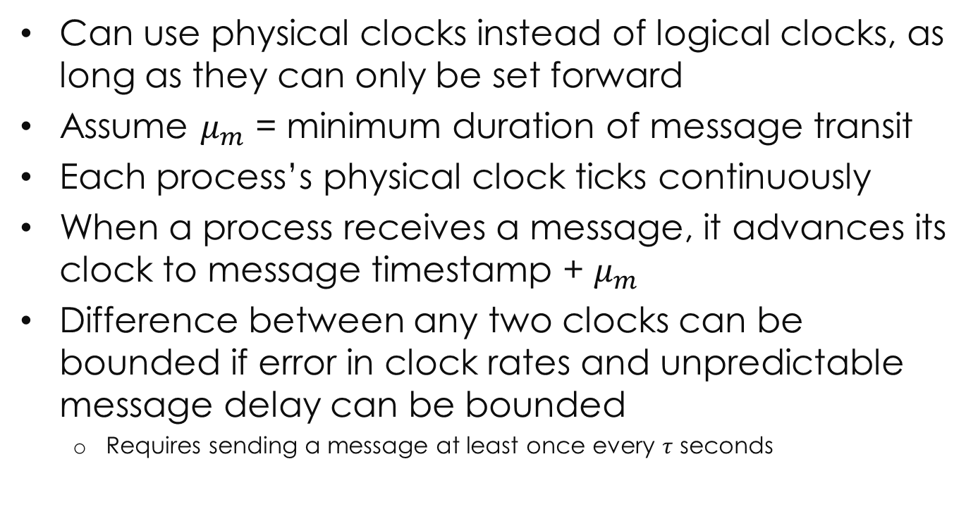
Physical Clocks
Can use physical clocks instead of logical clocks, as long as they can only be set forward
Assume $μ_{m}$ = minimum duration of message transit
Each process’s physical clock ticks continuously
When a process receives a message, it advances its clock to message timestamp + $μ_{m}$
Difference between any two clocks can be bounded if error in clock rates and unpredictable message delay can be bounded
Requires sending a message at least once every $τ$ seconds

Slide 18
Significance
Lamport’s opinion:
“Jim Gray once told me that he had heard two different opinions of this paper: that it's trivial and that it's brilliant. I can't argue with the former, and I am disinclined to argue with the latter.”
References: 4
Citations: 8196
Basis of vector clocks (Fidge), which are often used in distributed systems
Also network time, Paxos protocol
But most people remember it for causality relation or distributed mutual exclusion, not state machines

Slide 19
Questions
Is this brilliant? Trivial? Both?
What’s more important: intended goal or remembered result?
Is application to physical clocks necessary or helpful?
What about inescapable forward drift? Clocks can’t be set back…

Slide 20
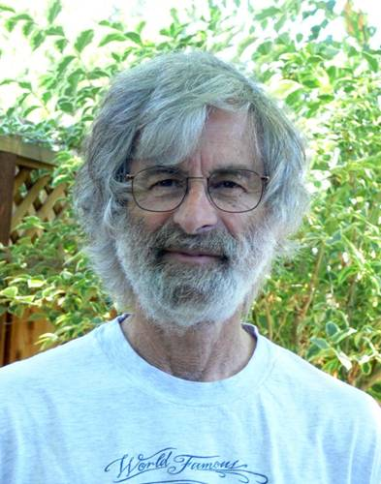

Distributed Snapshots
Leslie Lamport
At this point, working at Stanford Research Institute (SRI International)
K. Mani Chandy
PhD from MIT in EE, 1969
Professor at UT Austin 1970-89
Professor at Caltech since 1989

Slide 21
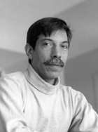
Origins of the Paper
“The distributed snapshot algorithm described here came about when I visited Chandy, who was then at the University of Texas in Austin. He posed the problem to me over dinner, but we had both had too much wine to think about it right then. The next morning, in the shower, I came up with the solution. When I arrived at Chandy's office, he was waiting for me with the same solution. I consider the algorithm to be a straightforward application of the basic ideas from [Time, Clocks, and the Ordering of Events in Distributed Systems].”
—Leslie Lamport
Acknowledgements: Dijkstra, Hoare, Fred Schneider
Notes:
Source: Conversation with Leslie Lamport, while drinking wine.

Slide 22
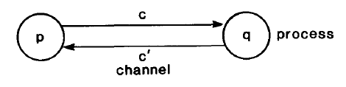
The Problem
Recording state of a distributed system is important
Determining stable properties, such as “phase completed”
No way to ensure all nodes record state at “exactly” the same time
Naïve solution can record an impossible state
Record state of p and c’ while p has token
Then p sends token along c
Record state of q and c, showing token is in c
Snapshot shows token in two places, but only one token exists!

Slide 23
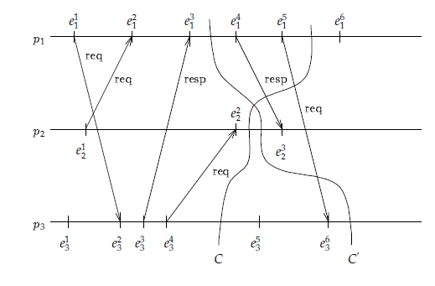
Consistent Cuts
consistent
inconsistent
Need a consistent cut: If an event is in the snapshot, all events that happen before it must be in snapshot
(image copied from Dinesh Bhat’s 2010 presentation)

Slide 24
The Solution
Send a marker along all channels immediately after recording state
Upon receipt of a marker along channel c:
Record process state if not already recorded
Record state of c as all messages received between recording process state and receiving marker
Eventually markers will reach all processes, so all state will be recorded

Slide 25
Assumptions
Graph of processes is strongly connected
If your network is really Ethernet, it is
Processes can atomically record their own state
Processes keep log of messages received
Processes do not fail
Channels are still reliable and FIFO
There is some way to collect the snapshot from all nodes once done recording

Slide 26
Example
p
q
1
2
s
r
(shamelessly stolen from Isaac’s presentation last year)
Notes:
Messages in flight from p to r and q to s when algorithm starts

Slide 27
Example
p
q
1
2
s
r
r’s state
Notes:
R starts by recording its state and sending a marker (note directed channels)

Slide 28
Example
p
q
1
3
2
s
r
r’s state
s’s state
Notes:
S records its state and sends markers. Q sends another message to s.

Slide 29
Example
p
q
1
3
s
r
2
r’s state
s’s state
Notes:
When s receives a message, it records it in the snapshot of its channel from q

Slide 30
Example
p
q’s state
q
1
3
s
r
4
2
r’s state
s’s state
Notes:
Q takes a snapshot and sends out a marker. Meanwhile r continues processing and sends a message to s.

Slide 31
Example
p’s state
p
q’s state
q
1
3
s
r
2
r’s state
s’s state
Notes:
P takes a snapshot and sends a marker, meanwhile s processes and does not record r’s message 4

Slide 32
Example
p’s state
p
q’s state
q
s
r
2
1
3
r’s state
s’s state
Notes:
Messages received and logged

Slide 33
Example
p’s state
p
q’s state
q
s
r
2
1
3
r’s state
s’s state
Notes:
Marker received at s, so it can stop logging the channel from q

Slide 34
Example
p’s state
p
q’s state
q
s
r
2
1
3
r’s state
s’s state
Notes:
Marker received at r, so it can stop logging the channel from p

Slide 35
Properties of Snapshot
Produces a consistent cut: If a message’s receipt is recorded, then its sending is also recorded (FIFO)
Global system state recorded in snapshot may not have ever occurred
But it will be possible and reachable by a re-ordering of events within snapshot window
Sequentially consistent with state actually reached by system during snapshot
Only relative order of unconnected events on different processes is changed
Only events within snapshot window affected
Notes:
Some messages that were sent after one process recorded state and after another process recorded state may not appear at all in recording because they were behind markers

Slide 36
Significance
References: 11, one of which doesn’t exist
Citations: 2564
First “consistent cut” algorithm, basis of more complex ones such as Mattern’s
Useful for logging, fault-tolerance

Slide 37
Questions
This still assumes reliable, FIFO channels between processes. Is that reasonable?
Is the “sequentially consistent” snapshot good enough?
Are clocks actually necessary for this algorithm? (Lamport claims it’s an extension of clocks).
Is it efficient to use this algorithm for stability detection?

