Slide 1
Statistics and data analysis I
Week 13
“Hypothesis test”
2019.9th July.
Hirotada Honda

Slide 2
１．Summary on Interval estimation

Slide 3
Interval estimation on population mean
Two cases:
①In case the population variance, σ² , is known;
②In case the population variance is unknown.

Slide 4

Interval estimation on population mean
95%-CI when the population variance is known to be σ²：
Upper2.5-percentile of z-dist.
95%-CI when the population variance is unknown：
S:Unbiased SD.
Upper2.5-percentile of t-dist.
Two differences; percentile and SD.

Slide 5
Interval estimation with python
Pythonの人・・・Population variance is known→norm.interval
Population variance is
unknown→t.interval. You need df (=degree of freedom) also!

Slide 6
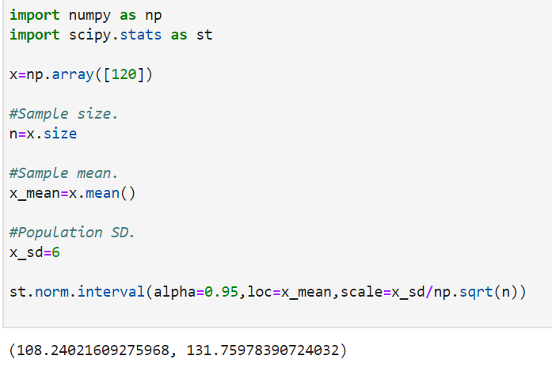
CI by python（Population SD is known）
Population SD

Slide 7
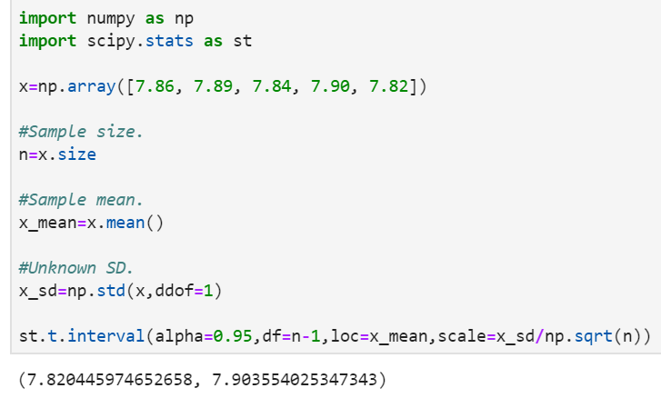
CI by python（Population SD is unknown）
Unbiased SD
Don’t forget df!

Slide 8
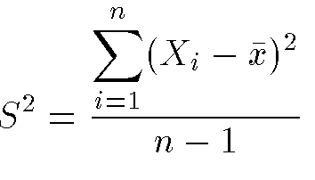
【Ref.】Sample SD and unbiased SD
In case the population variance σ² is unknown, you need to estimate it from the sample.
The estimator for the population variance σ² is, usually,the unbiased variance defiend as below ：

Slide 9
２．Hypothesis test

Slide 10
Hypothesis test
“Verifying a hypothesis though a statistical method”

Slide 11
Use cases
Ex①）A certain lady says concerning the milk tea: “By drinking a cup of milk tea, I can detect which of milk tea is inserted first.”
We tested this statement, and she really answered correctly 5 times in a row. Can we say she says “truth”?
Ex②)In a certain company, they trained the employees in different ways. After half a year passed from the start of the course, examine whether the training programs work well.

Slide 12
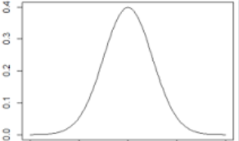
Quiz for population mean
Now we generate r.v.s that follow the normal dist. with R.
Based on the observed values, estimate the value of its expected value.

Slide 13
Quiz for population mean
Mr. A and Mr. B now make hypotheses (=null hypothesis).
Answer true or false.

Slide 14


Slide 15
Mr.A：「Expected value is 0.」
T/F?

Slide 16
Mr.B： 「Expected value is 10.」
T/F?

Slide 17
Mr.A seems (likely to be) true.
What Mr.B said is probably not true.
Why did you think so?

Slide 18
Normality is assumed.
If Mr. A is correct…
0
Observed data are around here.

Slide 19
If Mr. B is correct…
Observed data are around here.
→Seems not likely.
10

Slide 20
However, it might happen with a very low probability.
So we cannot assert that ‘what Mr.B said is absolutely false’.
⇒ The possibility of ‘incorrect conclusion’ should be taken into account.
10

Slide 21
However, it might happen with a very low probability.
So we cannot assert that ‘what Mr.B said is absolutely false’.
⇒ The possibility of ‘incorrect conclusion’ should be taken into account.
-’Might be incorrect with 5%-probability, but Mr.B’s hypothesis is probably not true.’

Slide 22
However, it might happen with a very low probability.
So we cannot assert that ‘what Mr.B said is absolutely false’.
⇒ The possibility of ‘incorrect conclusion’ should be taken into account.
-’Might be incorrect with 5%-probability, but Mr.B’s hypothesis is probably not true.’

Slide 23
However, it might happen with a very low probability.
So we cannot assert that ‘what Mr.B said is absolutely false’.
⇒ The possibility of ‘incorrect conclusion’ should be taken into account.
-’Might be incorrect with 5%-probability, but Mr.B’s hypothesis is probably not true.’
Significance level.
If this conclusion is acutually incorrect, then we say that it is type-I error. （asserted a correct hypothesis as incorrect）.

Slide 24
The spirit of hypothesis test is ‘The benefit of the doubt ’
In the sense that..
We assert ‘the (null) hypothesis is not true’ if and only if we can say so almost surely (i.e., 95%).

Slide 25
On the other hand, Mr.A’s hypothesis is actually true?
It is true that ‘it does not seem incorrect.’
But then, you certainly guarantee that ‘the expected value is actually 0.00’?
Might be 0.0001…. (Such a case is sufficiently possible.)

Slide 26
On the other hand, Mr.A’s hypothesis is actually true?
It is true that ‘it does not seem incorrect.’
But then, you certainly guarantee that ‘the expected value is actually 0.00’?
Might be 0.0001…. (Such a case is sufficiently possible.)
We do not say ‘the null hypothesis is true’. We say
‘We cannot reject the (null) hypothesis with significance level of 5%.’(seems not incorrect) 」

Slide 27
「Seems not incorrect」
Very passive representation. On the other hand, we like to detect an incorrect hypothesis surely.
The prob. with which an incorrect hypothesis is detected as ‘not true’
：Called power.
Contrary, the issue that you cannot detect an incorrect hypothesis is
Called type-II error.
The power means that prob. that you don’t make a type-II error.

Slide 28
2-2. Flow of hypothesis test

Slide 29
Flow of hypothesis test
i) Set the population（☚Similar to confidence interval）
ii) Set the null hypothesis H_{0.}
iii) Extract samples x₁,x₂,…,x_{N} from the population.
iv) Find a statistics T(x₁,x₂,…,x_{N}) from the sample above.
v) Calculate the probability density of the statistics T(X₁,X₂,…,X_{N}) for r.v.s X₁,X₂,…,X_{N}.

Slide 30
Flow of hypothesis test
vi) For a certain significance level α, find a region R, where
P(T(X₁,X₂,…,X_{N})∈R)＝α
holds(This region R is called as the critical region）
vii) If T(x₁,x₂,…,x_{N})∈R, reject the null hypothesis H₀ / otherwise, H₀ cannot be rejected.
Usually, α=0.01
or 0.05
To the definition of terms

Slide 31
2-3. definition of terms

Slide 32
Hypothesis
Null hypothesis H₀ usually takes the following form（in case of the test of mean）
“the population mean is μ_{０}”
A hypothesis different from H₀ is called as alternative hypothesis H₁
In the example above, there are 3 possible H₁:
“The population mean μ is not μ₀”, i.e., μ≠μ₀
“The population mean μ is larger than μ₀”, i.e., μ>μ₀
“The population mean μ is smaller than μ₀”, i.e., μ<μ₀
Depends on the purpose of the survey / experiment.

Slide 33
Null hypothesis and alternative hypothesis
You must write them correctly.
Null hypothesis is:
hypothesis that assumes ‘not changed’ in many cases.
Pointwise statement like ‘μ=1.0’. -> hard to verify!
We can’t support its actual correctness. Called ’null hypothesis’ in that sense.

Slide 34
Ex.
Answer the null and alternative hypotheses:
A certain product is specified as its mean and SD of weight are 12 [kg] and 1[kg2], resp.
Now, as a result of a sample survey, they observed:
11, 12,15,14,17,20,18,14,18,11,17,14,16,13,15,19.
Now, check if you can say the strength of this product is improved or not. Do the hypothesis test
with the significance level of 5%.

Slide 35
Ex
H0:’not changed’ (the mean is 12, is also allowed.)

Slide 36
Ex
H1:’the strength has increased’ (the mean is larger than 12, is also allowed.)

Slide 37
Significance level
Significance level：probability that you may incorrectly reject a correct null hypothesis. Should be determined in advance! Usually, α=0.05 or 0.01. (0.05 throughout this course)
On the basis of the correctness of H₀, determine whether a rare situation happens or not, from the observed samples.
If you judged that a rare situation happens, then the null hypothesis H₀ is incorrect. The probability that the test statistic takes the observed or more extreme value under H₀ is called as p-value.

Slide 38
P-value
Smaller p-value = The observed result is likely to be extreme. = H0 seems incorrect.

Slide 39
Significance level
The smaller the p-value is, the smaller the probability is that the test statistic takes the observed value.
Under the significance level of 5%, if the p-value is 4.5%, then, the null hypothesis is rejected.

Slide 40
Significance level, type I and II errors
The significance level is the probability that “you may incorrectly reject a correct null hypothesis”.
This type of error is called as the “type I error”.
In other words, the significance level α denotes the probability that you make a type I error.

Slide 41
Power
The probability that you correctly reject a incorrect null hypothesis H₀.
The error that you cannot reject a incorrect null hypothesis is called as the “type II error”.
In other words, the power means the probability that you do not make the type II error.

Slide 42
Results and errors
 |  | Actual situation
 |  | H0 | H1
Results of test | H0 | Correct （Probability：1-α） | Type II error （Probability：β）
 | H1 | Type I error （Probability：α） | Correct （Probability：１－β=power）

Slide 43
Test statistic
In hypothesis test, we transfer the measured value (height, weight and so on) into the value for the test.
This value is called as the test statistic.
In hypothesis test, you should carefully watch whether the observed value of test statistics belongs to the rejection region or not.

Slide 44
Two-sided test / one-sided test
Depends on the alternative hypothesis.
In the former example,
H₁:「μ≠μ₀」 is the two-sided test.
H₁ :「μ>μ₀」「μ<μ₀」 are one-sided tests.

Slide 45
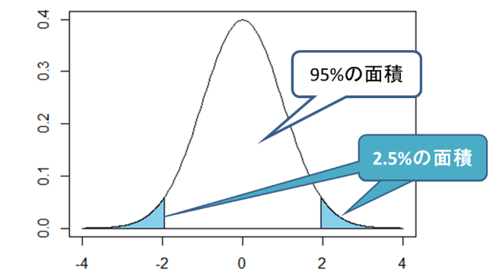
Two-sided p-value and one-sided p-value
In the two-sided test, we should think of the prob. of the extreme situations ‘in both sides’.

Slide 46
Two-sided p-value and one-sided p-value
In the two-sided test, we should think of the prob. of the extreme situations ‘in both sides’.

Slide 47
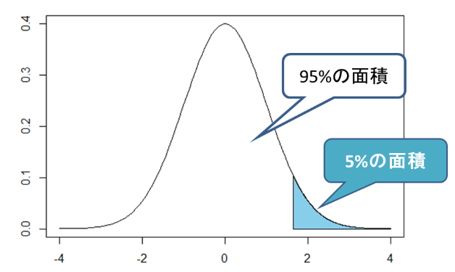
Two-sided p-value and one-sided p-value
In the one-sided test, the extreme situation only in either side is considered.

Slide 48

Two-sided test / one-sided test: examples
Survey of element B in drug A. How much B is included in A?
Let us sample 25 tablets of drug A, and then measure the weight of B per tablet. The sample mean isが [mg]、unbiased variation is
Null hypothesis H₀:”100mg of B on average is included in A.” ⇒ 3 possible alternative hypotheses;
i) The content of B in A is not 100mg per tablet.
ii) The content of B in A is larger than 100mg per tablet.
iii) The content of B in A is smaller than100mg per tablet.

Slide 49
Two-sided test / one-sided test: examples
i) The content of B in A is not 100mg per tablet.
ii) The content of B in A is larger than 100mg per tablet.
iii) The content of B in A is smaller than100mg per tablet.
⇒ Check that the content of B is 100mg or not.
（Two-sided）
⇒ Check whether the content of B is larger than100mg or not.
（One-sided. We don’t care whether it’s smaller or not）.
One-sided
⇒ Check whether the content of B is smaller than100mg or not.
（One-sided. We don’t care whether it’s larger or not）.

Slide 50
Two-sided test / one-sided test
In case of significance level of 5%:
Two-sided（Alternative hypothesis：The content of B is not 100mg）
The rejection region is outside of the percentiles (both tails).
Reject H0 in case the content of B is extremely large or small.

Slide 51
Two-sided test / one-sided test
In case of significance level of 5%:
One-sided（ Alternative hypothesis：The content of B is larger than 100mg ）
The rejection region is the right part of the tail. Reject H0 in case the content of B is extremely larger than 100mg.

Slide 52
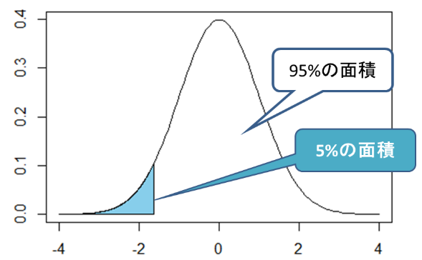
Two-sided test / one-sided test
In case of significance level of 5%:
One-sided（ Alternative hypothesis：The content of B is smaller than 100mg ）
The rejection region is the left part of the tail. Reject H0 in case the content of B is extremely smaller than 100mg.

Slide 53
Which you choose?
You should determine which of two- / one- sided test is used in advance.
Trying another way of test after obtaining a result is a serious mistake!

Slide 54
Examples.

Slide 55
Example of binomial test
After you tossed a coin 20 times, a specific side appeared 15 times. Can you say that both sides appear equivalently?
Intuitively, it’s distorted.
→ Let us do the hypothesis test.
cl1

Slide 56
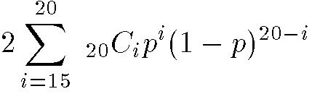

Example of binomial test
Let us denote the probability that a specific side appears as p, and verify the null hypothesis H₀: “p=1/2”.
On the basis of the hypothesis above, the probability that a specific side appears 15 times out of 20 times is:
→ H₀ is rejected under the significance level of 5%.
(i.e., the coin is distorted.)
You can’t reject H₀ under the significance level of 1%.
With N large, we can approximate the p.d.f by N(np,np(1-p)).

Slide 57
One- / two- sided test
In this example, the null hypothesis will be rejected under the too many appearance of either side of the coin.

Slide 58
Rejection region
Rjection region means the range of a r.v. X, where the null hypothesis is rejected. In the former example, “a specific side appears more than 15 times ” is the rejection region.
The probability under H₀
Rejection region
The number that a specific side appears

Slide 59
Statistical power
New issues:
By the way, if the coin is actually distorted, can we correctly detect that through the trial of 20 times coin tossing?
Let us assume, for instance, p=0.6.
Either side of the coin should appear 15 times or more so that the incorrect null hypothesis “p=0.5” is correctly rejected.
→ Find the probability of such situations under the situation “p=0.6”.

Slide 60

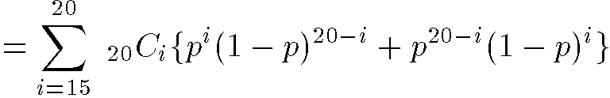

Statistical power
→ The probability of rejecting H₀ under “p=0.6”.
→We can reject H₀ with the probability of only 12.5%..

Slide 61
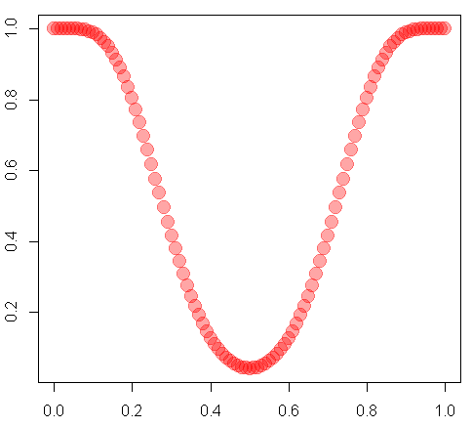
Power function
As p changes, power also changes.
→ Power function L(p)
L(p)
L(p)
p

Slide 62
Requirements for power
Requirement:
“We should detect the distortion of the coin with the probability of 90% if p=0.6.”
How can we attain this?
→ Increase the sample size!

Slide 63
Sample size and power
For each p, the corresponding power is plotted.
If p=0.6, we can attain the requirement with the sample size of 260 or more.
→ With such a large sample size, we can approximately employ the normal distribution.
As p increases, we can attain the
requirement with fewer sample size.
Power
Sample size

Slide 64
3. Distributions of test statistic

Slide 65
Distributions of test statistic
We will often use:
T-test, χ²-test， and F-test.
These names come from t-dist.，χ²-dist.，and F-dist.

Slide 66
3-1. Normal distribution

Slide 67
On test statistic
A function T=f(X₁, X₂, …,X_{n}) of r.v.s X₁, X₂, …,X_{n} is called as test statistic.
【Typical example】
Let r.v.s X₁, X₂, …,X_{n} be independent, and follow the distributionsＮ（μ₁，σ₁²）,Ｎ（μ₂，σ₂²）, …,Ｎ（μ_{n}，σ_{n}²）.
Then, T=a₁X₁+a₂X₂+…+a_{n}X_{n}
follows
N(a₁μ₁+a₂μ₂+…+a_{n}μ_{n} , a₁σ₁² +a₂σ_{２}² +…+a_{n}σ_{n}²).

Slide 68
Sum of normal dist.
As a special case of the former slide,
【Special case】
Let X₁, X₂, …,X_{n} be independent and follow the same dist.：Ｎ（μ，σ²）. Then,
T=(X₁+X₂+…+X_{n})/n
follows
N(μ, σ²/n)

Slide 69
3-2. t-dist.

Slide 70
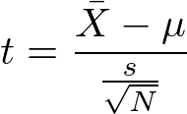
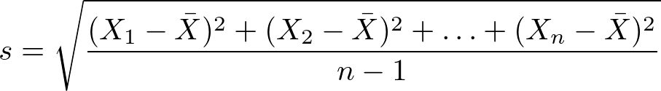
T-distribution
【Ex】
Let r.v.s X₁, X₂, …,X_{n} be independent with each other, and subject to N（μ，σ²）. Then, the quantity
is subject to t-distribution of (n-1) degree of freedom. Here,

Slide 71


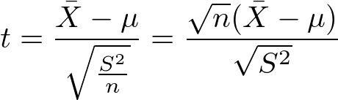
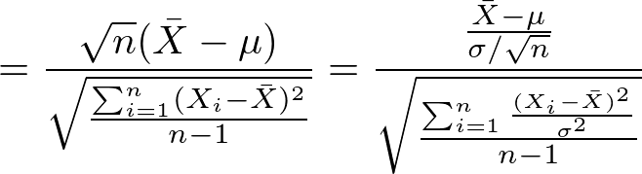
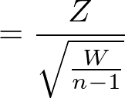
t-distribution
In other words…
Let Z～N(0, 1) and W be subject to -distribution of n degree of freedom. We also assume that they are independent of each other. Then, the following quantity is subject to t-distribution of n degree of freedom.

Slide 72
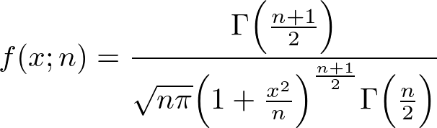
t-distribution
T-distribution has degree of freedom.
Used for the interval estimation / hypothesis testing of population mean.
【Probability density】
The probability density of t-distribution of n degree of freedom is

Slide 73
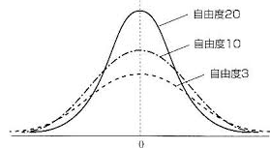
t-distribution
Probability density of t-distributions of various degree of freedom (df).
Df=20
Df=10
Df=3
Symmetric with respect to x=0 (as z-dits.)！
Asymptotically tends to z-dist. as df=n→∞.
If df=n is n large (n≧30, for instance), can be regarded as z-dist.

Slide 74
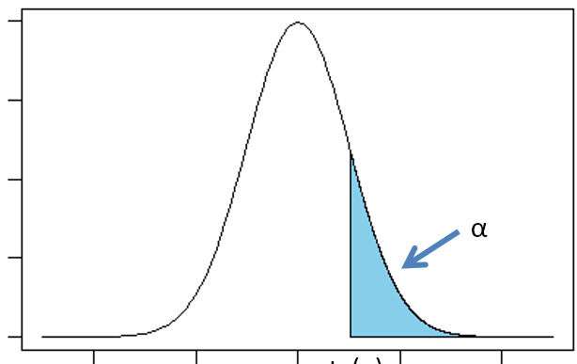
Percentile of t-distribution
We denote t-distribution of n degree of freedom as t_{n} hereafter.
It’s upper α-percentile is denoted as t_{n}(α).
Ex：
Upper 5-percentile of t-distribution of df=5.
▲
5％点
t₅(0.05)=2.015

Slide 75
How to find percentile?
Tables（z-table / t-table）
Python

Slide 76
Percentile of t-distribution
For instance, the upper 2.5-percentile of t-distribution of df=5 is about 2.57.
▲
t₅(0.025)=2.57

Slide 77
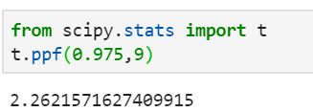
Using python;
E.g.）Find the upper 2.5-percentile of t-dist. With df=9.

Slide 78
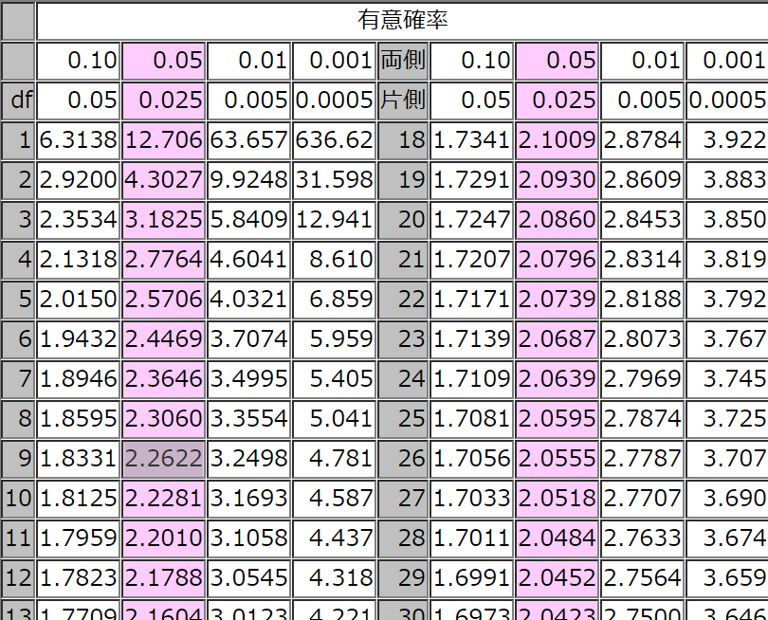
T-table
In making 95% confidence interval, upper 2.5-percentile is needed.
Therefore, you should look into the pink column of “2.5%” in “one-side(片側)”

