Slide 1
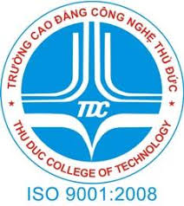
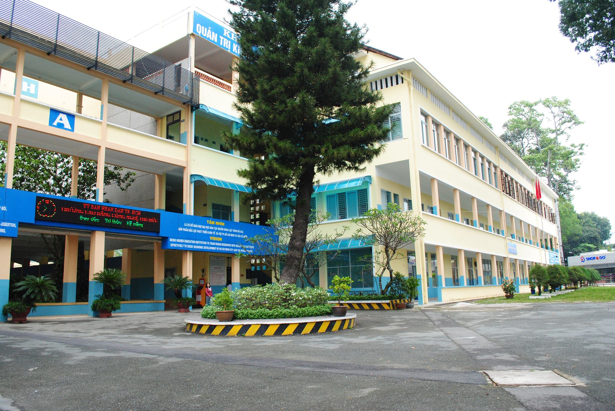
Your College

Slide 2

About me:
Name: Nguyễn Thanh Phong
Country: Long An
Study at: Thủ Đức College of technology

Slide 3
I. INTRODUCTION:
Thu Duc College of Technology has more than 30 years history of establishment and development. It was previously Thu Duc Technical Education and Vocation Center established in 1984. The school was officially named Thu Duc College of Technology in 2008.

Slide 4
And here is my school picture:

Slide 5
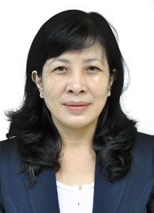
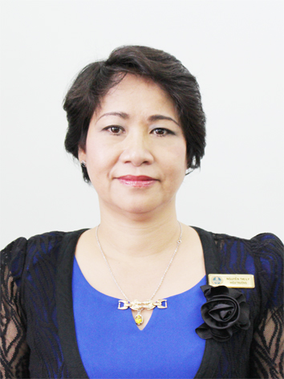
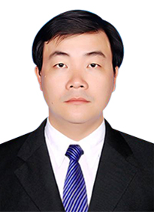
II. ADMINISTRATORS:
Principal:
Nguyễn Thị Lý
Vice-president:
Nguyễn Xuân Toán
Vice-president:
Phạm Ngọc Tường

Slide 6
III. BRANCHES:
The university has 11 branches.
These are: Information Technology, Mechanical Engineering, Finance - Accounting, Business Administration, Faculty of Automobile Engineering, Korean Language, Automation Technology, English Language, Foundation Sciences, Tourism.

Slide 7
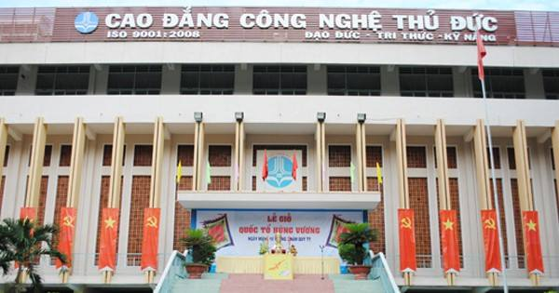
IV. TARGET:
1. Mission:
Training human resources with ethics and competencies, career passion, creativity, self-assertion, traditional culture preservation and awareness of life-long learning.

Slide 8
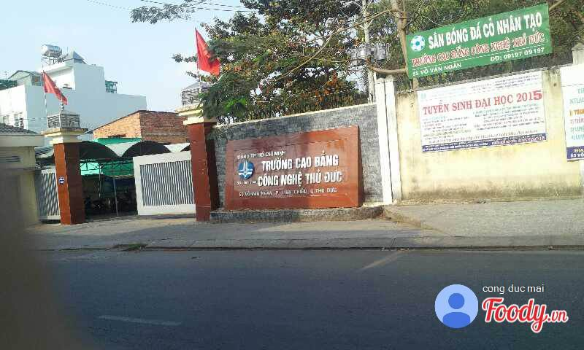
IV. TARGET:
2.Vision:
Being a higher education institution to train highly qualified human resources to effectively contribute to the socio-economic development of Ho Chi Minh City and the whole country.

Slide 9
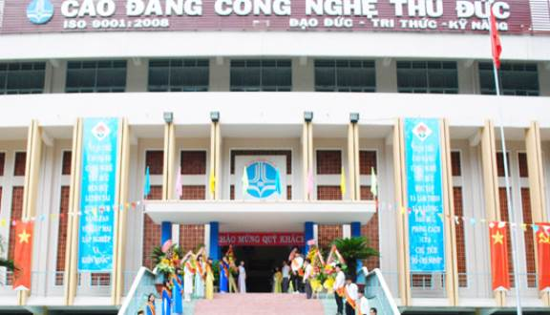
IV. TARGET:
3. Value:
Integrity - Confidence - Ambition - Sharing - Creativity -Activeness - Teamwork

Slide 10


