Slide 1
Creational Patterns
Design patterns

Slide 2
Creational Pattern
Singleton
Factory
Prototype
Abstract Factory
Builder

Slide 3
SINGLETON
The one and only

Slide 4
Why Singleton?
When you only need only one instance of the class

Slide 5
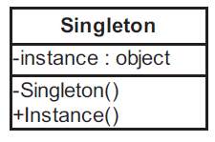
Singleton class diagram
Hide the constructor
Only create the instance at the first time of accessing the instance

Slide 6
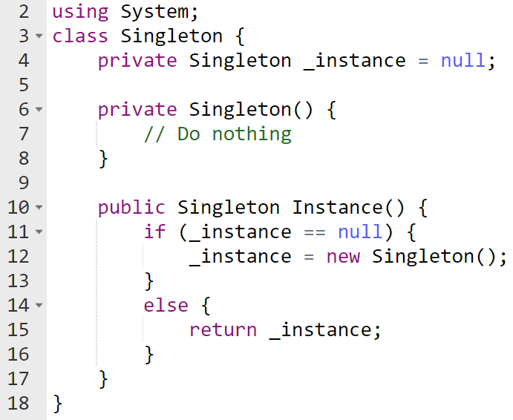
C# Proof of concept implementation

Slide 7
Example
Write a SingletonCounter class
Display the data inside this class

Slide 8
FACTORY
The creator

Slide 9
Why Factory?
Based on the choice of the user, the Factory class create the respective product

Slide 10
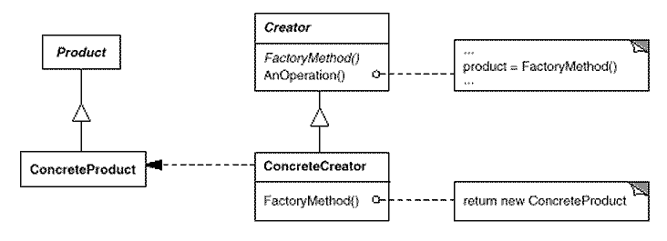
Factory core concept

Slide 11
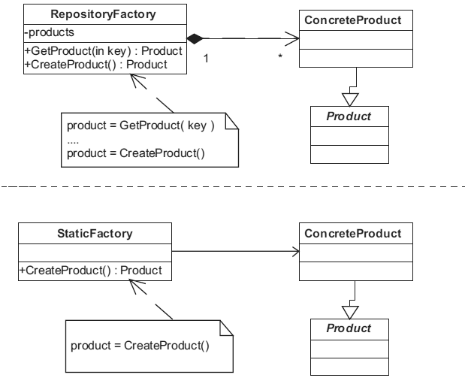
Two ways of implementing
[Christopher G. Lasater (2007). Design Patterns, Wordware Publishing, Inc.]

Slide 12
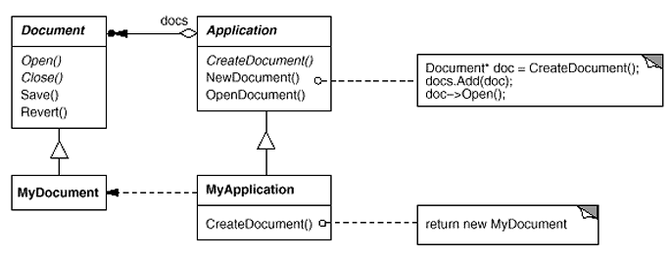
Factory in context
[Erich Gamma, Richard Helm, Ralph Johnson, John Vlissides (1995). Design Patterns - Elements of Reusable Object-Oriented Software, Addison-Wesley]

Slide 13
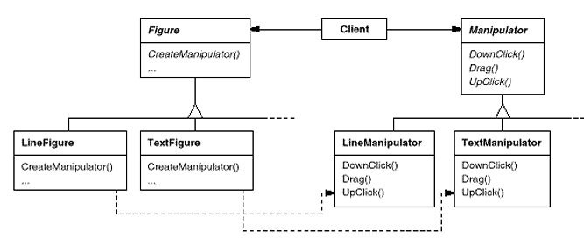
Factory common usage
[Erich Gamma, Richard Helm, Ralph Johnson, John Vlissides (1995). Design Patterns - Elements of Reusable Object-Oriented Software, Addison-Wesley]

Slide 14
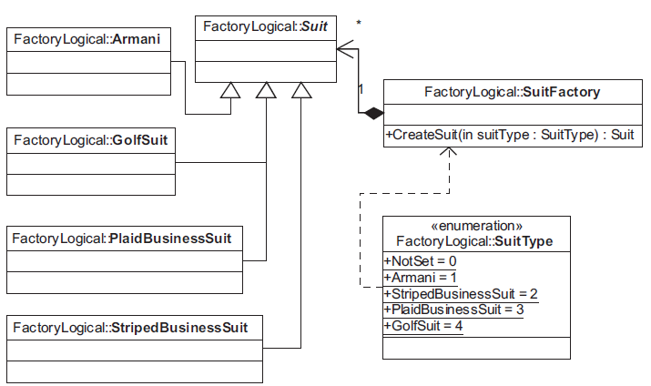
Factory basic implementation
[Christopher G. Lasater (2007). Design Patterns, Wordware Publishing, Inc.]

Slide 15
Example 01
Read back the list of graphic objects from text file
Point (3, 7)
Line ( (x1, y1), (x2, y2) )
Point (3, 7)
Rectangle ( (x1, y1), (x2, y2))
Ellipse ((x1, y1), (x2, y2))

Slide 16
Example 02
Read back the list of employees from text file
DailyEmployee: John Walker
DailyPayment=100$; TotalDays=28
HourlyEmployee: Rachyl Napier
HourlyPayment=15$; TotalHours=1200
ProductEmployee: Romaine Donna
PaymentPerProduct=10$; TotalProducts=180
Manager: Clarinda Hyram
FixedPayment=500$; TotalEmployees=5; PaymentPerEmployee=100$

Slide 17
PROTOTYPE
The preview

Slide 18
Why prototype?
Propose the user with all possible choices
Then clone the choice

Slide 19
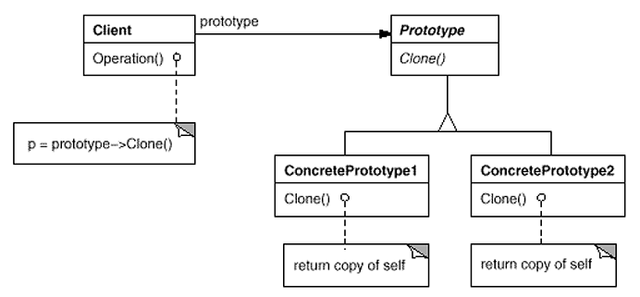
Prototype
[Erich Gamma, Richard Helm, Ralph Johnson, John Vlissides (1995). Design Patterns - Elements of Reusable Object-Oriented Software, Addison-Wesley]

Slide 20
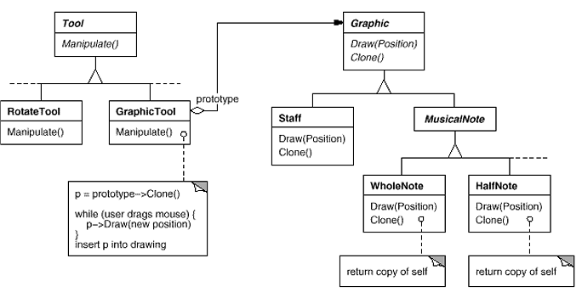
Prototype

Slide 21
Examples
Improve the factory patterns for
Reading graphic objects
Reading employees

Slide 22
BUILDER
The waiter

Slide 23
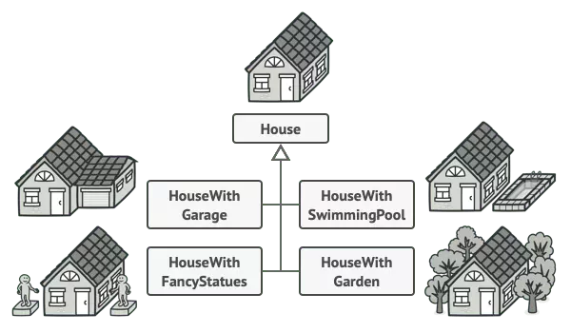
Why builder?
When we want to create an object composed of multiple parts

Slide 24
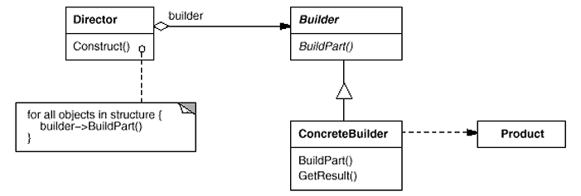
Builder concept
[Erich Gamma, Richard Helm, Ralph Johnson, John Vlissides (1995). Design Patterns - Elements of Reusable Object-Oriented Software, Addison-Wesley]

Slide 25
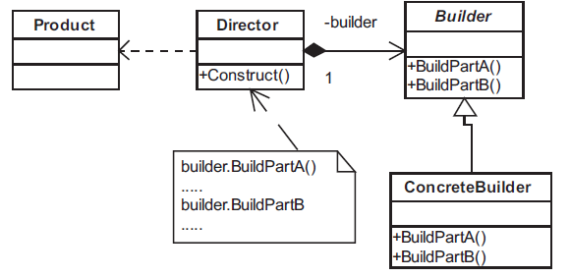
Builder
[Christopher G. Lasater (2007). Design Patterns, Wordware Publishing, Inc.]

Slide 26
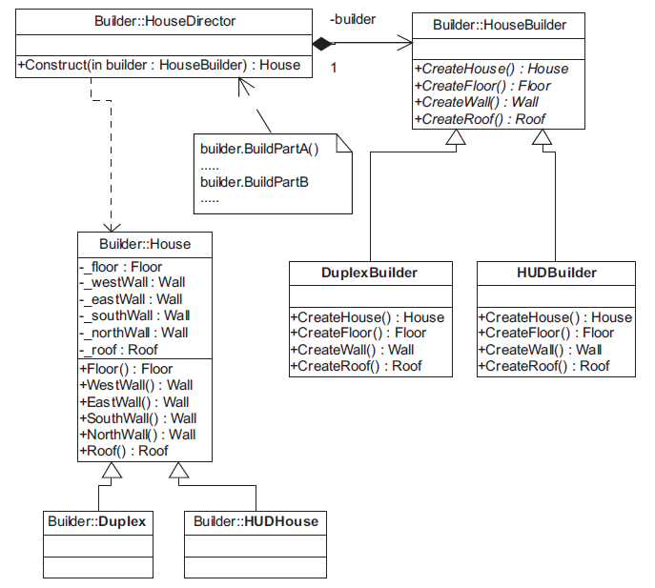
Mẫu Builder
[Christopher G. Lasater (2007). Design Patterns, Wordware Publishing, Inc.]

Slide 27
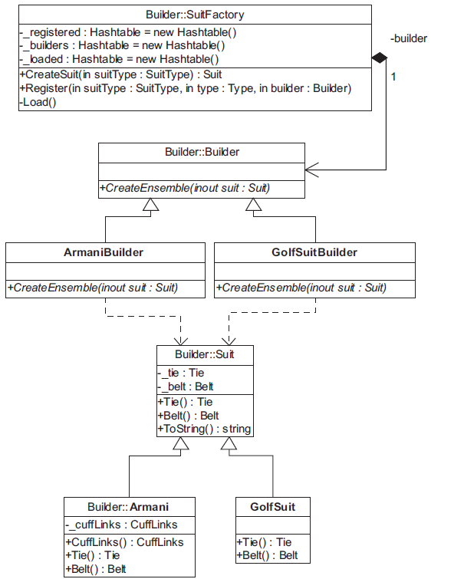
Mẫu Builder
[Christopher G. Lasater (2007). Design Patterns, Wordware Publishing, Inc.]

Slide 28
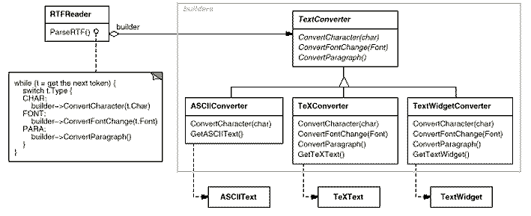
Builder
[Erich Gamma, Richard Helm, Ralph Johnson, John Vlissides (1995). Design Patterns - Elements of Reusable Object-Oriented Software, Addison-Wesley]

Slide 29
ABSTRACT FACTORY
The collector

Slide 30
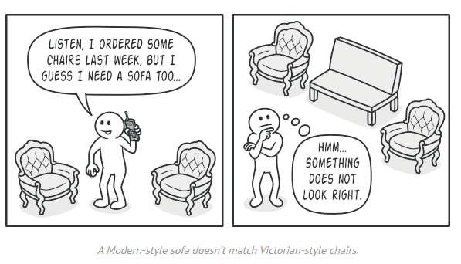
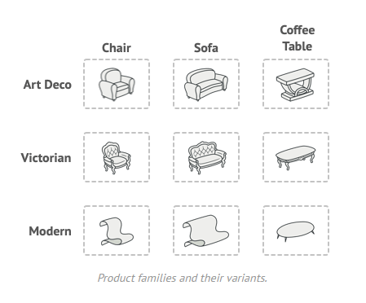
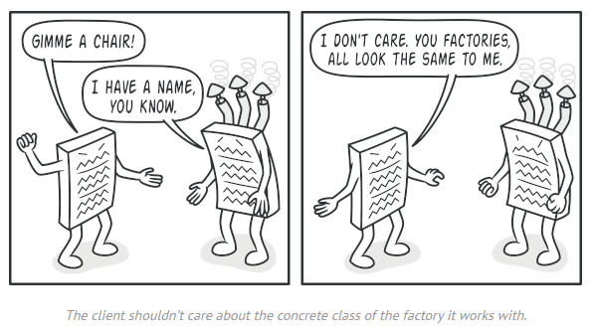
Abstract factory story
refactoring.guru

Slide 31
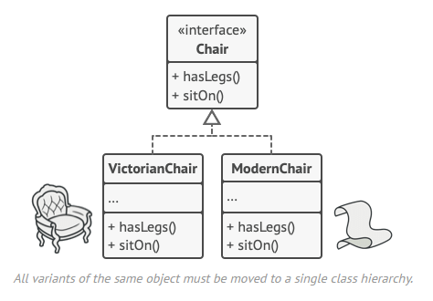
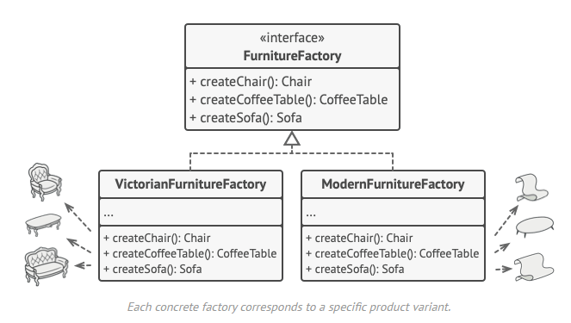
Solution

Slide 32
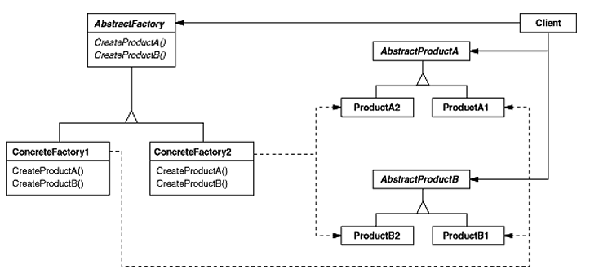
Abstract Factory
[Erich Gamma, Richard Helm, Ralph Johnson, John Vlissides (1995). Design Patterns - Elements of Reusable Object-Oriented Software, Addison-Wesley]

Slide 33
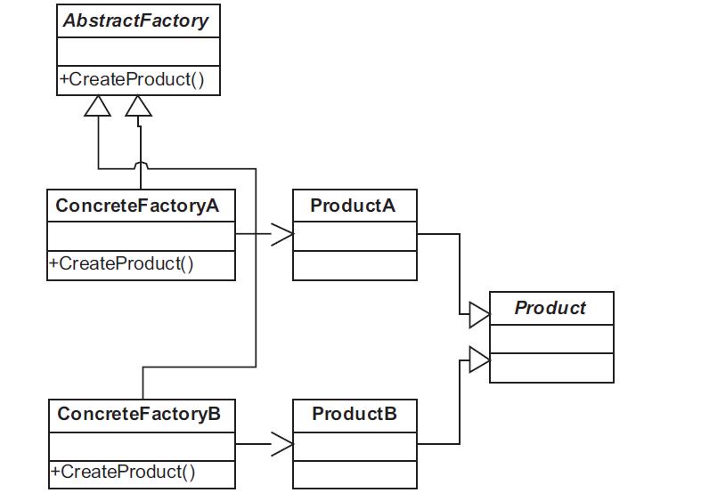
Abstract Factory
[Christopher G. Lasater (2007). Design Patterns, Wordware Publishing, Inc.]

Slide 34
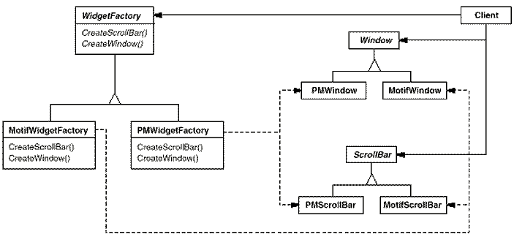
Abstract Factory
[Erich Gamma, Richard Helm, Ralph Johnson, John Vlissides (1995). Design Patterns - Elements of Reusable Object-Oriented Software, Addison-Wesley]

Slide 35
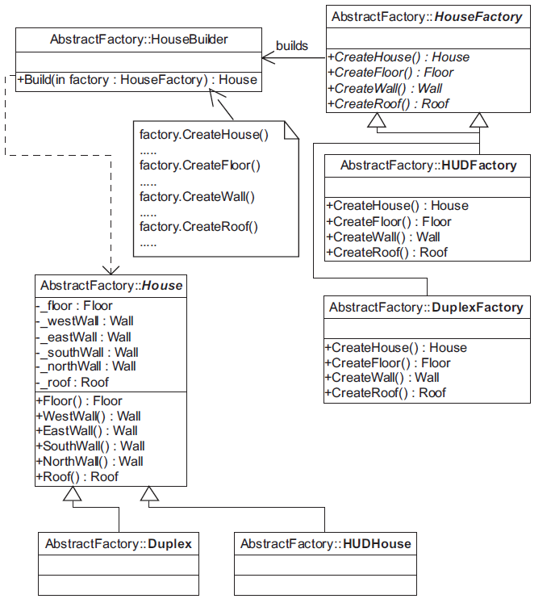
Abstract Factory

Slide 36
Exercise
The school trains students major in 4 bulks: A, B, C, D
A: Mathematics, Physics, Chemistry
B: Mathematics, Chemistry, Biology
C: Literature, History, Geography
D: Mathematics, Literature, ForeignLanguage (English / French / Chinese / Japanese)
Each subject will have a teacher who can teach that subject :D
Suppose you have made the configuration for all of the bulks, print out the available bulks for the students

Slide 37
For example
A: Mathematics (Mr Luong), Physics (Mr Thanh), Chemistry (Ms Hong)
A: Mathematics (Mr Tan), Physics (Mrs Nhung), Chemistry (Ms Le)
B: Mathematics (Ms Diem), Chemistry (Mr Hai), Biology (Mr Thai)
C: Literature (Ms Huong), History(Mr Tung), Geography(Mr Lam)
D: Mathematics (Ms Diem), Literature (Mr Hai), French (Mr Toan)
D: Mathematics (Ms Diem), Literature (Mr Hai), Japanese (Mr Long)

