Slide 1
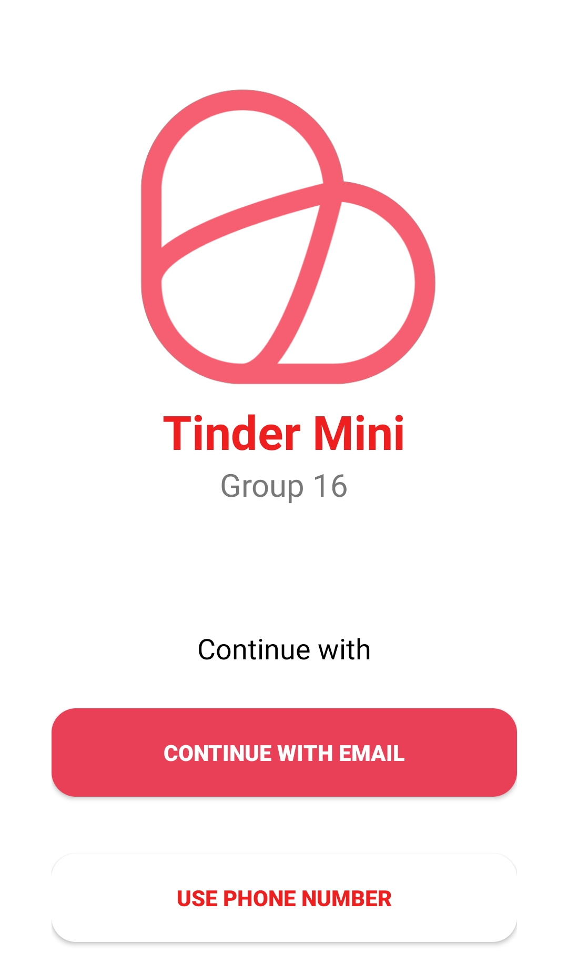
Tinder Mini
Group 16
Online Dating Application

Slide 2
Problem statement
Table of contents
01
04
Analysis and design
02
Project management
05
Software testing
Product position statement
User/maket
Architecture and technologies used
Team structure
Responsibilities of team members
03
Software requirements
Test environments, test plan, and test results
Use-case model,
non-functional requirements
06
Demo

Slide 3
01
Problem statement

Slide 4
Problem statement
Problem
Young people are single or have a need to chat and confide in strangers but lack a tool to help connect people
Affects
Young people: ages 16 – 30
Impact
Young people have the need to chat, meet people, expand relationships, and most importantly find their love
Solution
Help people connect with each other

Slide 5
Product position statement
For
Young people are between the ages of 16 – 30
Who
Connecting people
Product name
Tinder Mini
Unlike
Facebook Dating, Waodate
Our product
Connecting people who are suitable for each other, then recommending dates, community events to meet each other in real life

Slide 6
02
Project Management

Slide 7
Team Structure
Team Lead, Developer
Nguyen Hai Dang
Developer, Business Analyst
Ho Si Duc
Developer
Nguyen Quang Hien
Designer, Tester
Nguyen Van Hieu
Developer
Nguyen Khac Tan

Slide 8
Responsibilities
Name
Role
Responsibilities
1 | Nguyen Hai Dang | Project manager | Login, Logout, Register
2 | Nguyen Quang Hien | Developer | Suggest Paring, Notifications, Reminders
3 | Nguyen Van Hieu | Tester, Designer | Design App Interface
4 | Ho Si Duc | Developer, Business analyst | Handle Sending & Receiving Text Messages, Image/Audio/Video, Location
5 | Nguyen Khac Tan | Developer | Create Profile, edit profile, entertainments

Slide 9
Software Requirement
03

Slide 10
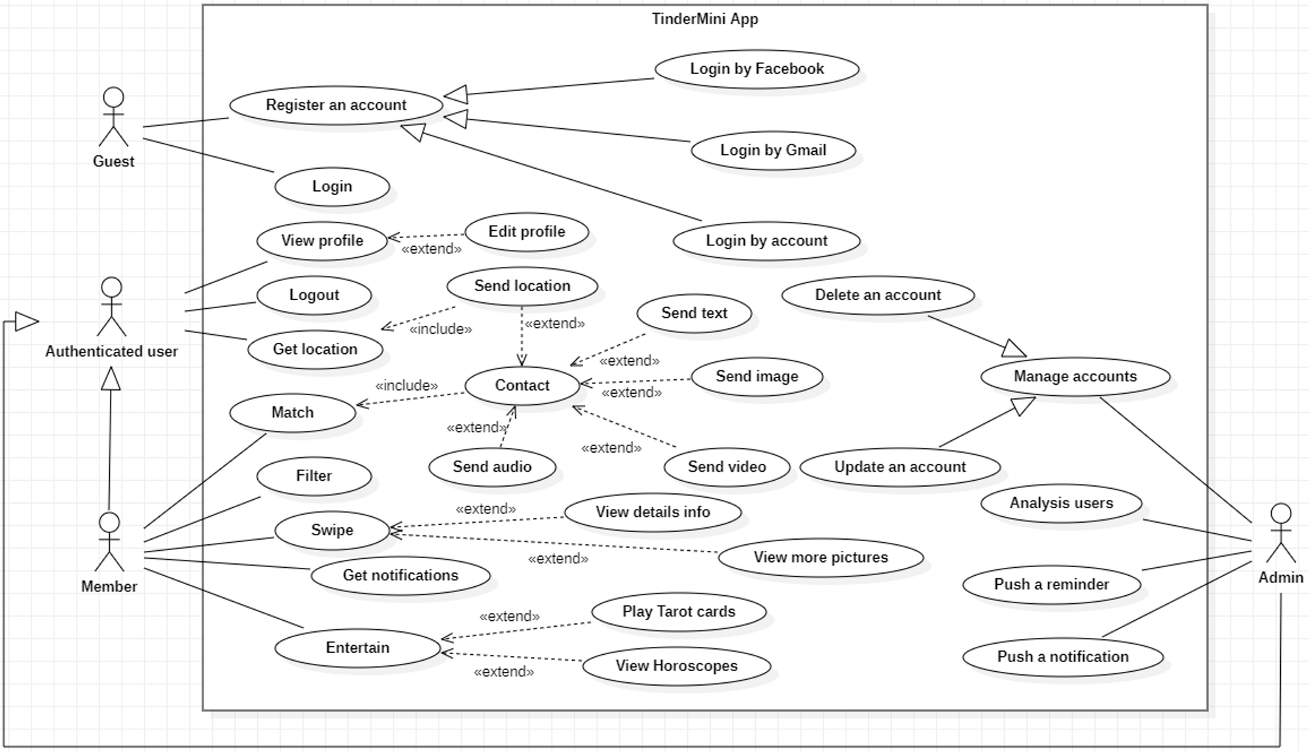
Use case model

Slide 11
Non – Functional Requirements
Performance
- App when there are 1000 users at the same time must have a response time of less than 5 seconds for each user when users register, log in, update profile, match.
- App can respond quickly in unexpected cases such as overflowing memory, losing internet connection, ...
- App consumes less space of phone.
- Users can chat realtime with the speed of sending/receiving messages less than 1s.
Portability
- App running on Android 9.0 operating system can run on both Android 10.0→12.0 while keeping performance and behavior.
- 2 people using the app on 2 different Android versions can still chat with each other normally.

Slide 12
Non – Functional Requirements
Scalability
- The system must be scalable enough to support 10,000 concurrent visits while maintaining optimal performance.
- App can support increasing server load by 10% per year.
Compatibility
- App can be compatible with Android version 9.0 and above.
- App can customize the position of elements to match the screen resolution.
Reliability, maintainability, availability
- Users access correctly according to the use-cases.
- The probability of the app crashing is 0.0001 (1 out of 10000 users) when accessing the app.
- Ensure full exceptions so that users are not out of the app when there is an error.

Slide 13
Non – Functional Requirements
Security
- User data is stored securely, only those with access rights (admin) can access it.
- Users who log in incorrectly 3 times within 1 minute will be temporarily locked out.
- Password must be more than 6 characters.
- Users use email and google account to register and log in, this is safe because email and google security is better than phone number.
Usability
- App has an easy-to-use interface, users can use the features by simple operations.
- The error rate of users when they update the profile when the internet is not allowed to exceed 10%.
- The percentage of users who do not send/receive messages when the internet is stable is less than 5%.
- App is accessible 24/7.

Slide 14
04
Analysis and design
Architecture and technologies used

Slide 15
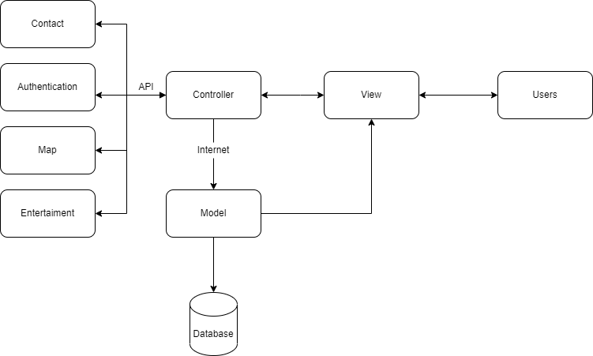
Software Architecture

Slide 16



Technologies
The main programming language for the application.
Compiler used in the project.
Authentication, Database, Storage

Slide 17
05
Software Testing
Test environments, test plan, and test results.

Slide 18
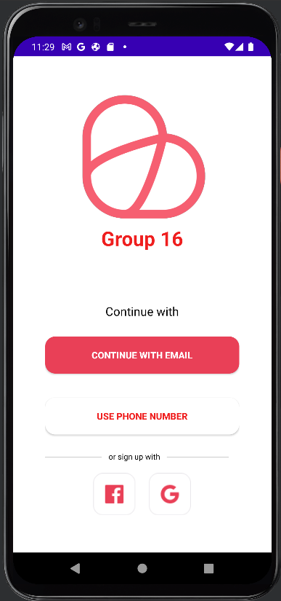
Test Environments
To be able to launch and test the Tinder Mini application, we need a smartphone running the Android operating system with the specific mid-range configuration as follows:
• Chip: CPU 2.5 GHz 4 Cores.
• RAM: 2 GB.
• Version: Android Pie 9.0 or higher.
• Free memory space: 500 MB or more.

Slide 19
Test Environments
Software Name | Purpose | Version | Type and Other Notes
Android | Operating system | 9.0 | Operating System
Android Studio | Start the virtual machine | 2021.3.1 | Intergrated Development Environment
Katalon Studio | Automated testing software | 8.5.5 | Automated testing software

Slide 20
Test Plan
Number of test-cases
Tester
No
Function
1
Login by Email
8
Nguyen Hai Dang
2
Login by Google
2
Nguyen Quang Hien
3
Forgot Password
4
Nguyen Van Hieu
4
Sign up by Email
9
Ho Si Duc
5
Swipe left - Swipe right (Dislike and like)
2
Nguyen Khac Tan

Slide 21
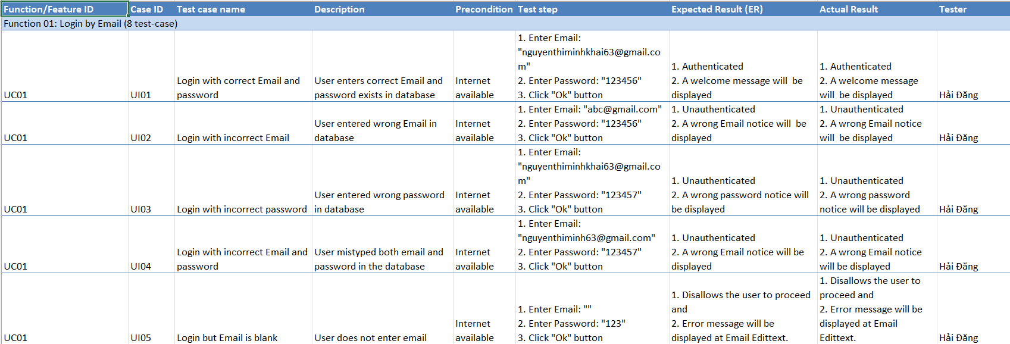
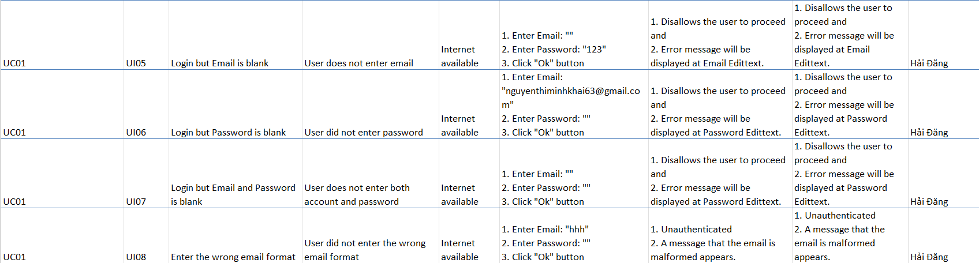
Function 1

Slide 22
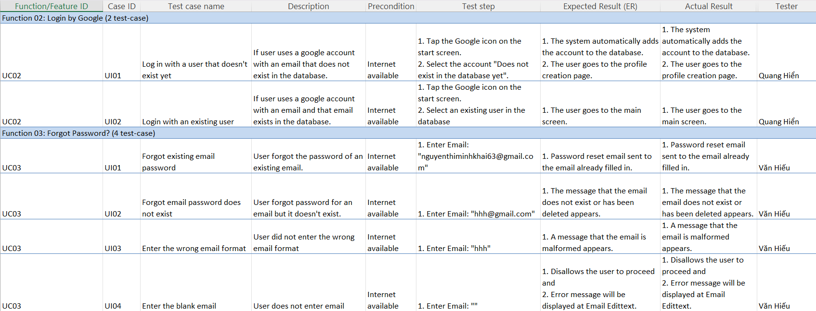
Function 2

Slide 23
Function 3

Slide 24
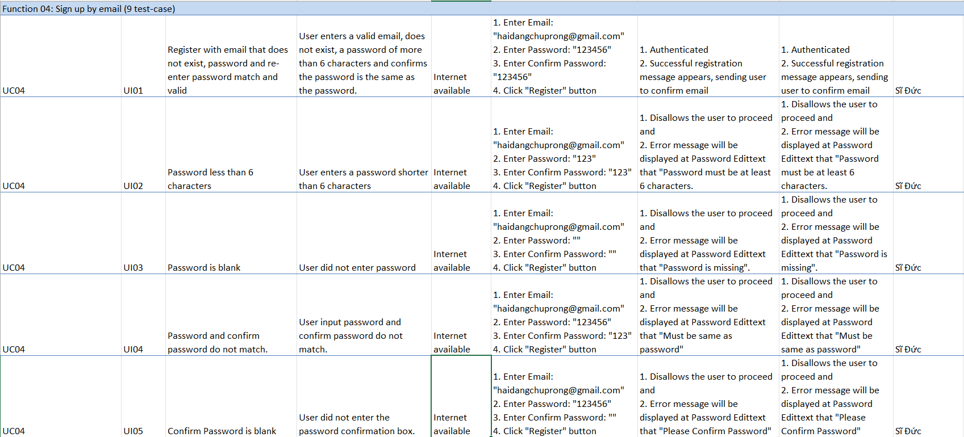
Function 4

Slide 25
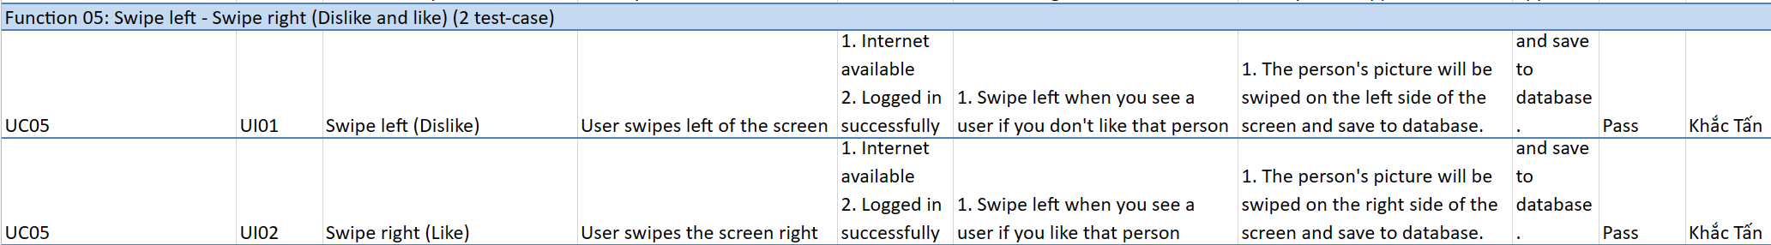
Function 5

Slide 26
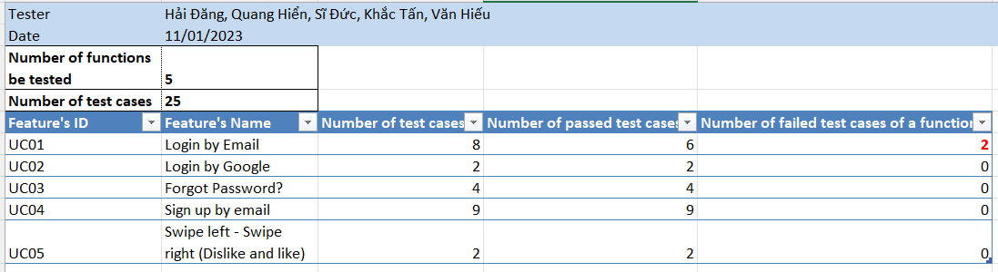
Test Results
On request, we test 5 functions with 25 test-cases
Each member has conducted automated testing of 1 function with 2 test-cases.

Slide 27
Test Results Automated testing
On request, we test 5 functions with 25 test-cases
Each member has conducted automated testing of 1 function with 2 test-cases.
Nguyễn Hải Đăng - UI01: Login by Email
UI01:
UI02: https://youtu.be/eiBVJhttps://youtu.be/voBD3KhZtxIEqFCSQ
Nguyễn Quang Hiển - UC03: Login with Gmail
UI01: https://www.youtube.com/watch?v=2TqRmVNclMw
UI02: https://www.youtube.com/watch?v=am1YPkUeHJA
Nugyễn Văn Hiếu - UC03: Forgot Password
UI02 & UI03: https://youtu.be/UvG9faAAukY
Nguyễn Khắc Tấn - UC05: Swipe right & Swipe left
UI01: https://youtu.be/T39wQQElB5Y
UI02: https://youtu.be/sVi4onYV1UE
Hồ Sĩ Đức - UC04: Register by Email
UI04: https://youtu.be/PX7NSFfbNt0
UI09: https://youtu.be/-62utUU58oM

Slide 28
06
Demo
Demo a key scenario of the software.

