Slide 1
Trex自动化测试
Byzoro.com

Slide 2
Agenda
TRex基本介绍
安装和运行
运行模式

Slide 3
测试工具需求
费用：
购买费用、使用和维护成本
性能和功能需求
标准化
可扩展性：
购买、自研、开源
Notes:
一句话总结：trex比spirent/ixia商用测试仪性能更好，性价比更高

Slide 4
Trex功能性能
支持高达200Gb/s的流量测试，大流量 20mpps (1G线速1.488mpps)需要网卡及CPU支持
支持时延和抖动
支持NAT/PAT自动学习
支持L4~L7
状态和无状态
轻易产生stateless traffic stream
支持stream并发
支持更改报文字段范围
支持Continuous/Burst/Multi-burst support
支持console/GUI
支持每条流的统计
虚拟设备：AWS/Laas/ESXi 低性能设备比如桌面电脑和笔记本

Slide 5
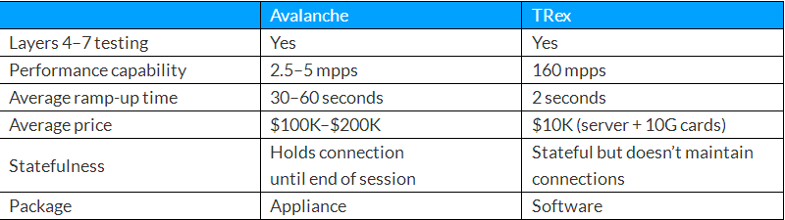
Avalanche与TRex的比较
网卡
Intel I350
Inter 82599
Inter X710
Mellanox ConnectX-4
Cisco1300 series
VMXNET/VMXNET3
E1000

Slide 6
安装
[bash]>uname -m x86_64
CentOS/RHEL 7.6, 64-bit kernel (not 32-bit) (Recommended) — This is the only working option for ConnectX-4.
[bash]>uname –m
mkdir –p /opt/trex
cd /opt/trex
wget --no-cache http://trex-tgn.cisco.com/trex/release/latest
tar -zxvf latest
历史版本：https://trex-tgn.cisco.com/trex/release

Slide 7
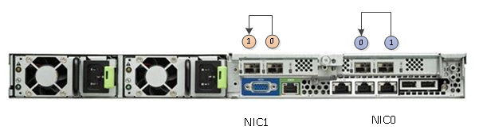
运行TRex
检查网卡接口自环功能正常，建议使用相同NUMA获得最佳性能
配置文件/etc/trex_cfg.yaml
[bash]>sudo ./dpdk_setup_ports.py -s
[bash]>cp cfg/simple_cfg.yaml /etc/trex_cfg.yaml
[bash]>sudo ./dpdk_setup_ports.py -i
[bash]>sudo ./dpdk_setup_ports.py -t
更多信息：
https://trex-tgn.cisco.com/trex/doc/trex_manual.html#_script_for_creating_config_file

Slide 8
Stateless模式
1、Service mode 简单基于端口的一些测试模式，如ARP, PING
2、命令行交互，需要特定的py脚本
3、纯Python接口编写的py脚本，可直接执行

Slide 9
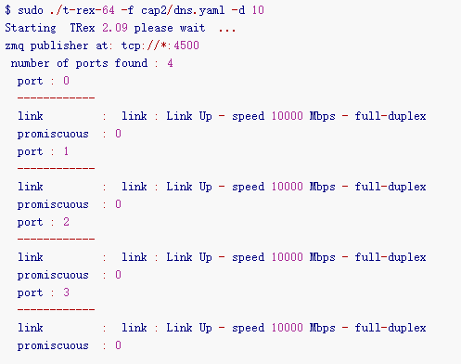
[bash]>sudo ./t-rex-64 -f cap2/dns.yaml -c 4 -m 1 -d 10

Slide 10
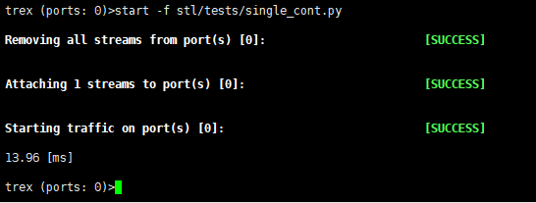
stateless交互
服务器端：
sudo ./t-rex-64 -i --cfg /etc/trex2.yaml
客户端：
./trex-console
stateless模式下包模板在/opt/trex/v2.28/stl这个目录下

Slide 11
Stateless流定义:scapy
1 from trex_stl_lib.api import *
2 import argparse
4
5 class STLS1(object):
7 def create_stream (self):
8 return STLStream(
9 packet =
10 STLPktBuilder(
11 pkt = Ether()/Dot1Q(vlan = 1100)/Dot1Q(vlan = 1110)/Dot1Q(vlan = 1120)/IP(src="16.0.0.1",dst="48.0.0.1")/
12 UDP(dport=53,sport=1025)/(1000*'x')
13 ),
14 mode = STLTXCont())
15
16 def get_streams (self, tunables, **kwargs):
17 parser = argparse.ArgumentParser(description='Argparser for {}'.format(os.path.basename(__file__)),
18 formatter_class=argparse.ArgumentDefaultsHelpFormatter)
19 args = parser.parse_args(tunables)
20 # create 1 stream
21 return [ self.create_stream() ]
24 # dynamic load - used for trex console or simulator
25 def register():
26 return STLS1()

Slide 12
Stateless流定义:scapy
# UDP header
Ether()/IP(src="16.0.0.1",dst="48.0.0.1")/UDP(dport=12,sport=1025)
# UDP over one vlan
Ether()/Dot1Q(vlan=12)/IP(src="16.0.0.1",dst="48.0.0.1")/UDP(dport=12,sport=1025)
# UDP QinQ
Ether()/Dot1Q(vlan=12)/Dot1Q(vlan=12)/IP(src="16.0.0.1",dst="48.0.0.1")/UDP(dport=12,sport=1025)
#TCP over IP over VLAN
Ether()/Dot1Q(vlan=12)/IP(src="16.0.0.1",dst="48.0.0.1")/TCP(dport=12,sport=1025)
# IPv6 over vlan
Ether()/Dot1Q(vlan=12)/IPv6(src="::5")/TCP(dport=12,sport=1025)
#Ipv6 over UDP over IP
Ether()/IP()/UDP()/IPv6(src="::5")/TCP(dport=12,sport=1025)
#DNS packet
Ether()/IP()/UDP()/DNS()

Slide 13
在脚本中使用trex
ssh连接
TREX
自动化脚本
Port0
Port1
1/43
1/44
ssh连接
T9600

Slide 14
在脚本中使用trex
建立连接句柄
Log Connecting to Trex client
${trex} Connect SSH to Device ${trex_ip} username=${trex_username} password=${trex_password}
Set Suite Variable ${trex}
Log start trex server
${trex_svr} Connect SSH to Device ${trex_ip} alias=H_trex_svr username=${trex_username} password=${trex_password}
Start Trex Server ${trex_svr}
Stop Trex Server ${trex_svr}
Log upload traffic file to target trex server ${trex_traffic}
${ret} Execute Shell Command on ${trex} command=rm -rf ${trex_traffic}; mkdir -p ${trex_traffic}
Put Directory trex ${TEMPDIR}${/}${log}

Slide 15
在脚本中使用trex：statefull
662 ${trex_sum}= Operation Send Trex Traffic ${trex} traffic_template=${trex_traffic}/dns.yaml
663 ... cfg_file=${trex_traffic}${/}trex_cfg.yaml
664
665 ${int1_stats}= Fetch Interface Stats Detail ${dut} interface=${int_d0t0}
666 ${int2_stats}= Fetch Interface Stats Detail ${dut} interface=${int_d0t1}
667
668 Log Check interfaces counters to match expectation
669 Should Be Equal as Integers ${trex_sum}[port0_opackets] ${int1_stats}[Received Good Packets]
670 Should Be Equal as Integers ${trex_sum}[port0_ipackets] ${int1_stats}[Transmitted Good Packets]
671 Should Be Equal as Integers ${trex_sum}[port1_opackets] ${int2_stats}[Received Good Packets]
672 Should Be Equal as Integers ${trex_sum}[port1_ipackets] ${int2_stats}[Transmitted Good Packets]

Slide 16
在脚本中使用trex：stateless
3577 Log send packets
3578 Start Trex Server ${trex_svr}
3579 Log start trex-console
3580 Execute Shell Command on ${trex} command=cd ${trex_dir};./${trex_console}
3581 Execute Shell Command on ${trex} command=clear -a
3582 Execute Shell Command on ${trex} command=start -f ${trex_traffic}${/}vlan_tc_fun_020.py -p ${trex_port0_id}
3583 Sleep 5s
3584 Log stop trex traffic
3585 Execute Shell Command on ${trex} command=stop
3586 ${trex_sum}= Fetch Trex Console Stats ${trex}
3587 Exit Trex Console ${trex}
3588
3589 ${int1_stats}= Fetch Interface Stats Detail ${dut} interface=${int_d0t0}
3590 ${int2_stats}= Fetch Interface Stats Detail ${dut} interface=${int_d0t1}
3591 Should Be Equal as Integers ${trex_sum}[port0_opackets] ${int1_stats}[Received Good Packets]
3592 Should Be Equal as Integers ${trex_sum}[port0_ipackets] ${int1_stats}[Transmitted Good Packets]
3593 Should Be Equal as Integers ${trex_sum}[port0_opackets] ${int2_stats}[Transmitted Good Packets]

Slide 17
在脚本中使用trex：抓包
389 Log start capturing on port 1
390 Execute Shell Command on ${trex} command=service -p ${trex_port1_id} timeout=40s
391 #${ret} Execute Shell Command on ${trex} command=capture record start --rx ${trex_port1_id} --limit 2000 -f udp and dst 53 # timeout=40s
392 ${ret} Execute Shell Command on ${trex} command=capture record start --rx ${trex_port1_id} --limit 3000
393 ${match} ${capture_id} Should Match Regexp ${ret} Capturing ID is set to '(\\d+)'
394 Execute Shell Command on ${trex} command=clear -a
395 Execute Shell Command on ${trex} command=start -f ${trex_traffic}${/}mob_7_1_1_nested_vlan.py -d 30 -m 500 -p ${trex_port0_id}
396 Sleep 20s
397 Log stop trex traffic
398 Execute Shell Command on ${trex} command=stop
399 Execute Shell Command on ${trex} command=capture record stop --id ${capture_id} -o ${trex_traffic}${/}trex_capt.pcap
400 ${trex_sum}= Fetch Trex Console Stats ${trex}
401 Execute Shell Command on ${trex} command=service --off
402 Exit Trex Console ${trex}
403
404 ${int1_stats}= Fetch Interface Stats Detail ${dut} interface=${int_d0t0}
405 ${int2_stats}= Fetch Interface Stats Detail ${dut} interface=${int_d0t1}
406
407 Should Be Equal as Integers ${trex_sum}[port0_opackets] ${int1_stats}[Received Good Packets]
408 Should Be Equal as Integers ${trex_sum}[port0_ipackets] ${int2_stats}[Received Good Packets]
409 Should Be Equal as Integers ${trex_sum}[port0_opackets] ${int2_stats}[Transmitted Good Packets]

Slide 18
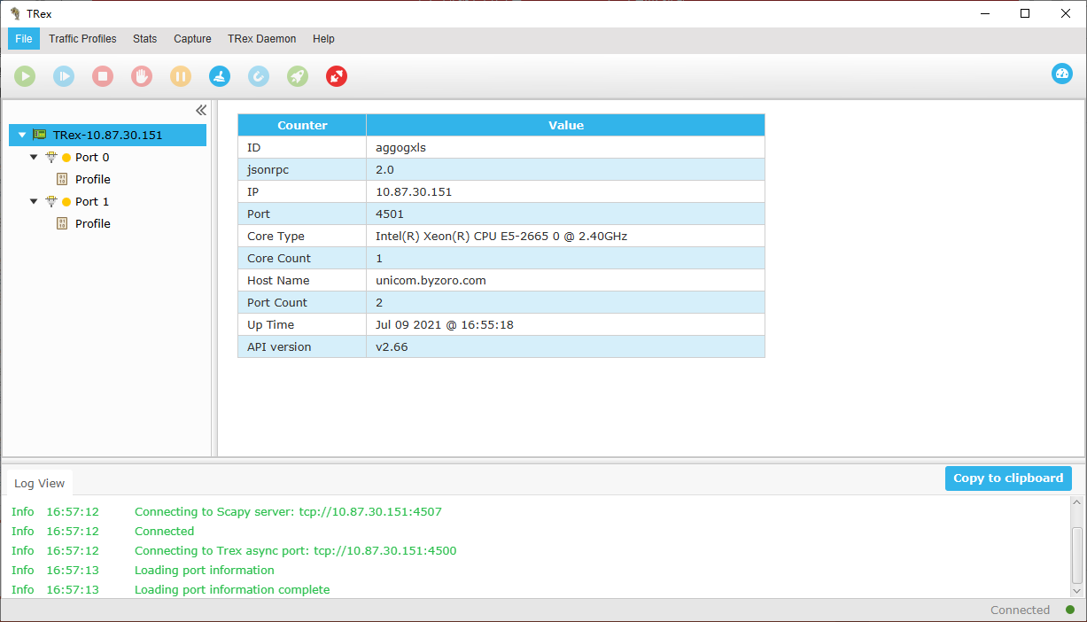
图形客户端v2.66

Slide 19
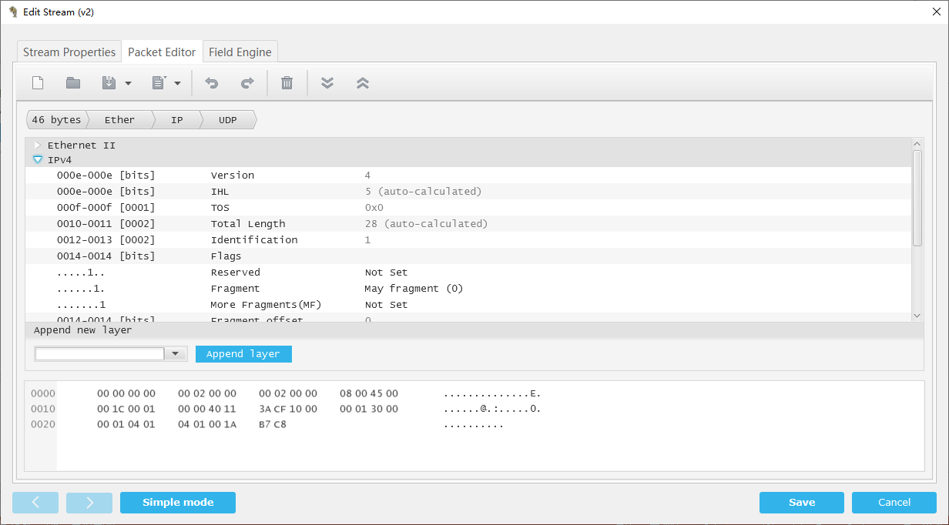
图形接口

Slide 20
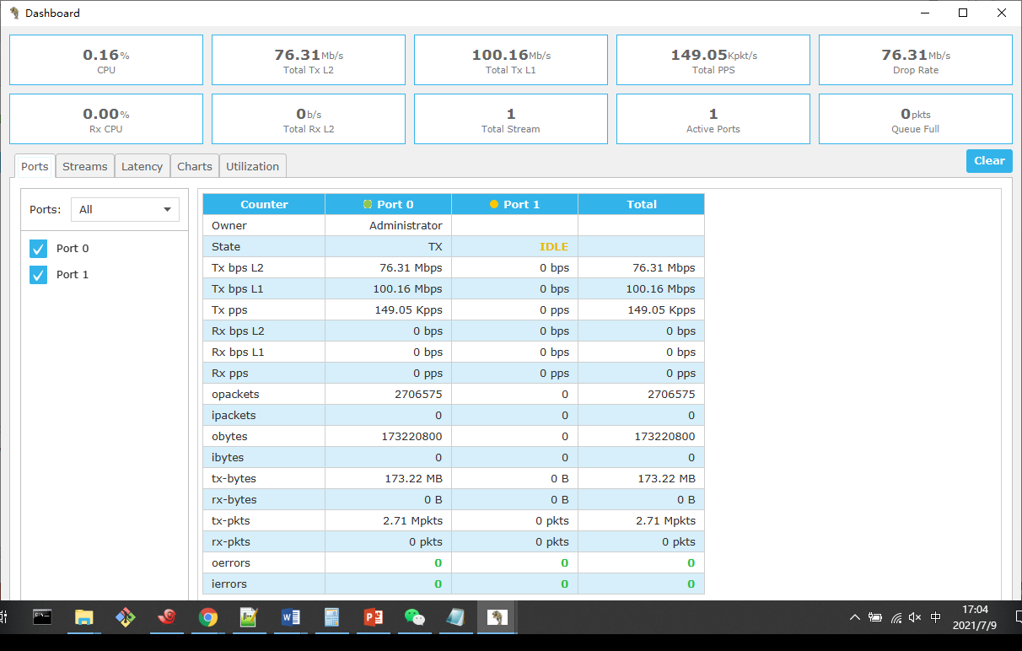

Slide 21
Robot脚本语言： 框架
*** Settings ***
Documentation
Resource
Variables
Suite Setup
Suite Teardown
*** Variables ***
*** Keywords ***
*** Test Cases ***
TC7_1_1
[Documentation]
[SETUP]
[TEARDOWN]
[TAGS]
测试用例
自定义关键字
第三方库
自定义库
内置关键字
Robot

Slide 22
Robot脚本语言： 框架(续)
1 *** Settings ***
2 Documentation This file is the test suite for T9600 VLAN testing automation.
3 ...
4 ... 测试用例： 附件2：中国移动汇聚分流设备测试规范v1.1.0_定稿20200223.docx
5 ... Init by: fanhua@byzoro.com
6 ... Modified: 2021/07/01
7
8 resource T9600_MainLine_Lib.robot
9 Variables T9600_CMCC.yaml
10
11 Suite Setup Run Keywords
12 ... Init User Variables
13 ... AND Init User Test Bed
14 ... AND Start Trex Server ${trex_svr}
15 ... AND Execute Shell Command On ${dut} command=configure terminal
16 ... AND Execute Shell Command On ${dut} command=@{init}
17
18 Suite Teardown Run Keywords
19 ... Stop Trex Server ${trex_svr}
20 ... AND Run Keyword If All Tests Passed Execute Shell Command on ${trex} command=rm -rf ${trex_traffic};
21 ... AND Run Keyword If All Tests Passed Execute Shell Command on ${trex} command=delete rule all
22 ... AND Teardown Test Suite

Slide 23
自定义关键字
Library LibByz.py：建立ssh连接，连接维护，命令下发
Library t9600.py
T9600_MainLine_Lib.robot
*** Settings ***
Documentation Resources file to hold keywords for T9600_VLAN testing
...
... Author: fanhua@byzoror.com
... Created: 2021/06/02
... Modified: 2021/06/02
...
... List of keywords:
...
... End of Documention
Library OperatingSystem
Library String
Library Collections
Library yaml
Library LibByz.py
Library t9600.py

Slide 24
自定义关键字(续)
Library LibByz.py：建立ssh连接，连接维护，命令下发
Library t9600.py
T9600_MainLine_Lib.robot
*** Settings ***
Documentation Resources file to hold keywords for T9600_VLAN testing
...
... Author: fanhua@byzoror.com
... Created: 2021/06/02
... Modified: 2021/06/02
...
... List of keywords:
...
... End of Documention
Library OperatingSystem
Library String
Library Collections
Library yaml
Library LibByz.py
Library t9600.py
*** Keywords ***
Init User Variables
Init User Test Bed

Slide 25
自定义关键字(续)
${trex} Connect SSH to Device ${trex_ip} username=${trex_username} password=${trex_password}
${trex_svr} Connect SSH to Device ${trex_ip} alias=H_trex_svr username=${trex_username} password=${trex_password}
Start Trex Server ${trex_svr}
Execute Shell Command On ${dut} command=@{cmd}
${config_mode} ${config_mode} Check Config Mode ${dut} check_string=)#
Config Mode ${dut}
${ret}= Fetch Running Config on Device device=${dut}
Delete Vlan ID ${dut} 1000
Exit Config Mode ${dut}

Slide 26
自定义关键字(续)
${pvid} Set Variable ${2}
${ret}= Config Interface PVLAN ID ${dut} interface=${int_d0t0} pvid=${pvid} timeout=3s
${ret}= Fetch Interface Info ${dut} interface=${int_d0t0}
Log ${ret}
Log ${ret}[pvid]
Log ${ret['pvid']}
Should Be Equal As Numbers ${ret}[pvid] ${pvid}
${pvid} Set Variable ${1000}
${ret}= Config Interface PVLAN ID ${dut} interface=${int_d0t0} pvid=${pvid} timeout=3s
${ret}= Fetch Interface Info ${dut} interface=${int_d0t0}
Should Be Equal As Numbers ${ret}[pvid] ${pvid}
${pvid} Set Variable ${4094}
${ret}= Config Interface PVLAN ID ${dut} interface=${int_d0t0} pvid=${pvid} timeout=3s
${ret}= Fetch Interface Info ${dut} interface=${int_d0t0}
Should Be Equal As Numbers ${ret}[pvid] ${pvid}

Slide 27
约定
Python编程规范
Robot
框架setup/teardown/文档/注释，
命名约定：有意义，中文处理
${/}, ${None}, ${\n}, ${\n}, ${SPACE}, ${EMPTY}
Robot Automatic variables
关键字命名：动词开头
Config
Operation
Fetch
Check
Run

Slide 28
QA
测试用例
测试工具
自动化
如何开始
参考：
http://10.87.30.52/
Robot Builtin Keywords
TRex Documentation

