Slide 1
Second column (named “Group”):
groups identifiers
First column:
samples identifiers
(no replicates)
Values start at the third column
Table must be tab delimited (.txt or .csv) with point as decimal separator
...

Slide 2
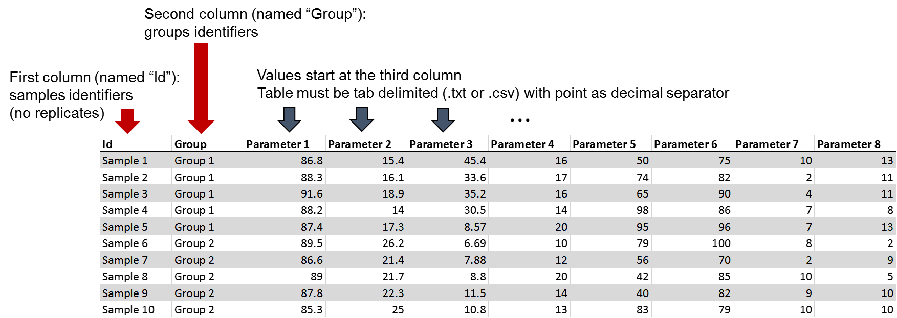

Slide 3
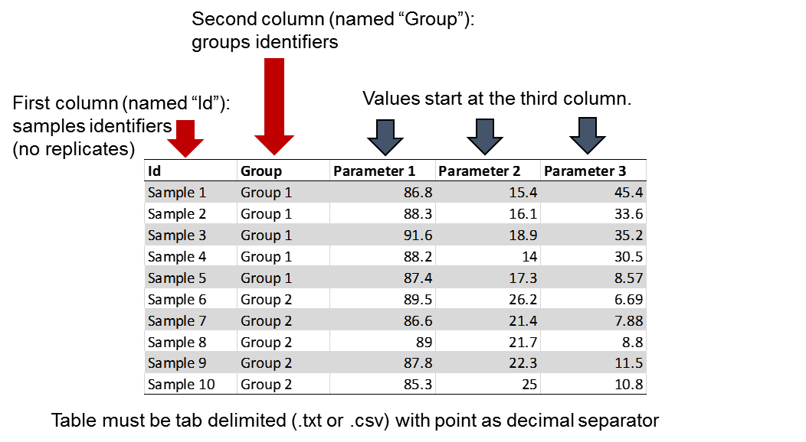
Second column (named “Group”):
groups identifiers
First column:
samples identifiers
(no replicates)
Values start at the third column.
Table must be tab delimited (.txt or .csv) with point as decimal separator

Slide 4
First row (named “Id”):
samples identifiers
(no replicates)
Second row
(named “Group”):
groups identifiers

Slide 5
Second column, named “Group”:
groups identifiers
First column:
samples identifiers
(no replicates)
Values start at the third column.
First row:
samples identifiers
(no replicates)
Second row,
named “Group”:
groups identifiers
Table must be tab delimited (.txt or .csv) with point as decimal separator.
Table must be tab delimited (.txt or .csv) with point as decimal separator.

Slide 6
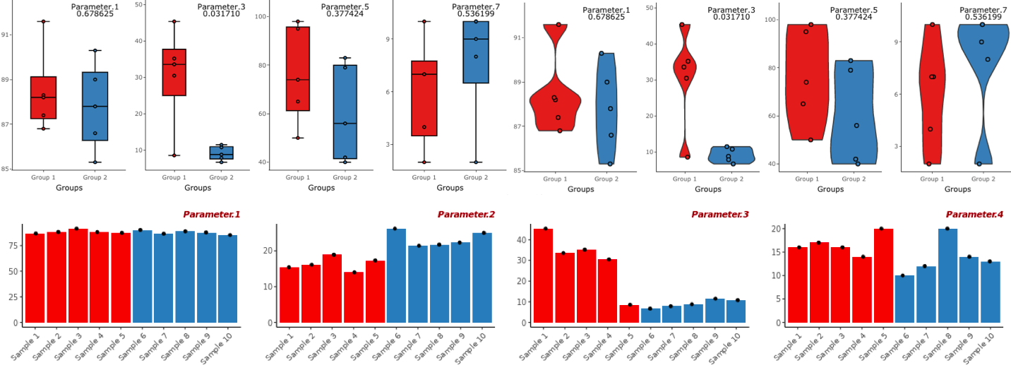

Slide 7
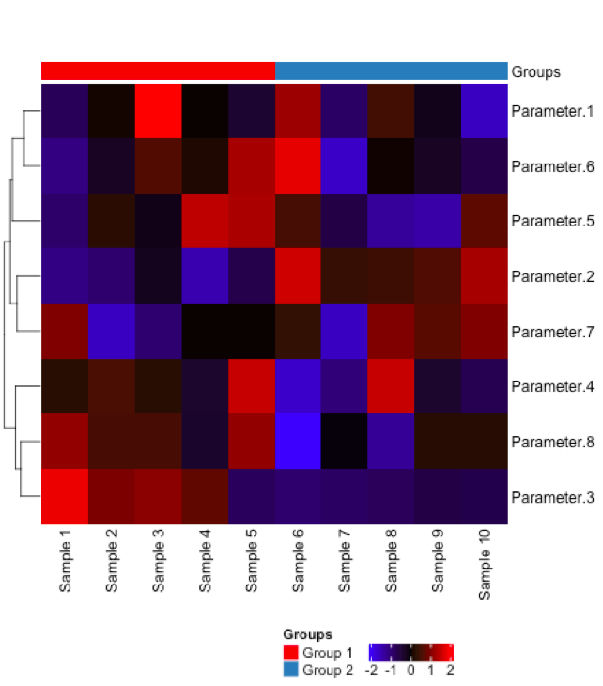
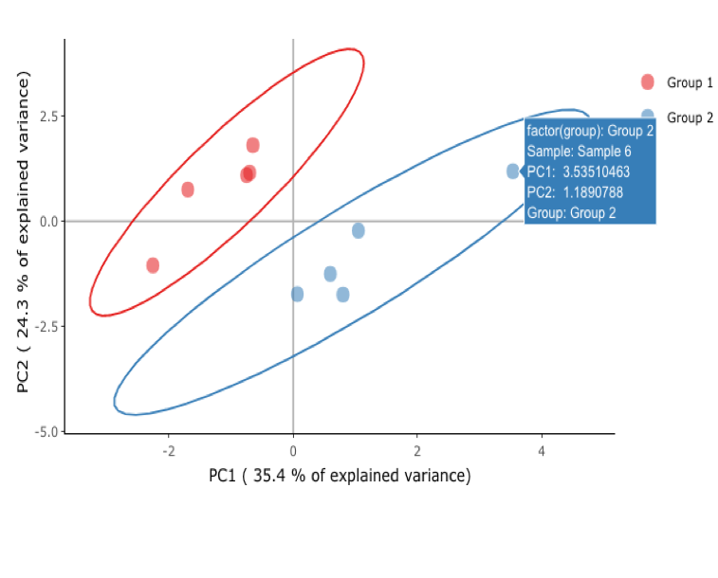

Slide 8
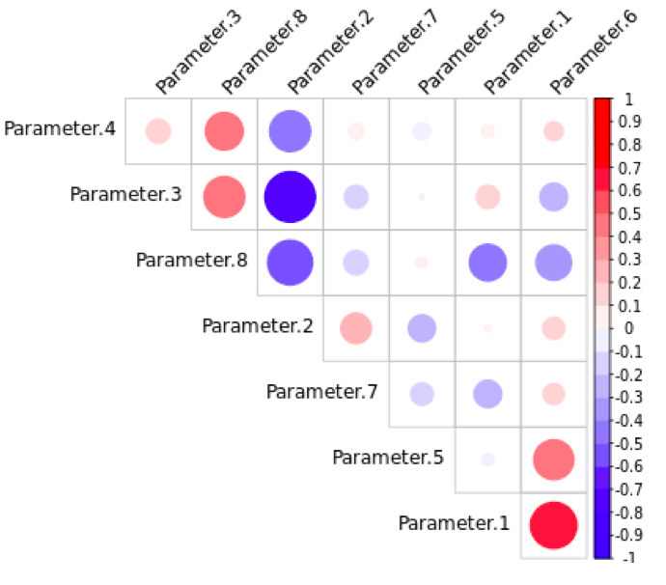
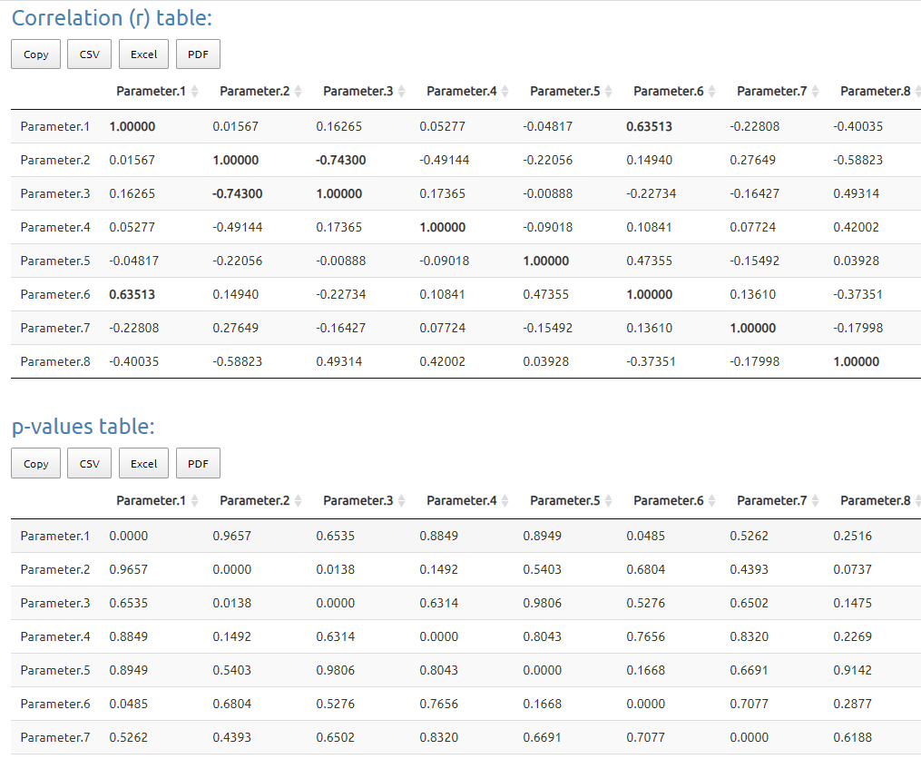

Slide 9
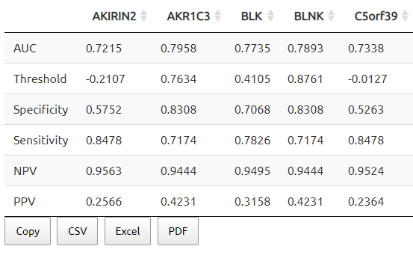
para. 1
para. 2
para. 3
para. 4
para. 5

