Slide 1
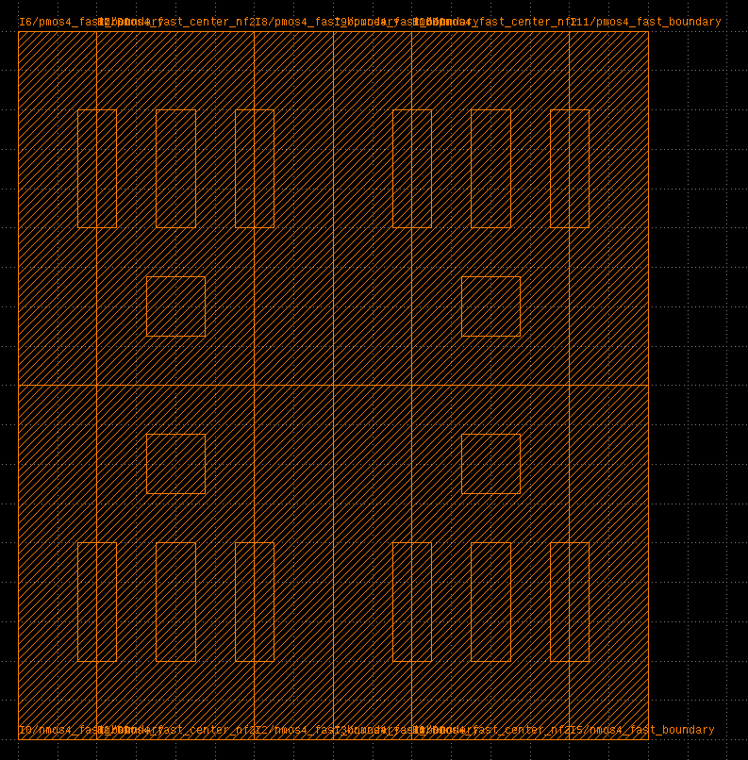
nmos4_fast_boundary
nmos4_fast_center_nf2
(virtual NMOS layout)

Slide 2
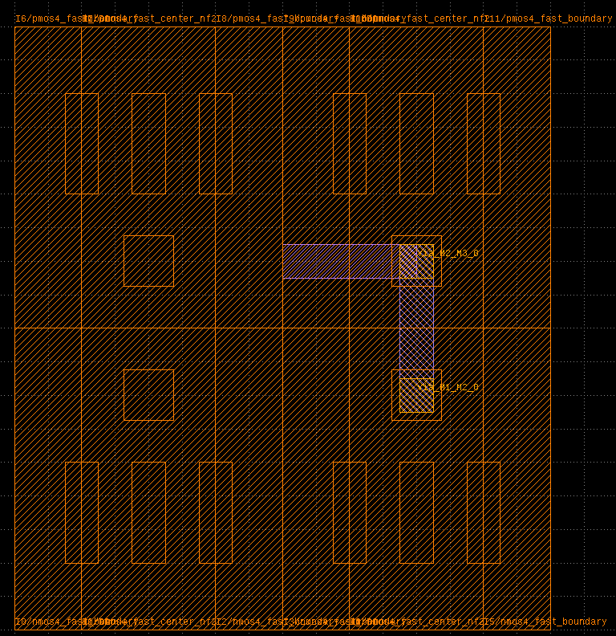
r1 (M2 horizontal)
r0 (M1 vertical)
ra0 (M3 vertical)
2vias

Slide 3
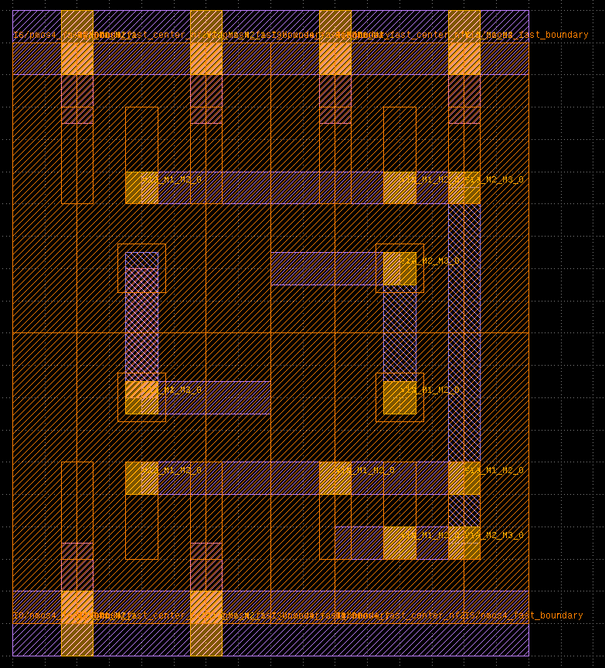
vdd
output
a
b
internal
vss

Slide 4
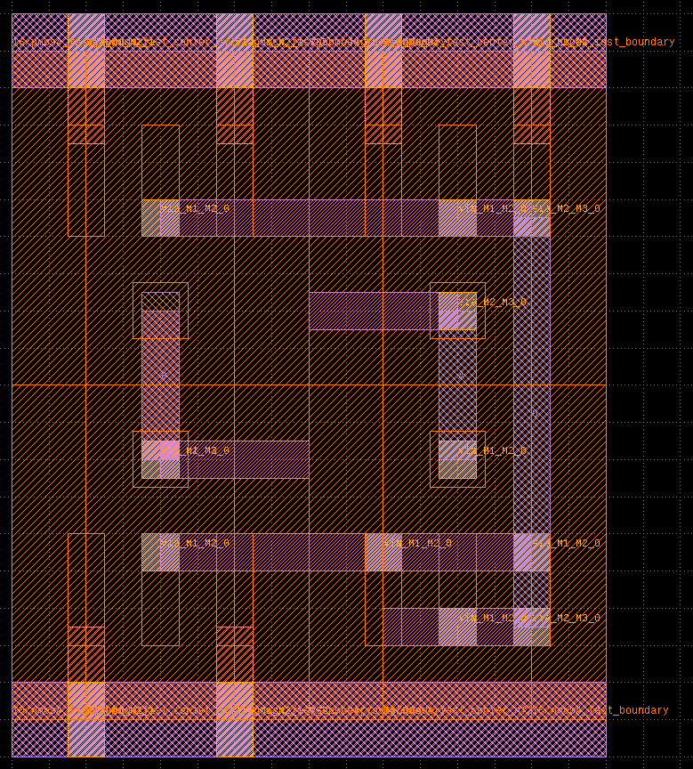
vdd
o
a
b
vss

Slide 5
inst0
(1,3)
inst0
(1,3)
mygrid
mygrid

Slide 6
inst0
inst1
inst0
inst1
inst2
mygrid
mygrid

