Slide 1
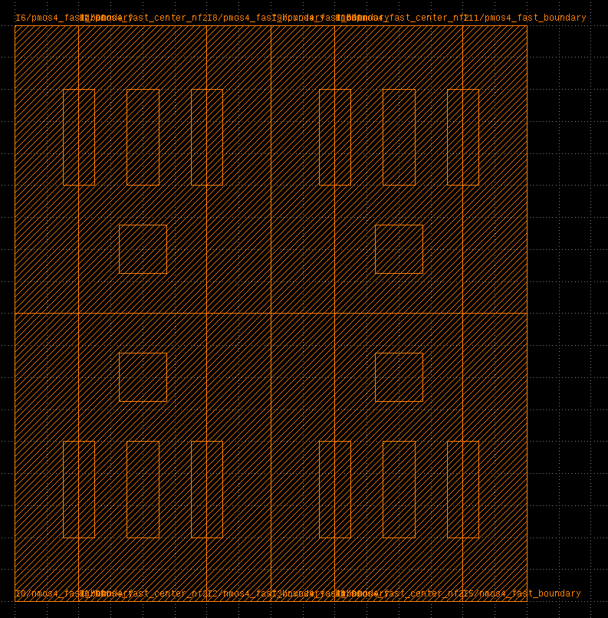
nmos4_fast_boundary
nmos4_fast_center_nf2
(virtual NMOS layout)

Slide 3
(instname)
B0
NL[0:1]
B1
B2
NR[0:1]
B3
(cellname)
BND
NMOS_NF2
NMOS_NF2
BND
BND
NMOS_NF2
NMOS_NF2
BND
G0
G0
(c) via(ref=NL.D0)
G0
G0
D0
D0
D0
D0
(route grid-y)
S0
S0
S0
S0
S0
S1
S1
S1
(route grid-x)
(a) NL=relplace(‘NMOS_NF2’, shape=[2,1], ref=B0.right)
(b) route(ref0=NL[0].S0, ref1=NR[1].S1)
Instance
Pin
Horizontal/vertical routes
Vias

Slide 4
(instname)
B0
N[0:1]
B1
(cellname)
BND
NMOS_NF2
NMOS_NF2
BND
G0
G0
(c) via(ref=NL.D0)
D0
D0
(route grid-y)
S0
S0
S0
S1
(route grid-x)
(b) route(ref0=N[0].S0, ref1=N[1].S1)
(a) N=relplace(‘NMOS_NF2’, shape=[2,1], ref=B0.right)
Instance
Pin
Horizontal/vertical routes
Vias

Slide 5
TemplateDB
GridLayoutGenerator
+ relplace() + route() + via() + load_template() + load_grid() + export_BAG()
GridDB
LayoutDB
LayoutObject
LayoutIO
Instance, Rect, Pin, …
BagProject

Slide 6
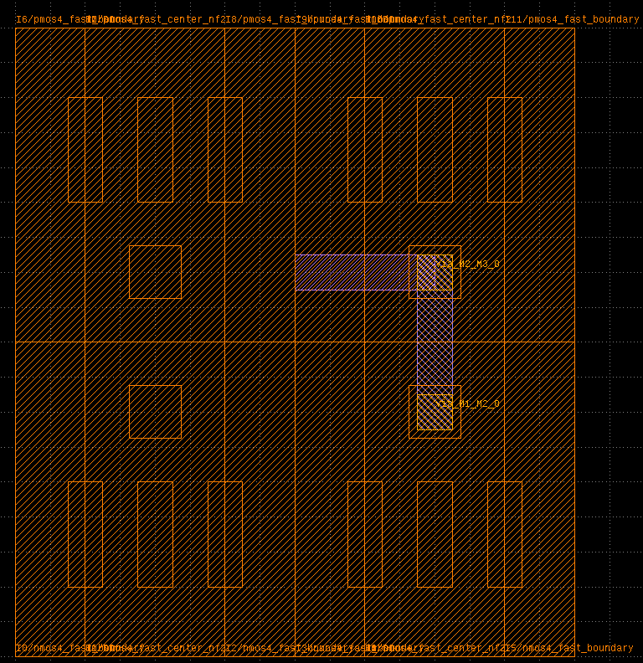
r1 (M2 horizontal)
r0 (M1 vertical)
ra0 (M3 vertical)
2vias

Slide 7
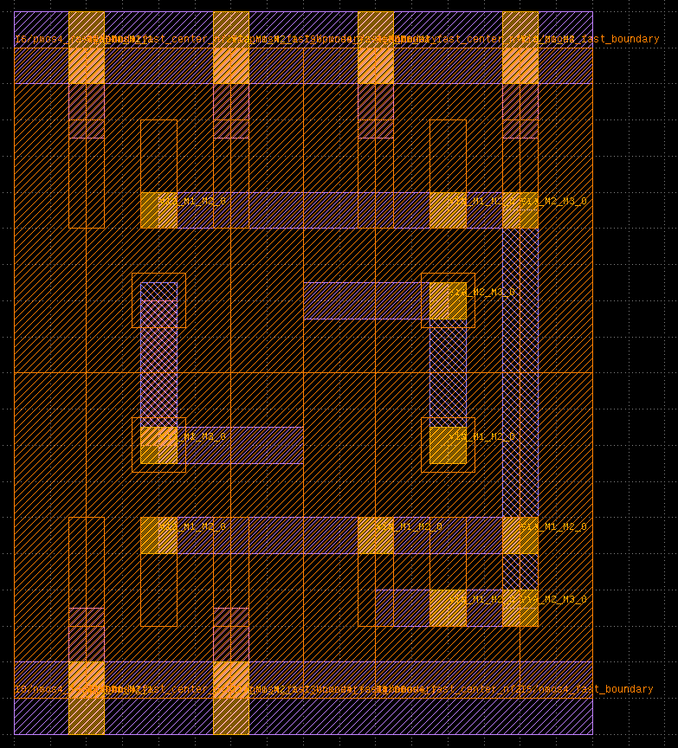
vdd
output
a
b
internal
vss

Slide 8
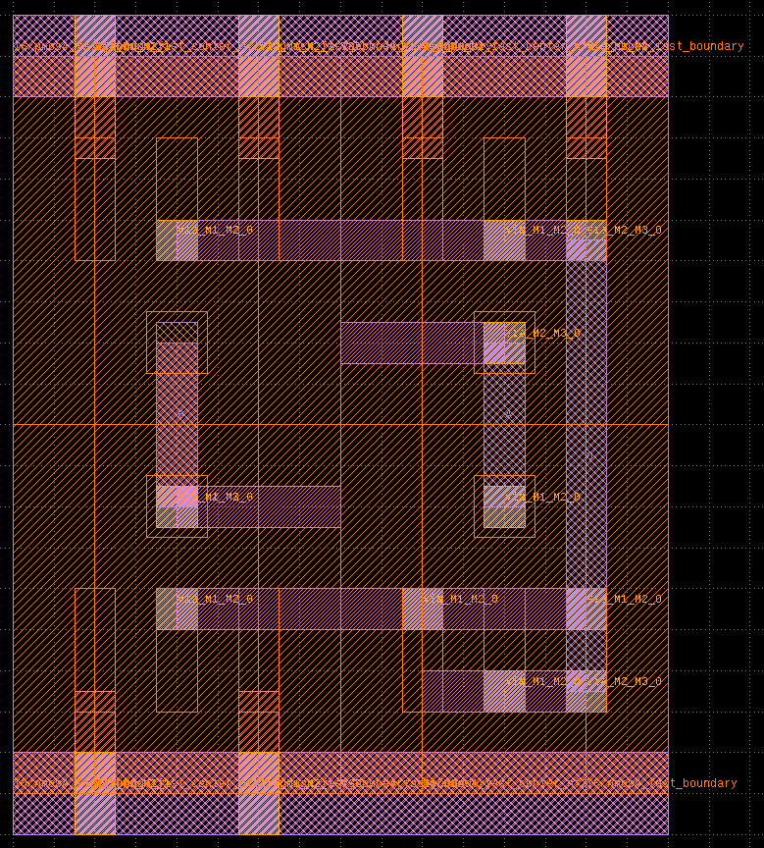
vdd
o
a
b
vss

Slide 9
inst0
(1,3)
inst0
(1,3)
mygrid
mygrid

Slide 10
inst0
inst1
inst0
inst1
inst2
mygrid
mygrid

Slide 11
inst0
inst1
inst3
inst2
mygrid

