Slide 1
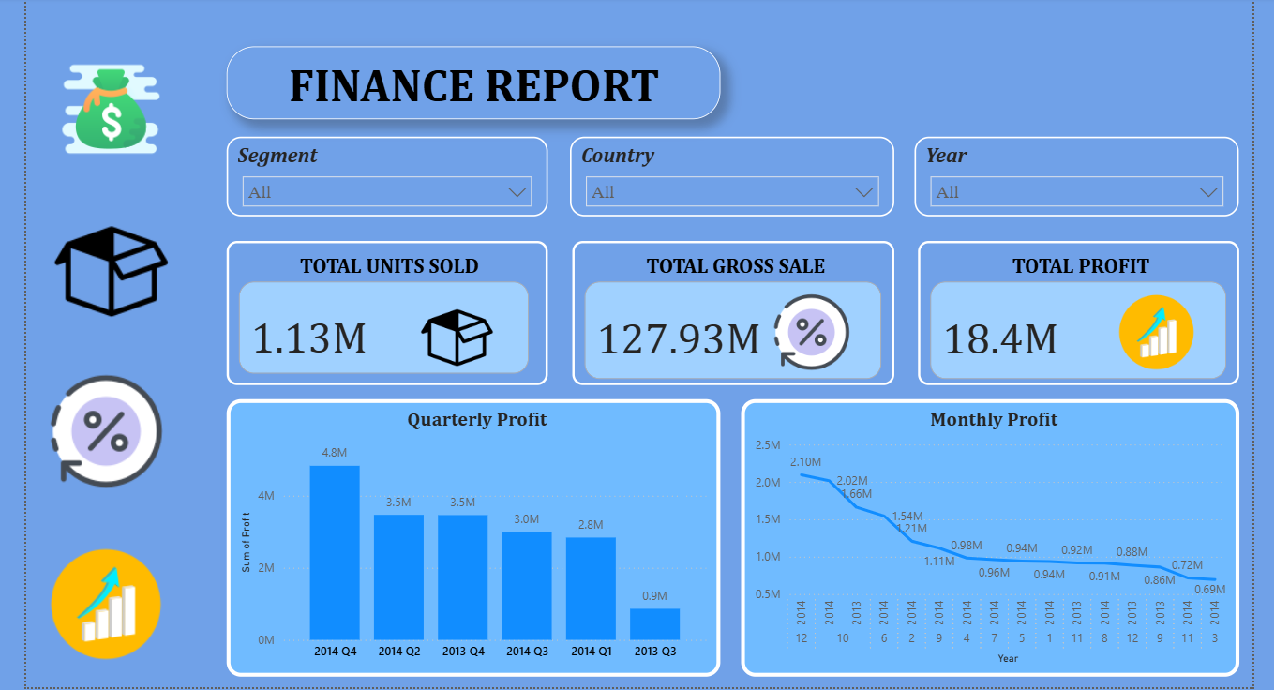
Finance Report Dashboard – Overview
This Power BI dashboard provides a comprehensive view of the company’s financial performance, enabling quick insights into sales, profit, and unit trends. 1. Filters & Interactivity: - Segment, Country, and Year slicers at the top allow users to dynamically filter the data. - Enables focused analysis for specific business segments, geographic regions, or time periods. 2. Key Performance Indicators (KPIs): - Total Units Sold – Displays the cumulative units sold, here shown as 1.13M units. - Total Gross Sale – Represents total revenue, amounting to 127.93M. - Total Profit – Summarizes profitability, reaching 18.4M. - Each KPI card is visually enhanced with relevant icons for quick recognition. 3. Visual Analytics: - Quarterly Profit (Bar Chart) – Compares profit across quarters, highlighting peak performance in 2014 Q4 at 4.8M. - Monthly Profit (Line Chart) – Shows month-on-month profit variation, enabling seasonal and trend analysis. Notable peaks appear in late 2013 and early 2014. 4. Design & Usability: - Clean blue theme for a professional look. - Icons and KPIs are strategically placed for visual balance. - Data is presented in both aggregated (KPIs) and detailed (charts) formats for multi-level analysis. Purpose: To support strategic decision-making by providing an at-a-glance view of sales, revenue, and profit performance over time.

